Slide 1
Optimization thresholds
Full scintillator simulation to probe energy reaction (~6e5 biased photon-nuclear events)
Tracker, ECAL cut applied (Baseline here):
  One track, pf-pi>2000 MeV
  ECAL_energy < 2500 MeV
Changed series of Ecal cuts to see the total energy distribution

Slide 2
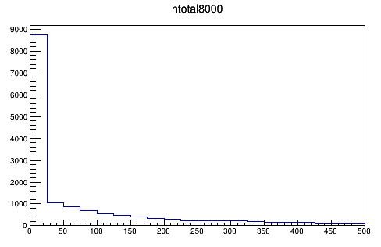
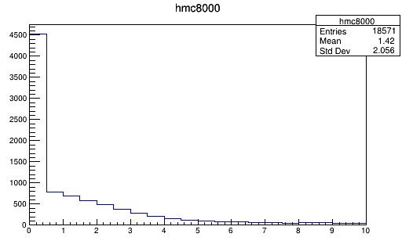
HCAL Total without ECAL cuts
Events/bin
HCAL Total [MeV]
HCAL Max Cell [MeV]
Peaks near 0 makes it hard to veto events.

Slide 3
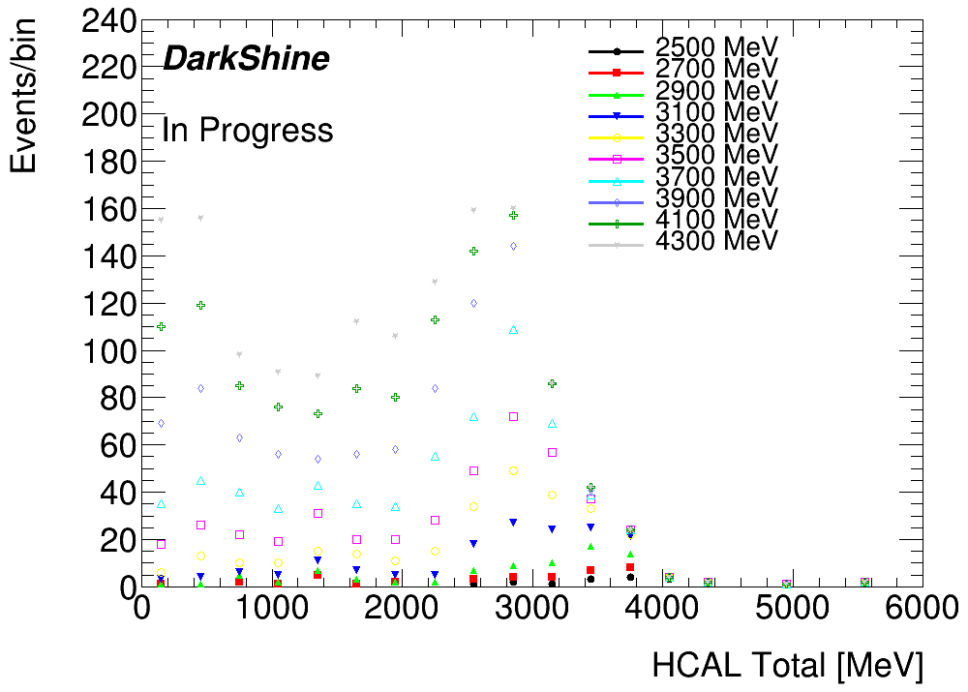
ECAL cuts 2500-4300
ECAL energy cut
Loose ecal cuts will let small energy pieces in HCAL.

Slide 4
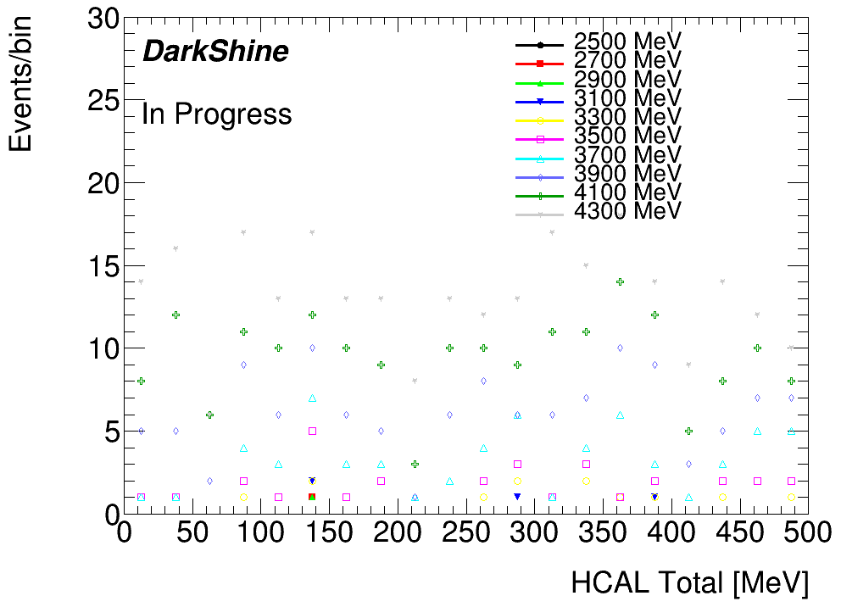
ECAL cuts 2500-4300
ECAL energy cut
If we loose our cut at ECAL to 3500 MeV (1GeV away from baseline ecal cut)

Slide 5
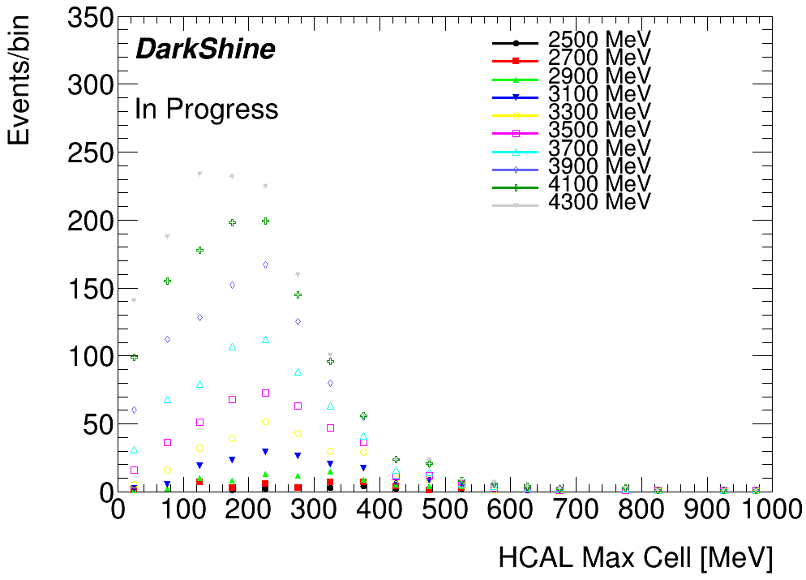
ECAL cuts 2500-4300
ECAL energy cut
Loose ecal cuts will let small energy pieces in HCAL.
2 MeV cut is enough for those events.

Slide 6
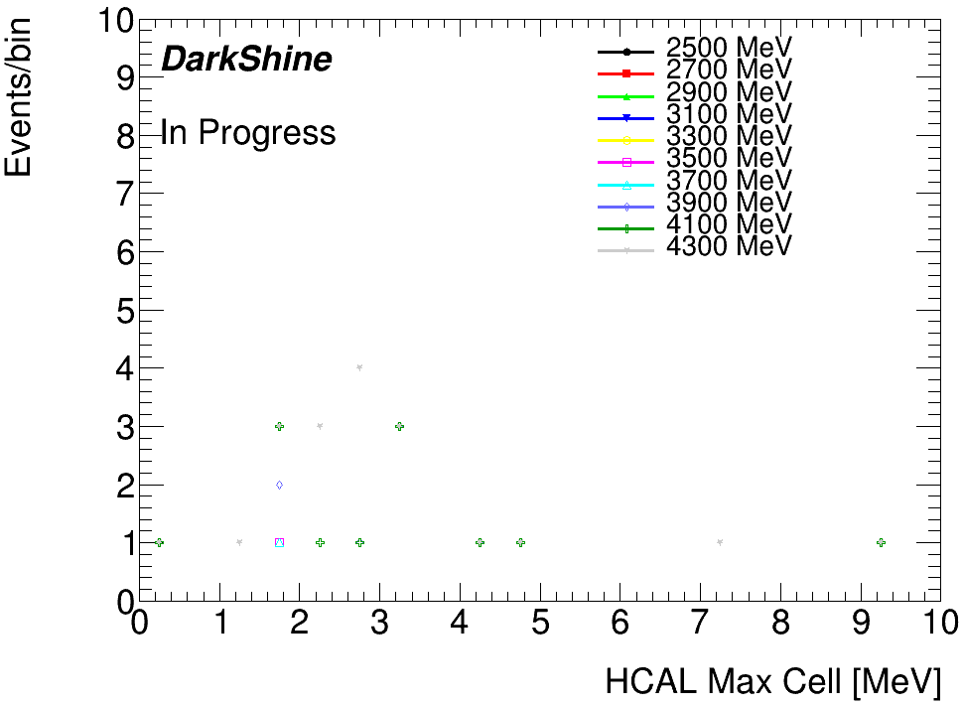
ECAL cuts 2500-4300
ECAL energy cut
If we loose our cut at ECAL to 3500 MeV (1GeV away from baseline ecal cut)
2 MeV cut is enough for those events.

Slide 7
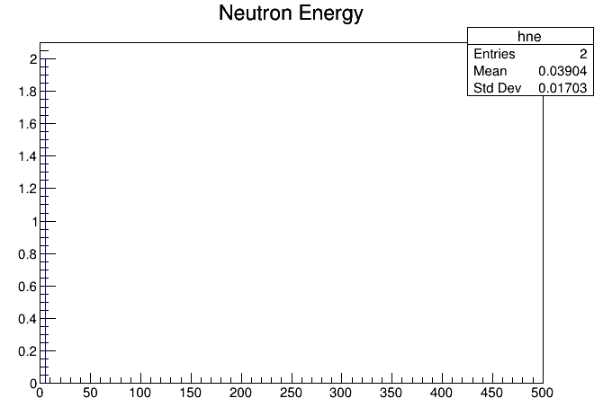
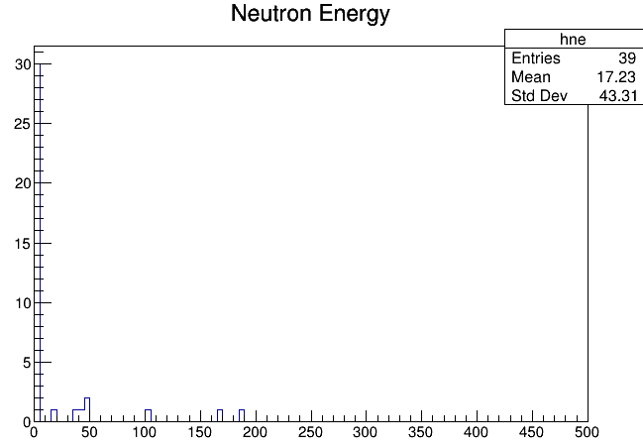
Neutron Energy
Kinetic Energy [MeV]
Kinetic Energy [MeV]
ECAL cut 2500 MeV
ECAL cut 3000 MeV

Slide 8
Summary
Take xx as our threshold.
Fire neutrons to optimize our HCAL

