Slide 1
WIMP dark matter hidden behind its companion
Zhang peng
2022.11.18

Slide 2
Standard Model

Slide 3
Dark Matter

Slide 4
WIMPs
Weakly interacting massive particles (WIMPs) are hypothetical particles that are one of the proposed candidates for dark matter.
There exists no formal definition of a WIMP, but broadly, a WIMP is a new elementary particle which interacts via gravity and any other force (or forces), potentially not part of the Standard Model itself, which is as weak as or weaker than the weak nuclear force, but also non-vanishing in its strength. Many WIMP candidates are expected to have been produced thermally in the early Universe, similarly to the particles of the Standard Model^{[1]} according to Big Bang cosmology, and usually will constitute cold dark matter.

Slide 5
Direct Detection

Slide 6
Motivation
present strong exclusion from DM direct detection
Solution→ DM direct detection makes no sense.
Phys. Lett. B 826, 136885 (2022)doi:10.1016/j.physletb.2022.136885 [arXiv:2108.129

Slide 7
Our Idea
DM has a companion
DM-DM-companion
Companion provides a portal to the standardmodel (SM) via, for instance, the coupling to Higgs doublet.
Then, DM semi-annihilates into thecompanion to arrive correct relic density, without leaving DM-nucleon scattering signal.

Slide 8
Z_3 Model ——A
Two scalars
S1 is DM, and S2 is companion.
DM annihilation channel S1 S1 → S2∗h

Slide 9
Z_3 Model ——B
A scalar(S_2) and a fermion(S_1)
fermionic DM, and scalar is companion
Annihilation： ψψ → hS*

Slide 10
Z_3 Model ——generation
Generalize the mechanism from Z3 to other possible symmetry G.
The initiate state is the DM-DM pair, carrying a non-vanishing G−charge, and the final states, containing the companion field, are not G invariant neither, carrying the same G−charge.
Others(Z_2) vs G(Z_3).

Slide 11
Phenomenology of the DM-companion dark sector
Freeze-out via semi-annihilation, including co-annihilation.
Parameter scan and result

Slide 12
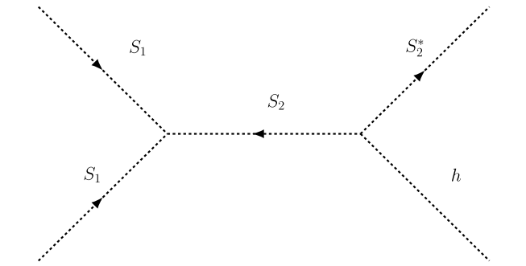
Freeze-out via semi-annihilation, including co-annihilation
The mass of the companion is supposed to be close to that of the DM. σ_{s,1} is the cross section of S1 S1 → S2*h
The coannihilation S1 S2 → S1*h is just the t-channel exchange of the companion. We denote its cross section as σ_{s,2}

Slide 13
Freeze-out via semi-annihilation, including co-annihilation
Moreover, σ_3, the cross section of the companion-companion annihilation S2 S2∗ → hh/V V / \bar{f} f with V = Z or W.

Slide 14
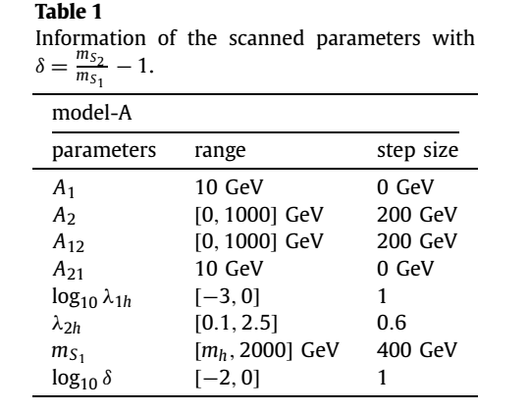
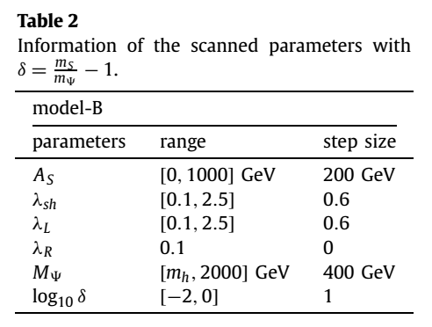
Parameter scan and result
.

Slide 15
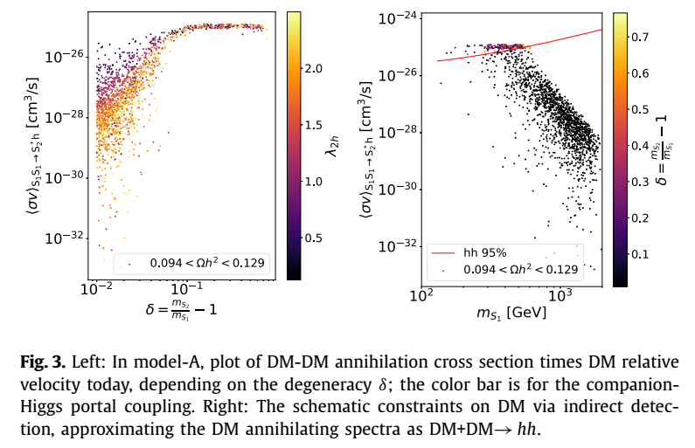
Parameter scan and result(A)

Slide 16
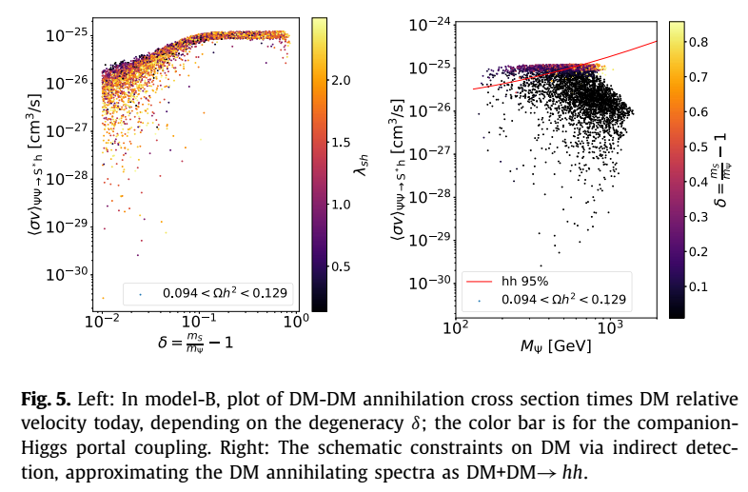
Parameter scan and result(B)

Slide 17
Conclusions and discussions
In order to save the WIMP DM scenario, we should consider a more complicated structure of the WIMP dark sector.
DM has a companion which is also charged under the DM protecting symmetry, and moreover the symmetry allows the companion (usually a spin-0 particle) to play the role of bridge be tween DM and SM, via the trilinear coupling DM-DM-companion.
Then, DM semi-annihilates into the companion to reduce its relic density, having no DM-nucleon scattering signals. Such an idea can be easily realized in the Z N symmetric models with N > 2.
Some open and pending issues: the asymmetry between DM and its companion….

Slide 18
Thank you!

