Slide 1
The Scattering of Dirac and Majorana Fermions by Kerr spacetime in the teleparallel gravity approach
Wei Lin
East China Normal University
Supervisor：Prof. Xun Xue

Slide 2
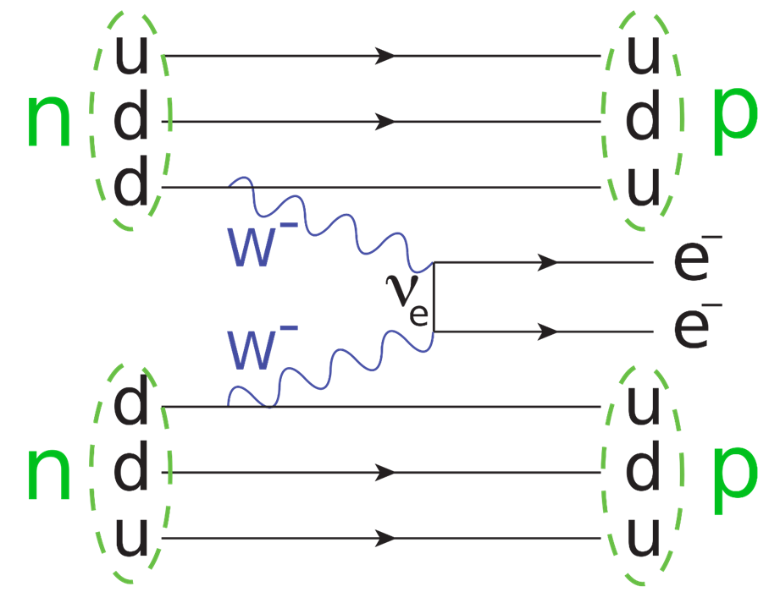
Detection of Majorana particle
Neutrinoless double beta decay
Spin-gravity interaction can distinguish Dirac and Majorana neutrino wave packets propagating via Lens-Thirring effect in rotating fields, Papini et. al. PRL 2006

Slide 3
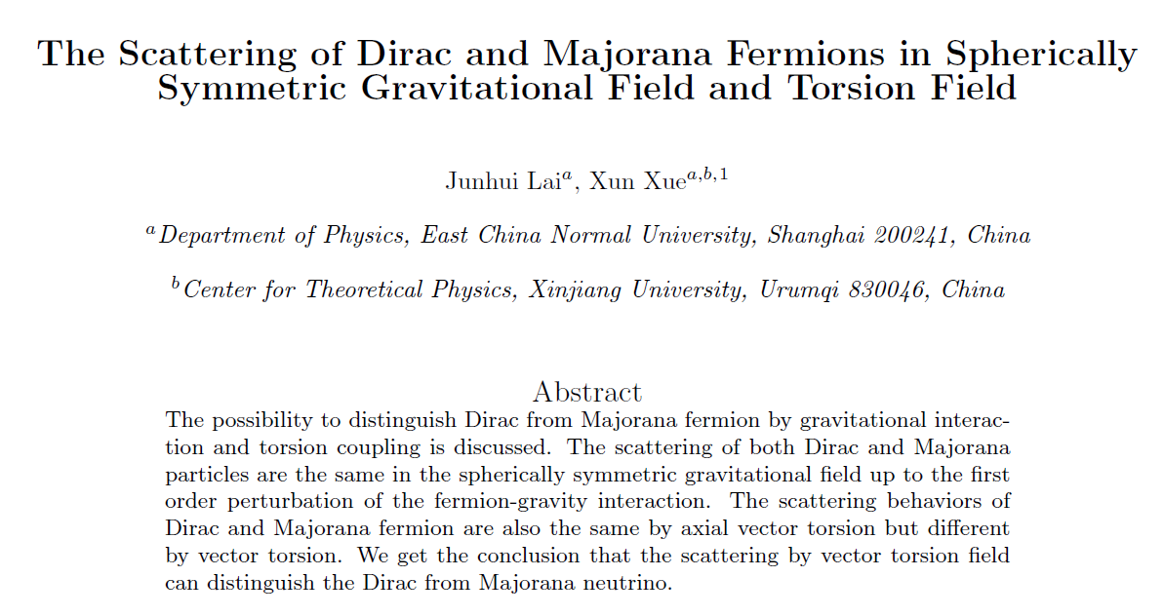
Distinguish fermions species via torsion
The scattering behaviors of Dirac and Majorana fermion are different by vector torsion in the non-minimal coupling case. Junhui Lai & Xun Xue arXiv:2112.10590
GR is a torsion free theory without spinor source
Teleparallel Gravity is a Curvature free theory while Gravity is described by Torsion.

Slide 4
Dirac action in Teleparallel Gravity Frame
$e_{ μ}^{a}$: inertial tetrads without gravity
Total tetrads with gravity denoted as $h_{μ}^{a}=e_{μ}^{a}+B_{μ}^{a}$

Slide 5
T-matrix under 1st order Perturbation theory
Under 1st order Perturbation theory:
Substituting

Slide 6
T-matrix under 1st order Perturbation theory
The last term of $S_{int}$ has no effect i.e.
We get the T-matrix has the form
The antiparticle has contribution to Majorana scattering because Majorana particles are is self charge conjugated.
Consider charge conjugation transform $v=C{\overline{u}}^{T}$
=0

Slide 7
T-matrix under 1st order Perturbation theory
We get
The difference between Dirac and Majorana particle:
Where

Slide 8
Kerr Tetrads
Kerr metric:
Kerr tetrads:

Slide 9
Weak fields approximation
Particles falling onto the star will be absorbed.
Only exterior gravitational fields are involved in scattering
For star radius $R≫r_{s}$, gravitational fields are weak
We expand tetrads to the order $\frac{1}{r^{2}}$, i.e.
In the region $r<R$, we expect $h_{μ}^{a}=e_{μ}^{a}$

Slide 10
T-matrix of Kerr scattering

Slide 11
Difference between Dirac and Majorana particle
Comparing to Schwarzschild case:
Junhui Lai & Xun Xue arXiv:2112.10590
Particles can be distinguished via the rotating of the field source!

Slide 12
Summary & Extension
The scattering of Dirac and Majorana fermions are distinguished by both tetrads and vector torsion while the contribution of axial vector torsion are the same in teleparallel gravity frame.
The scattering difference in Kerr spacetime are related to non- spherically symmetrical direction.
Particle species may be differed by spherically symmetrical gravity when considering higher order of Feynman diagram which can be calculated in the future.

Slide 13
Thank you for your attention!

