Slide 1
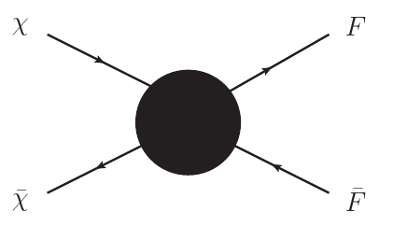
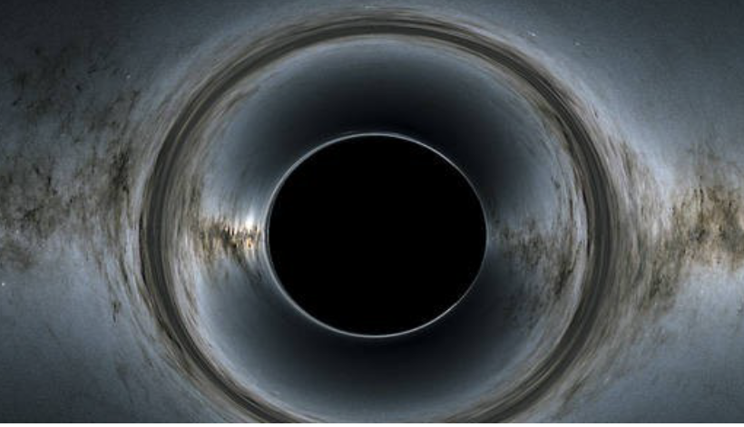
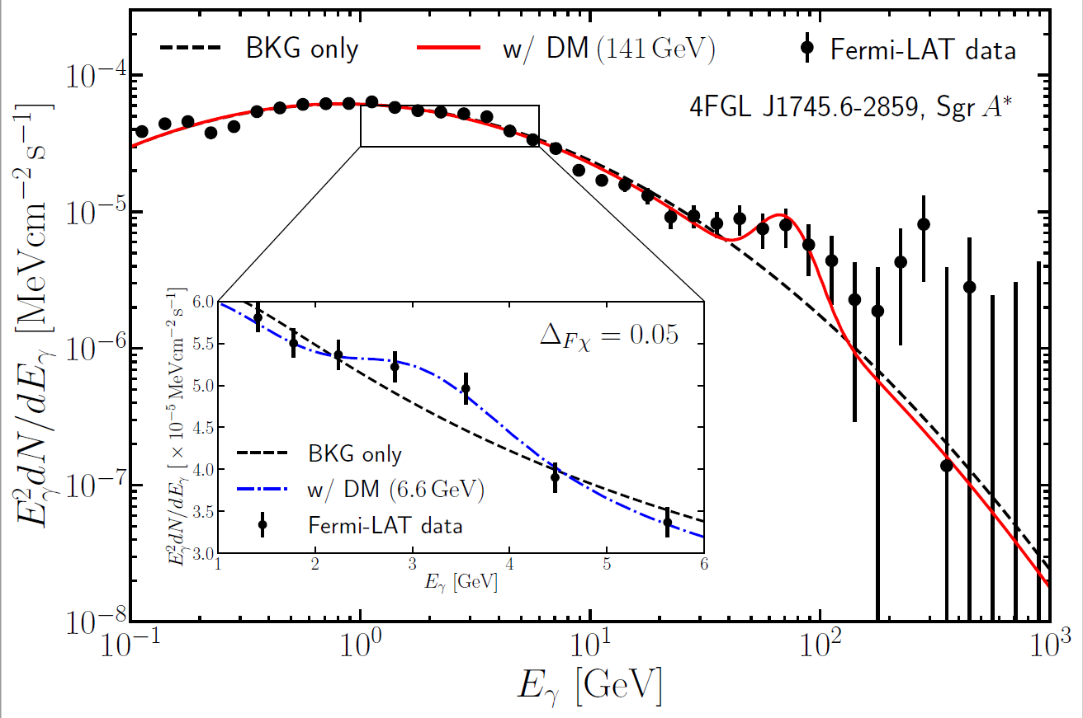
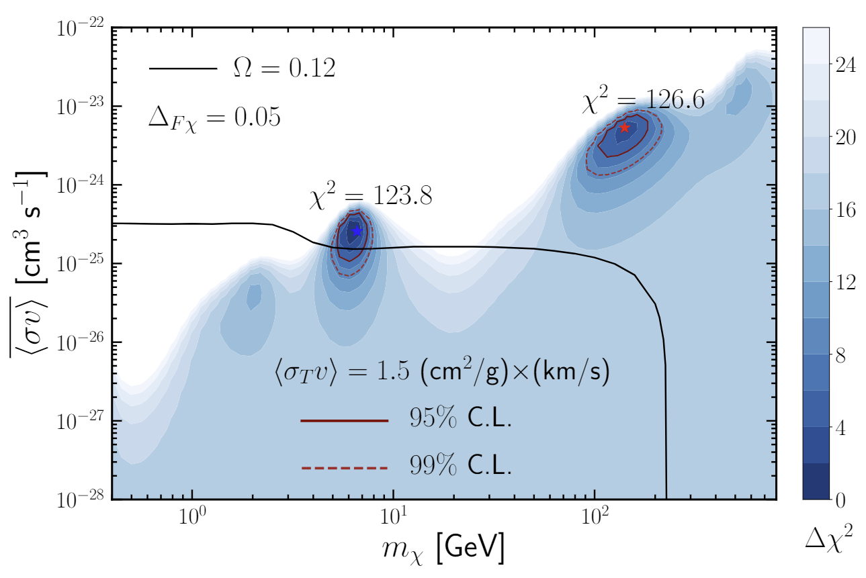
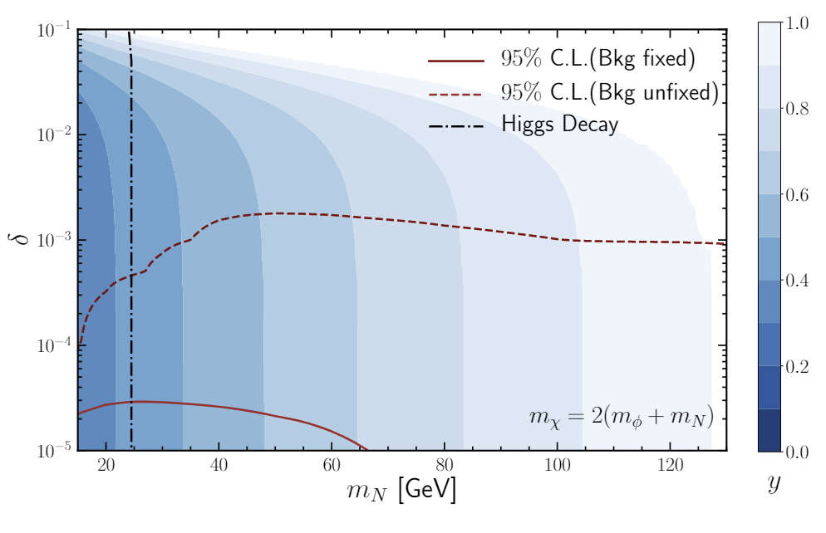
Forbidden Dark Matter Combusted Around Supermassive Black Hole
Jie Sheng (盛杰) [shengjie04@sjtu.edu.cn]
2016-2020 Bachelor, Jilin University.
2020-Now PHD, Tsung-Dao Lee Institute (TDLI).
Research Interests:
High Energy Physics, Dark Matter Phenomenology
1. Forbidden annihilation :
2. Black hole acceleration
$$m_{χ}<m_{F}$$
$$\left\langle σ_{χ\overline{χ}}v\right\rangle =\frac{{\left(n_{F}^{eq}\right)}^{2}}{{\left(n_{χ}^{eq}\right)}^{2}}\left\langle σ_{FF}v\right\rangle$$
$$\left\langle σ_{FF}v\right\rangle ∼\frac{α_{d}^{2}}{m_{F}^{2}}$$
$$v^{2}∼\frac{GM}{r}$$
$$v\left(r\right)∼\frac{1}{\sqrt{r}}$$
$$n_{eq}∝exp\left(−\frac{m}{T}\right)$$
$r^{−7/3}$ (CDM)
$\left\langle σ_{χ\overline{χ}}v\right\rangle$ $≈8πf_{Δ}\frac{α_{d}^{2}}{m_{χ}^{2}}e^{−2Δx}$
$$Δ≡\frac{m_{F}−m_{χ}}{m_{χ}}$$
$$ρ∝$$
$r^{−7/4}$ (SIDM)
3. Gamma ray flux and constrains:
4. Right-Handed Neutrino DM model with Forbidden Annihilation:
$$ℒ_{DM}=g_{χ}\overline{χ}γ^{μ}χφ_{μ}+g_{Fχ}\overline{F}γ^{μ}Fφ_{μ}$$
Forbidden channel
Decay signal
Seesaw mechanism
$$N_{3}$$
Neutrino oscillation
$$χ\overline{χ}→F\overline{F}$$
$$F→νγ$$
$$N_{2}$$
Baryon asymmetry
The Fermi-LAT data (black points with error bar), background-only fit (black dashed line), and the signal fit with forbidden DM annihilation for $m_{χ}=141GeV$ (red solid) and $m_{χ}=6.6GeV$ (blue dash-dotted).
$$N_{1}$$
DM O(100) GeV
$$ℒ_{\text{int} }=(yφN_{1}χ+ \text{h}\text{.}\text{c}\text{. })+λm_{φ}φH^{†}H$$
$N_{1}$odd
Stable, DM
$Z_{2}$ Symmetry
$χ$ odd
Decay, Signal
$φ$ even
The sensitivity contours of forbidden DM annihilation cross section obtained by fitting the Fermi-LAT data. The red solid and dashed lines are the sensitivity contours at 95% and 99% C.L.[1]
The allowed parameter space contour to obtain the DM relic density through freeze out. Red lines show the 95% limit. Both cases with fixed (solid red) and unfixed (dashed red) background are shown for comparison.[2]
[1] Yu Cheng, Shao-Feng Ge, Xiao-Gang He and J.S., [arXiv:2211.05643 [hep-ph]].
[2] Yu Cheng, Shao-Feng Ge, J.S. and Tsutomu T. Yanagida, [arXiv:2304.02997 [hep-ph]].

