Slide 1
Data Processing Upgradation in PandaX-4T
周钰博
上海交通大学 物理与天文学院
第一届实验粒子物理研讨会

Slide 2
Outline
Current status of PandaX-4T
Data reduction strategy
Event reconstruction optimization
Data quality monitoring upgradation
Summary and outlook

Slide 3
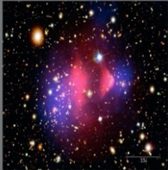
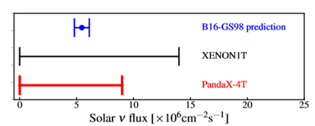
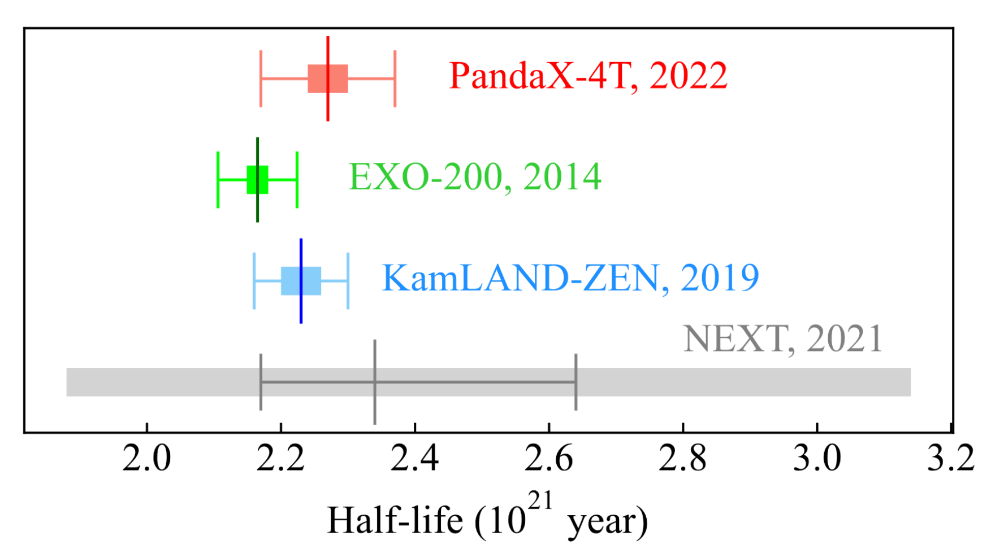
Multi-mission of PandaX-4T
Dark matter
<10keV
Astrophysics neutrino
<300 keV
Majorana neutrino
>2 MeV
Research Vol 2022, 9798721 (2022)
W. Ma et al. PRL 130, 021802 (2023)
Notes:
Pandax-4T experiment is a multi-purpose experiment

Slide 4
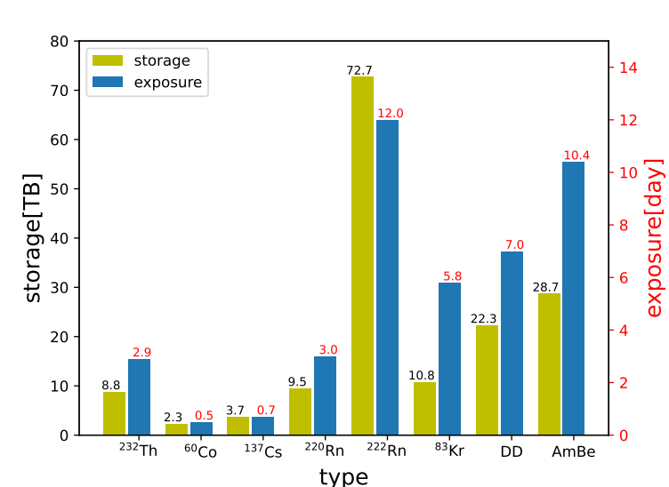
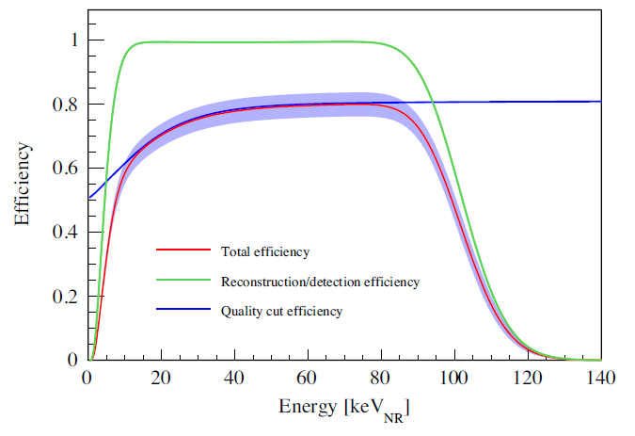
Current challenge
Huge storage
1year ~ 1PB data
DM data: 68% storage
Duplicated sampling rate
$×2$ storage
~keV events efficiency loss
S1 mistagged
Event splited
Unresponsive monitoring
Insufficient parallel processing

Slide 5
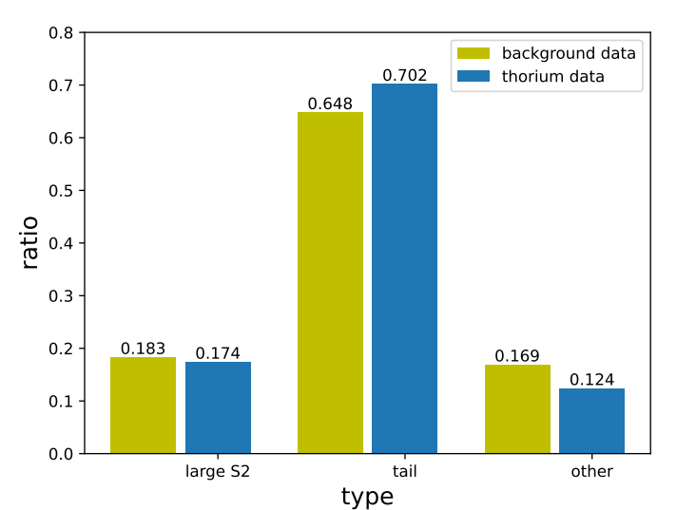
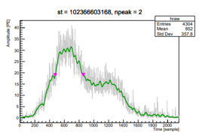
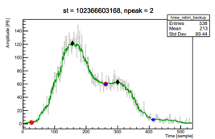
Data reduction strategy
Non-physical part
60% storage
Valueless information
Cut off directly
Large S2
²rd prominent
Excessive time accurancy
Rebin raw waveform

Slide 6
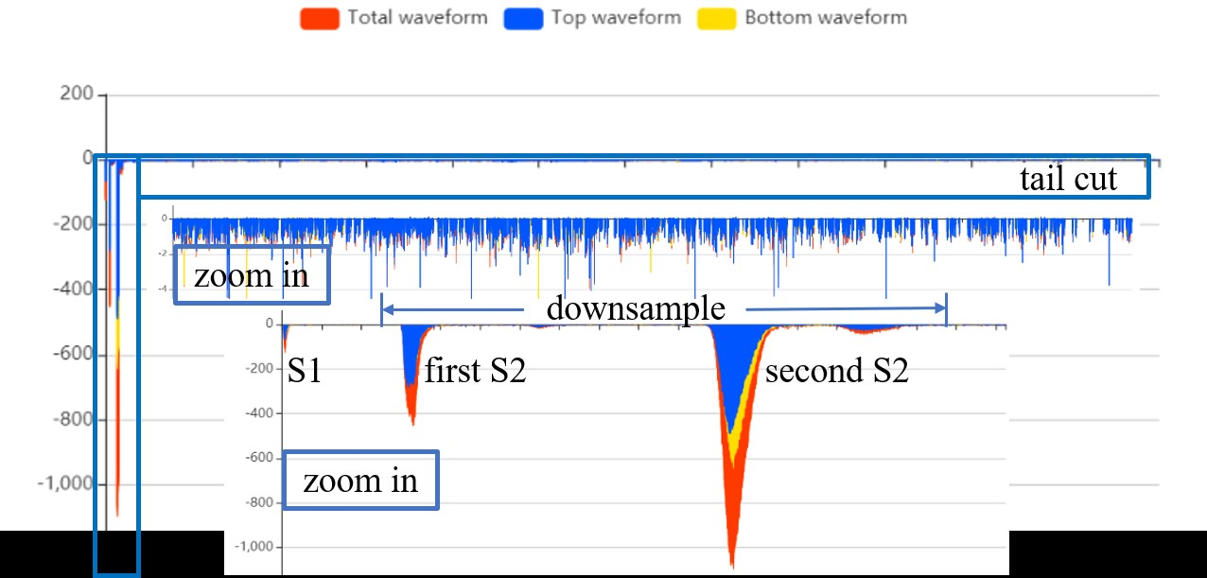
Implementation
Locate large S2
Delineate processing area
ReProcess raw data
60% storage saved

Slide 7
Modification of processing chain
Raw data
Reprocess
Once reprocessed
Further analyses
speed $×2$
67.6s 29.1s
generate time scope
calculate deadtime
Signal data
49.8s 17.7s
Meta-data
Database
PE data
Record
Further analysis

Slide 8
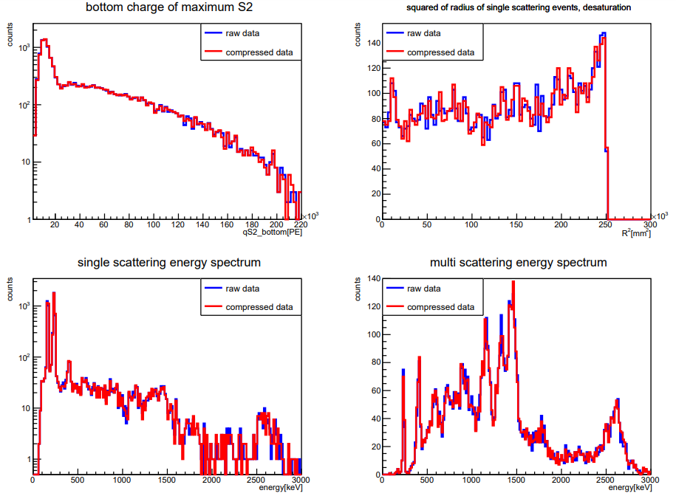
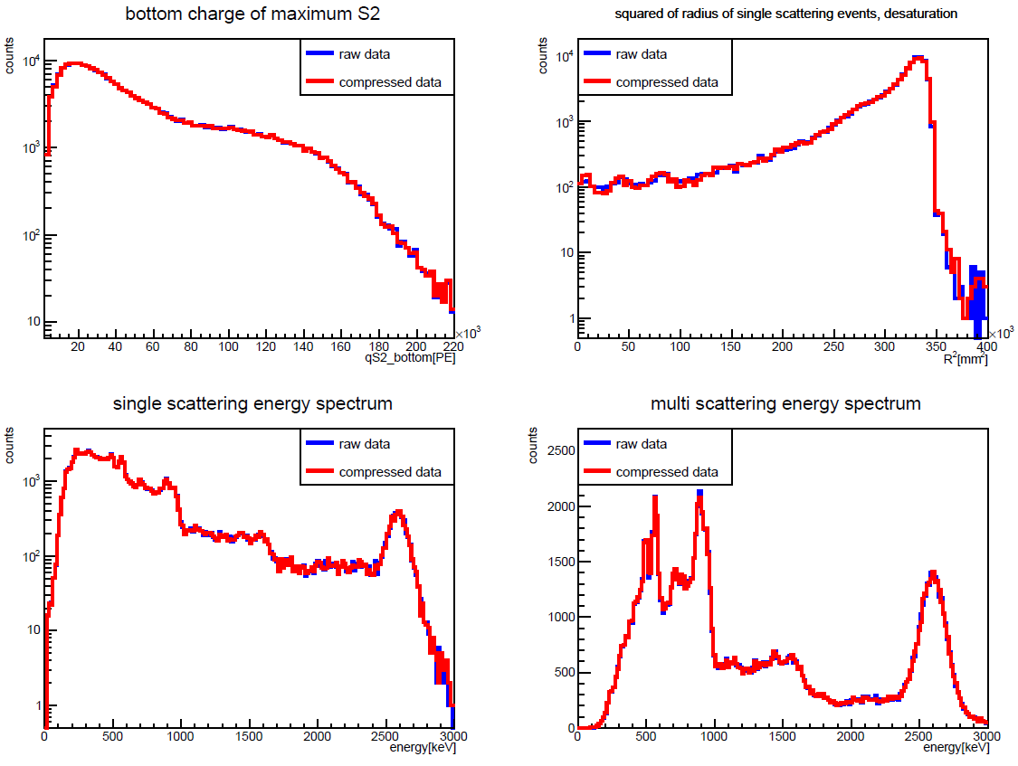
Influence on physical analyses
background data
²³²Th data
reduced data result coincides well
data reduction works

Slide 9
Physical Event Reconstruction
Rely on S2
S1 mistagged with single electrons
S2 hard to mistag
Fix event window
Unify cleanliness variable definition
S2_max
……
1ms
1ms
yes
check 2ms after S2_max
no
encounter larger S2
construct events

Slide 10
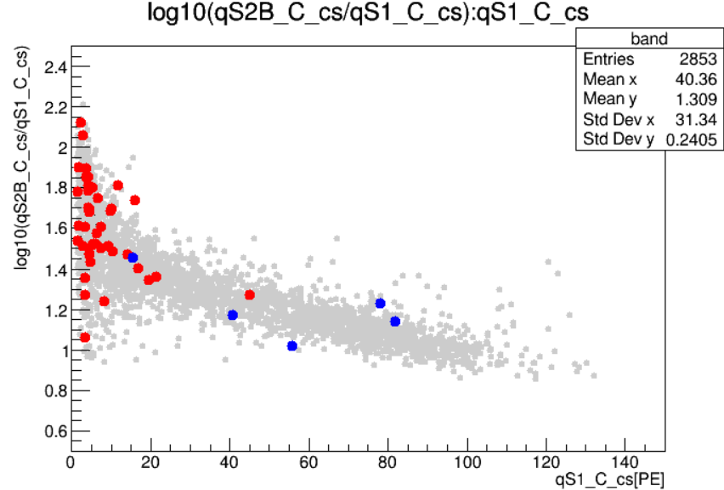
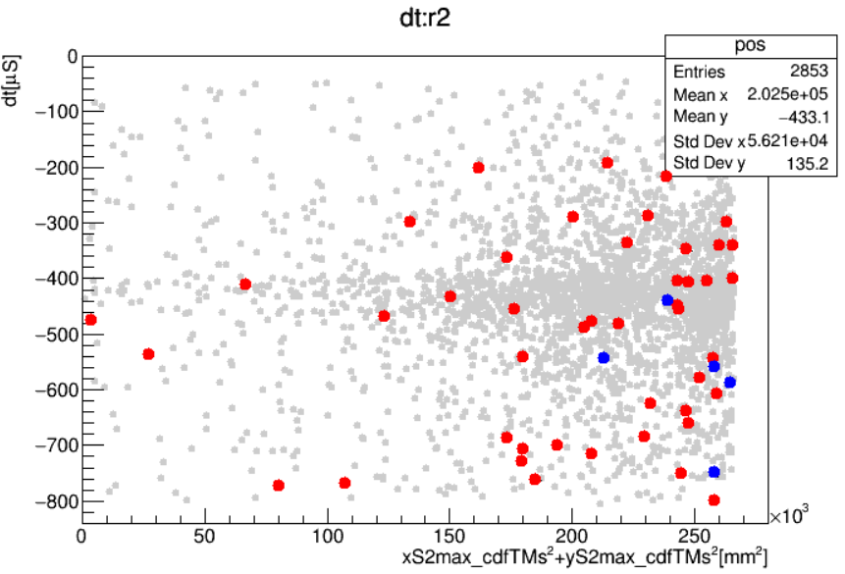
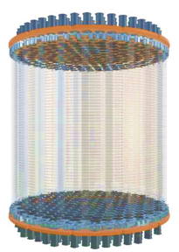
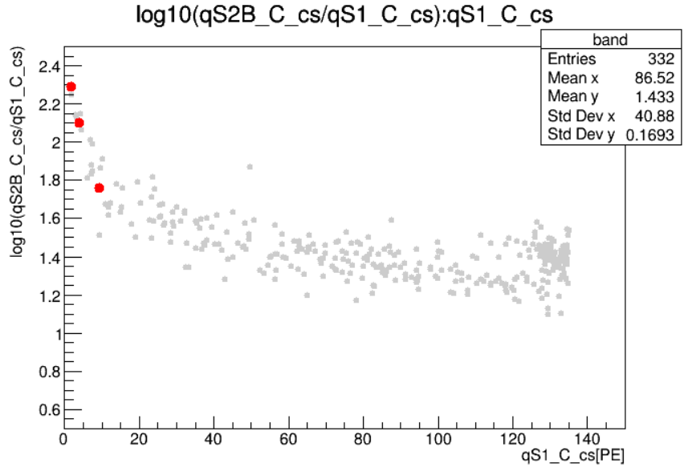
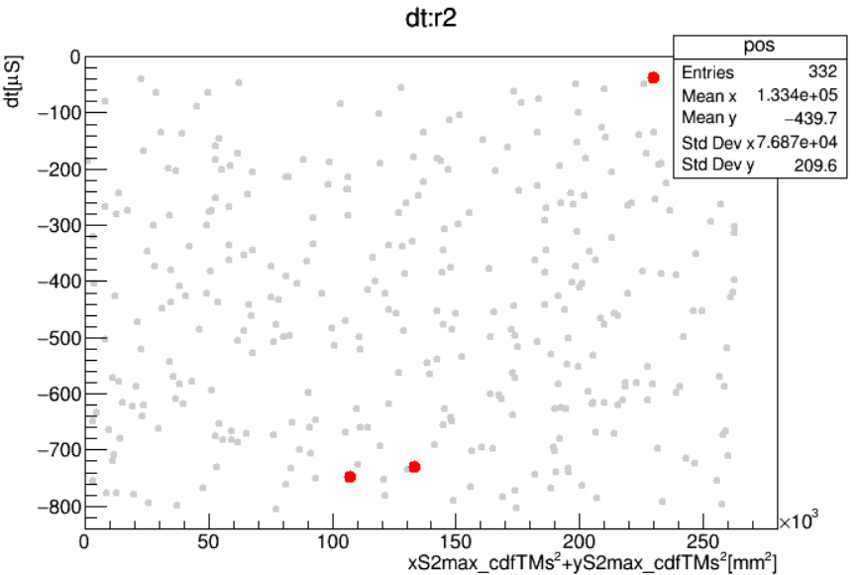
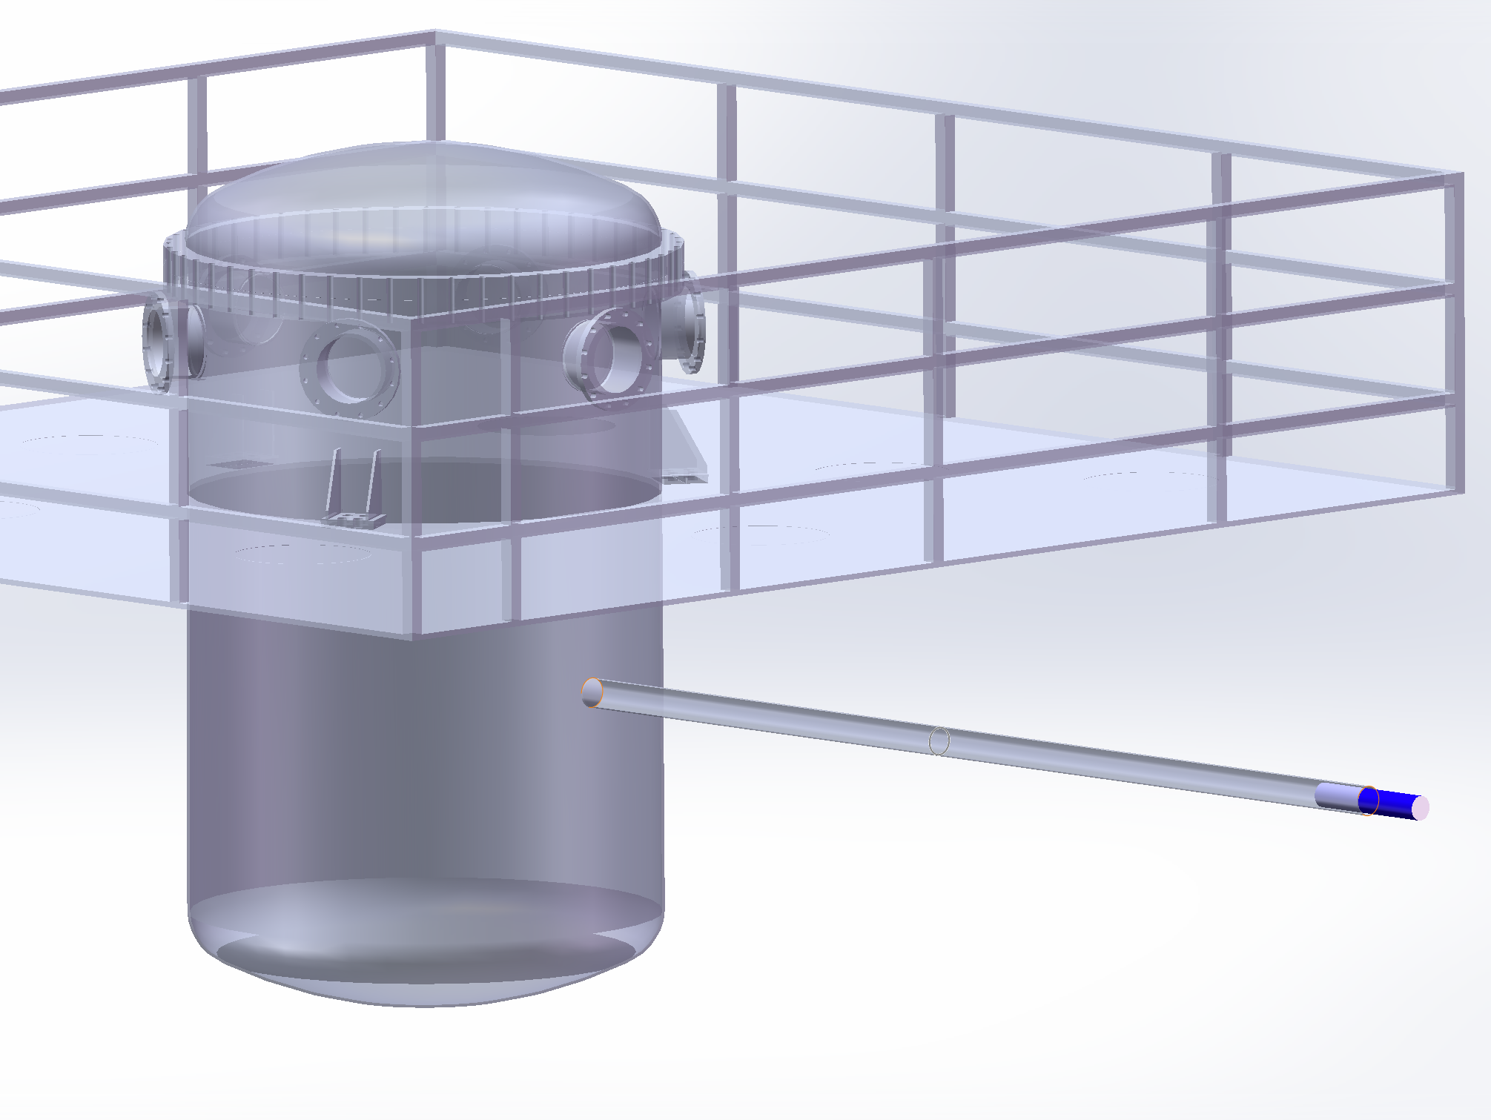
~keV efficiency ascension
rescue
loss
DD
DD
Rn
Rn
D-D generator
loss due to high event rate, adjacent event
obvious selection efficiency increment around ~keV

Slide 11
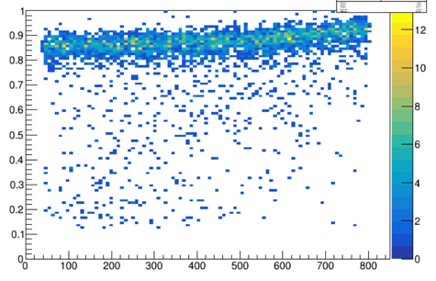
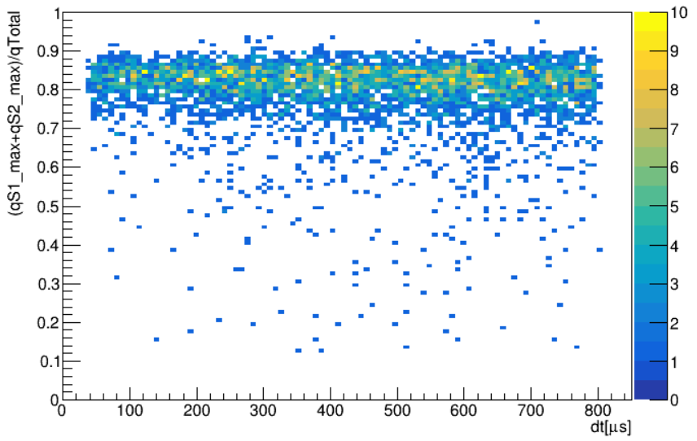
Cleanliness variable
cleanwf : (qS1_max+qS2_max)/qTotal
event window dependent on dt
fix window avoid the definition ambiguity
cleanwf independent with dt
in order cleanwf : dt
fix window cleanwf : dt

Slide 12
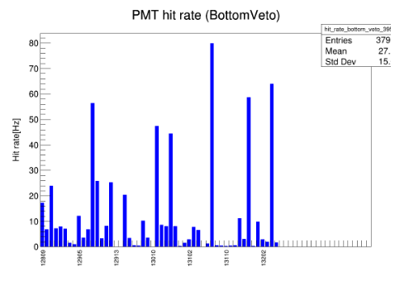
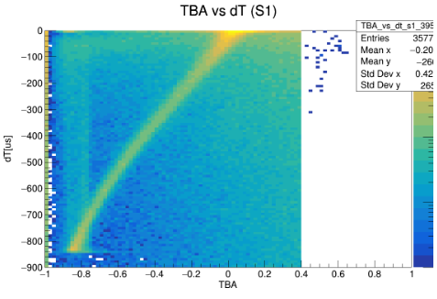
Data quality monitoring
limited resources to process
crash in high Rn calibration
parallel file by file
jpg output compatibility not well
independent json output run by run
limited resources to process
crash in high Rn calibration
parallel file by file
jpg output compatibility not well
independent json output run by run
1core 1run
change to
global parameter
file0
file1
file2
file3
…
file0
file1
file2
file3

Slide 13
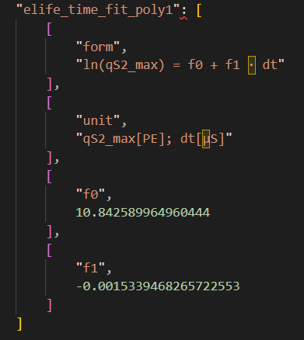
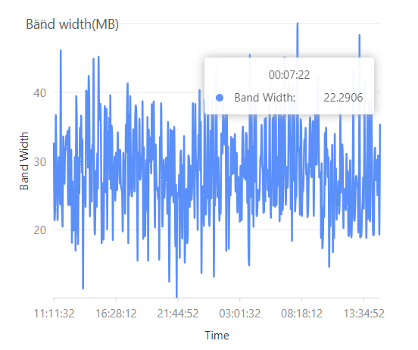
Upgradation revenue
$×5 speed$
Rn calibration run, 4 core
320 files processed 1hour
competent to process all files
in DM data
light-weight json output
result stored as array
easily read from plot
~7M(400KB compressed) per run

Slide 14
Summary and Outlook
A data reduction framework works and under consideration for further experiment
~keV data reconstruction efficiency is optimized.
The efficiency of data quality monitoring system promotes much
Customed optimization will load in next period data acquisition

Slide 15
BACK UP

Slide 16
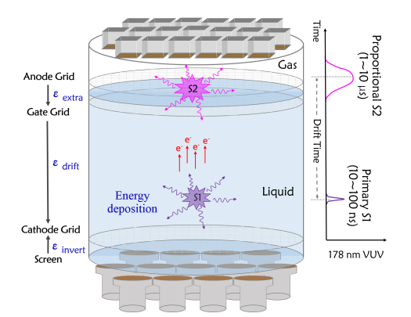
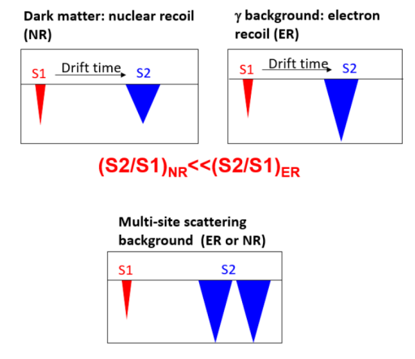
二相型液氙探测器原理图

