Slide 1
ATLAS LAr calorimeter and particle flow algorithm
Jiannan Tang
Shanghai Jiao Tong University
2019.06.28

Slide 2
ATLAS LAr calorimeter
2. Jet reconstruction and performance using particle flow algorithm

Slide 3
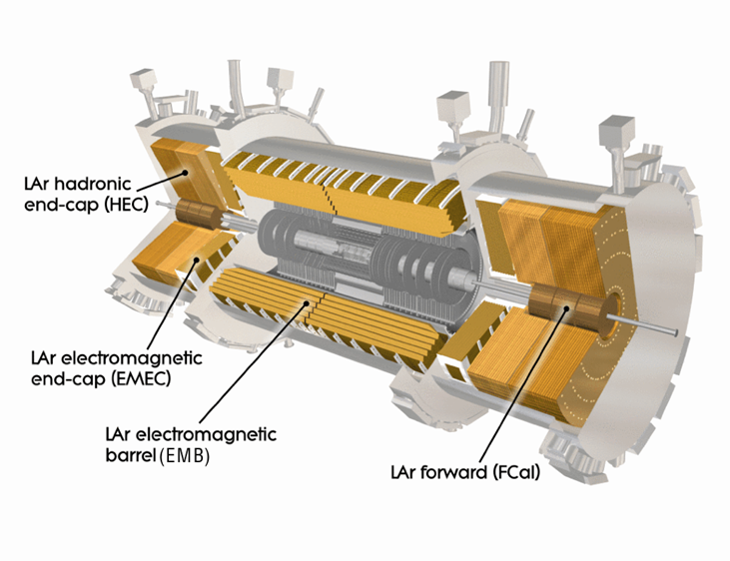
1. ATLAS Liquid Argon calorimeter system

Slide 4
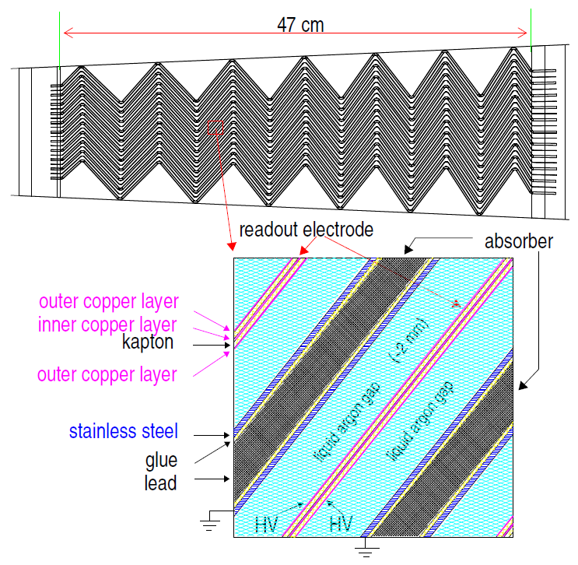
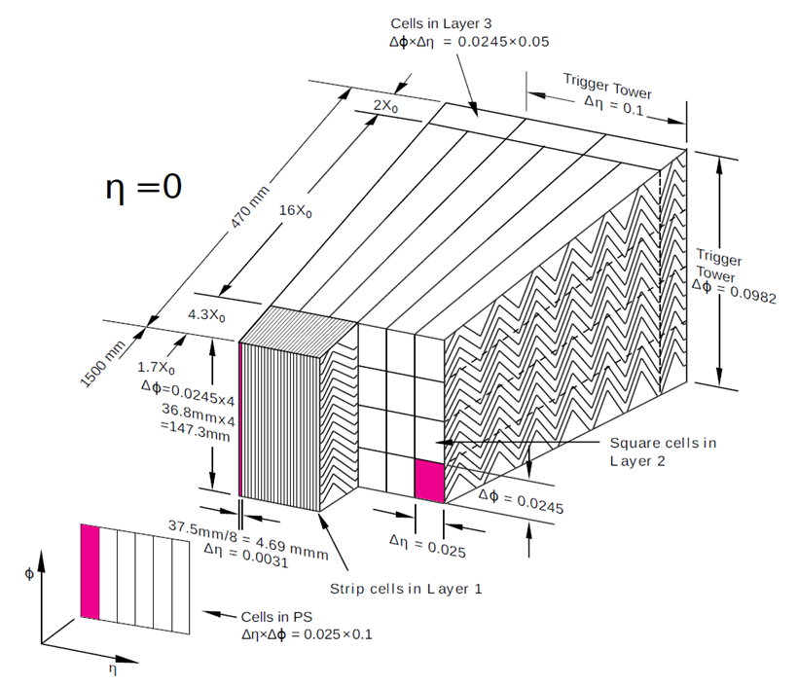
Accordion structure of the EMB and Sketch of an EMB module

Slide 5
2. particle flow algorithm
For the final Run 1 jet calibration, this JES correction factor also took into account the tracks associated with the jet. And this was found to greatly improve the jet resolution.
Particle flow(Pflow) algorithm combines both the tracker and the calorimeter measurements to form the signals.
Why should we combine them to form the signals?

Slide 6
2.1 Advantages of Pflow algorithm
For low-energy charged particles, the momentum resolution of the tracker is significantly better than the energy resolution of the calorimeter.
The angular resolution of a single charged particle, reconstructed using the tracker is much better than that of the calorimeter.
Low-pT charged particles originating within a hadronic jet are swept out of the jet cone by the magnetic field by the time they reach the calorimeter.
When a track is reconstructed, we can see whether it is associated with a vertex. And so we can reject the signals originating from pile-up vertices.
Notes:
The capabilities of the tracker in reconstructing charged particles are complemented by the calorimeter’s
ability to reconstruct both the charged and neutral particles. At high energies, the calorimeter’s energy
resolution is superior to the tracker’s momentum resolution. Thus a combination of the two subsystems
is preferred for optimal event reconstruction.

Slide 7
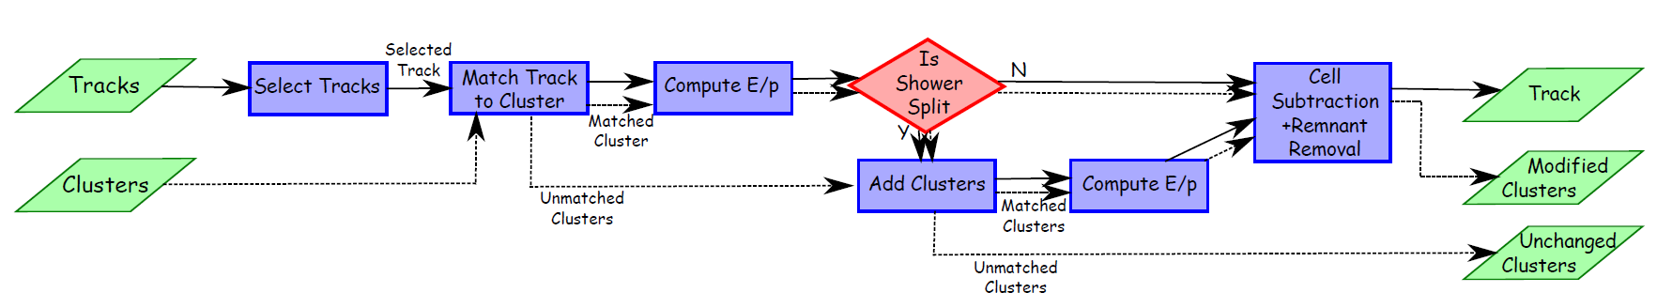
2.2 Procedure of Pflow algorithm
This is a flow chart of how the particle flow algorithm proceeds. Tracks and topo-clusters form the basic inputs to the particle flow algorithm.
Tracks with pT > 40 GeV are excluded from the algorithm.

Slide 8
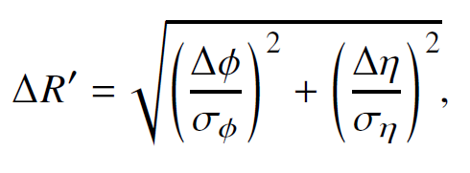
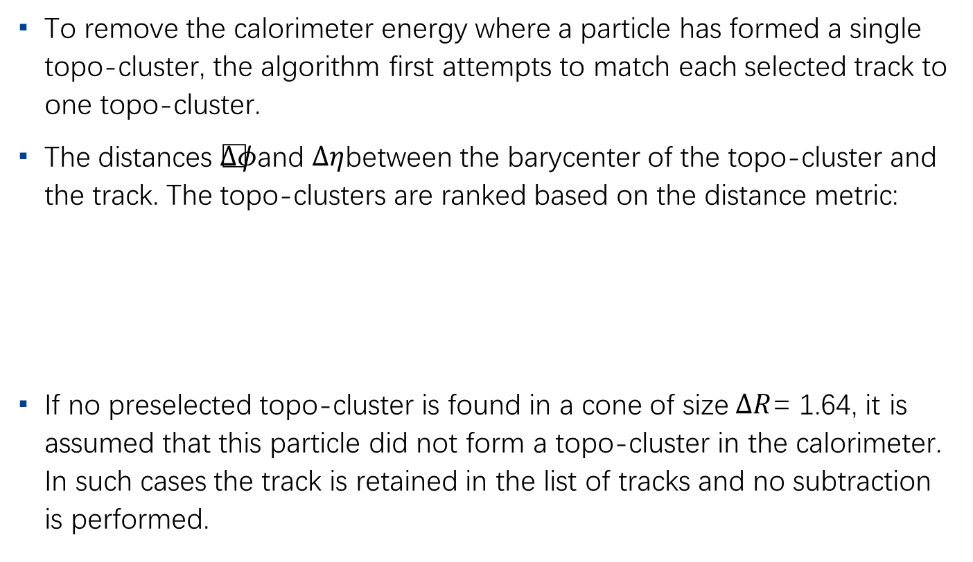
Matching tracks to topo-clusters
To remove the calorimeter energy where a particle has formed a single topo-cluster, the algorithm first attempts to match each selected track to one topo-cluster.
The distances $Δφ$and $Δη$between the barycenter of the topo-cluster and the track. The topo-clusters are ranked based on the distance metric:
If no preselected topo-cluster is found in a cone of size$ΔR$= 1.64, it is assumed that this particle did not form a topo-cluster in the calorimeter. In such cases the track is retained in the list of tracks and no subtraction is performed.
Notes:
The expected energy in the calorimeter, deposited by the particle that also created the track, is computed based on the topo-cluster position and the track momentum (Section 6.4). It is relatively common for a single particle to deposit energy in multiple topo-clusters. For each track/topocluster system, the algorithm evaluates the probability that the particle energy was deposited in more than one topo-cluster. On this basis it decides if it is necessary to add more topo-clusters to the track/topocluster system to recover the full shower energy

Slide 9
Evaluation of deposited particle energy and recovering split showers
The expected energy in the calorimeter, deposited by the particle that also created the track, is computed based on the topo-cluster position and the track momentum.
It is common for a single particle to deposit energy in multiple topo-clusters. For each track/topocluster system, the algorithm evaluates whether the particle energy was deposited in more than one topo-cluster. On this basis it decides if it is necessary to add more topo-clusters to the track/topocluster system to recover the full shower energy.

Slide 10
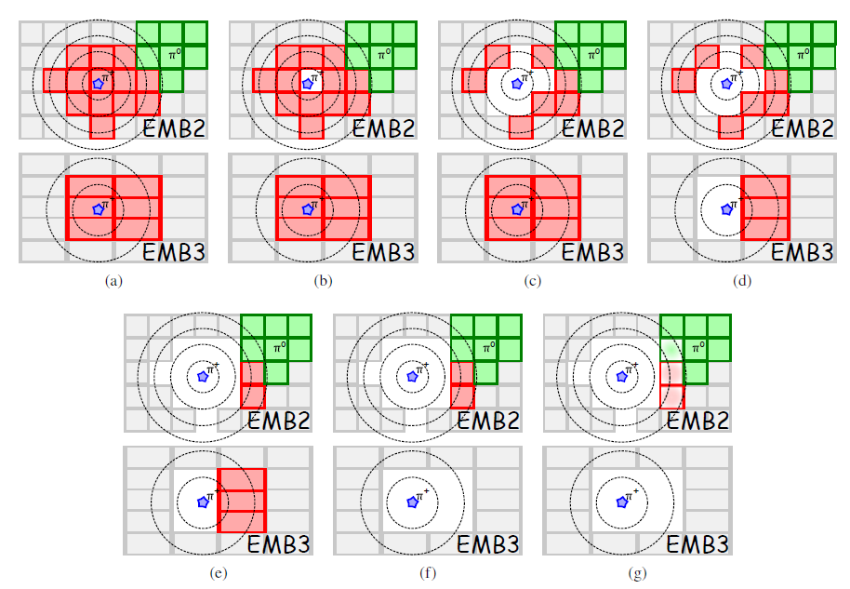
Cell-by-cell subtraction
This figure shows how this subtraction works. Rings are placed around the track (represented by a star) and then the cells in these are removed ring by ring starting with the centre of the shower, where the expected energy density is highest and moving outwards.

Slide 11
Remnant removal
If the energy remaining in the set of topo-clusters that survive the energy subtraction, specifically if this energy is below the threshold, The remnant energy therefore originates purely from shower fluctuations and so the energy in the remaining cells is removed.
After this final step, the selected tracks and the remaining topo-clusters in the calorimeter together should ideally represent the reconstructed event with no double counting of energy.

Slide 12
2.3 Resolution of jets in Monte Carlo simulation
The largest expected benefit from using the particle flow reconstruction is an improvement of the jet energy and angular resolution for low-pT jets.
In this section, the jet resolution achieved with particle flow methods is compared with that attained using standard calorimeter jet reconstruction.

Slide 13
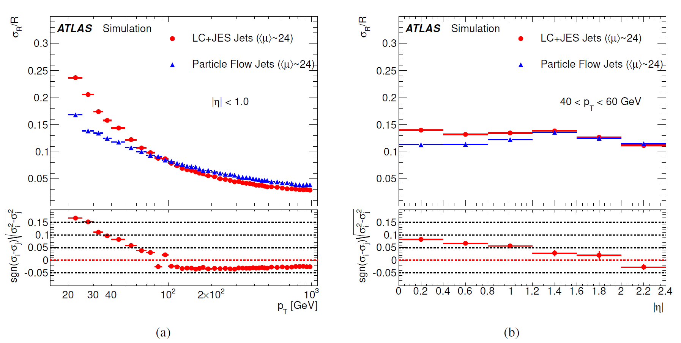
Transverse momentum resolution
Subfigure (a) shows the resolution as a function of pT for jets and (b) shows the resolution as a function of η for jets

Slide 14
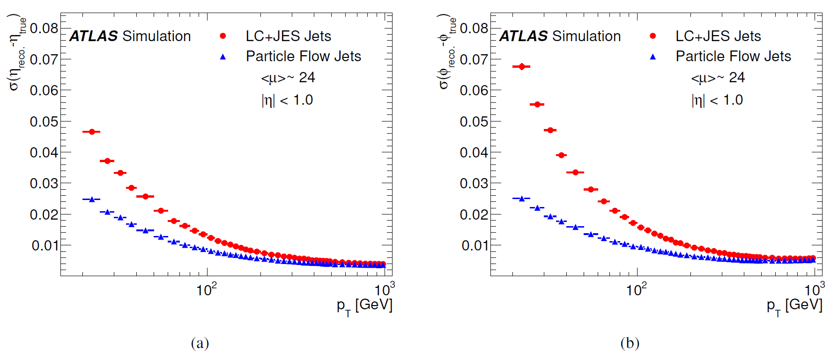
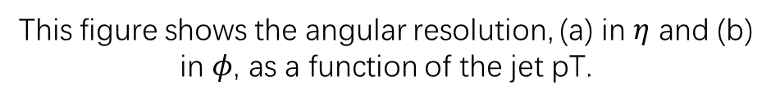
Angular resolution of jets
This figure shows the angular resolution, (a) in $η$ and (b) in $φ$, as a function of the jet pT.

Slide 15
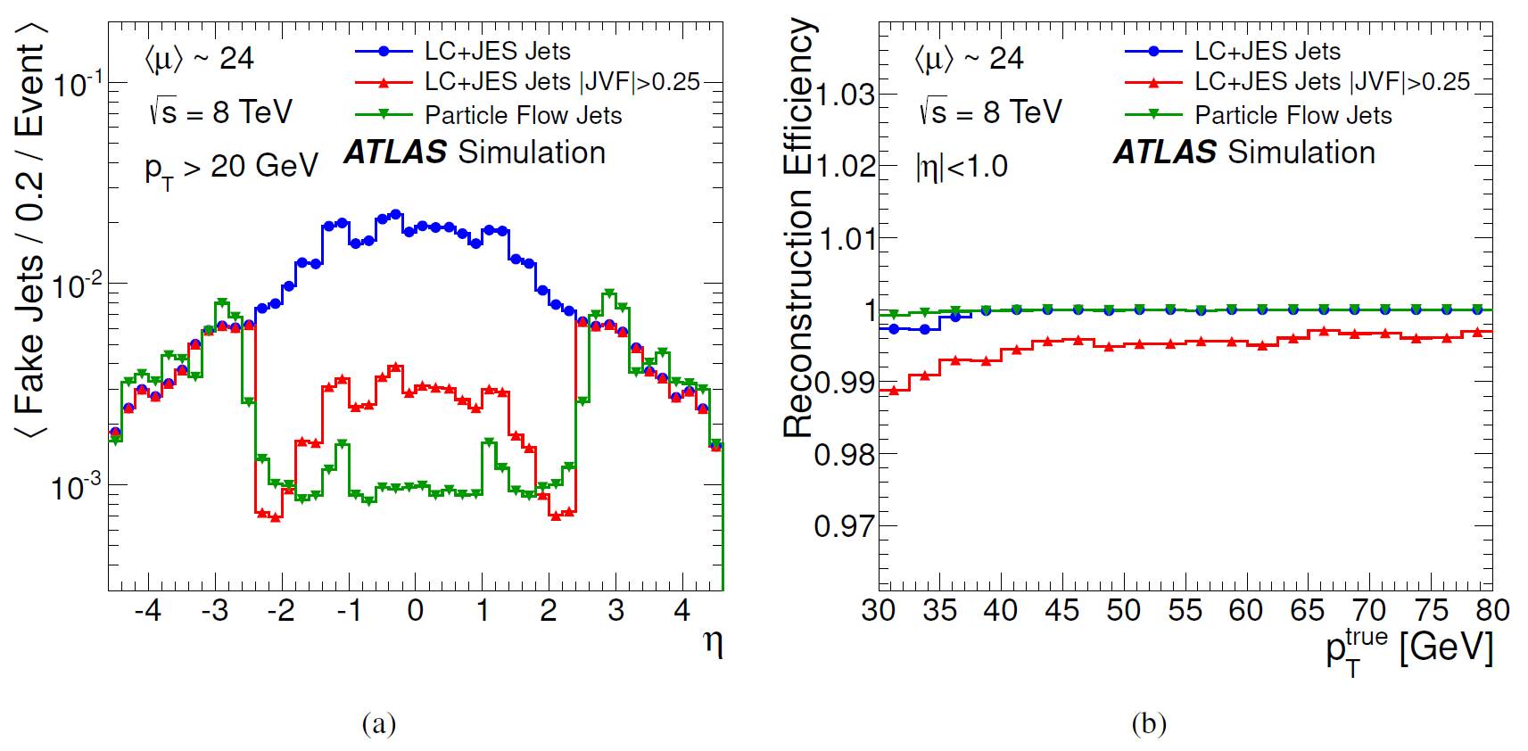
2.4 Pile-up jet rate
Subfigure (a) shows the number of fake jets and (b) the efficiency of reconstructing a hard-scatter jet in dijet MC events.

Slide 16
Thank you

