Slide 1
Spectrum fitting with Bayes’ statistics
Ni Kaixiang

Slide 2
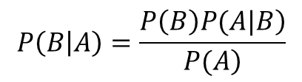

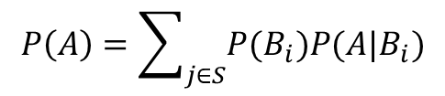
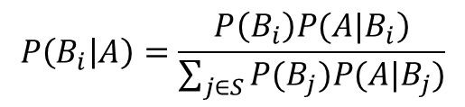
Bayes’ theorem
B happen, given that A happened
Assume B consists of several independent events $Bi$, since
So for each $Bi$,
$$P\left(B | A\right)=\frac{\left.P\left(B\right)P(A|B\right)}{\left.P(A\right)}$$
$$P\left(A\right)=\sum_{j∈S}{P(B_{i})P(A|B_{i})}$$
$$P\left(B_{i} | A\right)=\frac{\left.P\left(B_{i}\right)P(A|B_{i}\right)}{\sum_{j∈S}{P(B_{j})P(A|B_{j})}}$$

Slide 3
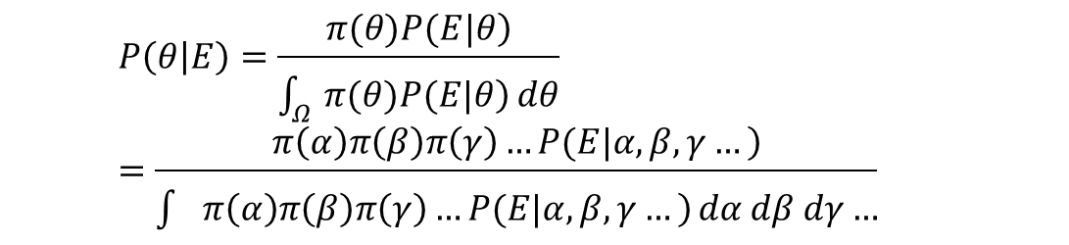



Bayes’ statistics
A is our detected spectrum, we call it $E$
$Bi$ is one possible background/signal rate
  Multiple background sources(parameters), $α, β, γ…$
  The total collection is called $θ$, i.e. hypothesis
  Continuous, infinite $Bi$. We rewrite it into integral form:
Poster probability of $θ$
Prior probability of $θ$
hypothesis probability of E
  $$P\left(θ | E\right)=\frac{\left.π(θ)P(E|θ\right)}{\int_{Ω}{\left.π(θ)P(E|θ\right)}dθ}=\frac{\left.π\left(α\right)π\left(β\right)π\left(γ\right)…P(E|α, β, γ…\right)}{\int{\left.π\left(α\right)π\left(β\right)π\left(γ\right)…P(E|α, β, γ…\right)}dα dβ dγ…}$$

Slide 4
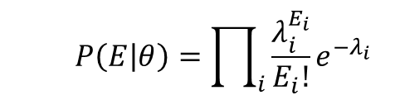

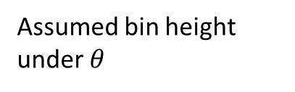
For a spectrum
$P(E|θ)$: hypothesis probability
  given background rate, the probability of getting the detected spectrum
  Calculate Poisson probability for each bin, sum them up:
  $$P\left(E | θ\right)=\prod_{i}{\frac{λ_{i}^{E_{i}}}{E_{i}!}e^{−λ_{i}}}$$
Detected height of bin i
Assumed bin height under $θ$

Slide 5
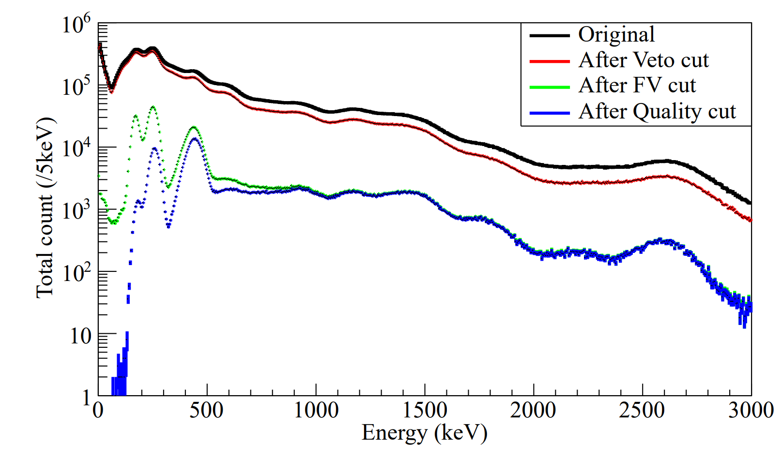
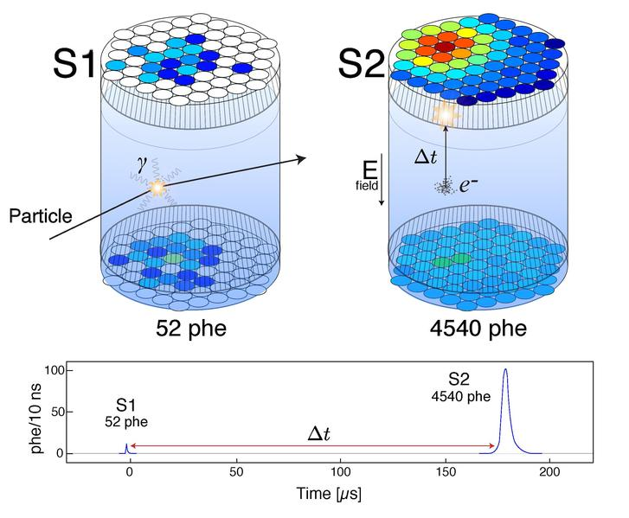
Target: NLDBD search with PandaX-II HE data

Slide 6
Background modeling
MC steps
Geant4 simulation for all the detector components and for all the isotopes
Merge hits into clusters with 8.5 mm separation threshold(simulates SS cut)
Remove events with veto volume energy deposition(simulates veto cut)
Remove events outside fiducial volume(simulates FV cut)
Combine components’ spectrum according to their radioactivity
Fit isotopes’ radioactivity

Slide 7
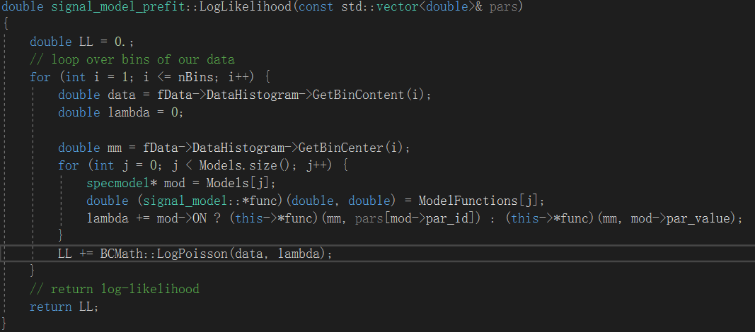
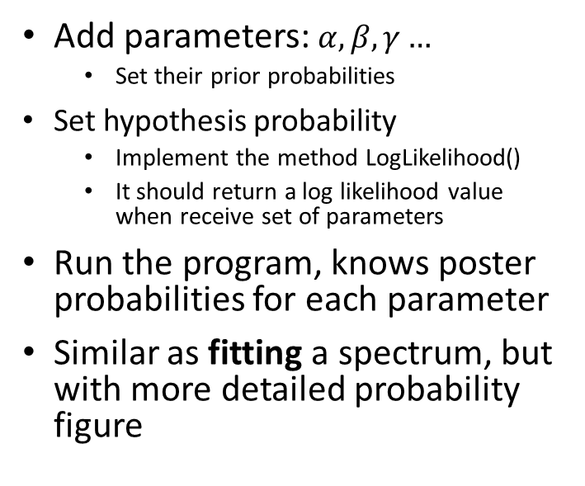
BAT software
Add parameters: $α, β, γ…$
  Set their prior probabilities
Set hypothesis probability
  Implement the method LogLikelihood()
  It should return a log likelihood value when receive set of parameters
Run the program, knows poster probabilities for each parameter
Similar as fitting a spectrum, but with more detailed probability figure

Slide 8
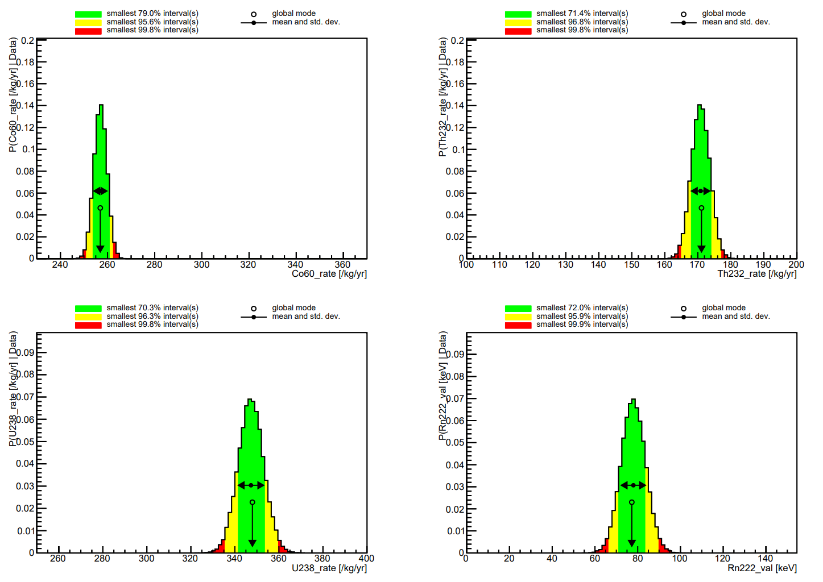
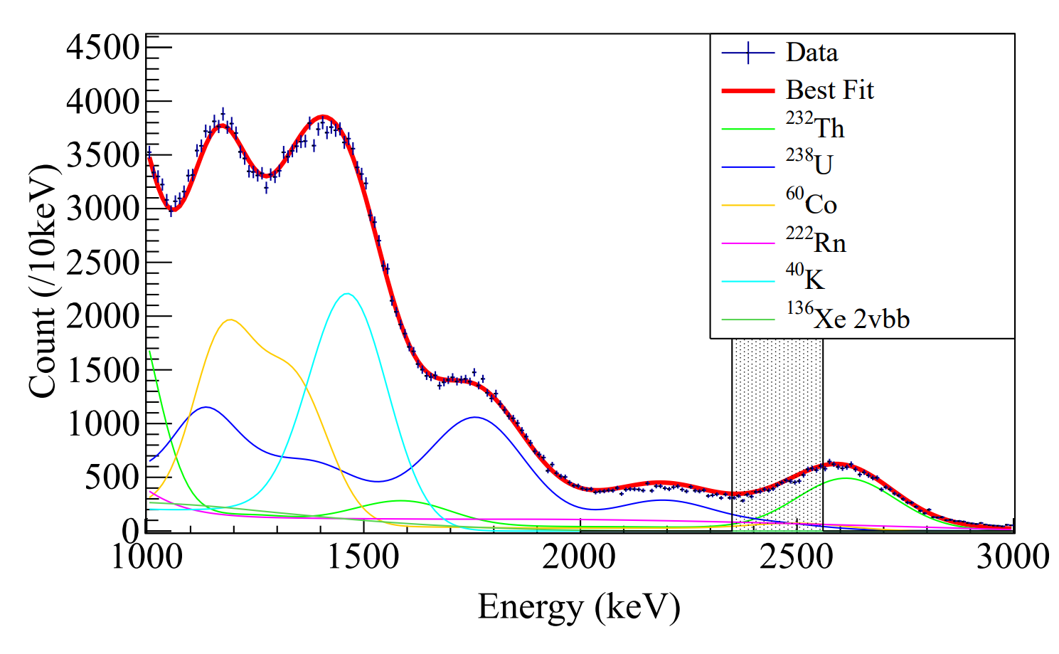
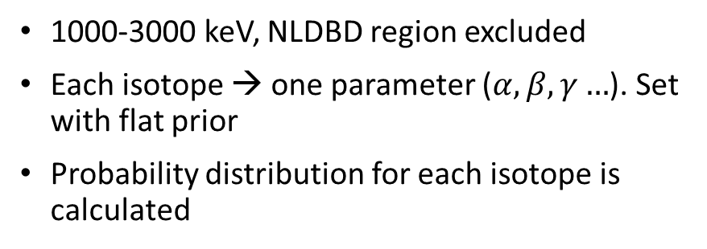
Fit with BAT - flat
1000-3000 keV, NLDBD region excluded
Each isotope → one parameter ($α, β, γ…$). Set with flat prior
Probability distribution for each isotope is calculated

Slide 9
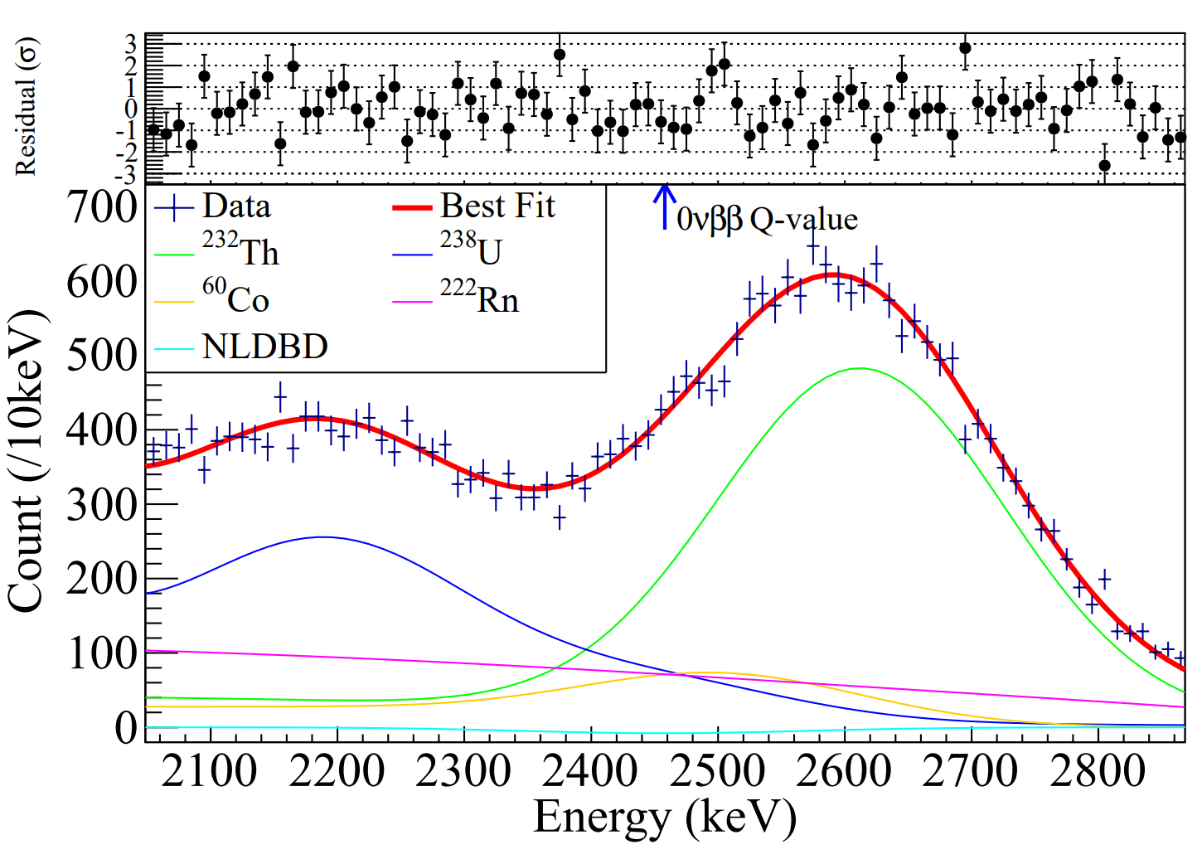
Fit with BAT - Gaussian
2458 +- 400 keV
Gaussian prior, sigma from the previous fit
Best fit: −0.25±0.21 ×10⁻²³ yr⁻¹

Slide 10
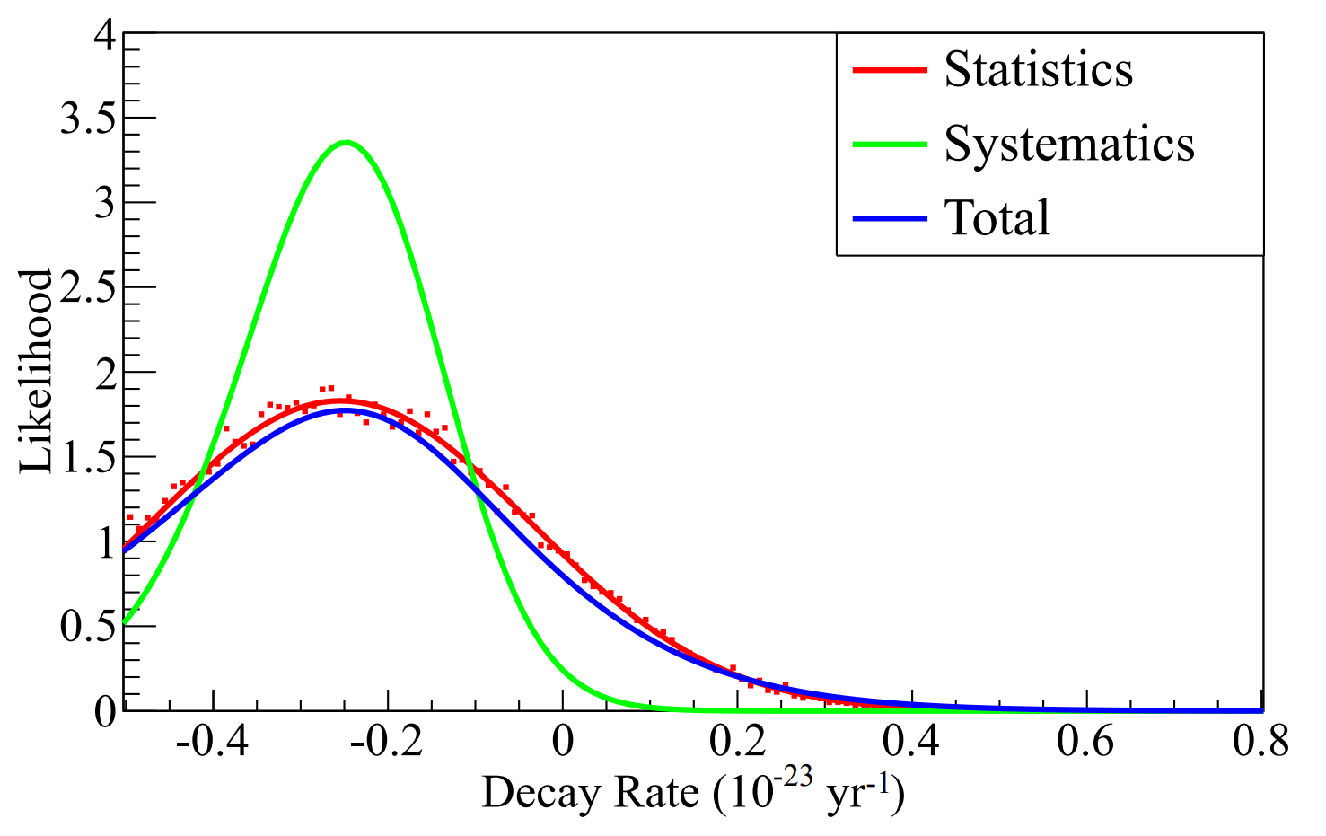
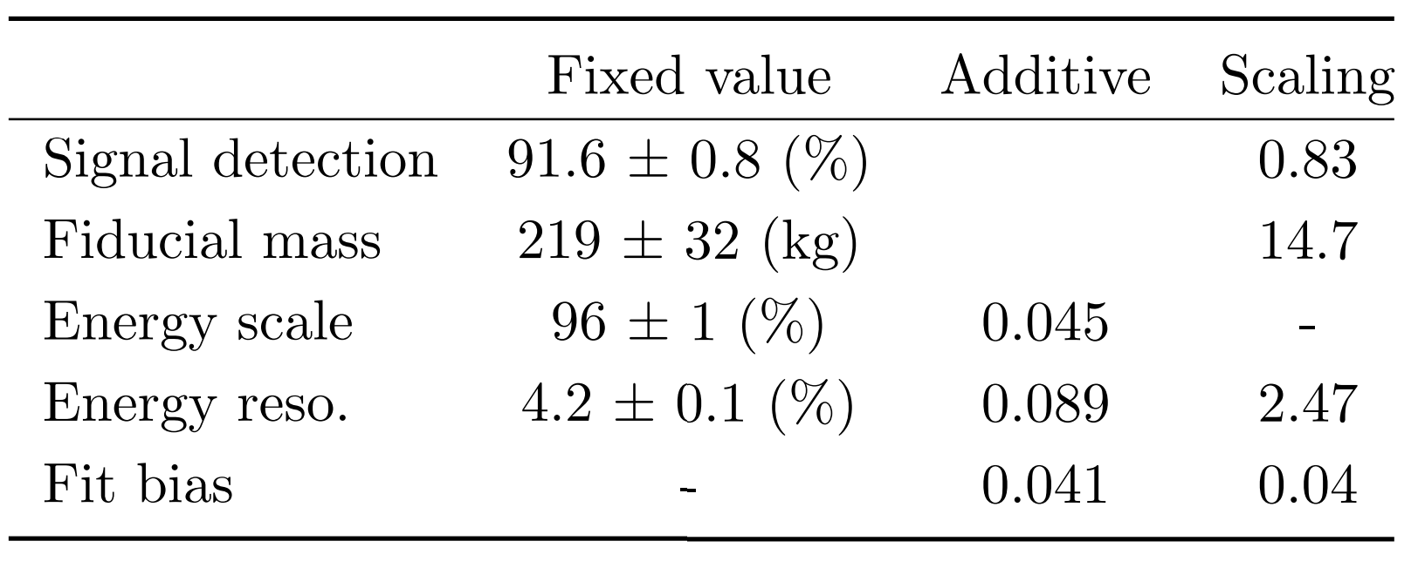

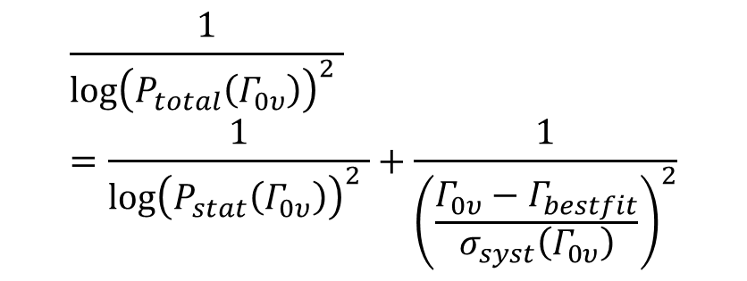
Systematics-associated probability
Systematics uncertainty contribution
$$\frac{1}{{\log\left(P_{total}\left(Γ_{0υ}\right)\right)}^{2} }=\frac{1}{{\log\left(P_{stat}\left(Γ_{0υ}\right)\right)}^{2} }+\frac{1}{{\left(\frac{Γ_{0υ}−Γ_{bestfit}}{σ_{syst}\left(Γ_{0υ}\right)}\right)}^{2}}$$
Integrate positive part to 90%
Result NLDBD half-life: 2.4×10²³ yr (90% C.L.)

Slide 11
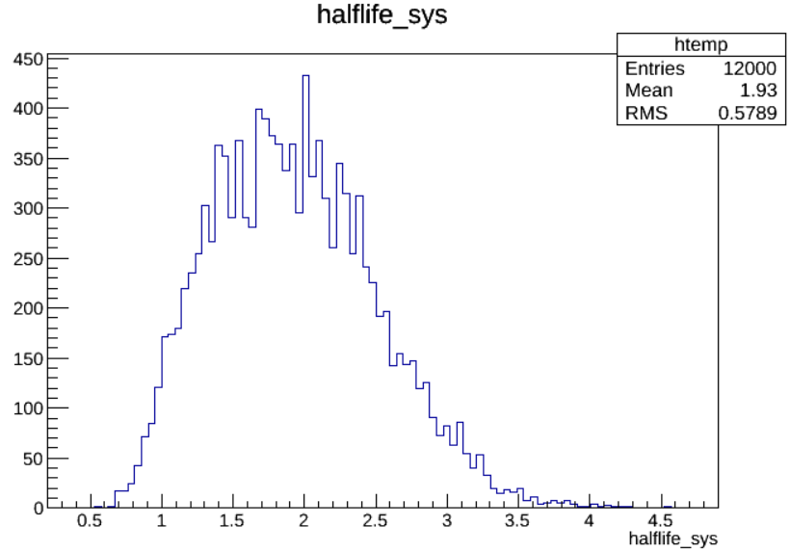
Sensitivity: pseudo-experiments
pseudo-experiments:
  Assume parallel universe
  Their “PandaX-II” yield different spectra
  All the “PandaX-II” experiments follow Poisson distribution.
Frequent analysis
  Carry out pseudo-experiments, generate fake spectra
  Process the fake spectra, procedure is same as previous
  Record the 90% C.L. NLDBD half-life limit
Median: 1.9×10²³ yr
This experiment: 2.4×10²³ yr
20% to get a more stringent limit
Median result of “all” PandaX-II experiment
Result of “this” PandaX-II experiment

Slide 12
Thanks!

