Slide 1
Probing Electroweak Phase Transition in the Singlet Standard Model via bbγγ and 4l channels
Yang Lin
2023/12/6

Slide 2
1
Physical Motivations
2
Parameter Constraints
3
Simulation
4
Sensitivity Analysis

Slide 3
Physical Motivations

Slide 4
Contents
Experimental Evidence
Matter-Antimatter Asymmetry
Sakharov
Conditions
Electro-Weak Baryogenesis
xSM Model
Baryogenesis Arises

Slide 5
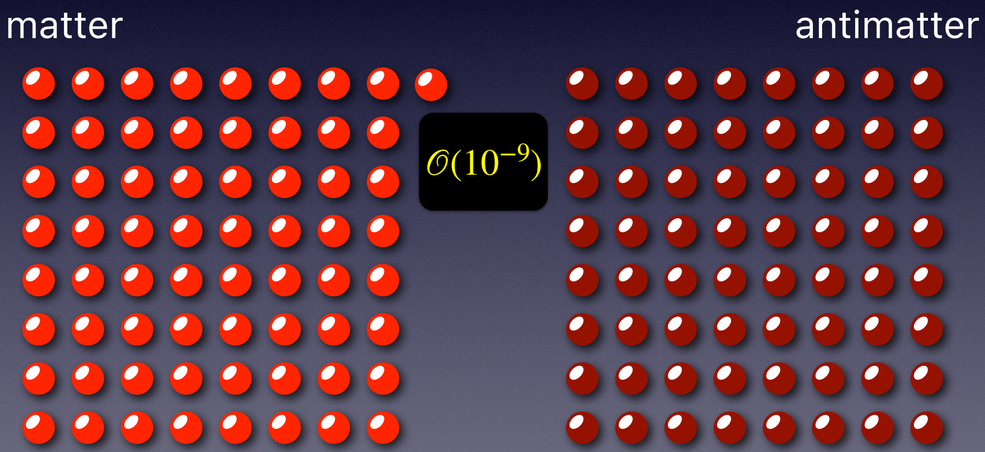

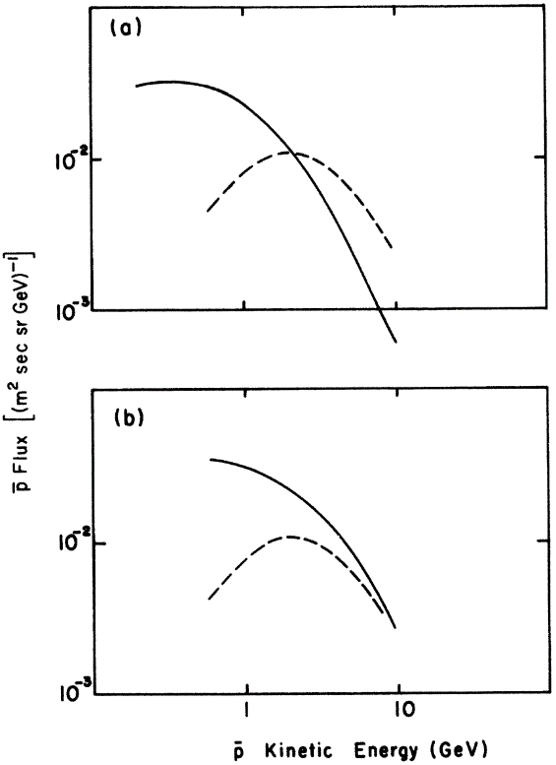
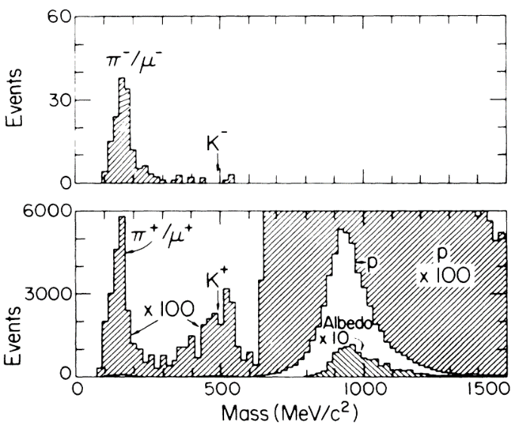
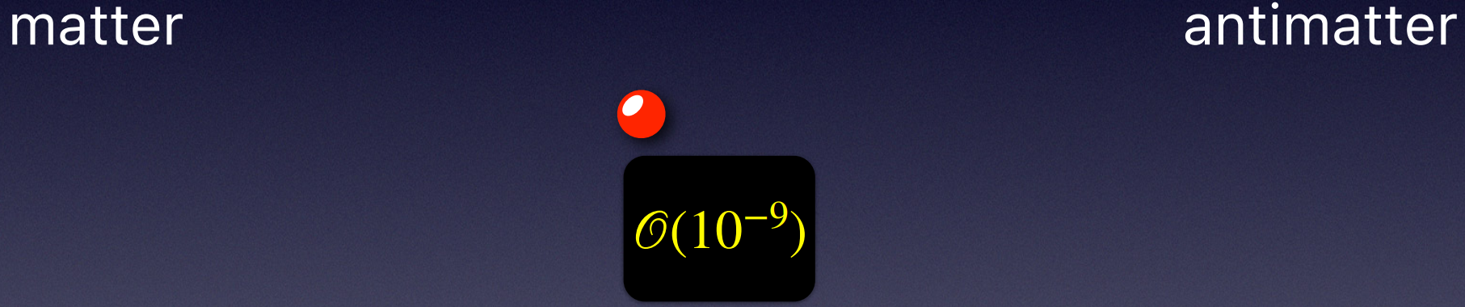
Matter-Antimatter Asymmetry
The very early Universe contains almost an Equal number of matters and antimatters.
Experimental Evidences showing that our Universe is made of matter rather than antimatter.
1. Antiproton-to-Proton flux ratio in cosmic rays
Two Sources:
Secondary antiprotons through interstellar collisions
Antiprotons from primordial antimatters sources
When the Universe got cooler, they pair-annihilated.
But only matter remains (no antimatter)!
Mass spectra of charged secondary particles in cosmic rays: Phys. Rev. Lett. 61 (1988) 145-148.
PUZZL: How was the initial excess of matter created?
NO antiproton candidates !
Phys. Rev. D 10, 1731

Slide 6
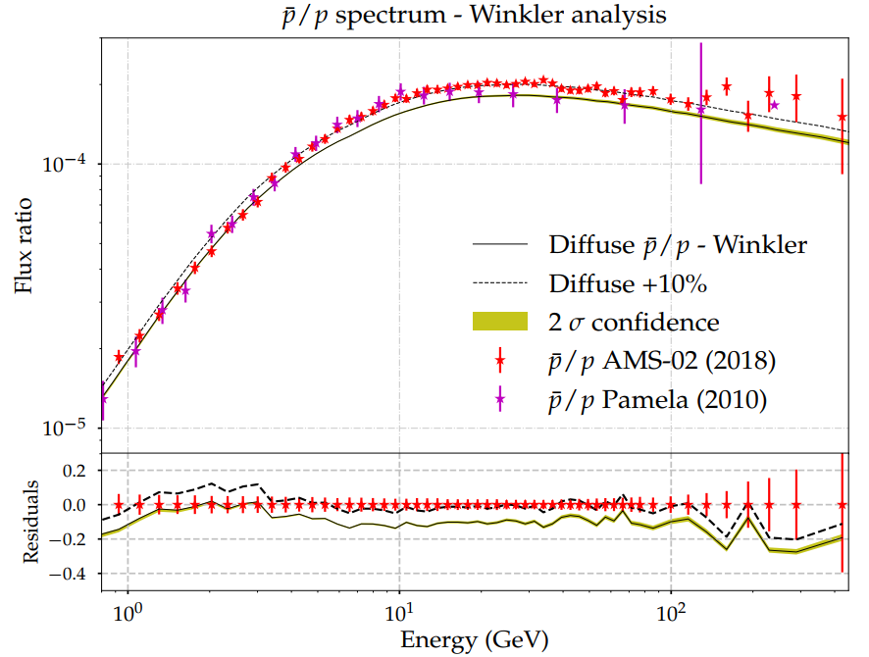




Matter-Antimatter Asymmetry
Experimental Evidences showing that our Universe is made of matter rather than antimatter.
1. Antiproton-to-Proton flux ratio in cosmic rays
2. Annihilation backgrounds within clusters of galaxies
Most useful probe: annihilation gamma-ray distribution
Expected Limits:
if $>{10}^{−5}$ observable $γ$-ray sources
Experimental Upper Bounds:
A&A Vol. 20, p.1 (1972)
A&A Vol. 198, pp. 163–182, 1975
Possibly-Existed antimatter regions:
At distance separated at least as large as clusters of galaxies.
Energy spectrum of antiproton/proton flux ratio in the combined analysis with B/C, Li/C, Be/C, Li/B, Li/Be and Be/B spectra: JCAP11(2021)018.
﻿Not only no antimatter in the intergalactic medium,
but also no antimatter in the intergalactic medium!
﻿Compatible with a pure secondary origin.
NO primordial antimatter in our galaxy!

Slide 7
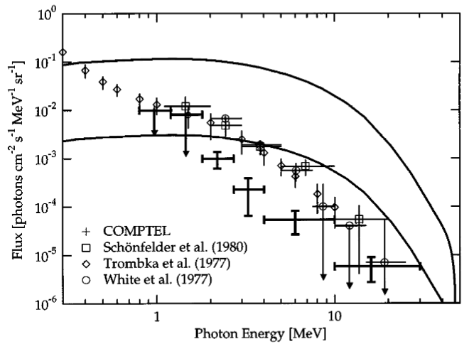


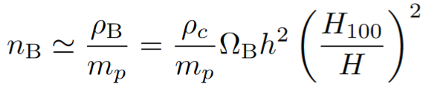
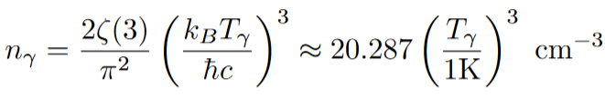




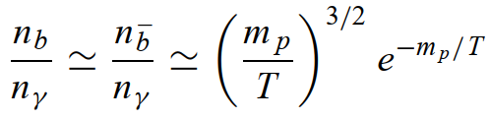

Matter-Antimatter Asymmetry
Experimental Evidences showing that our Universe is made of matter rather than antimatter.
How to Quantify the excess of matter over antimatter?
Baryon-to-Photon Ratio
Intuitive to understand
Constant only in the early universe
3. Annihilation backgrounds on the level of LSS
A&A 641, A6 (2020)
ApJ 707 916 (2009)
Baryon-to-Entropy Ratio
Always conserved during adiabatic expansion of the universe
Most commonly used baryon asymmetry parameter
﻿Data et al. and expectations for the diffuse gamma-ray spectrum: Astrophys. J. 495 (1998) 539-549.
Starting with , the standard cosmology model predicts
Consist entirely of either matter or antimatter on all scales up to the Hubble size (observable universe).
Much smaller than experiments!

Slide 8
Matter-Antimatter Asymmetry
Why Not Mesogenesis?
Why Not Mesogenesis?

Slide 9
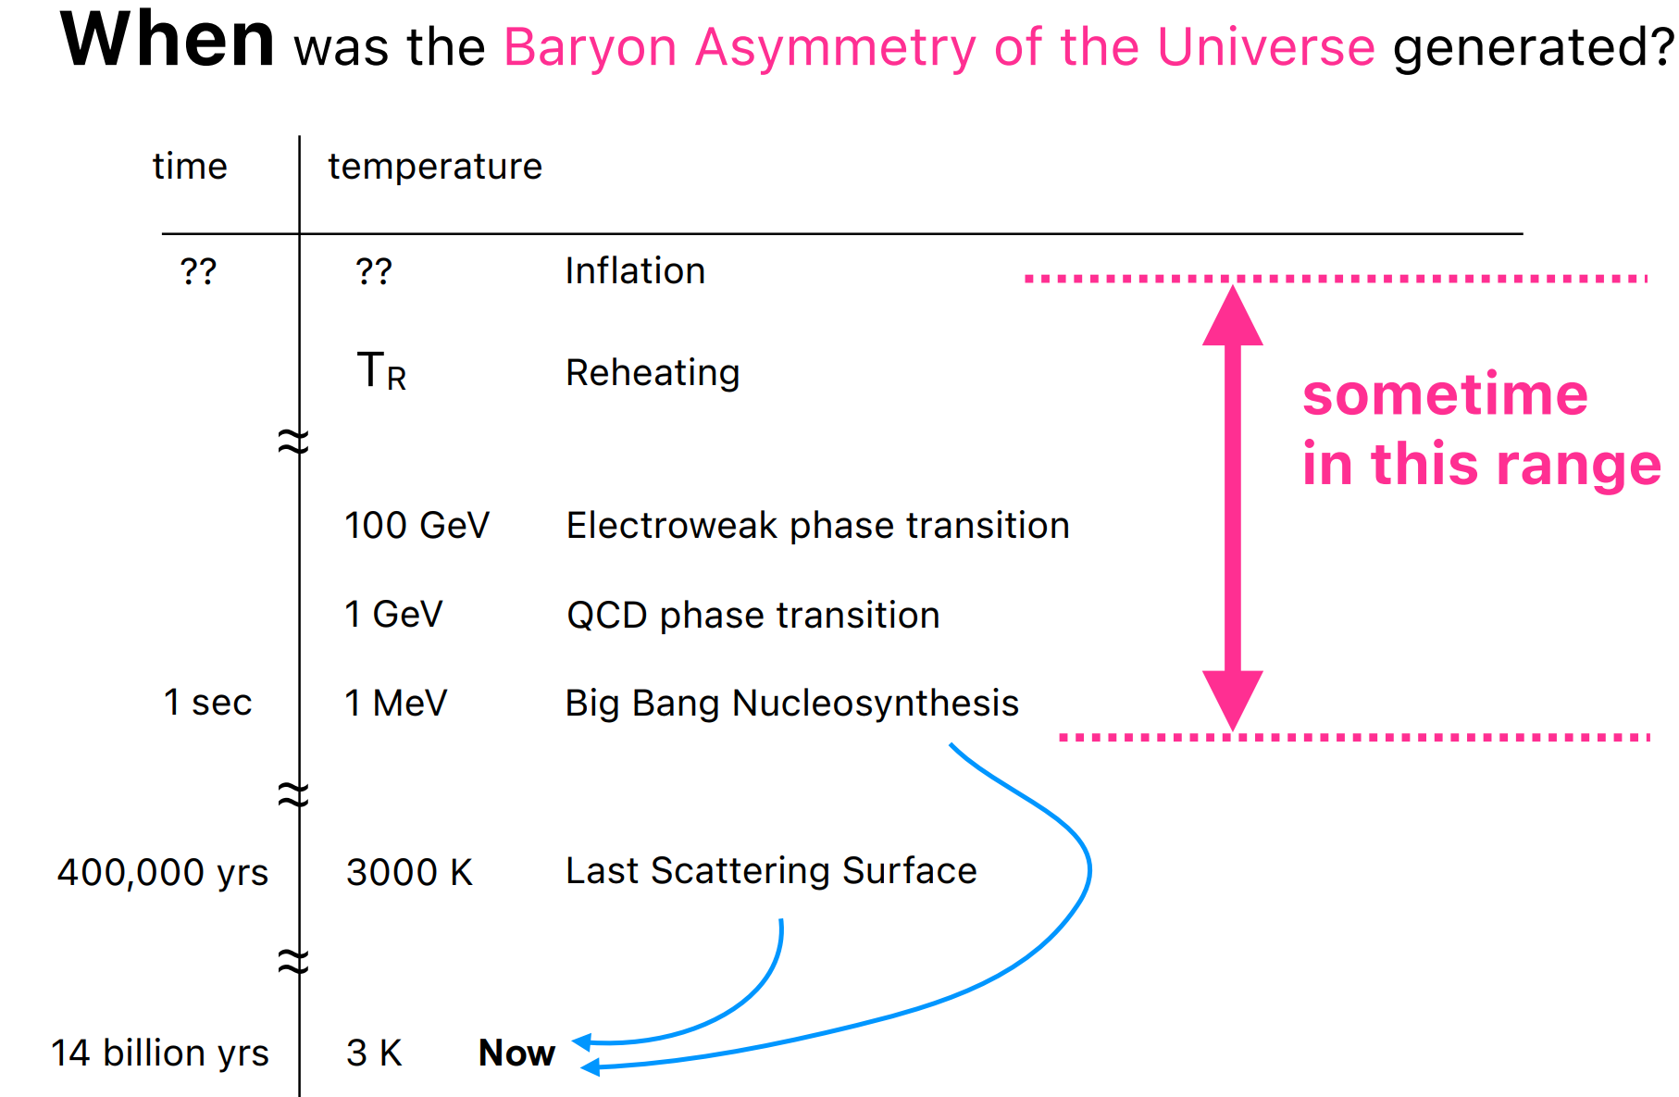
Matter-Antimatter Asymmetry

