Slide 1
Universal Love-C relation for hybrid stars with a crystalline quark core
Zoey Zhiyuan Dong
Prof. Kent Yagi
Shu Yan Lau
Tsung-Dao Lee Institute
31st Mar. 2024
Notes:
Hi, my name is Zhiyuan Dong. You can also call me Zoey. and I‘m from Shanghai. Currently, I’m an undergraduate student at CCNU. In my junior year, I had the opportunity to start research on Universal Relations under the guidance of Dr. Lin at Hong Kong. Today, I‘ll be presenting the work I’ve done in collaboration with Professor Kent Yagi and Dr. Shu Yan Lau during my time in the United States. The subject of my presentation is Universal Love-C relation for hybrid stars with a crystalline quark core.

Slide 2
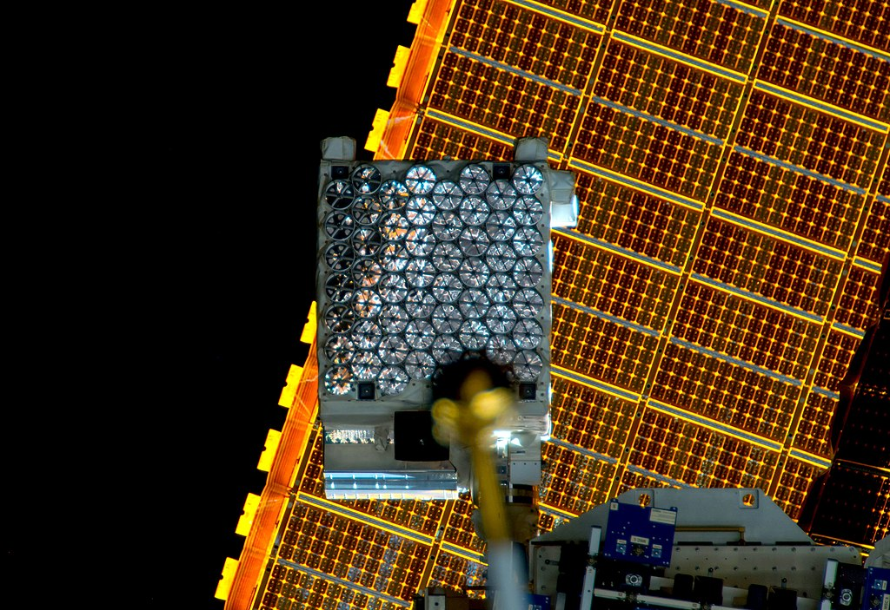
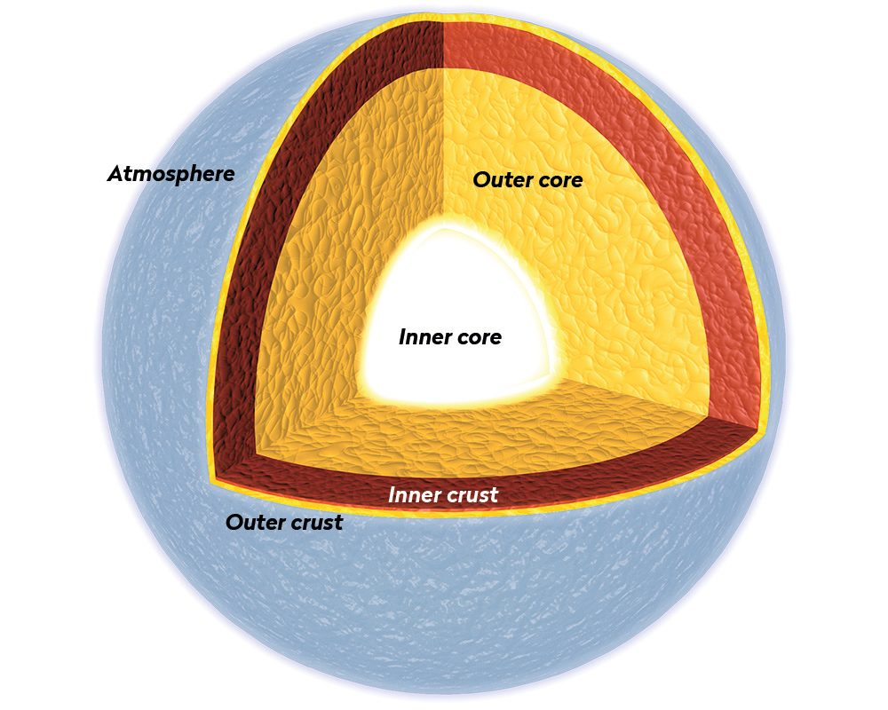

Big picture
NICER
(X-ray)
LIGO
(Gravitational waves)
Observing neutron star to study its interior
Notes:
Just to give you a big picture.
A neutron star has a structure similar to our planet, with an atmosphere, crust, and core. But what goes on inside is very different.
Observations through gravitational wave detector LIGO and X-ray detector NICER and other astrophysical methods can provide us with critical insights into their internal structure and composition.

Slide 3
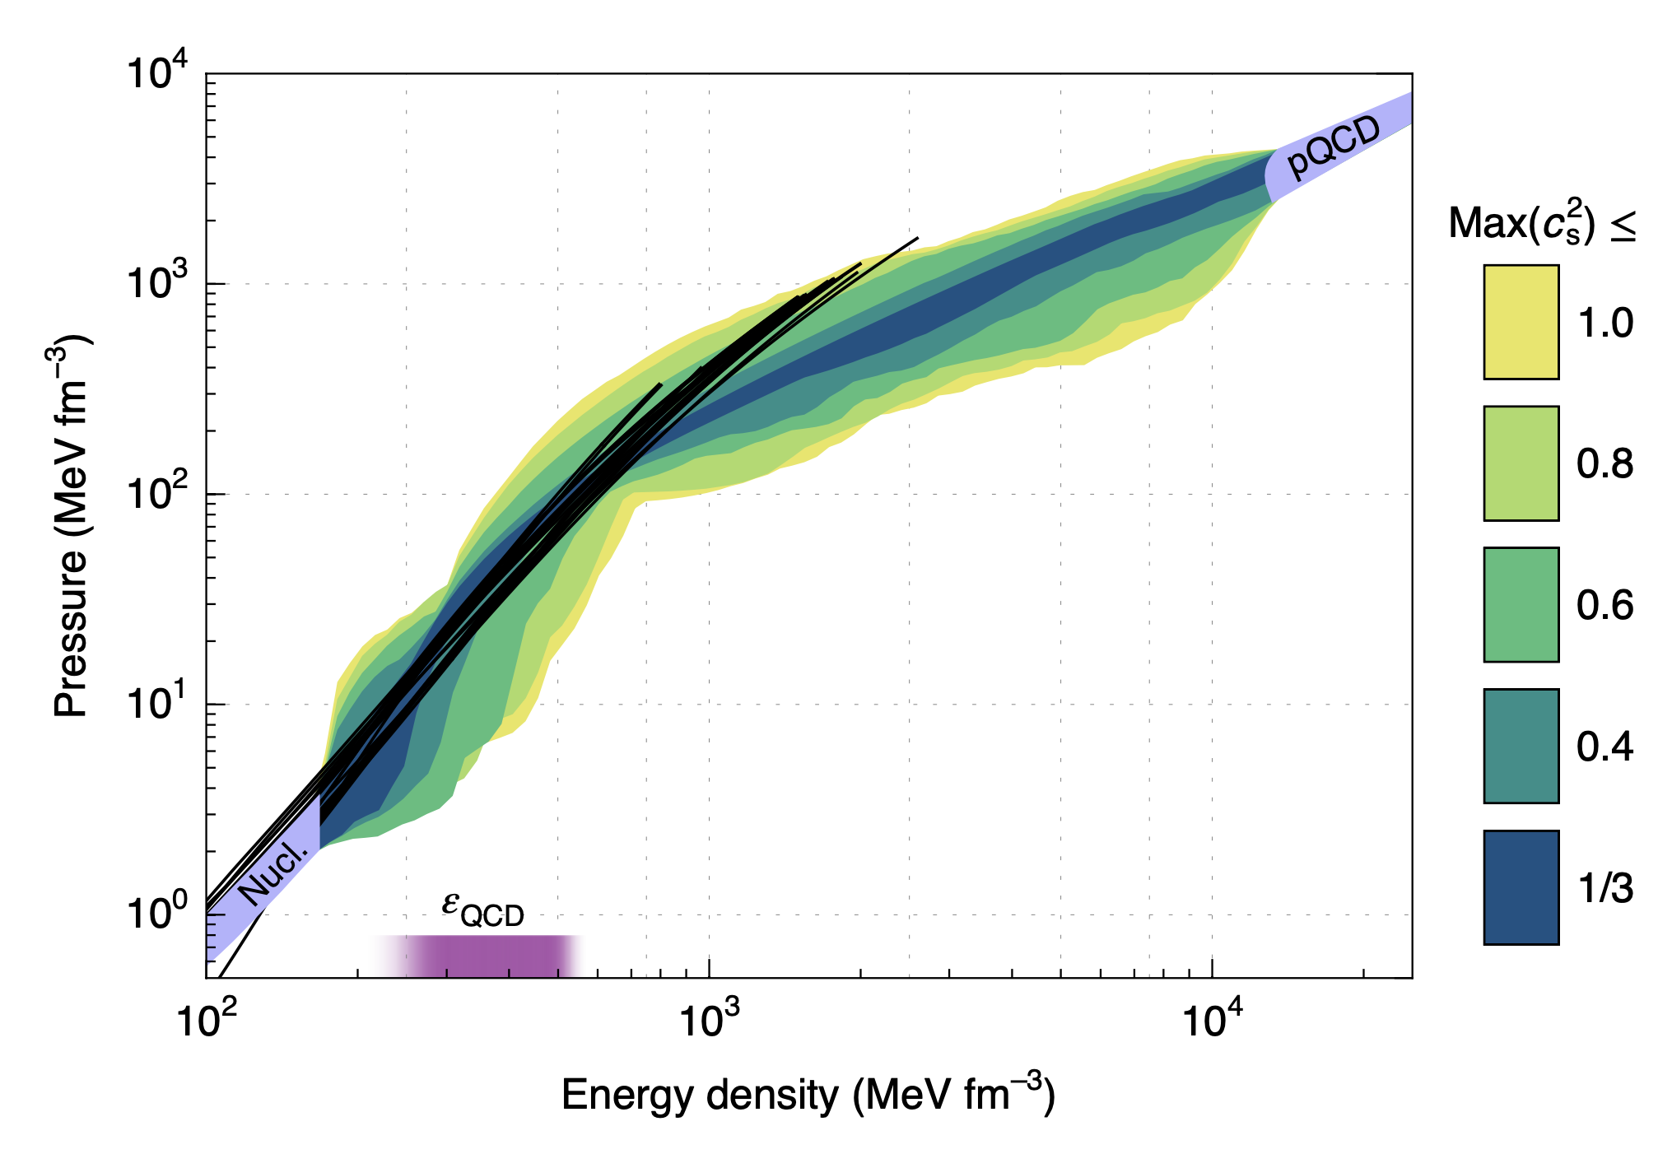

Hybrid star model
Eemeli Annala et al.(2020)
Neutron star cross-section
nuclei, n
n, p, e, $μ$ matter
?
Core
Hyperons? Meson condensates?
Quark matter?
Notes:
The graph on the right shows that existing theories can precisely describe regions below nuclear saturation density and at extremely high densities, but there’s significant uncertainty in the intermediate densities, where neutron star cores lie.
The core of an NS is the most uncertain region due to the various possible phases of matter emerging.
In particular, An NS with quarks inside its core is named a ‘hybrid star’ (HS).
The uncertainty in the Equation of State within the core regions leads to significant variations in the Mass-Radius relation. Therefore, if we want to investigate the quark matter in the core, alternative approaches are necessary to circumvent these uncertainties.

Slide 4
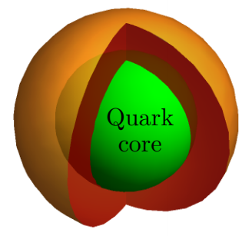
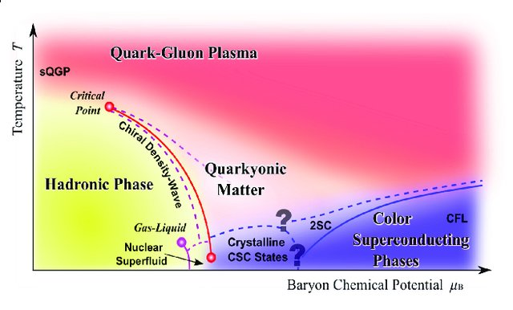
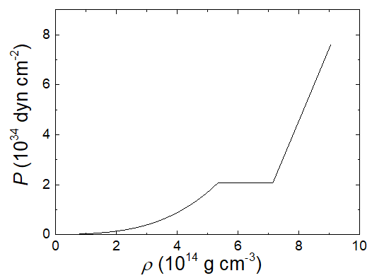

Solid core in a hybrid star
Fluid nuclear matter
M. Heuser et al. (2013)
QCD phase diagram
Crystalline
Quark matter
Quark matter
First order transition
Hadron
Density gap $Δε$
Notes:
We now turn to the inner structure of hybrid stars. Past research has considered various cases for the core of a hybrid star to be a rigid solid. One possibility is a crystalline colour superconducting phase within the core.
Imagine a hybrid star with a solid core enveloped in a fluid outer layer. The transition from nuclear matter to quark matter could exhibit a stark density discontinuity at the interface—this is what we call the first-order transition.
Such discontinuities generally lead to a softening of the equation of state. This softening effect is expected to have significant consequences for the properties of hybrid stars.

Slide 5
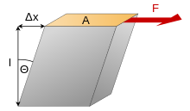
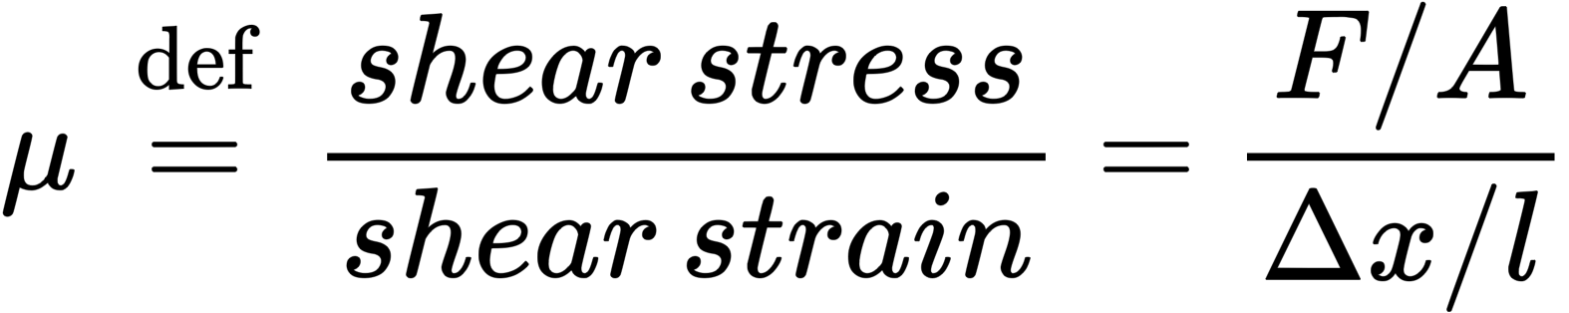
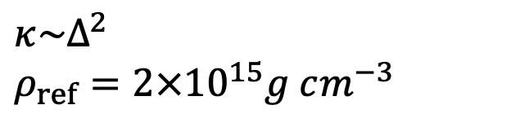
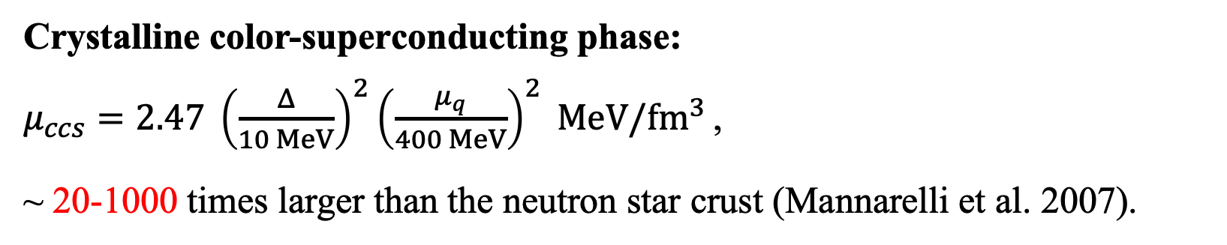
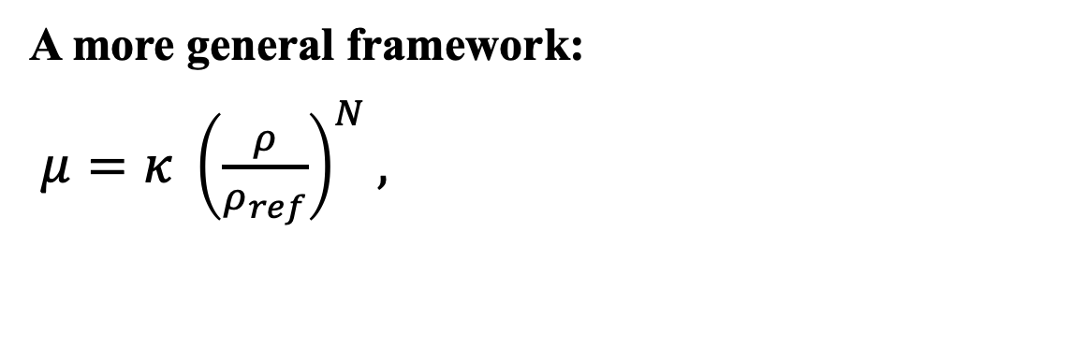
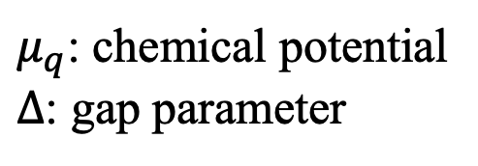
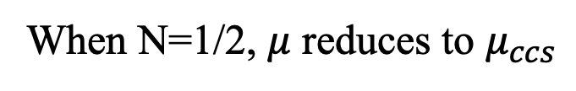
The shear modulus
Source: Wikipedia
Crystalline color-superconducting phase:
$μ_{ccs}=2.47 {\left(\frac{Δ}{10 MeV}\right)}^{2}{\left(\frac{μ_{q}}{400 MeV}\right)}^{2} MeV/fm^{3 }$,
~ 20-1000 times larger than the neutron star crust (Mannarelli et al. 2007).
$μ_{q}$: chemical potential
$Δ$: gap parameter
A more general framework:
$μ=κ {\left(\frac{ρ}{ρ_{ref}}\right)}^{N},$
When N=1/2, $μ$ reduces to $μ_{ccs}$
$κ\sim Δ^{2}$
$ρ_{ref}=2×{10}^{15}g cm^{−3}$
If you are interested in how it was obtained, you can refer to J. P. Pereira et al.(2018).
Notes:
In addition to the density gap, the solid core‘s shear modulus will also affect the properties of neutron stars. This physical quantity is a measure of a material’s ability to resist shear forces, which is defined as the ratio of shear stress, the force per unit area, to shear strain, and the deformation relative to a fixed base. ***It AFFECTS how neutron stars deform in response to tidal forces.***
In the context of a hybrid star, the crystalline color-superconducting phase matter within the core is theorized to have a remarkably large shear modulus. This is estimated to be about 20 to 1000 times greater than that of the crust of a typical neutron star. Such rigidity is basically determined by the gap parameter – a higher value indicates a more rigid core. The key question we explore here is: if this solid phase exists within the core of a hybrid star, how significantly could it affect the star’s properties?
Furthermore, to accurately quantify the shear modulus of a solid core, we adopt a more general framework that correlates the modulus with the star’s density. The shear modulus μ is characterized by a scaling factor κ, which is approximately proportional to the square of the gap parameter and also related to the density index N. When N=1/2, $μ$ reduces to $μ_{ccs}$.
***In essence, the shear modulus‘s dependence on density can provide insights into the microscopic interactions of matter within neutron stars, which is informative to help us improve the EOS.***

Slide 6
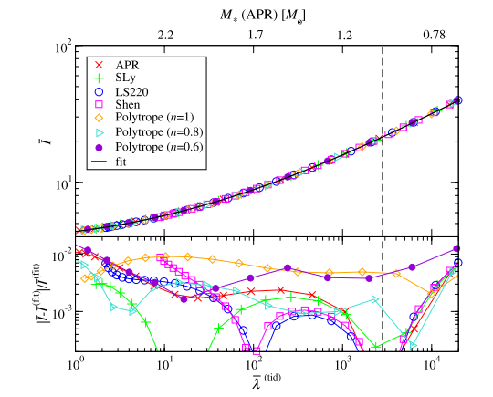
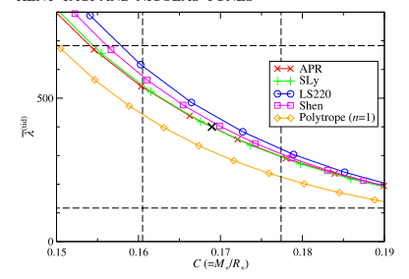
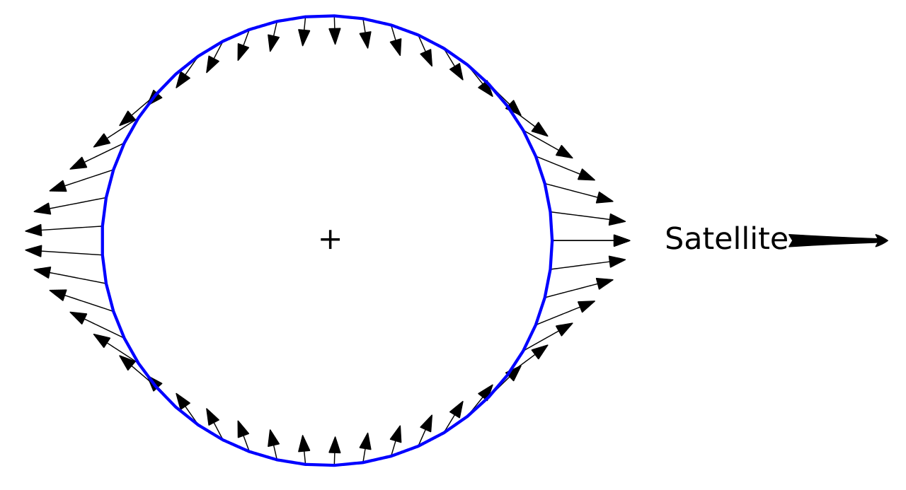
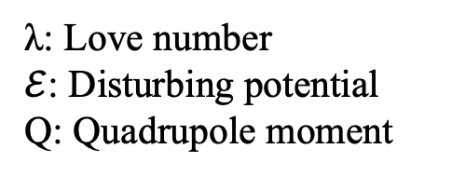

Method - Relations between NS properties
I-Love relation
Tidal deformability
Love-C relation
$$Q_{ij}=−λ{\text{ℇ}}_{ij}$$
λ: Love number
$ℰ$: Disturbing potential
Q: Quadrupole moment
Yagi & Yunes (2013)
Insensitive to the Equation of State!
Notes:
I previously discussed how the equation of state has enormous uncertainties in the core region. Therefore, exploring the possible existence of quark matter in the core requires some other methods.
The universal relations can help us a lot because they provide a way to understand the internal structure of neutron stars without the need for precise knowledge of the Equation of State.
Here, I take the I-Love-C relation as an example, where "I" stands for the moment of inertia, "Love" refers to the tidal Love number, and "C" represents Compactness (M/R). The tidal Love number quantifies how much a celestial body deforms in response to the tidal forces exerted by another celestial body in its vicinity./versineti/
***My project aims to study the Love-C relation for hybrid stars with a CCS quark core because both Compactness and tidal love numbers can be MEASURED, which helps us constrain the EOS AND GET SOME INSIGHT ON QUARK MATTER PROPERTIES.***

Slide 7
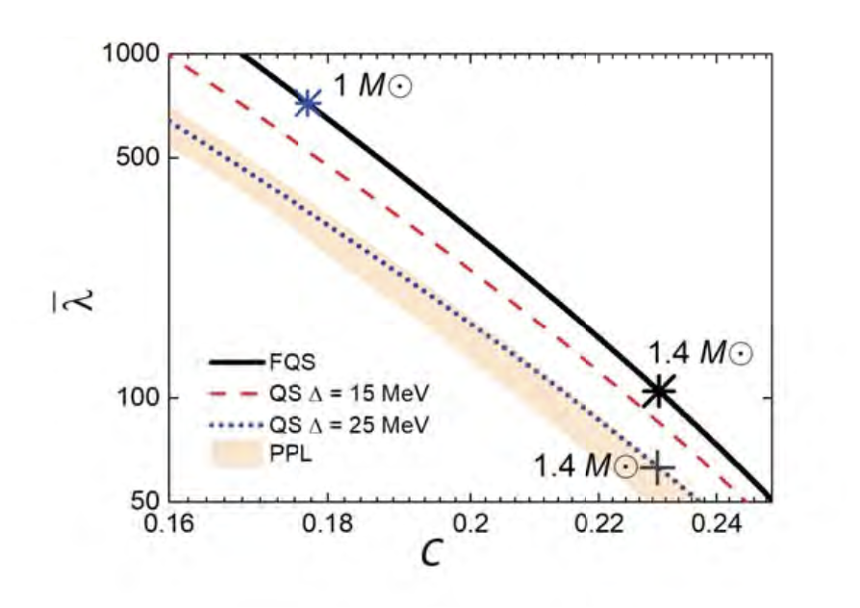
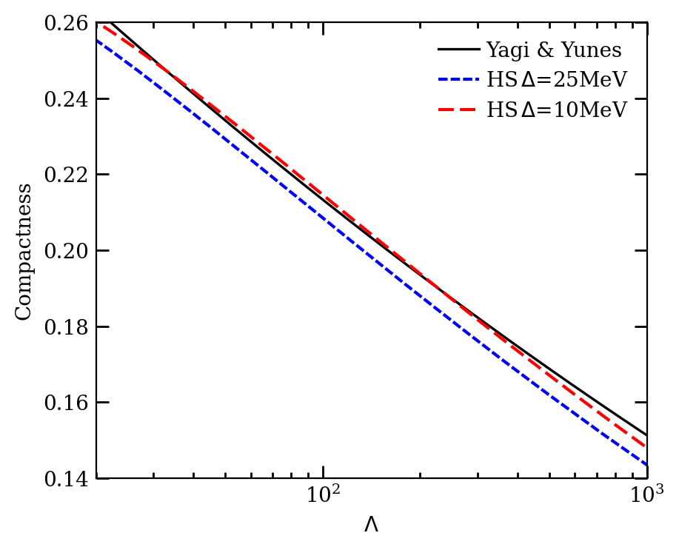
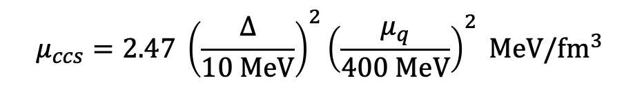
Effect on the Love number (CCS phase)
Credit: Shu Yan Lau
$$μ_{ccs}=2.47 {\left(\frac{Δ}{10 MeV}\right)}^{2}{\left(\frac{μ_{q}}{400 MeV}\right)}^{2} MeV/fm^{3 }$$
FQS: Fluid Quark Star
QS: Solid Quark Star
PPL: results of Love-C relation of various fluid neutron star models
HS: Hybrid Star
Yagi & Yunes: a line of best fit
Notes:
In the work conducted by Mr. Lau, the impact of the shear modulus on the Love number was examined by using the Love-C relations. One thing to remind everyone is that we assume the background to be in an unstrained state, which means that we do not consider the impact of the shear modulus on mass and radius. A significant deviation in the Love-C relation between fluid quark stars and typical neutron stars arises primarily because quark stars differ fundamentally from neutron or hybrid stars. Gravity is not the only attractive force in quark stars, unlike in typical neutron stars.
His results indicated that the shear modulus will decrease the Love numbers.
I‘ve also conducted a study on the Love-C relation in the context of hybrid stars. The right graph illustrates that as the shear modulus increases, the deviations of Love numbers from the line of best fit—established by Yagi & Yunes for typical neutron stars—become more pronounced.

Slide 8
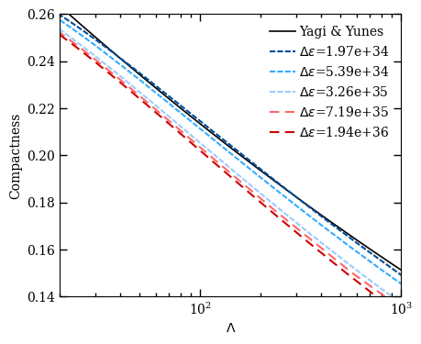
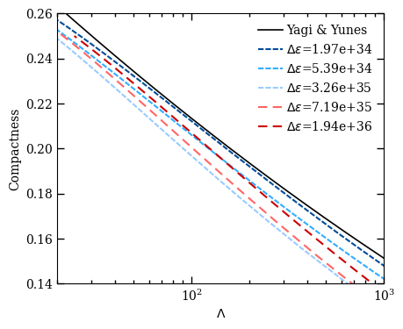
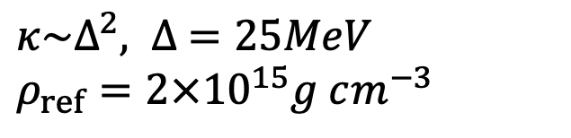
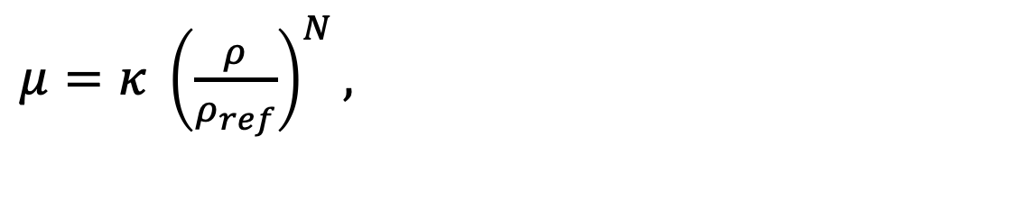
Effect on the Love number (general case)
$μ=κ {\left(\frac{ρ}{ρ_{ref}}\right)}^{N},$
$κ\sim Δ^{2}, ∆ =25MeV$
$ρ_{ref}=2×{10}^{15}g cm^{−3}$
Non-monotonic behaviour?
N = 1
N = 0
Notes:
We now extend our exploration into the effects of the shear modulus on the Love number in a more general case.
If we consider kappa to be a constant and vary the density gap, we can also observe deviations in the Love-C relation for both cases of N = 0 and N = 1. ***There should be a density gap dependence within this model.***
However, an interesting non-monotonic behaviour emerges in the case where N = 0 (density-independent).
-Not need to mention-
***[My guess]
The non-monotonic trend could indicate the limitations of the analytical model in capturing the behaviour of the star's matter under extreme conditions. It may signal that the model requires refinement or additional physical parameters to describe the state of matter in neutron stars accurately.
Treating the shear modulus as a constant throughout the star might only be valid up to a certain point, beyond which other factors become significant.
An excessively large density gap is non-physical.***
Comments from Kent:
I agree constant shear modulus model is unphysical, but I don’t think it’s because of the non-monotonic behavior. I’d think the non-monotonic behavior itself is fine. We do see this explicitly in the analytic model when the density gap is small or large, the 2 fluid model is giving us effectively 1 fluid model, so it’s not too surprising that the behavior is different in the intermediate density gap regime, creating the U-shape behavior. So, I don’t think the non-monotonic behavior is signaling the limitations of the analytical model.

Slide 9
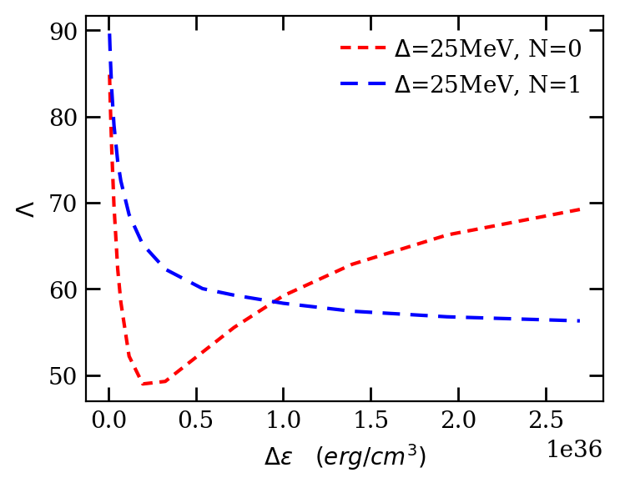
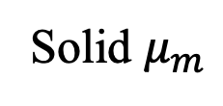
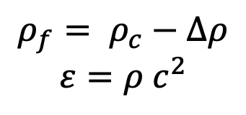

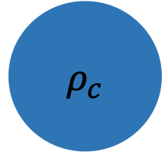


A non-monotonic dependence?
$μ=κ {\left(\frac{ρ}{ρ_{ref}}\right)}^{N}$
C = 0.22
A very simple analytical model
Solid $μ_{m}$
$ρ_{f}$
Constant
$ρ_{c}$
Fluid
$$ρ_{f}= ρ_{c}−Δρ$$
$$ε=ρ c^{2}$$
$$p_{transition}$$
Notes:
To see it more clearly, I plotted the Love-delta epsilon profile when Compactness is 0.22.
We use a two-layer incompressible model to do further analytical exploration. It is also a two-layer model with a solid core and a fluid outer layer, but the density and the shear modulus are constant.

Slide 10
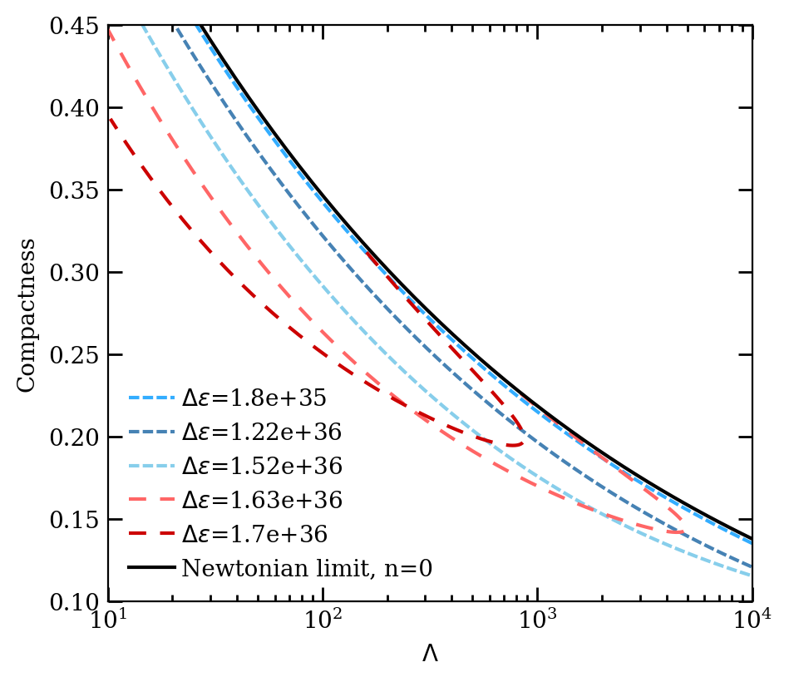
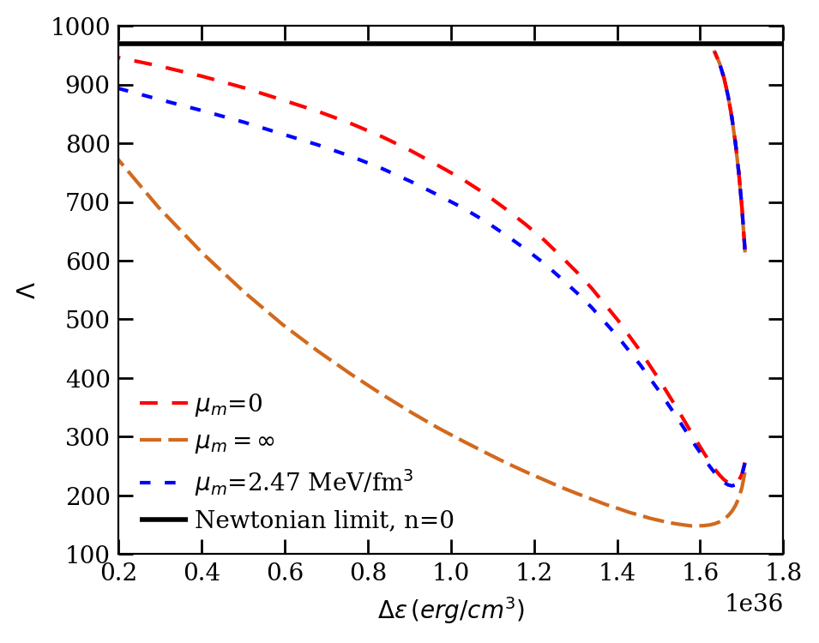

Go Further – Analytical Model
C = 0.22
U shape?
$$μ_{m}=2.47MeV/fm^{3}$$
0.22
Notes:
On the left, we see the results obtained by varying the density gap. Consistent with the numerical solutions, an increase in the density gap results in a larger deviation of the Love-C curve.
When we specify a compactness of 0.22, we observe the graph on the right, also including cases where the shear modulus is set to zero, representing a fluid limit, and infinity, namely an utterly rigid body. The non-monotonic behaviour of the Love number is apparent here as well, just as it was in our previous models.
However, a curious phenomenon arises — the red lines on the left bend upward, creating a ‘U-shape.’ What happened?

Slide 11
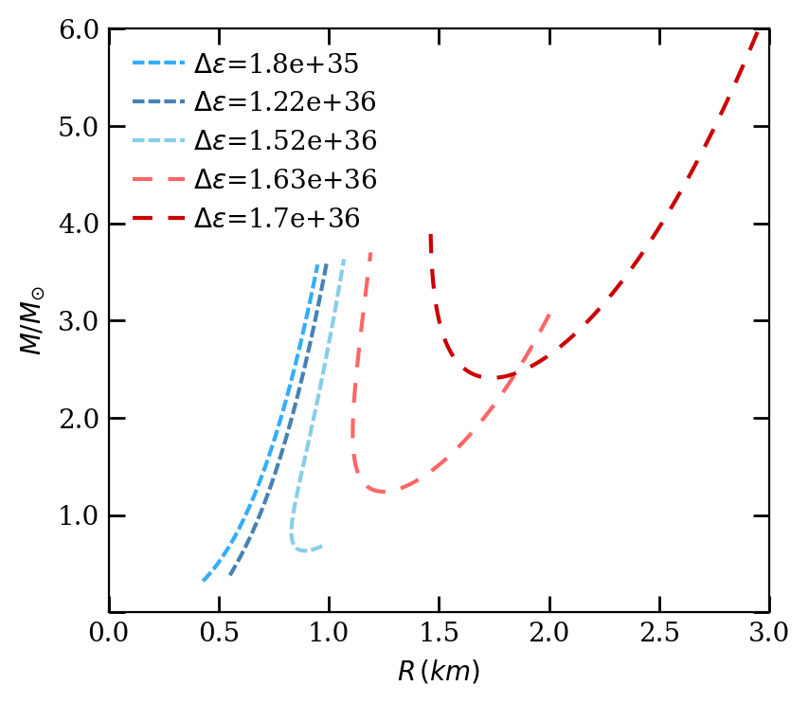
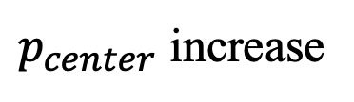
Analytical Model – U shape
$p_{center}$ increase
Notes:
The right graph is a M-R relation profile. As the central pressure increases, the mass-radius relation of the red lines first decreases to a minimum value before curving back up, resulting in the U-shaped curve. the part where the mass decreases may be the unstable branch while the one where the mass increases is stable (just like the typical NS enters into an unstable branch once it reaches the max mass).

Slide 12

Summary
Fluid nuclear matter
?
Crystalline
Quark matter
Method: Universal relation
Tidal Love number – Compactness
Explored the effect of shear modulus in more general cases
N
Investigated the relation between Love number and density gap with an incompressible model
Non-Monotonic
Notes:
In summary, our investigation has focused on the interior of neutron stars, particularly the hybrid star with a crystalline quark core. We‘ve utilized a method based on the universal Love-C relation.
We have achieved two main results from our study:
We examined the effect of the shear modulus on tidal love numbers, considering more general cases indicated by the variable N. This allowed us to understand how the shear modulus affects tidal Love numbers.
2. We delved into the relation between the Love number and the density gap within an incompressible model, revealing a non-monotonic behaviour. This non-standard behaviour could point towards complex interactions within the quark matter at extreme densities and pressures.

