Slide 1

Pion-mediated Cooper pairing of neutrons at low densities
Hao-Fu Zhu
Department of Astronomy, University of Science and Technology of China
TDLI, 2024. 03. 31
Notes:
Ladies and gentlemen, good day to all. My name is Zhu Hao-Fu. professor Liu Guo-Zhu is my supervisor.
I am very grateful to the organizers for giving me this opportunity to share our recent work. My report's name is "Pion-mediated Cooper pairing of neutrons at low densities".

Slide 2
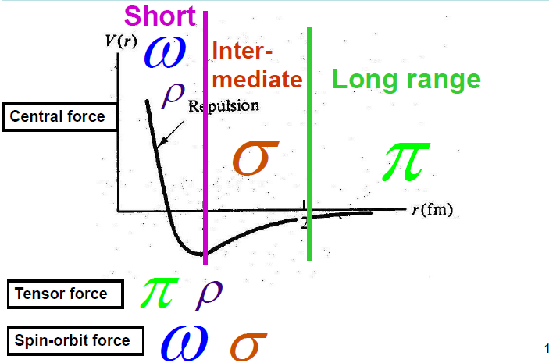
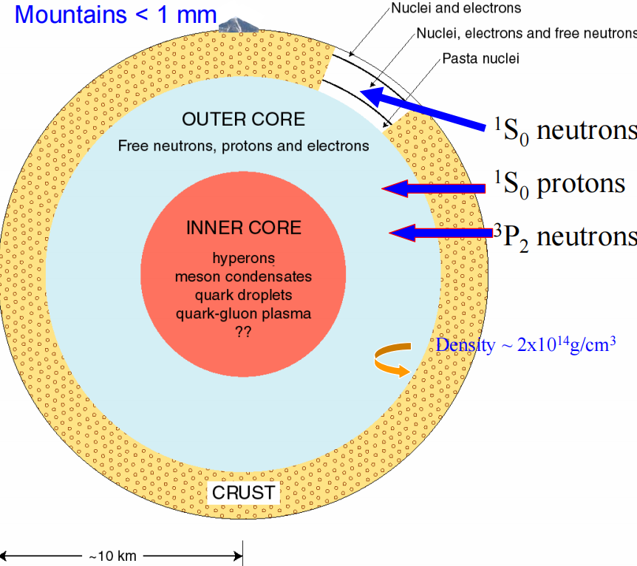
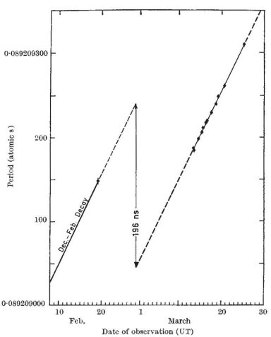
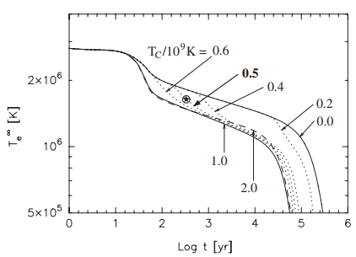
10 -100 MeV
Glitch
Cooling
Notes:
It is well-known that there is an attractive force at long-range and a repulsive force at short-range between nucleans. In neutron stars, which are abundant in neutrons, the Fermi energy of neutrons is around 10-100 million electron volts, significantly greater than the internal temperature 0.01million electron volts of neutron stars. Thus, it is conceivable that neutron stars are essentially degenerate zoro-temperature systems, where superfluid or superconducting states are highly likely to exist. The current consensus is that S-wave neutron superfluidity exists in the crust of neutron stars, while P-wave neutron superfluidity and S-wave proton superconductivity are present in the outer core of neutron stars.
Research on superfluidity in neutron stars is crucial for understanding the dynamic evolution of glithes and the fast cooling mechanisms. To study it more deeply, we must accurately calculate the superfluid pairing gap, critical temperature, and critical density.

Slide 3
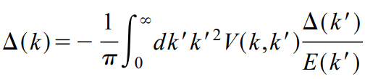
Lombardo & SchulzearXiv:astro-ph/0012209:
BCS gap eqution：
Notes:
Traditionally, people have used the BCS gap equation under the BCS approximation to obtain the value of gap, critical temperature, and critical density. Over the past few decades, different groups have used various realistic or phenomenological nucleon-nucleon interaction potentials to it. It has been observed that in the case of S-wave pairing, the gap obtained using several potential functions are close across different density regions. However, for P-wave pairing, the gap show little difference in low-density areas but significant differences in high-density regions.The reason for this discrepancy is that we cannot directly obtain potential information for higher densities, and extrapolations from different methods and approximations produce vastly different results.

Slide 4
BCS theory has made great achievements, but the mean field approximation has limitations!
1. It simplifies the contribution of boson to the interaction V, which is too rough.
2. It ignores the important quantum
many-body correlations, including the retardation effects of boson propagation, Landau damping caused by fermion-boson coupling and fermion mass renormalization.
3.The BCS theory lacks predictive power !!!
Notes:
In condensed matter physics, BCS theory has made great achievements, but the mean field approximation has many defects! 1. It simplifies the contribution of boson to the interaction V. 2. It ignores the important quantum many-body correlations. 3. The BCS theory lacks predictive power! For instance, BCS theory cannot explain the isotope effect observed in many superconducting material. BCS theory always gives α = 0.5, which fails to explainα = 0.08 in compound metal superconductors.

Slide 5






Introducing the Dyson-Schwinger equation with the example of the electron-phonon coupling model
electron propagator
phonon propagator
electron free propagator
Landau damping
mass renormalization
superconducting gap
Notes:
Condensed matter physicist has go beyond BCS theory by introducing the Dyson-Schwinger equation. Professor Liu's report has made a wonderful introduction to the DS equation, so I am not going to repeat it.
Taking the electron-phonon coupling model as an example, by introducing the Nambu spinor, the electron-phonon coupling model can be rewritten in the following form. The introduction of Nambu spinor allows us to naturally introduce the pairing gap in the renormalized electron propagator, as well as other quantum many-body correction such as Landau damping A1 and mass renormalization A2.

Slide 6
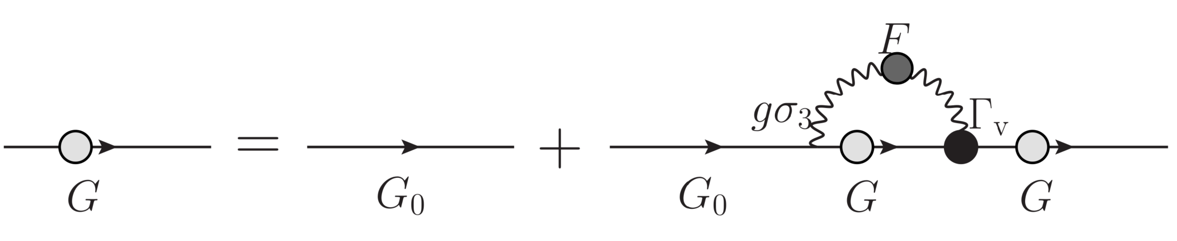
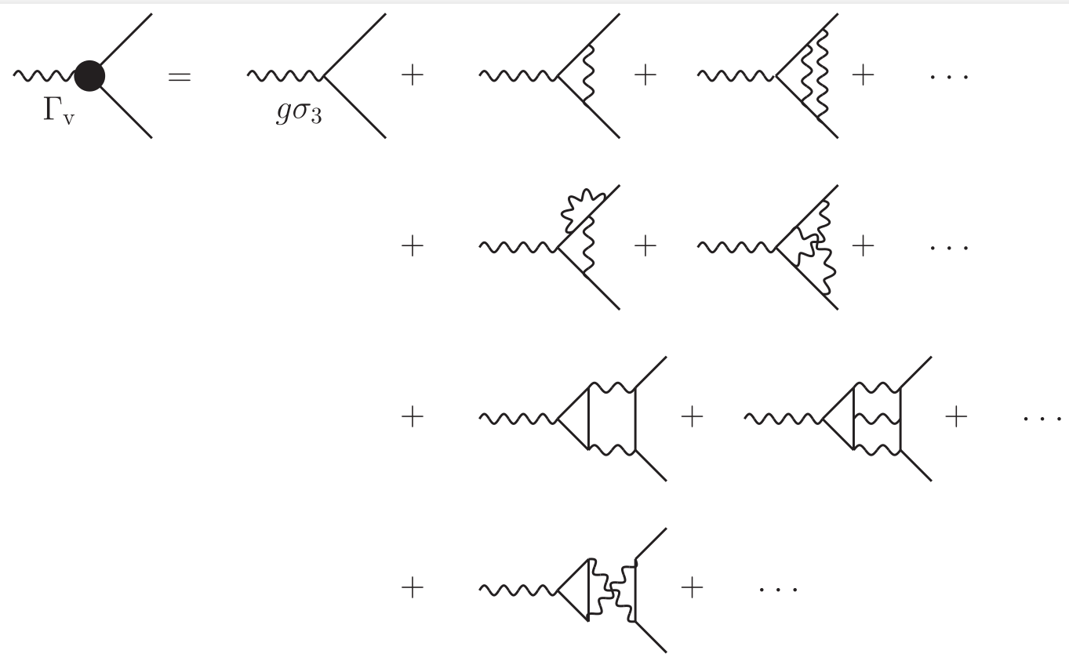

Strict Dyson-Schwinger equation satisfied by the electronic propagator
is the electron-phonon vertex function, which consists of infinitely many Feynman diagrams
Notes:
And then we can substitute the renormalized electron propagator into the strict electron Dyson-Schwinger equation, where Gammav is the electron-phonon vertex function, consisting of infinitely many Feynman diagrams. Solving the above integral equation in principle can produce A1, A2, and gap at the same time. However, there is still a problem: the renormalized phonon propagator may be not important, but we do not know the exact form of the vertex function, so the DS equation is not self-closed.

Slide 7
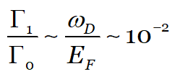

Under the bare vertex approximation, the Dyson-Schwinger equation is called the Migdal-Eliashberg (ME) equation. Now we have a self-closed integral equation that can be solved completely, and it can well explain the isotope effect which can not be explained by BCS mean field theory.
Migdal theorem: in common metal, the correction of electron-phonon vertex is very small and can be ignored completely.
A. Migdal, JETP (1958):
common metal
bare vertex
Notes:
Fortunately, the Migdal theorem states that in ordinary metals, the electron-phonon vertex correction is very small and can be completely ignored. Under the bare vertex approximation, the DS equation is known as the Migdal-Eliashberg (ME) equation. Now we have a self-closed integral equation that can be solved completely, and it can well explain the isotope effect which can not be explained by BCS mean field theory!

Slide 8
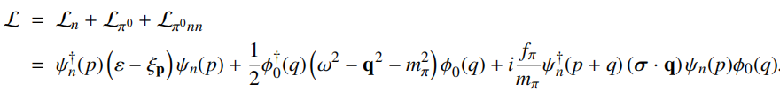
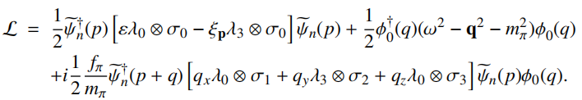


Hao-Fu Zhu & Guo-Zhu Liu, JPG (2023)
        Neutron and neutral pion interaction
        Non-relativistic model :
        Nambu spinor of neutron operator
        Rewrite the above Lagrangian density into：
Notes:
Inspired by this, we can perform a non-perturbative analysis of the ME equation into the study of neutron star superfluidity. We should adopt a neutron-meson model, in which mesons play the role of bosons that provide attractive or repulsive interactions. As an attempt, we ignored the role of other mesons and finished a work to explore the interaction between neutrons and neutral pions at low densities. After introducing the Nambu spinor, the Lagrangian of non-relativistic neutrons and neutral pions can be written as follows. Therefore, we naturally introduce A1 and A2 representing quantum corrections, and gaps representing superfluidity.

Slide 9

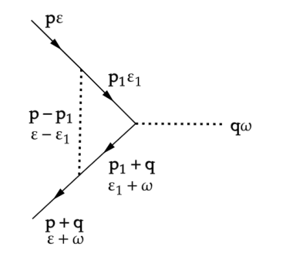
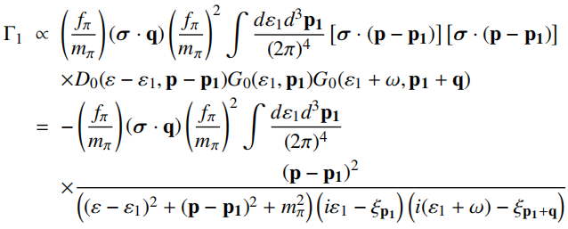
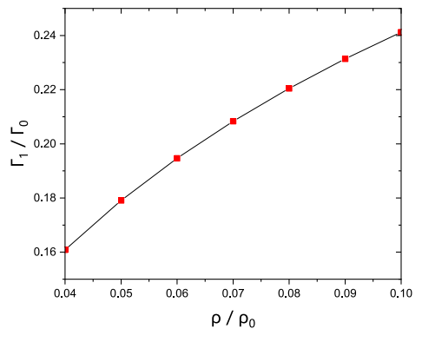
Hao-Fu Zhu & Guo-Zhu Liu, JPG (2023)
Migdal theorem fails!
the contribution of the lowest-order vertex correction of neutron-pion can not be ignored. With the increase of neutron density, we can approximately use
to replace .
Notes:
However, in this model, we found that the Migdal theorem fails! The contribution of the lowest-order vertex correction of neutron-pion can not be ignored. These results indicate that the vertex corrections play a significant role and need to be seriously taken into account. As the neutron density increases, we can approximately use the bare vertex gama0 plus one-loop vertex correction gama1 to replace Gama0

Slide 10
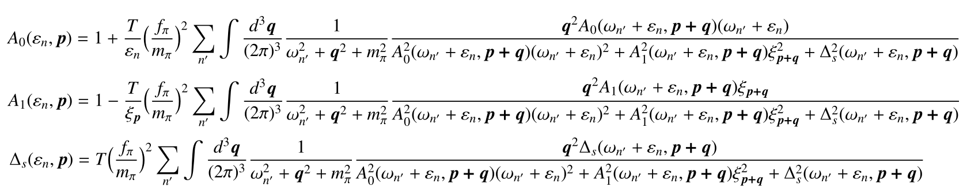
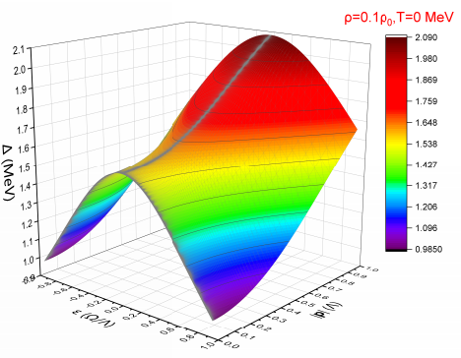
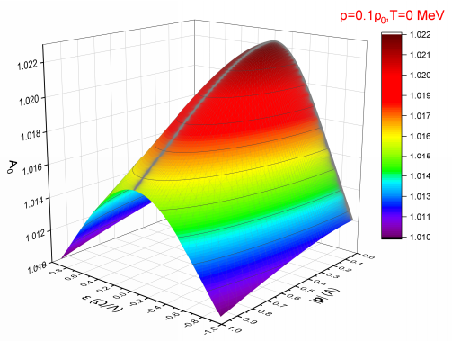
Hao-Fu Zhu & Guo-Zhu Liu, JPG (2023)
Improved
ME equations
Notes:
Therefore, the traditional ME theory is also invalid in this model, but we can correct the ME equation based on gama1+gama0 instead of gama0 , and finally obtain an improved ME equation. Now, by numerically solving the self-closed nonlinear ME equation, we obtained all the information about A1, A2, and the gap.

Slide 11
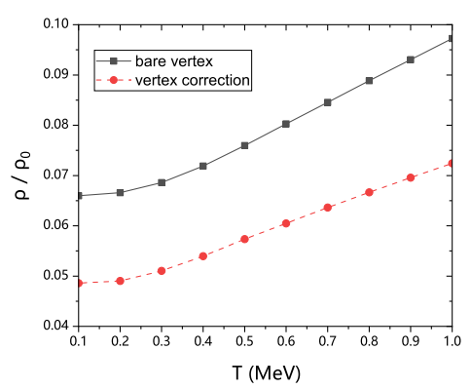
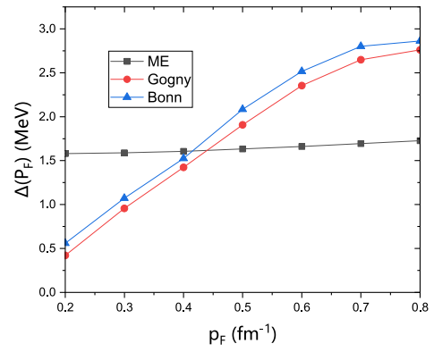
Hao-Fu Zhu & Guo-Zhu Liu,
JPG (2023)
Phase diagram
Notes:
A global phase diagram is also plotted in the plane spanned by the normalized density ρ/ρ0 and the temperature T. The superfluid phase (upper left corner) and the normal phase (lower right corner) are separated by a critical line. It is clear that the inclusion of oneloop vertex correction can substantially alter the critical line.
We also make a comparison between our results and some previous results on the pairing gap at low density up to 0.1 times the saturation density. The S-wave superfluid pairing gap has been previously calculated at the BCS level based on a non-relativistic Gogny force and also on a relativistic Bonn potential . The Gogny result and Bonn result are quite similar to each other, but these two results are substantially different from our ME-level result. The Gogny force and the Bonn potential are determined by fitting with experimental data of scattering phase shifts and thus are more realistic than our πN model。
This indicates that in order to obtain more realistic results of S-waves in the future, we need to consider the contributions of other mesons. Only by considering the ME theory of other mesons and as many possible quantum many-body effects as possible, can we safely study P-waves neutron superfluidity and S-waves proton superconductivity in neutron stars .

Slide 12
Only by considering as many possible quantum many-body effects as possible, can we safely extend the theory to a higher density！
Thank you!
超导
Notes:
Thank you all for listening, and I look forward to any questions you may have.

