Slide 1
Bubble wall velocity and gravitational wave in the minimal left-right symmetric model
[2405.01949], Dian-Wei Wang , Qi-Shu Yan, Mei Huang
09/29/2024
Notes:
Thanks to the organizer giving me this opportunity to introduce our recent work on bubble wall velocity and gravitational waves in minimal left-right symmetric model.

Slide 2
Content
Minimal left-right symmetric model and FOPT
Field-plasma system
Gravitational waves
Summary
Notes:
This is the outline of this talk. First, I will introduce the minimal LRSM and its phase transition.

Slide 3
Minimal Left-Right Symmetric Model
Symmetry in LRSM $SU{\left(3\right)}_{C}×SU{\left(2\right)}_{L}×SU{\left(2\right)}_{R}×U{\left(1\right)}_{B−L}$
fermion | $$SU{\left(3\right)}_{C}$$ | $$SU{\left(2\right)}_{L}$$ | $$SU{\left(2\right)}_{R}$$ | $$U{\left(1\right)}_{B−L}$$ | scalar | $$SU{\left(3\right)}_{C}$$ | $$SU{\left(2\right)}_{L}$$ | $$SU{\left(2\right)}_{R}$$ | $$U{\left(1\right)}_{B−L}$$
$$Q_{L}$$ | $$3$$ | $$2$$ | $$1$$ | $$1/3$$ | $$Φ$$ | $$1$$ | $$2$$ | $$2$$ | $$0$$
$$Q_{R}$$ | $$3$$ | $$1$$ | $$2$$ | $$1/3$$ | $$Δ_{L}$$ | $$1$$ | $$3$$ | $$1$$ | $$2$$
$$L_{L}$$ | $$1$$ | $$2$$ | $$1$$ | $$−1$$ | $$Δ_{R}$$ | $$1$$ | $$1$$ | $$3$$ | $$2$$
$$L_{R}$$ | $$1$$ | $$1$$ | $$2$$ | $$−1$$
Scalar potential
$$V=−μ_{1}^{2}\operatorname{Tr}{Φ^{†}Φ}−μ_{2}^{2}\left(\operatorname{Tr}{{\tilde{Φ}}^{†}Φ}+\operatorname{Tr}{{\tilde{Φ}Φ}^{†}}\right)−μ_{3}^{2}\left(\operatorname{Tr}{Δ_{L}Δ_{L}^{†}}+\operatorname{Tr}{Δ_{R}Δ_{R}^{†}}\right) \\ +ρ_{1}\left(\operatorname{Tr}\left[Δ_{L}Δ_{L}^{†}\right]\operatorname{Tr}\left[Δ_{L}Δ_{L}^{†}\right]+\operatorname{Tr}\left[Δ_{R}Δ_{R}^{†}\right]\operatorname{Tr}\left[Δ_{R}Δ_{R}^{†}\right]\right)+ρ_{3}\operatorname{Tr}\left[Δ_{L}Δ_{L}^{†}\right]\operatorname{Tr}\left[Δ_{R}Δ_{R}^{†}\right] \\ +ρ_{2}\left(\operatorname{Tr}\left[Δ_{L}Δ_{L}\right]\operatorname{Tr}\left[Δ_{L}^{†}Δ_{L}^{†}\right]+\operatorname{Tr}\left[Δ_{R}Δ_{R}\right]\operatorname{Tr}\left[Δ_{R}^{†}Δ_{R}^{†}\right]\right)+λ_{1}\operatorname{Tr}\left[Φ^{†}Φ\right]\operatorname{Tr}\left[Φ^{†}Φ\right] \\ +α_{3}\left(\operatorname{Tr}\left[{ΦΦ}^{†}Δ_{L}Δ_{L}^{†}\right]+\operatorname{Tr}\left[Φ^{†}ΦΔ_{R}Δ_{R}^{†}\right]\right)$$
$$α_{1,2}=β_{1,2,3}=λ_{2,3,4}=ρ_{4}=0$$
Notes:
As we know, cosmological first order phase transition could play an important role in baryogenesis, the formation of primordial black holes, and the production of gravitational waves. However, the electroweak symmetry breaking has been proved to be a crossover and there is no FOPT. To study the bubble wall dynamics and the gravitational waves, we need an underlying particle physics model that have an FOPT. In this work, we choose minimal left-right symmetric model as the underlying particle physics model. LRSM enlarges the electroweak sector of standard model with an additional right-handed gauge symmetry. As a result of this enlargement, the right-handed neutrino has been introduced in the model, and the Higgs doublet is enlarged to the bi-doublet $Φ$. Furthermore, to introduce the FOPT, we need these 2 triplets of each $SU\left(2\right)$ symmetry. This is most simple scalar potential that we can write down.

Slide 4
Minimal Left-Right Symmetric Model
Symmetry breaking in LRSM
$SU{\left(2\right)}_{R}×U{\left(1\right)}_{B−L}→U{\left(1\right)}_{Y}$: $Δ_{R}$ developing VEV $v_{R}\sim 10 TeV$ $Δ_{R}=\left(\begin{matrix}{+δ_{R}^{+}}/{\sqrt{2}} & δ_{R}^{++} \\ δ_{R}^{0} & {+δ_{R}^{+}}/{\sqrt{2}}\end{matrix}\right)$ before SSB $Δ_{R}=\left(\begin{matrix}0 & H_{2}^{++} \\ H_{3}^{0} & 0\end{matrix}\right)+\frac{1}{\sqrt{2}}\left(\begin{matrix}0 & 0 \\ v_{R} & 0\end{matrix}\right)$ after SSB
$SU{\left(2\right)}_{L}×U{\left(1\right)}_{Y}→U{\left(1\right)}_{em}$: SSB as in SM, $v_{EW}=246 GeV$ $\begin{matrix}\left\langle Φ\right\rangle =\frac{1}{\sqrt{2}}\left(\begin{matrix}κ_{1} & 0 \\ 0 & κ_{2}\end{matrix}\right), & v_{EW}=\sqrt{κ_{1}^{2}+κ_{2}^{2}}\end{matrix}$
Particle masses
before SSB | After SSB | mass
$$L_{R}$$ | $$E_{R}$$ | $$0$$
 | $$N_{R}$$ | $$m_{N_{R}}$$
$$Φ$$ | $$H$$ | $$\sim 0$$
 | $$\left(H_{1}^{0},A_{1}^{0},H_{1}^{±}\right)$$ | $$m_{H_{1}^{0}}$$
$$Δ_{L}$$ | $$\left(H_{2}^{0},A_{2}^{0},H_{2}^{±},H_{1}^{±±}\right)$$ | $$m_{H_{2}^{0}}$$
$$Δ_{R}$$ | $$H_{3}^{0}$$ | $$m_{H_{3}^{0}}$$
 | $$H_{2}^{±±}$$ | $$m_{H_{2}^{±±}}$$
Notes:
The spontaneous symmetry breaking from LRSM to our vacuum occurs in 2 stages. The first stage is the breaking of right-hand $SU\left(2\right)$. In this study, we take the breaking scale to be above 10 TeV, which is limited by the lower bound of right-hand W boson mass. During the transition, the neutral component of right-handed triplet develops a VEV. And these scalar particles become massive. In this study, we take these masses as our physical parameters. And these massive particles are the so-called active species, they will contribute to the friction force exerting on the bubble wall. And the second stage is the electroweak symmetry breaking which similar to the case in 2HDM. In this study, we focus on the right-hand symmetry breaking with a first order phase transition and study the bubble wall dynamics.

Slide 5
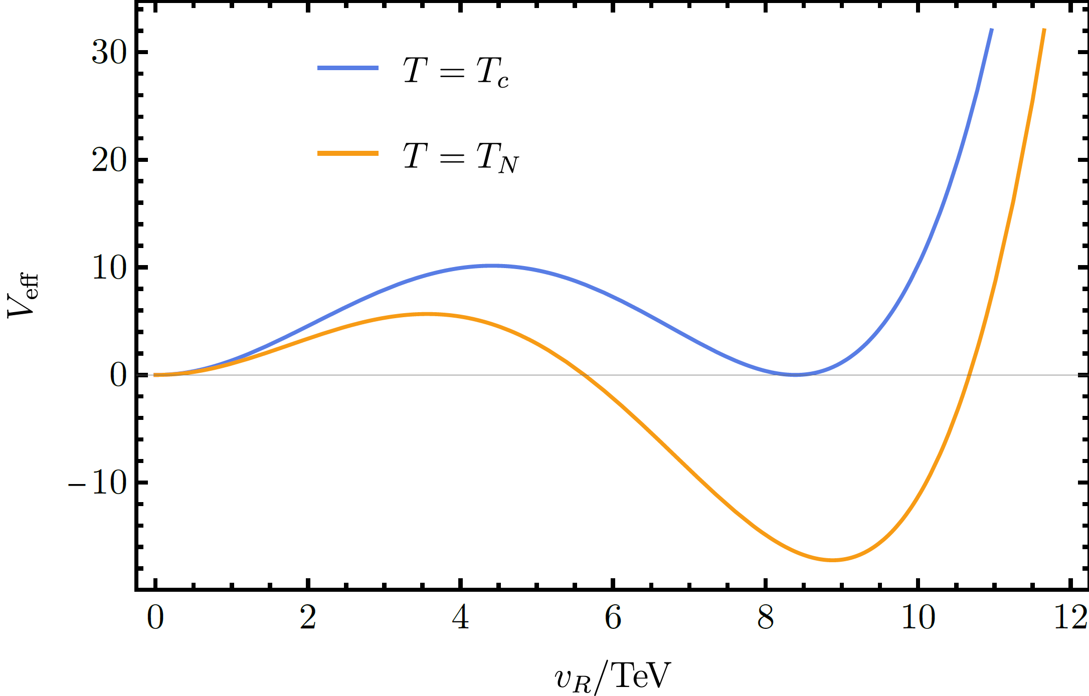
Cosmological FOPT
Bubble evolution
Critical bubble: bounce solution $S_{3}=\int{d^{3}x\left[\frac{1}{2}{\left(∇φ\right)}^{2}+ΔV_{eff}\left(φ\right)\right]}$, $\begin{matrix}\frac{∂^{2}φ}{∂r^{2}}+\frac{2}{r}\frac{∂φ}{∂r}=\frac{∂}{∂φ}ΔV_{eff}, & \left\{\begin{aligned}φ_{r=0}^{′}=0 \\ φ_{r→∞}=0 \end{aligned}\right.\end{matrix}$
Nucleation rate: $Γ=Γ_{0}e^{−{S_{3}}/T}$, where $Γ_{0}\sim T^{4}{\left({S_{3}}/{2πT}\right)}^{3/2}$
Nucleation criterion: $Γ/{H_{∗}^{4}}\sim 𝒪\left(1\right)$
Effective potential $V_{eff}=V_{0}+V_{CW}+V_{T}$
Where $V_{0}=−\frac{μ_{3}^{2}}{2}φ^{2}+\frac{ρ_{1}}{4}φ^{4}$ $V_{CW}=\sum_{i}{g_{i}m_{i}^{4}\ln{\frac{m_{i}^{2}}{μ^{2}}}−C_{i}}$ $V_{T}=\frac{T^{4}}{2π^{2}}\sum_{i}{g_{i} J_{±}\left(\frac{m_{i}^{2}}{T^{2}}\right)}$
$m_{i}^{2}=m_{0,i}^{2}\left(φ\right)+Π\left(φ,T\right)$
nucleation
expansion
collision
$${m_{H_{3}^{0}}}/{TeV}$$ | $$0.125$$ | $$0.750$$ | $$1.375$$ | $$2.000$$
$${T_{c}}/{TeV}$$ | $$2.705$$ | $$2.784$$ | $$2.961$$ | $$3.212$$
$${T_{N}}/{TeV}$$ | $$2.068$$ | $$2.266$$ | $$2.616$$ | $$3.013$$
Notes:
The cosmological FOPT is initiated by the nucleation of vacuum bubbles. The interior pressure of the bubble is larger than the exterior, and this pressure difference pushes the bubble to expand. During the expansion, the plasma will exert a friction force on the bubble wall. If this friction force is big enough, the bubble wall velocity becomes constant before collision. So, the first thing to do is to calculate the nucleation rate of a critical bubble. The effective potential we used to solve the bounce equation consist of three terms: the tree level $φ^{4}$ potential, the Coleman-Weinberg terms and the 1-loop thermal corrections. All of the scalar masses we used are thermal mass. When the temperature drops below the critical temperature, there are vacuum bubbles nucleating in the universe through thermal quantum tunneling. The nucleation rate is a function of the temperature. When the nucleation rate over $H_{∗}^{4}$ equal to 1, we define that temperature to be the nucleation temperature.

Slide 6
Content
Minimal left-right symmetric model and FOPT
Field-plasma system
Gravitational waves
Summary
Notes:
Now, I will review the field-plasma system.

Slide 7
Field-Plasma System: Overview
Physics in different length scale
$$R_{∗}$$
$$v_{w}$$
$$v\left(r\right)$$
$λ\sim R_{∗}$: Local thermal equilibrium (LTE) e.g. Jose R. Espinosa, Thomas Konstandin, et. al. 2010
$R_{∗}={\left(8π\right)}^{1/3}v_{w}β$ $R_{∗}T_{N}\sim {10}^{11}$
$$r=r_{w}$$
$$r=0$$
$$r≃R_{∗}$$
$$δf$$
$λ\sim λ_{mfp}$: Boltzmann equation e.g. Guy D. Moore, Tomislav Prokopec, 1995
$λ_{mfp}^{−1}=\sum_{i}{n_{i}{\left\langle vσ\right\rangle }_{2→2}}$ $λ_{mfp}T_{N}\sim {10}^{4}$
$$r_{w}−λ_{mfp}$$
$$r_{w}+λ_{mfp}$$
$$φ\left(z\right)$$
$λ\sim L_{w}$: Free particle approximation e.g. Marc Barroso Mancha, Tomislav Prokopec, 2005
$L_{w}T_{N}\sim 𝒪\left(2\right)$
$$z→−∞$$
$$z=0$$
$$z→+∞$$
Notes:
After the bubble has been nucleated, the pressure difference will push the bubble to expand. To study the dynamics of the bubble wall, we need to study the field-plasma system in more detail. There are typically 3 length scale in this system. The first one is mean bubble separation $R_{∗}$. When the wall approaches its terminal velocity before collision, and the bubble radius is comparable with the mean bubble separation. In our study, this value is typically ${10}^{11}$ in the unit of nucleation temperature. At this length scale, people use local thermal equilibrium to study the fluid bulk motion, and one can calculated the ratio of how much latent heat has been convert into fluid kinetic energy. The second length scale is mean free path. In LRSM, this value is typically 10 thousand. At this length scale, the non-equilibrium effects become important. People use Boltzmann equation to study the physics in this length scale. And the third length scale is bubble wall thickness, which is more or less same order as inverse temperature. The point is, the thickness is much less than the mean free path. Thus, we could use free particle approximation to study the friction force on the bubble, makes the calculation much easier.

Slide 8
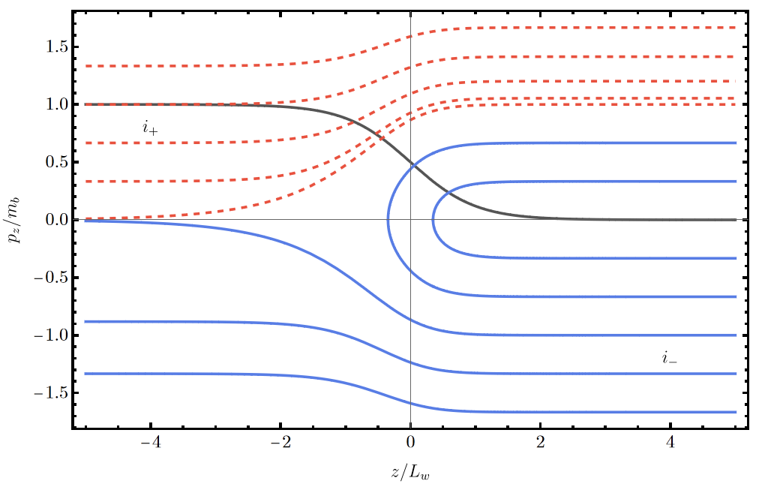
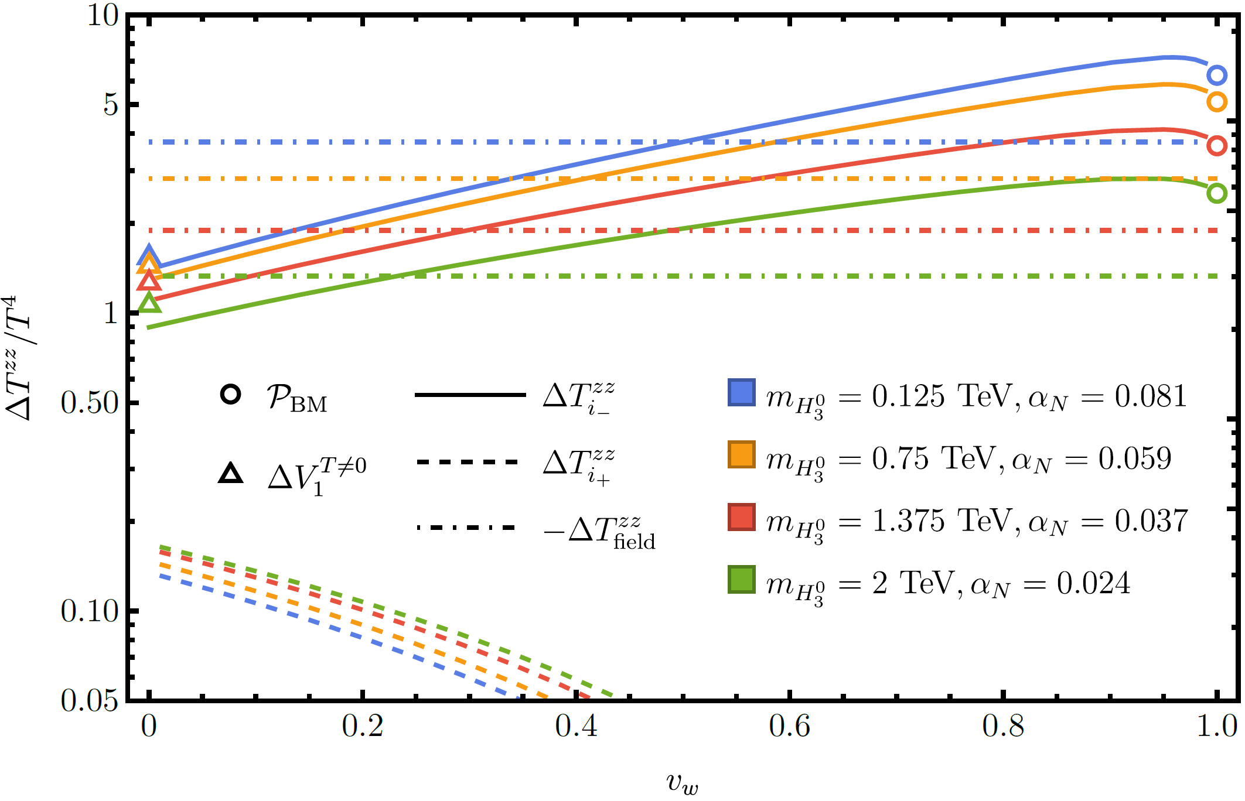
Field-Plasma System: Free Particle Approximation
Semiclassical force $\left(\frac{p_{z}}{E}\frac{∂}{∂z}−\frac{m}{E}\frac{∂m}{∂z}\frac{∂}{∂p_{z}}\right)f\left(p_{z},p_{⊥},z\right)=C\left[f\right]$
Ansatz: incident particles are in equilibrium $f_{i_{±}}=f_{b,s}^{eq}\left[γ_{w}E±u_{w}\sqrt{p_{z}^{2}+m^{2}\left(z\right)−m_{b,s}^{2}}\right]$ where $f_{b,s}^{eq}=\frac{1}{\exp\left(E/{T_{b,s}}\right)±1}$
Energy-momentum flux $T_{FP}^{μν}=\int{\frac{d^{3}p}{{\left(2π\right)}^{3}2E}p^{μ}p^{ν}f}+T_{field}^{μν}$ where $T_{field}^{μν}≡g^{μν}\left(V_{0}+V_{CW}\right)+…$
Non-runaway criterion: Bödeker-Moore limit $𝒫_{BM}=\sum_{i}{Δm_{i}^{2}\int{\frac{d^{3}p}{{\left(2π\right)}^{3}2E}f_{i}}}$
solid line: $i_{−}$ dashed line: $i_{+}$
Notes:
We start from the free particle approximation. We treat the particles to be classical. And because thickness is much smaller than mean free path, the force term dominates. So, we could neglect the collision term in Boltzmann equation. Intuitively, we can see this phase space of the particle motion, the gray line is the profile of the particle mass, the solid lines are incident particles coming from exterior of the bubble. When approaching the bubble wall, these particles lose their momentum, or bounced back. This momentum loss will dominate friction force on the bubble wall. The dashed lines are incident from the interior, which are Boltzmann suppressed. As an ansatz, we take the incident particles distribution from both side in thermal equilibrium, but they might have different temperatures. With this distribution function, we can calculate the energy momentum tensor. In bubble wall frame, when at terminal velocity, the pressure difference contribute from plasma and the field should be balanced. Thus one can roughly read off the $v_{w}$ on this plot. And one thing worth to mention is, when we set $v_{w}=0$, this pressure difference coincides with the difference in the effective potential. Another thing is, in our interested parameter region, this balance can hold with in the Bödeker-Moore limit, so we won’t bother to concern about particle splitting process.

Slide 9
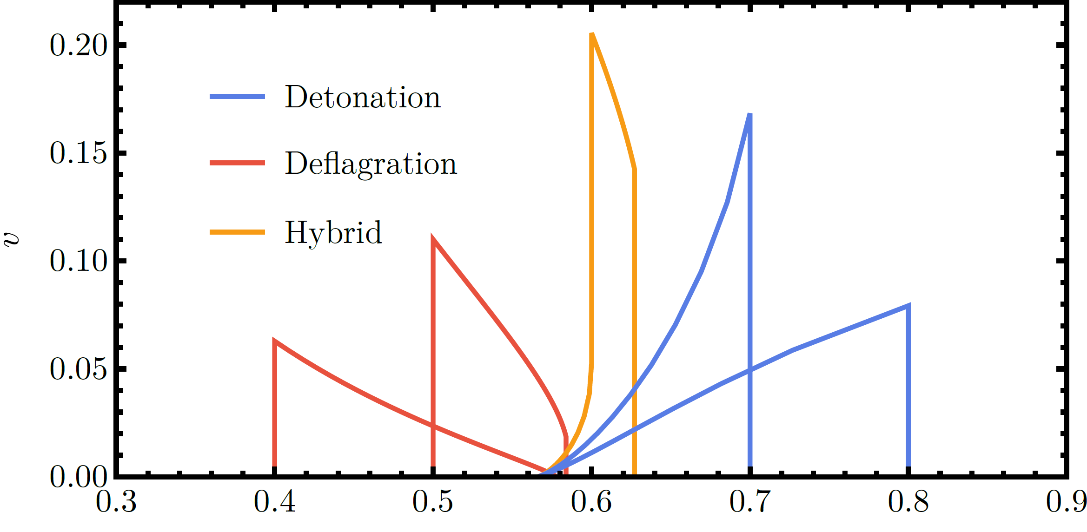
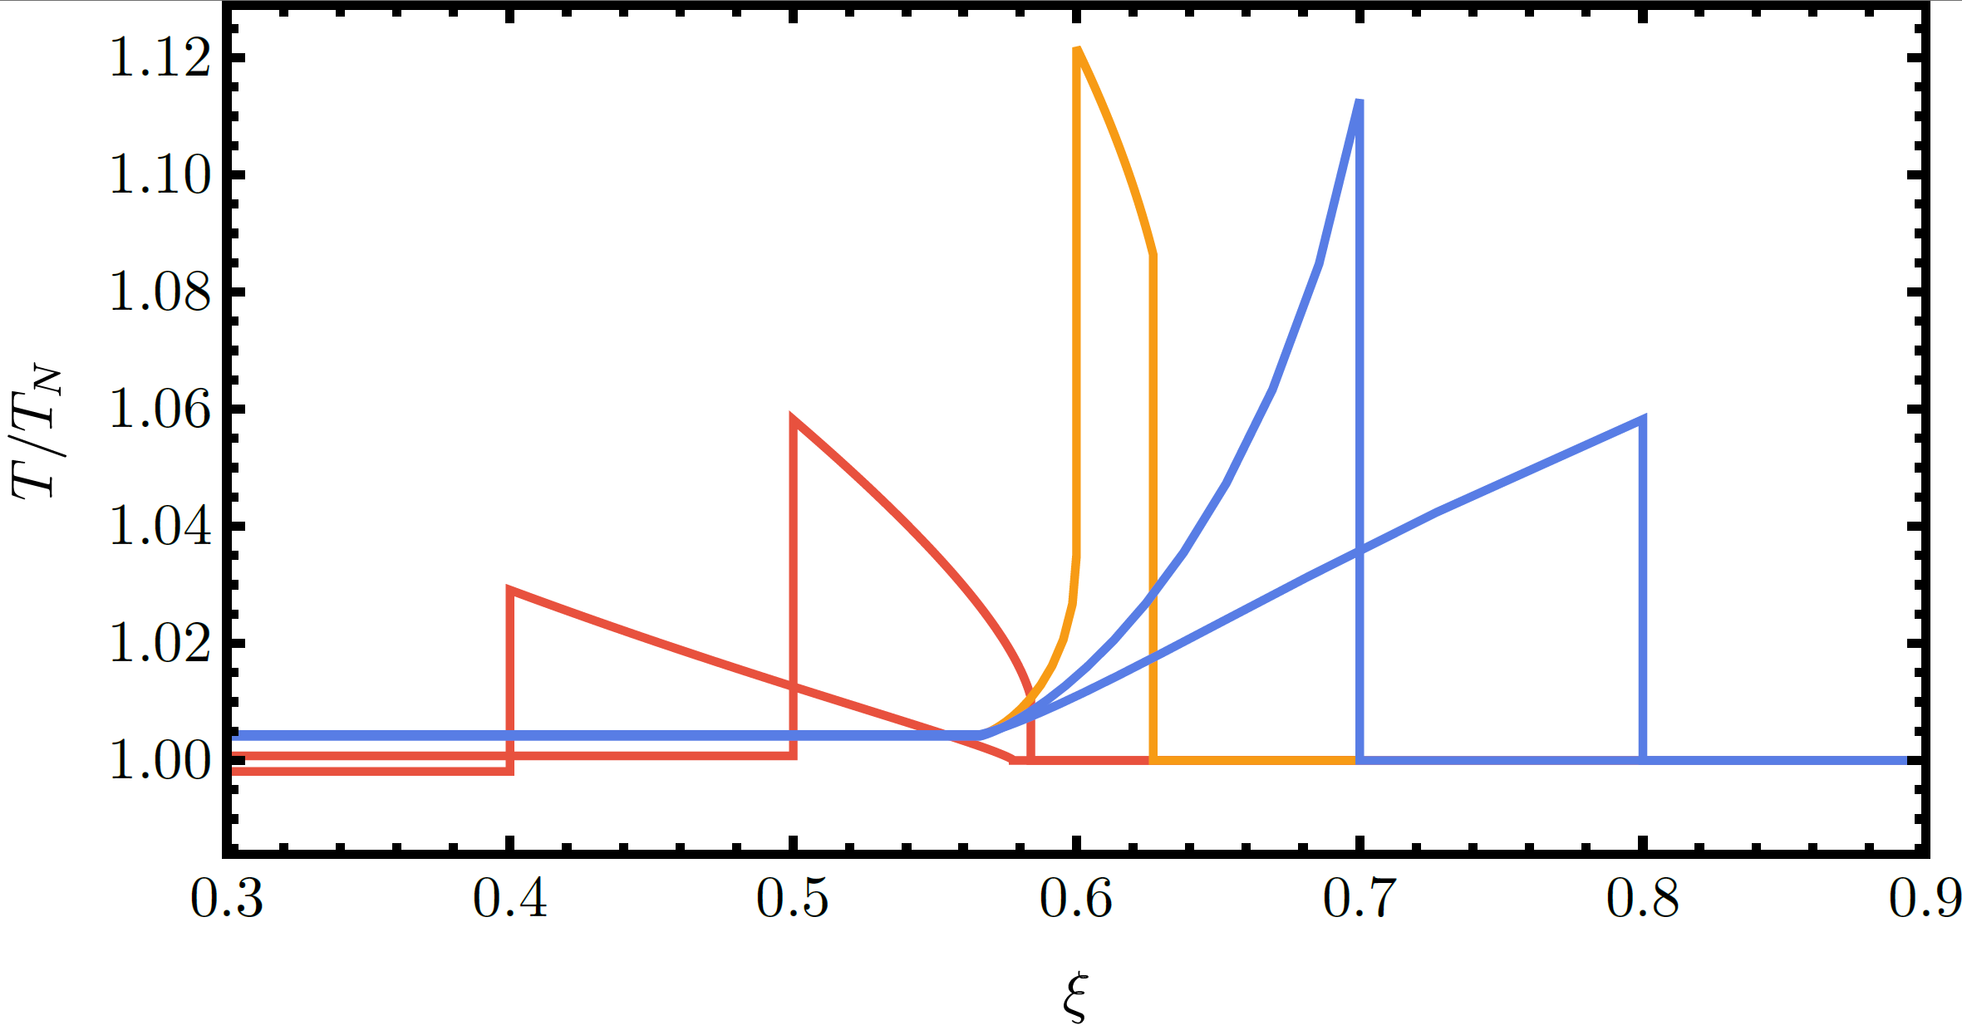
Field-Plasma System: LTE Approximation
Hydrodynamics $T_{LTE}^{μν}=wu^{μ}u^{ν}+pg^{μν}$ $p=−V_{eff}$, $w=−T\frac{∂V_{eff}}{∂T}$ $∂_{μ}T^{μν}=0$
Self-similar solution $2\frac{v}{ξ}=\left(\frac{μ^{2}}{c_{s}^{2}}−1\right)γ^{2}\left(1−ξv\right)∂_{ξ}v$ $2\frac{v}{ξ}=\left(\frac{μ^{2}}{c_{s}^{2}}−1\right)\frac{{\left(1−ξv\right)}^{2}}{ξ−v}\frac{∂_{ξ}T}{∂T}$ where $ξ≡r/t$
Matching condition $w_{+}γ_{+}u_{+}=w_{−}γ_{−}u_{−}$ $w_{+}u_{+}^{2}+p_{+}=w_{−}u_{−}^{2}+p_{−}$
deflagration
$$v_{w}<c_{s}$$
hybrid
$$c_{s}<v_{w}<v_{J}$$
detonation
$$v_{J}<v_{w}$$
Notes:
Then we come to LTE approximation. One can use hydrodynamics to study the fluid bulk motion. One can get the equation of state from the effective potential. When the bubble radius become large, the fluid motion tends to be self-similar. So, one can cast the fluid equation into this form and solve for the profile of fluid velocity and temperature. In this case, the bubble wall can be treated as a discontinuity, and here is the matching condition. By comparing the $v_{w}$ with sound velocity and the Jouguet velocity, the fluid bulk motion is divided into these three modes. At this moment, the $v_{w}$ can not be determined by LTE approximation itself. But once we know $v_{w}$, we can use LTE to calculate energy budget. Which is important when calculating the gravitational wave spectrum.

Slide 10
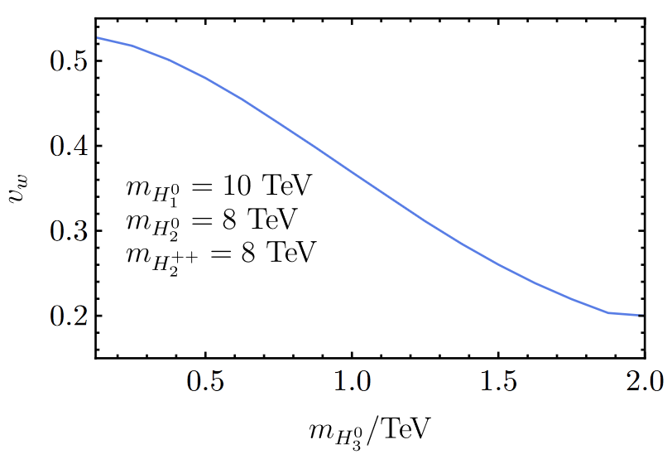
Field-Plasma System: Matching Condition and Bubble Wall Velocity
For non-runaway bubble wall, moving with constant $v_{w}$, VEV profile and $δf$ does not change with time $→$ No net energy/momentum accumulate near the bubble wall.
Matching condition (in wall frame) $T_{FP,b}^{zz}\left(T_{b},T_{s},v_{w}\right)=T_{FP,s}^{zz}\left(T_{b},T_{s},v_{w}\right)$ $T_{FP}^{zz}\left(T_{b},T_{s},v_{w}\right)=T_{LTE}^{zz}\left(v_{w}\right)$ $T_{FP}^{0z}\left(T_{b},T_{s},v_{w}\right)=T_{LTE}^{0z}\left(v_{w}\right)$
the typical value of $v_{w}$ is $0.2\sim 0.5$
Larger scalar mass $→$ smaller $v_{w}$
Didn’t find runaway solution.
Notes:
To determine the $v_{w}$, we combine the two methods working at two different length scale. For a non-runaway bubble wall, moving at a constant $v_{w}$, the profile of VEV and the distribution function near the bubble wall will not change with time. So, there is no net energy or momentum accumulated near the bubble wall. So, we proposal this matching condition. As mentioned before, in free particle approximation, the incident particle on both sides can have different temperatures. So, we take 2 temperatures and $v_{w}$ as unknowns. While in LTE approximation, once you know the nucleation temperature, the only unknown is $v_{w}$. So, we could match the energy and momentum flux calculated from these two methods, and won’t bother to solve the Boltzmann equation. In this minimal LRSM, the typical value for $v_{w}$ is 0.2~0.5. Qualitatively speaking, larger scalar particle mass will cause a smaller $v_{w}$. And we didn’t find runaway solution in our model.

Slide 11
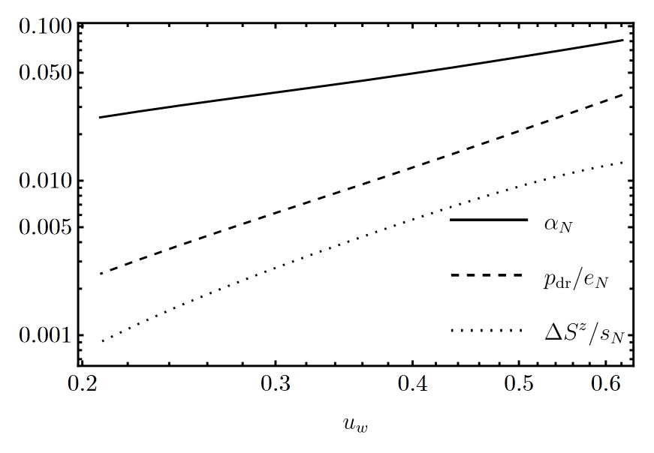
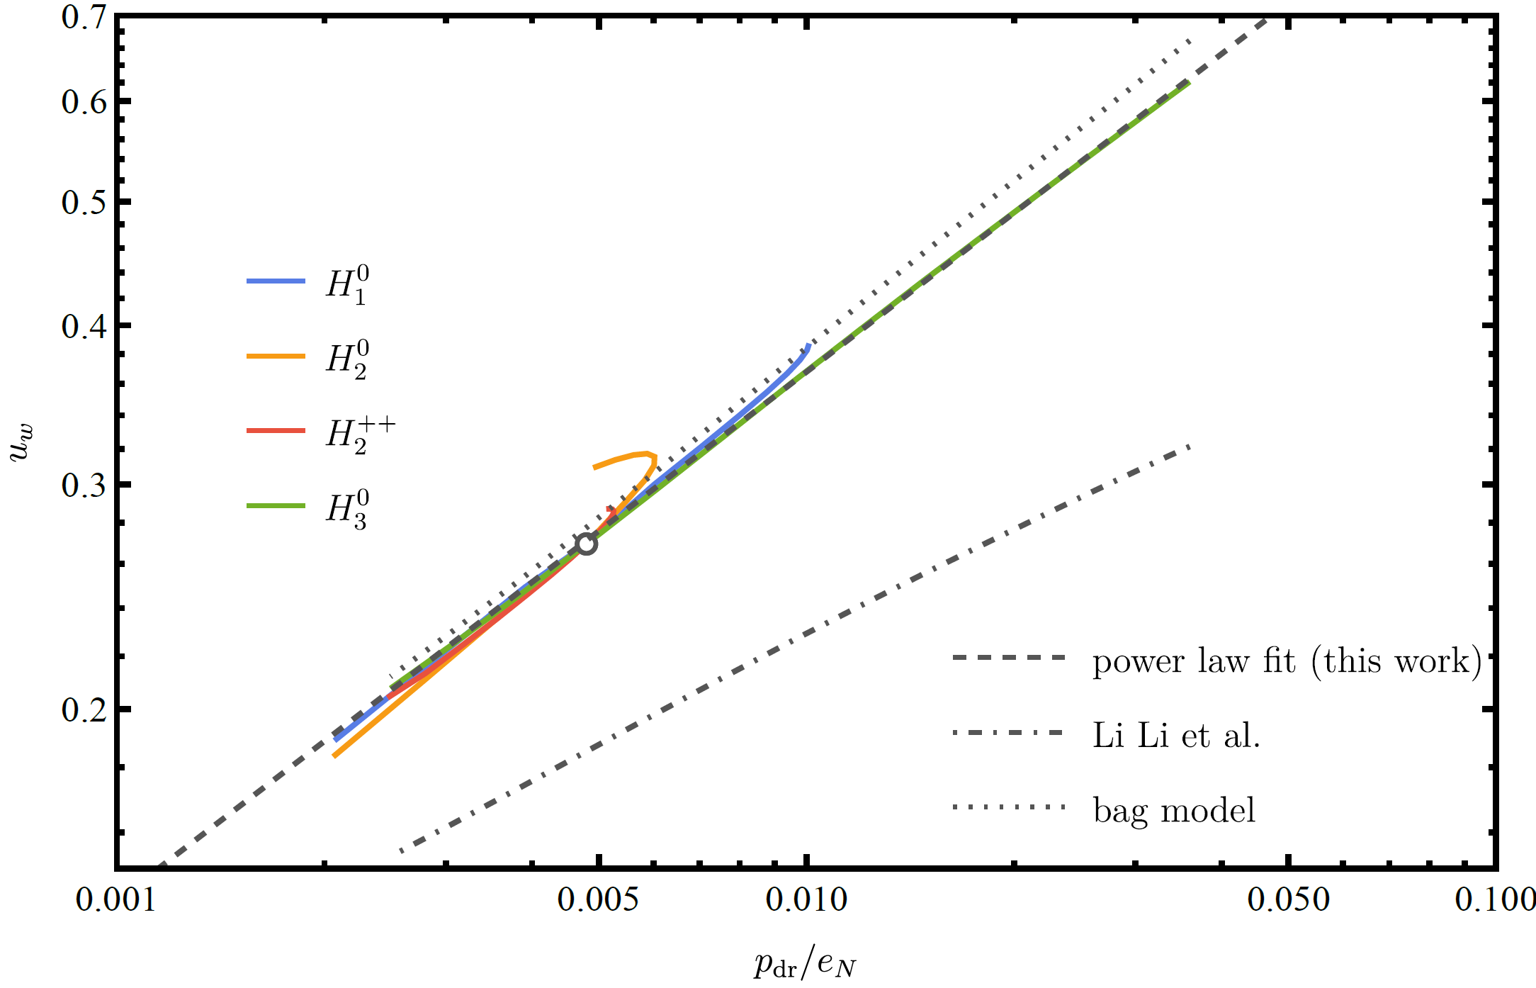
Field-Plasma System: Matching Condition and Bubble Wall Velocity
Normalized driving force $\frac{p_{dr}}{e_{N}}≡\frac{p\left(ξ=0\right)−p\left(ξ=1\right)}{e\left(ξ=1\right)}$
In this study, we find $u_{w}∝{\left({p_{dr}}/{e_{N}}\right)}^{0.41}$, $u_{w}≡γ_{w}v_{w}$
Bag model is still a good approximation for LRSM
We investigated entropy production rate ${Δ\left(su^{z}\right)}/{s_{N}}$
Small, but can not be neglected
Matching condition $Δ\left(su^{z}\right)=0$ can even lead to runaway solution
Note that $α_{N}$ is also small
Notes:
We tried to extract some universal behavior of the bubble wall velocity, we found that the normalized driving force, which is the pressure difference between the bubble center and far from the bubble, divided by energy density, follows a power law with $u_{w}$, with the power index about 0.4. We also tried to compare our LRSM equation of state with a bag model, we can see these results are close to each other, which means that bag model is still a good approximation to LRSM phase transition. Also, we investigated entropy production at the bubble wall. We find even if the entropy production rate is small, we still cannot use this entropy matching condition, which may lead to super-sonic $v_{w}$, or even runaway solution.

Slide 12
Content
Minimal left-right symmetric model and FOPT
Field-plasma system
Gravitational waves
Summary
Notes:
And now, I will talk about the gravitational wave.

Slide 13
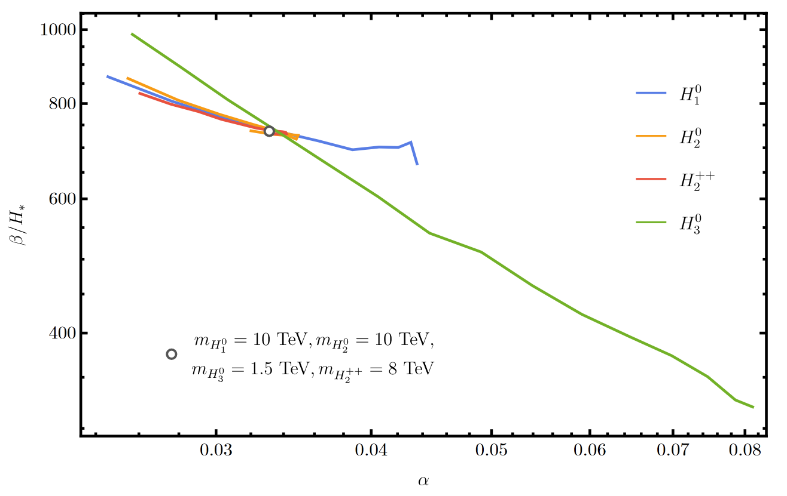
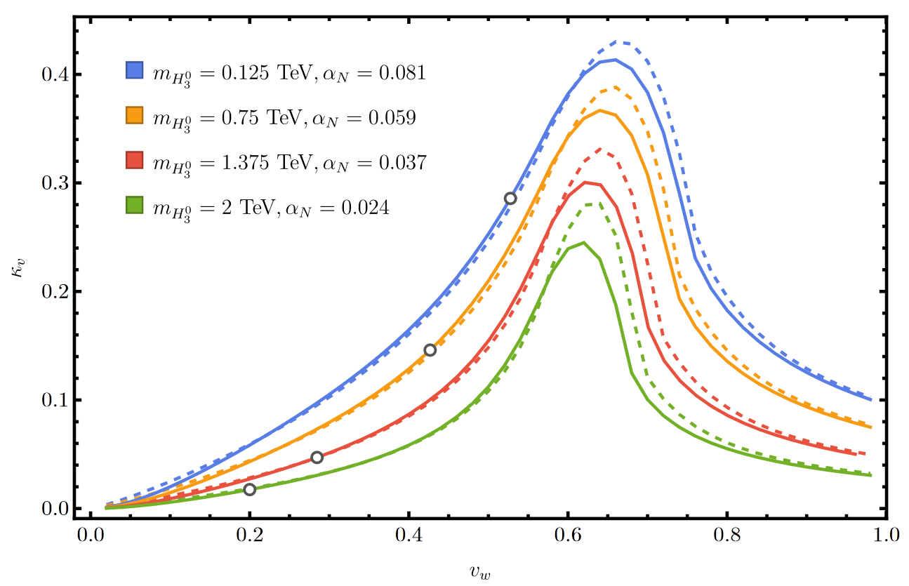
Gravitational Wave
Phase transition GW spectrum $h^{2}Ω_{GW}≃2.65×{10}^{−6}\frac{H_{∗}}{β} {\left(\frac{κ_{v}α_{N}}{1+α_{N}}\right)}^{2}{\left(\frac{100}{g_{∗}}\right)}^{1/3}v_{w}{\left(\frac{f}{f_{sw}}\right)}^{3}{\left(\frac{7}{4+3{\left(f/{f_{SW}}\right)}^{2}}\right)}^{7/2}Υ$
Pivot frequency $f_{SW}≃1.9×{10}^{−2}\frac{1}{v_{w}}\frac{β}{H_{∗}}\frac{T_{∗}}{100 GeV} {\left(\frac{g_{∗}}{100}\right)}^{1/6} mHz$
Strength parameter $α_{N}$ $α_{N}=\frac{4}{3}\frac{Δε }{w_{N}}$, where $ε$: trace anomaly, $w_{N}$: enthalpy density
Inverse time duration $\frac{β}{H_{∗}}=T\frac{d}{dT}\frac{S_{3}}{T}$
Efficiency factor $κ_{v}=\frac{3}{{α_{N}e}_{N}ξ_{w}^{3}}\int{wu^{2}ξ^{2}dξ}$
Notes:
We calculate the gravitational wave spectrum with this a commonly used formula. The typical value of strength parameter $α_{N}$ is less than 0.1, while the inverse duration $β/{H_{∗}}$ is several hundred. And the efficiency factor is sensitive to $v_{w}$. As we can see, these circle dots represent the $v_{w}$ corresponding to particle mass. Which can make the $κ_{v}$ different in 1 order of magnitude.

Slide 14
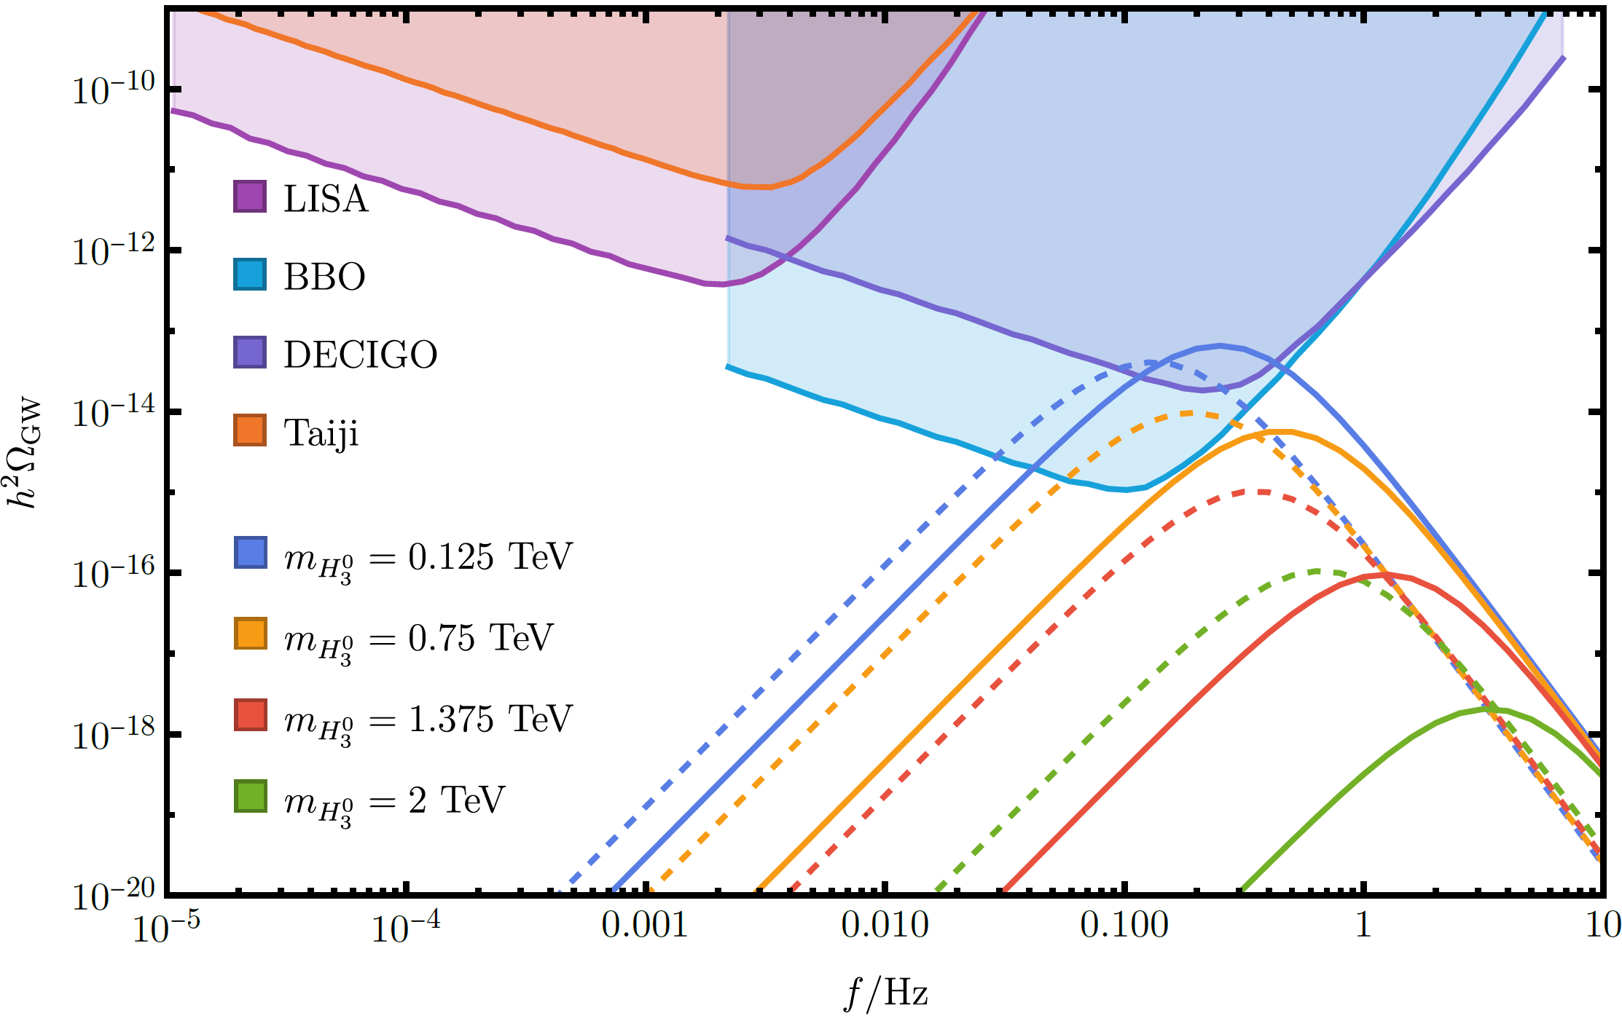
Gravitational Wave
Typical peak amplitude $h^{2}Ω_{GW}={10}^{−18}\sim {10}^{−13}$
Typical pivot frequency $f_{SW}=0.1\sim 1 Hz$
Efficiency factor $κ_{v}\left(α_{N},v_{w}\right)$ is sensitive to $v_{w}$, making difference in $h^{2}Ω_{GW}$.
$v_{w}\sim c_{s}$ or $v_{J}$: Larger peak amplitude, compared with $v_{w}=1$ case
solid line: this study dashed line: $v_{w}=1$
Notes:
And this is the result of the gravitational wave spectrum. The typical peak amplitude is less than ${10}^{−13}$, and pivot frequency is 0.1~1 Hz. Compared with the dashed line, where $v_{w}=1$ has been used, in some cases the peak can be even higher. This is because when $v_{w}$ is close to sound velocity, the $κ_{v}$ factor becomes large. But for $v_{w}$ much smaller than 1, the peak amplitude will be more suppressed.

Slide 15
Summary
At least in the parameter region this study, there is no runaway bubble wall in LRSM. The typical value of $v_{w}$ is $0.2\sim 0.5$.
$u_{w}$ and ${p_{dr}}/{e_{N}}$ follows a power law with power index $\sim 0.41$.
GW spectrum can have a higher peak when $v_{w}\sim c_{s}$, due to a larger $κ_{v}$.
$δf$ of incident particles will introduce uncertainty which should be study in our future work.
Notes:
This is the summary, thank you!

Slide 16
Thanks for your listening!

