Slide 1
H2a4b updates
--Zelin Yan

Slide 2
Analysis overview
Process:H→2a→4b
Transform to easyjet_Zcharm framework

Slide 3
Easyjet_Zcharm framework
Sample:mc23_13p6TeV.601229.PhPy8EG_A14_ttbar_hdamp258p75_SingleLep.deriv.DAOD_PHYS.e8514_s4159_r14799_p5980(from Rui)
Successly run Easyjet and ZCharmAnalysis
One problem in ZCharm cutflow

Slide 4
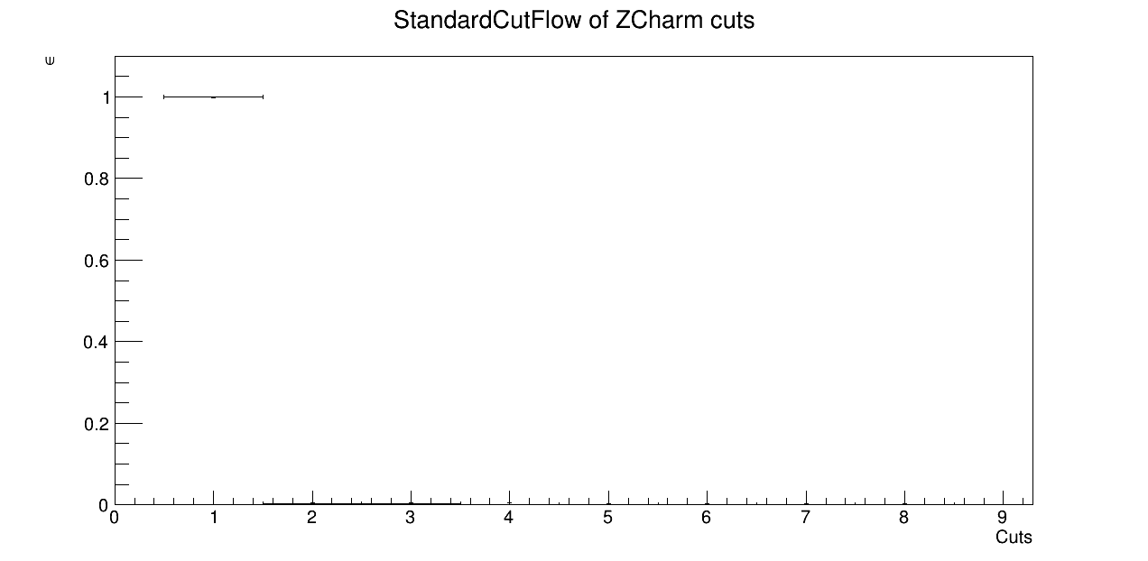
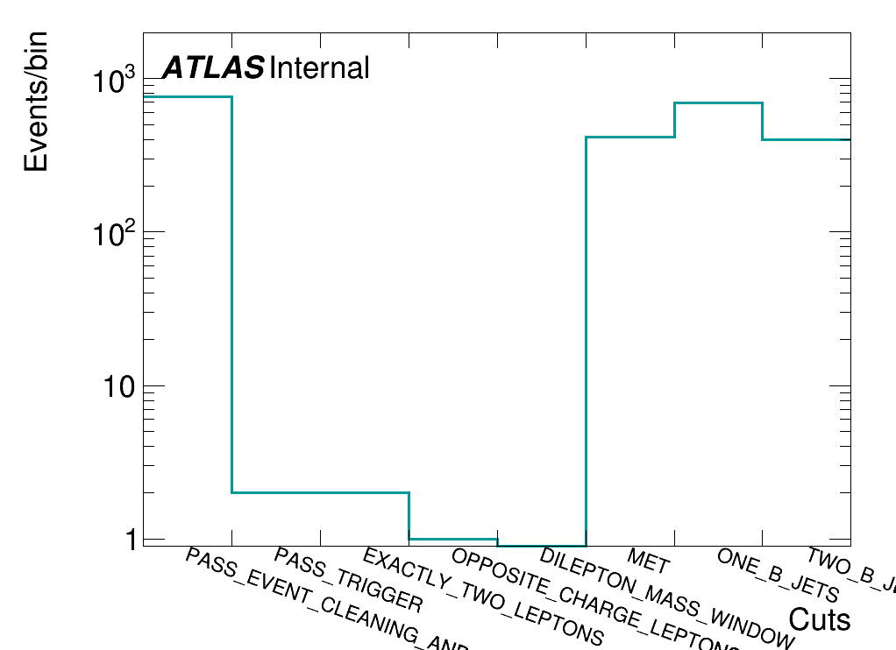
Problem in cutflow
Cut:
PASS_TRIGGER
EXACTLY_TWO_LEPTONS
OPPOSITE_CHARGE_LEPTONS
DILEPTON_MASS_WINDOW
MET
ONE_B_JETS
TWO_B_JETS
EvtNum = 2000
Events can’t pass trigger
1.PASS_EVENT_CLEANING_OR_OTHER_FILTER

Slide 5
Reason in ZCharmAnalysis(helped by Zhen)
PASS_TRIGGER
Vector of {cut : bool}
PASS_TRIGGER:false
EXACTLY_TWO_LEPTONS
evaluate
m_bools
●●●
CutManager
OPPOSITE_CHARGE_LEPTONS
●●●
●●●
yes
no
true
false
Events
In ZCharmAnalysis,default leptonNum is 2. But in used ttbar sample , there is singlelepton .
SingleLepton.ttbar | Def of leptons
Num_e = 1 | e1
Num_e ≥ 2 | e1,e2
Num_mu = 1 | mu1
Num_mu ≥ 2 | mu1,mu2
ZCharm | Def of leptons
Num_e ≥ 2 | e1,e2
Num_mu ≥2 | mu1,mu2
Num_e=1&Num_mu=1 | e1,mu1

Slide 6
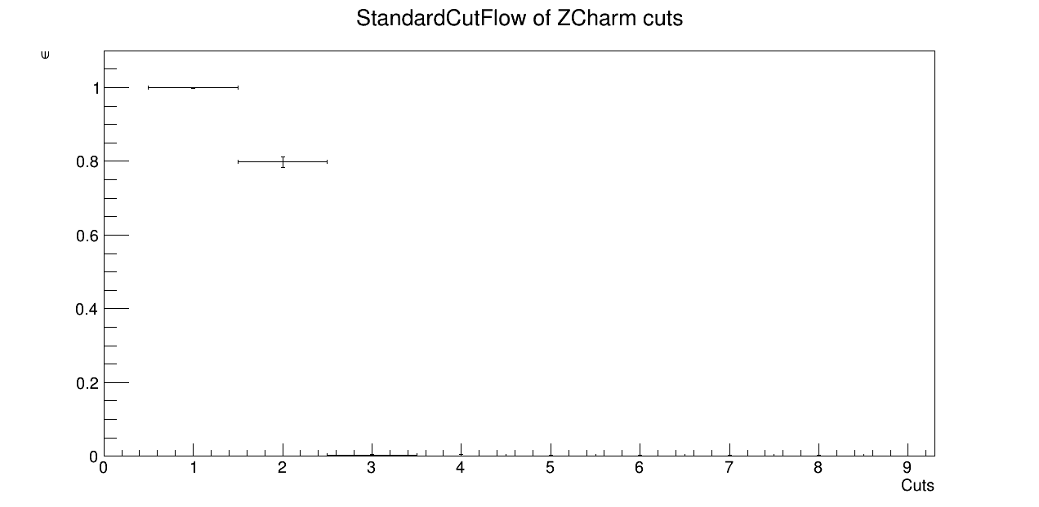
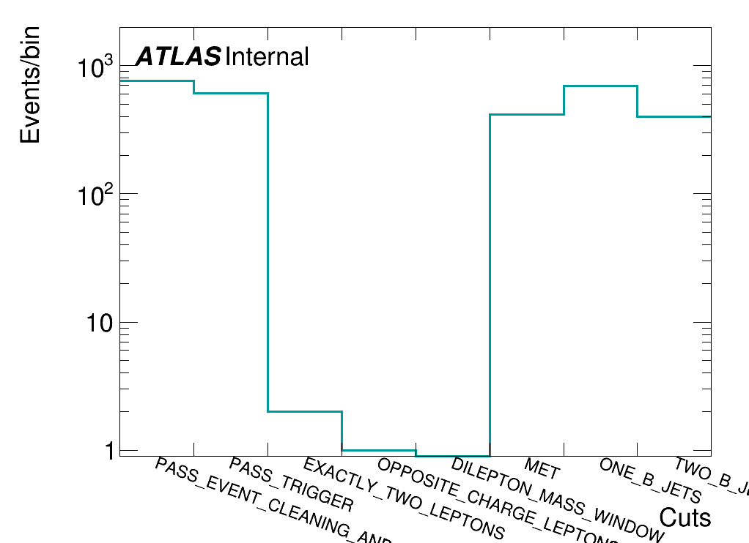
Cutflow Results
1.PASS_EVENT_CLEANING_OR_OTHER_FILTER

Slide 7
Summary & Plans
Successfully compile and run code on lxplus
Find and solve problem in cutflow
Plans
Continue to see other cuts
Get some variables

Slide 8
Other Filters

