Slide 1
Extension of Torsion Balance
10.11.2024 @ Particle Physics on Tabletops
Jie Sheng (盛杰),
Tsung-Dao Lee Institute (TDLI)
Based on: [arXiv: 2409.09950] by Shigeki Matsumoto, J.S., Chuan-Yang Xing
and [arXiv:2402.14514, 2405.16222] by Yu Cheng, Jiadu Lin, J.S., Tsutomu Yanagida
11.2024 @ PPTT

Slide 2
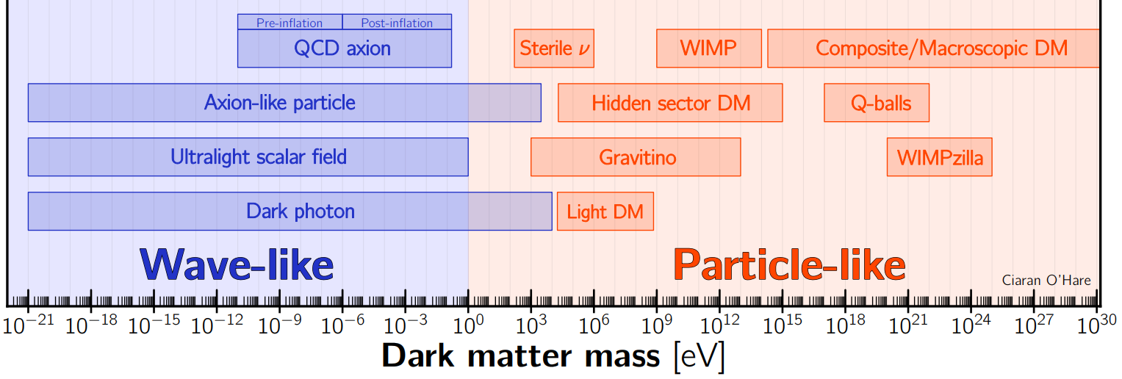
1. Q: How to detect DM?
We know that more than 80 percent of the matter in our Universe today is dark matter (DM) from astro and comic observations.
Now, the questions is how to detect it, especially through direct detections?
From wikipedia
Although the question is generic, we don’t have a generic answer to it.
The detection of DM highly depends on the DM mass and its interaction with SM particles.
In the same mass range, there can still be some common rules.

Slide 3
2203.08084
1.1 DM mass above keV
2203.08084
1) DM mass $m_{χ}>O(10GeV)$, (WIMP-like). Kinetic energy $T_{χ}\sim m_{χ}v^{2}>$keV.
DM-nucleon elastic scattering
2) DM mass $MeV<m_{χ}<O(10GeV)$, Kinetic energy $T_{χ}\sim m_{χ}v^{2}>1$eV.
DM-electron elastic scattering
3) DM mass k$eV<m_{χ}<MeV$, Kinetic energy $T_{χ}\sim m_{χ}v^{2}<1$eV.
Further lower the threshold:
Scattering with optical trapped atoms, superconductors;
Boosted DM;
DM absorption:
Hidden photon and Fermionic DM absorption
[2203.08084, 2203.07492, 2201.11497, 2111.03597v3…]
Single Scattering Event Beyond the Detection Threshold

Slide 4
1.2 DM mass below $10^{−5}$ eV
1) Pseudo-Scalar DM (axion, ALP).
[a-neutron: CASPEr, Comagnetometer…]; [a-electron: NV center…]; [a-photon: ADMX (Haloscope)…]
2) Scalar DM.
Atomic clock; Atom interferometers…
2) Vector DM (without Z2 symmetry).
[B-L gauge boson: Fifth force, Ligo…]; [dark photon: Haloscope…]
[2203.14915v1]
Coherent DM states as a background perturbation to affect the fundamental constants…

Slide 5
1.3 DM mass in between
States begin to overlap: $n V_{dB}≥1.$ DM number density is $n=\frac{ρ_{χ}}{m_{χ}}$ and the de Broglie volume of a particle is $V_{dB}={\left(m_{χ}v_{χ}\right)}^{−3}$.
Once $m_{χ}<$ 1 eV, the quantum wave of DM particle starts to overlap. Thus, we call ~1eV a crossover mass range between wave and particle DM.
The recoil energy from single DM scattering event is not enough. Not particle-like enough.
The DM can not form coherent modes. Not wave-like enough either.
There are currently few sensitive detection methods particularly targeting it.

Slide 6
Case I. DM with Z2 symmetry
DM-SM particle scattering $[\frac{m_{i} χ^{2}\overline{ψ_{i}}ψ_{i}}{Λ^{2}}$]
Case II. DM without Z2 symmetry
A new fifth-force gauge boson $[A^{′}\overline{ψ}γψ$]

Slide 7
2. Q: How to detect ~1eV Z2 DM?
or What is the merit of ~1eV DM?
Since all the particle targets we can find in SM is much heavier than 1eV, the momentum transfer of a single DM scattering event is roughly $q \sim p_{χ}=m_{χ} v_{χ}={10}^{−3} m_{χ}.$
$$q$$
$$\frac{ρ_{χ}}{m_{χ}}$$
$$m_{χ}$$
$$m_{χ}$$
Since individual event cannot be detected, we need some collective effects.

Slide 8
2.1 Acceleration (Force)
DM has a relative velocity with the earth. As a result the continuous scattering will induce some force and acceleration to the targets.
$$F=\frac{ρ_{χ}}{m_{χ}} σ_{tot} v q=\frac{ρ_{χ}}{m_{χ}} σ_{tot} v_{χ} m_{χ} v_{χ}=ρ_{χ} σ_{tot} v_{χ}^{2}.$$
$$a=\frac{F}{m_{target}}=\frac{ρ_{χ}σ_{tot} v_{χ}^{2}}{m_{target}}$$
The mass of DM seems to be cancelled in the formalism.
To enhance the signal, the only possibilities lies in the cross section.
Fortunately, we have coherent scattering effects for light DM with a macroscopic wave length.

Slide 9
2.2 Coherent Scattering
The coherent effect comes from a summation of phase factors of outcoming waves, $σ_{tot}=σ_{χA}\sum_{ij}{e^{iqΔr_{ij}}}$.
If $qR≪1, e^{iqΔr_{ij} }=1$. DM scattering with all particles in the ball. The enhancement of total cross section is $N_{A}^{2}$ as we expected. [This N square coherent factor is verified by neutrino scattering in CE$ν$NS.]
If $qR≥1,$ the phases start to cancel each other. Coherent effect disappears
$$…$$
Number of atoms $N_{A}$.
$$2 R$$

Slide 10
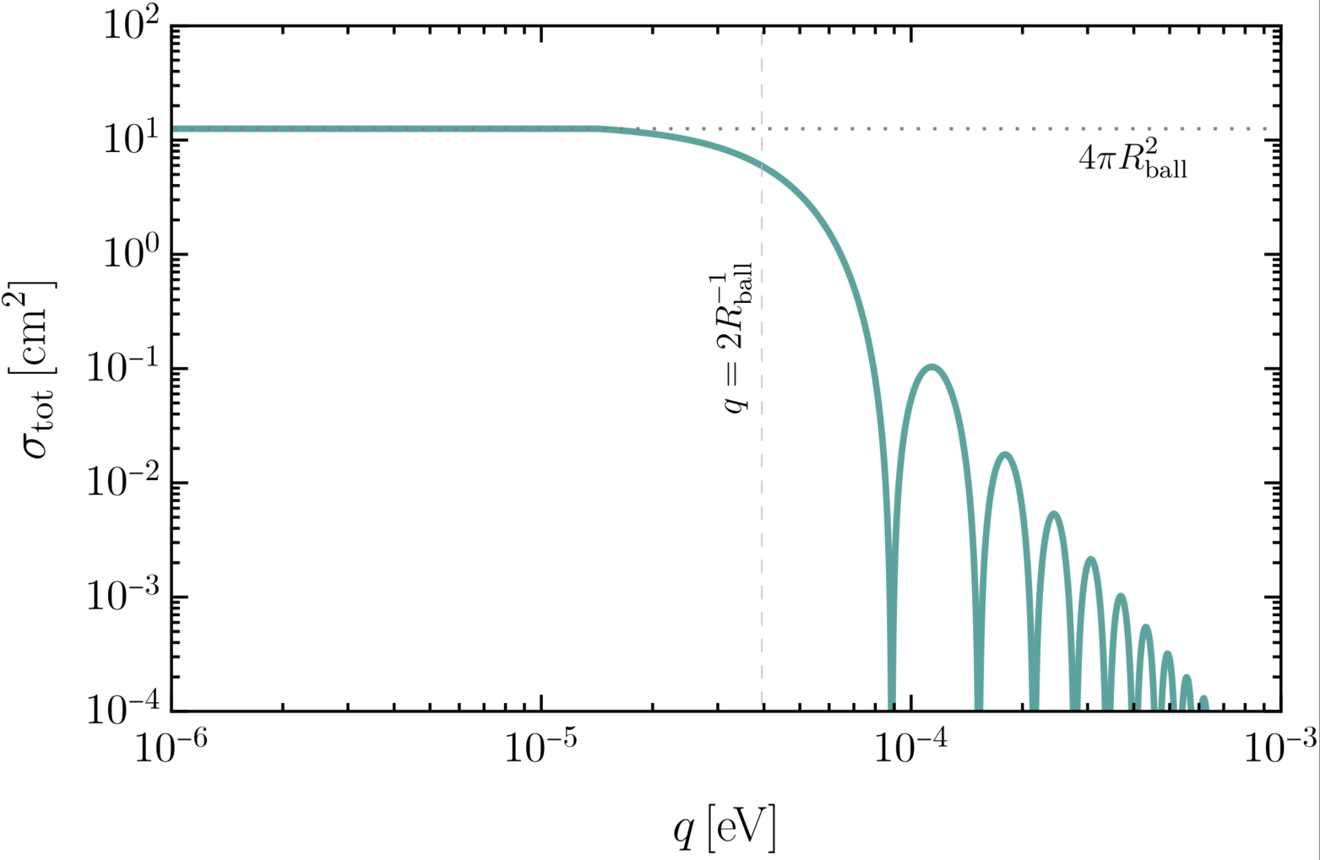
2.2 Coherent Scattering
Assuming $N_{A}$ atoms in a ball-like body with radius $R_{ball}$, the cross section dependence on momentum transfer is shown as the green line.
The coherent effects start to disappear when the momentum transfer roughly corresponds to the geometric size of the body $\frac{1}{q} \sim R_{ball}$.
Naively, the larges cross section for the small q limit should be $N_{A}^{2} σ_{χA}$. However, the cross section will saturate to the geometric area of the body $4 π R_{ball}^{2}$ due to the unitarity of quantum mechanics.
As a result, $σ_{tot}=Min \left[N_{A}^{2}σ_{χA},4 π R_{ball}^{2}\right].$

Slide 11
2.3 Enhancement of Acceleration
$$F=\frac{ρ_{χ}}{m_{χ}} σ v q=\frac{ρ_{χ}}{m_{χ}} σ_{tot} v_{χ} m_{χ} v_{χ}=ρ_{χ} σ v_{χ}^{2}.$$
$$a=\frac{F}{m_{target}}=\frac{ρ_{χ}σ_{tot} v_{χ}^{2}}{m_{target}}=\frac{ρ_{χ}N_{A}^{2} σ_{χA} v_{χ}^{2}}{N_{A} m_{A}}=\frac{ρ_{χ}N_{A} σ_{χA} v_{χ}^{2}}{ m_{A}}.$$
This rough derivation shows that, with coherent scattering effect, the acceleration can be enhanced by a factor a atom number, which is of order ${10}^{23}$ in macro-objects.

Slide 12
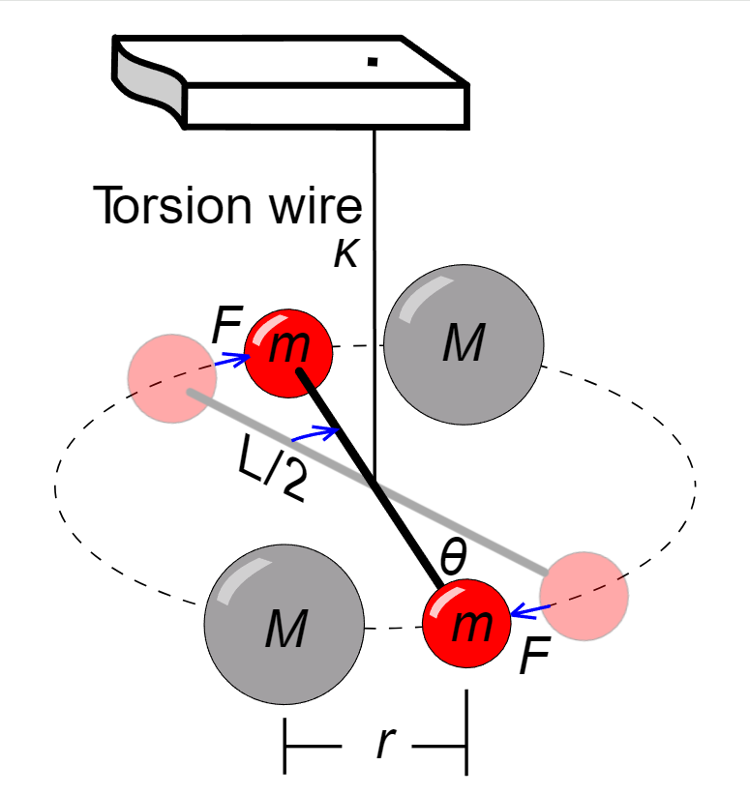
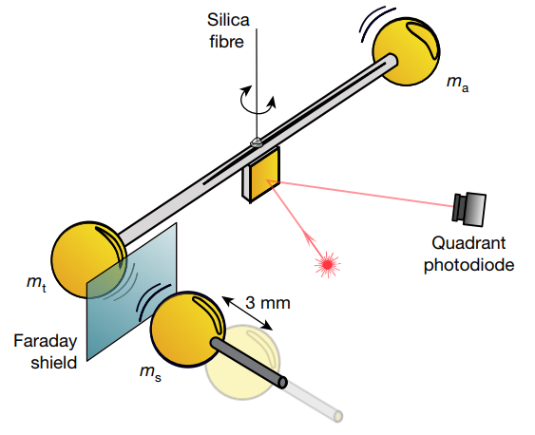
3. Q: How to detect an Acceleration?
3.1 A: Torsion Balance
Gravity is the weakest force.
The measurement of gravitational coupling
between millimeter-sized masses was first reported in 2021. [Nature 591, 225–228 (2021)]
[Cavendish Experiment (1797)]

Slide 13
3.2 Asymmetry is needed
Usually, the torsion balance setup using to measure the weak gravity and test equivalence principle contains two balls with same masses and same sizes.
The entire device has rotational symmetry around the central wire.
As a result, the DM wind induces same forces on both sides. No signal can be detected.
Asymmetry is needed!

Slide 14
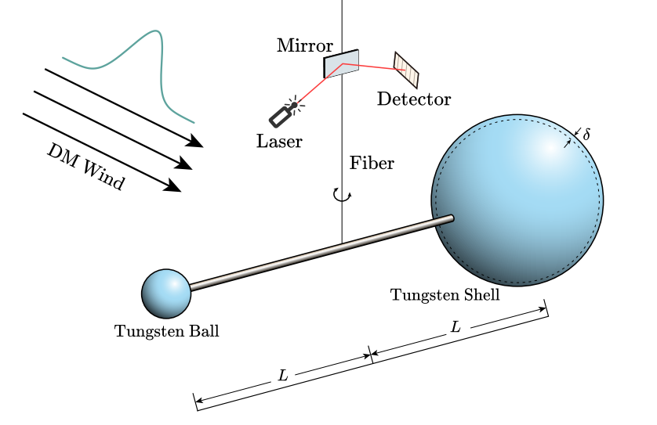
4. Q: How to design the setup?
To make the torsion in balance, the two targes should have the same mass (If the arm lengths are the same).
The masses means the same numbers of atoms.
To have different coherent form factor, the two targets should have different geometric sizes.
Targets with equal masses but different sizes.

Slide 15
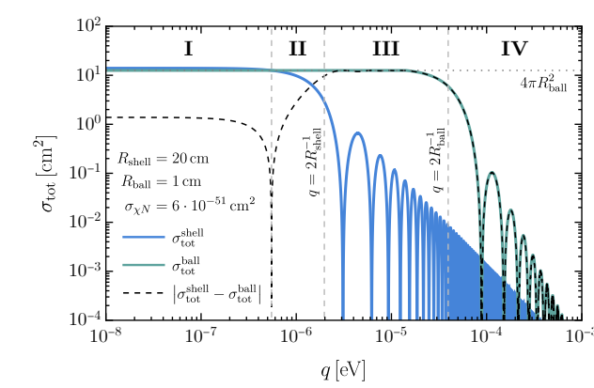
5. Results of Part I
Region I: DM wavelength much larger than both the radii of the ball and the shell.
Region II: DM wavelength ~ $R_{shell}$; Coherent effects of the shell starts to decrease.
Region III: $R_{ball}$<DM wavelength< $R_{shell}$; Coherent scattering only with the ball.
Region IV: DM wavelength< $R_{ball}$; Coherent effects gradually disappear.

Slide 16
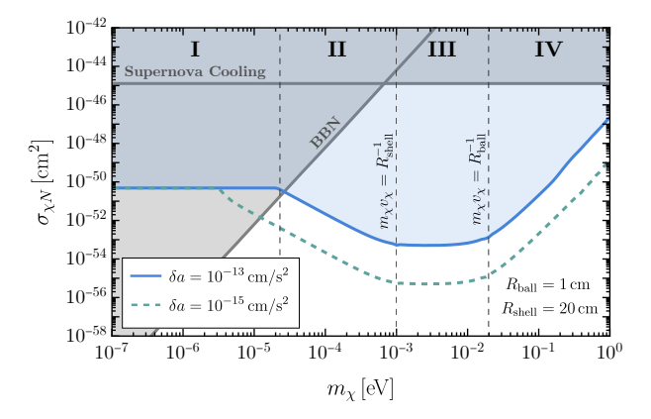
5. Results of Part I
Assuming no signal detected, we can get the limit as shown in Fig. The strength of limit corresponds to the four regions before.
Assume general models, such as $\frac{χ^{2}G_{μν}G^{μν}}{Λ^{2}}$, $\frac{m_{i} χ^{2}\overline{ψ_{i}}ψ_{i}}{Λ^{2}}$ with $ψ_{i}$ the SM quarks.
Constraint-1: supernova cooling due to the DM emission.
Constraint-2: the DM will change the nucleon mass and affect the BBN.

Slide 17
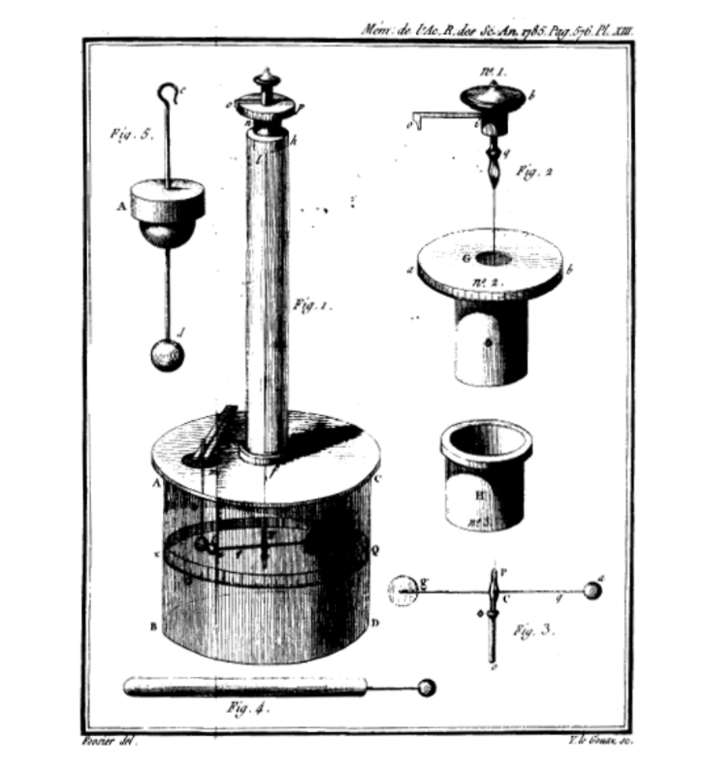
5. A Discussion
In 1785 (even earlier than Cavendish), Coulomb design the exact same setup (a ball and a shell) to measure the electric force.
This is called as Coulomb’s Torsion Balance[1785]!
Since we are focus on the measurement of gravity over hundreds of years. Coulomb’s torsion balance did not progress further.
Old devices, new purpose!
It is the time to develop Coulomb-type torsion balance again for DM detection!

Slide 18
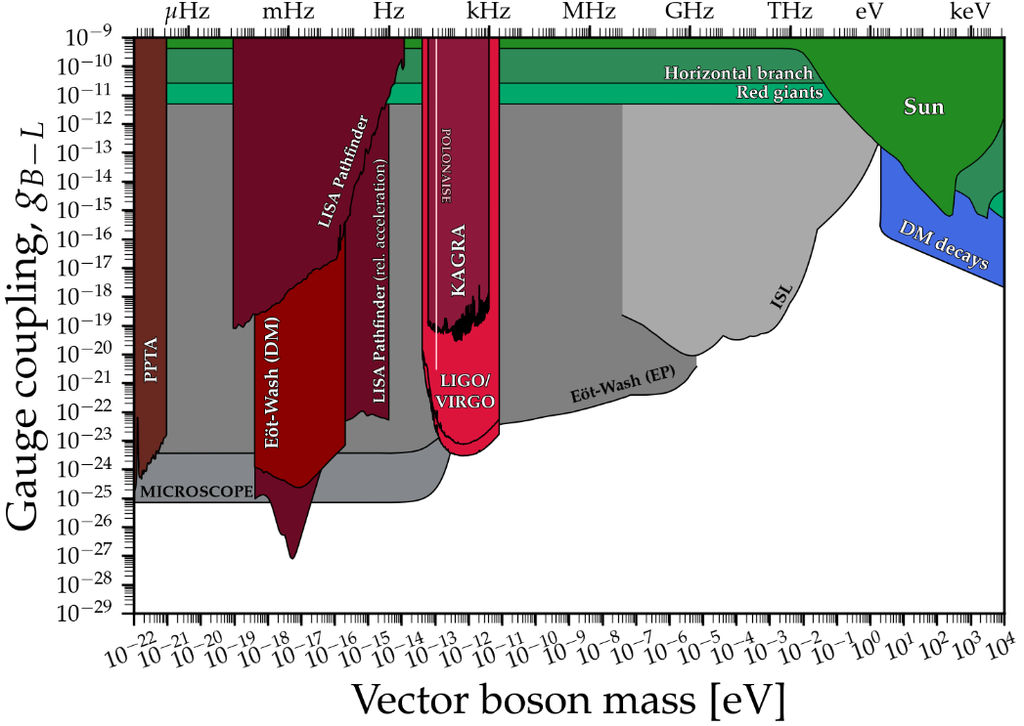
6. Q: How to detect ~1eV fifth-force boson?
6.1 A: Torsion Balance?
Notice: It is not necessary to be DM, it can simply be a hidden mediator.
$$V(r) \sim g\frac{e^{−m_{A′}r}}{r}$$
Here, we take B-L gauge boson as a well-motivated example. [Feeton dark matter!]

Slide 19
7. Q: How to reach such a small-scale?
If the mediator mass is around 1 eV, the interaction range is of order micro-meter or nano-meter.
The torsion balance is a complex mechanical device, it is not possible to make it so small.
The quantum test of gravity?
We need a very small, low-loss, low-background quantum detector that can detect potential or force.

Slide 20
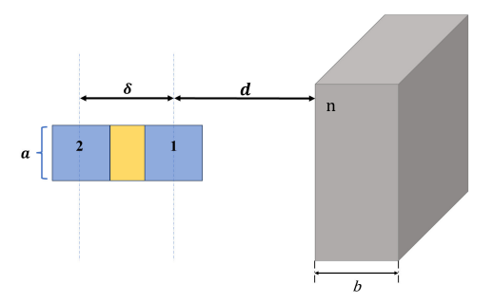
A: Josephson Junctions
A Josephson junction (100 nm) contains 2 superconductor and an insulator in between.
Inside superconductor 1 and 2, we have coherent states of Cooper pairs.
If the states have different phases, a Josephson current can be generated.
So, we put a junction nearby a fifth-force potential V(r). After a time $τ$, the state 1 has a phase $i V\left(d\right)τ$ while state 2 has $i V\left(d+δ\right)τ$.

Slide 21
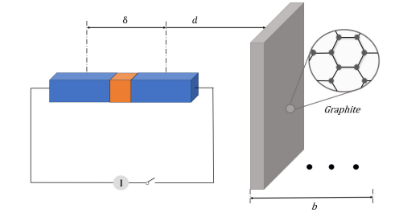
8. Measurement Scheme
1) We need to prepare the Josephson junction to be in the ground state (no initial phase difference)
2) Introduce the neutral graphite plate, which is carries fifth force charge, and let the system to evolve. [Some experimentalists suggest a rotating source]
3) Measure the Josephson current after time $τ$ and compare it with the prediction.
After estimation, we found the largest background is the phase uncertainty of coherent states?

Slide 22
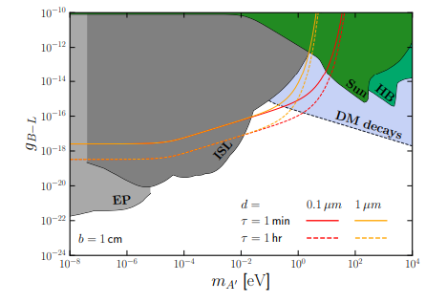
9. Results of Part II
With a smaller distance, we have a broader detection range.
With a longer evolution time, we have a stronger sensitivity.
It fills some detection gap of torsion balance around 1 eV.

Slide 23
10. Conclusion
How to detect DM?
The gap in the DM mass region in the crossover range of particle- and wave-DM
How to detect DM in the above mass range?
CASE I: DM with Z2 symmetry
Detecting coherent scattering via a novel torsion balance.
CASE II: DM without Z2 symmetry (fifth-force gauge boson)
Josephson junctions. (It can also be used to test small-scale gravity)
Both are new theoretical proposals. We need to really try it and see how far we can go.

Slide 24
Backup: References

Slide 25
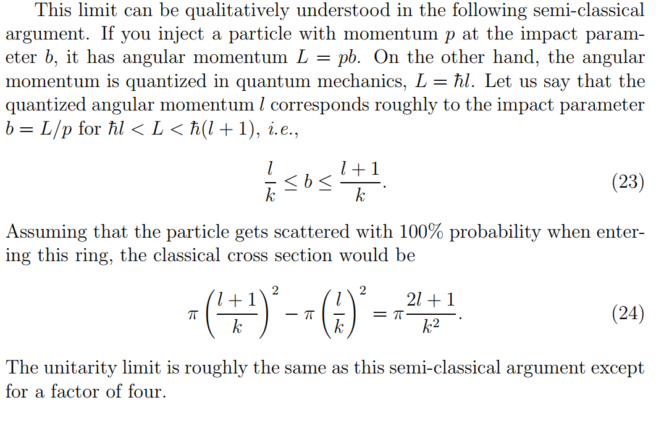
Backup: Unitarity

Slide 26
2.2 Coherent Scattering
If we receive the outgoing wave at infinite far with initial and final momentum fixed, the only difference of these waves is the phase factor $e^{iqr_{j} }.$
In the amplitude level, $Amp→Amp \sum{e^{iqr_{i}}}$.
In the cross section level, $σ_{tot}=σ_{χA}\sum_{ij}{e^{iqΔr_{ij}}}$.
If $qΔr_{ij}≪1, e^{iqΔr_{ij} }=1$. The enhancement of total cross section is $N_{A}^{2}$ as we expected. [This N square coherent factor is verified by neutrino scattering in CE$ν$NS.]
If $qΔr_{ij}≫1,$ all the phases cancel each other except for the cases $i=j, Δr_{ii}=0$. The enhancement factor is simply $N_{A}$.
$$…$$
Number of atoms $N_{A}$.
$$2 R$$

