Slide 1
H2a4b updates
--Zelin Yan

Slide 2
Analysis overview
Process:H→2a→4b
Use coffea for singal ntuples(from Binxuan)
Samples:
mc23a h2a4b qqZH 60GeV
mc23a h2a4b qqZH 30GeV
mc23a h2a4b qqZH 12GeV
https://github.com/CoffeaTeam/coffea/tree/master

Slide 3
Privious event preselection(easyjet)
Jet:
Jet_type:reco4PFlowJet
pt > 20GeV , |eta| < 4.5
Btag_wp:GN2v01_FixedCutBEff_85
Lepton:
Singlep. Trigger + dilep. trigger
Exactly 2 leptons and anti-flavour
Electron:
ID: MediumLH , Iso:Tight_VarRad
pt > 10GeV , |eta| < 2.47 & excluding 1.37 < |eta| < 1.52 ,
Muon:
ID:Tight , Iso:PflowLoose_VarRad
pt > 25GeV, |eta| < 2.5

Slide 4
Event preselection(coffea)
From h2a4b Run2 analysis and mono-b/c analysis:
Singlelep. triggers + dilep. Triggers
At least 2 jets
Lepton cut:
Exactly 2 leptons
Leading lep pt > 27GeV & sub-leading lep pt > 10GeV
Electron: |eta| < 2.47 & excluding 1.37<|eta|<1.52
Muon: |eta| < 2.5
Tight jet cut(selected):
pt > 20GeV , |eta| < 2.5
Jet_passTight
Dilepton mass window: mll>50GeV

Slide 5
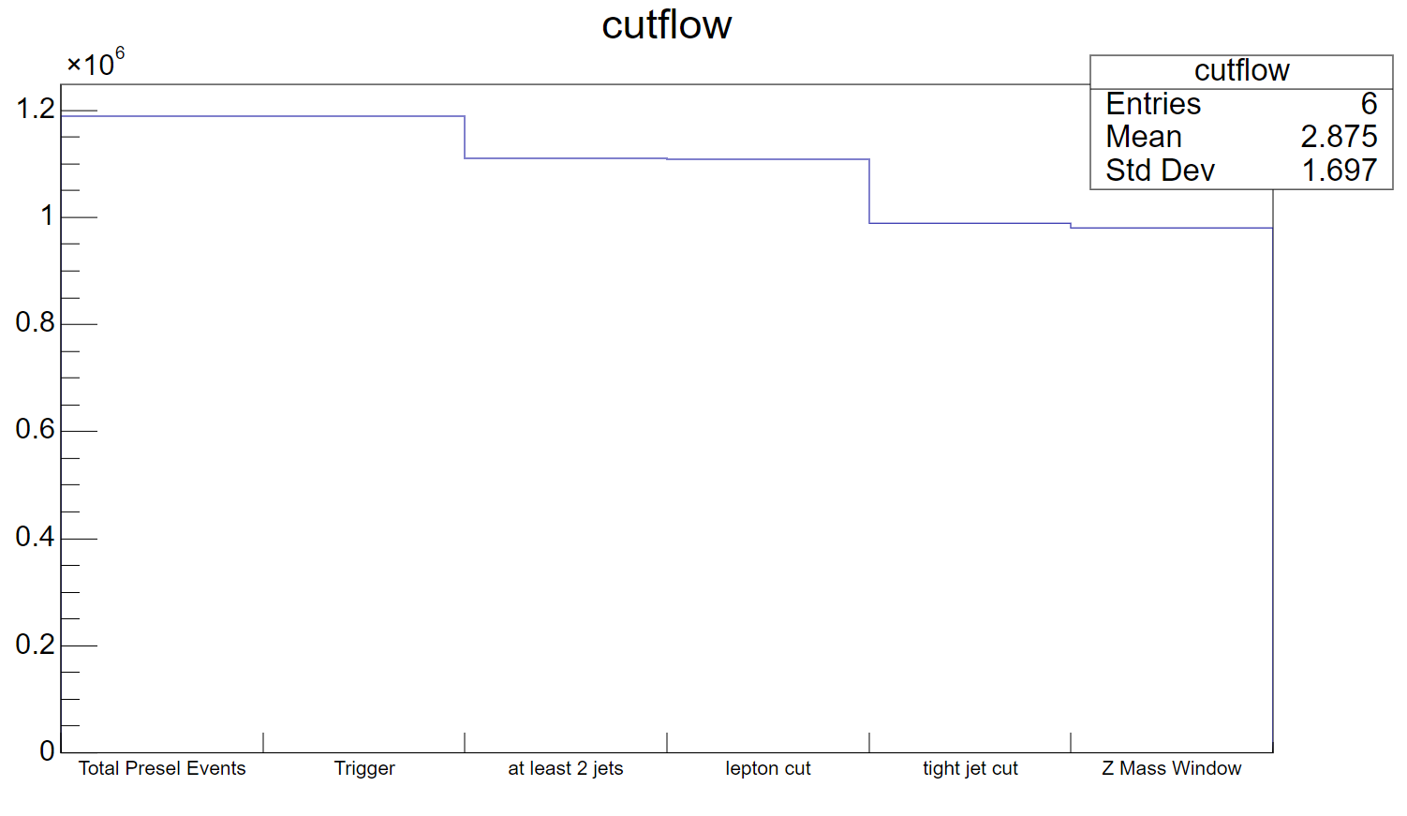
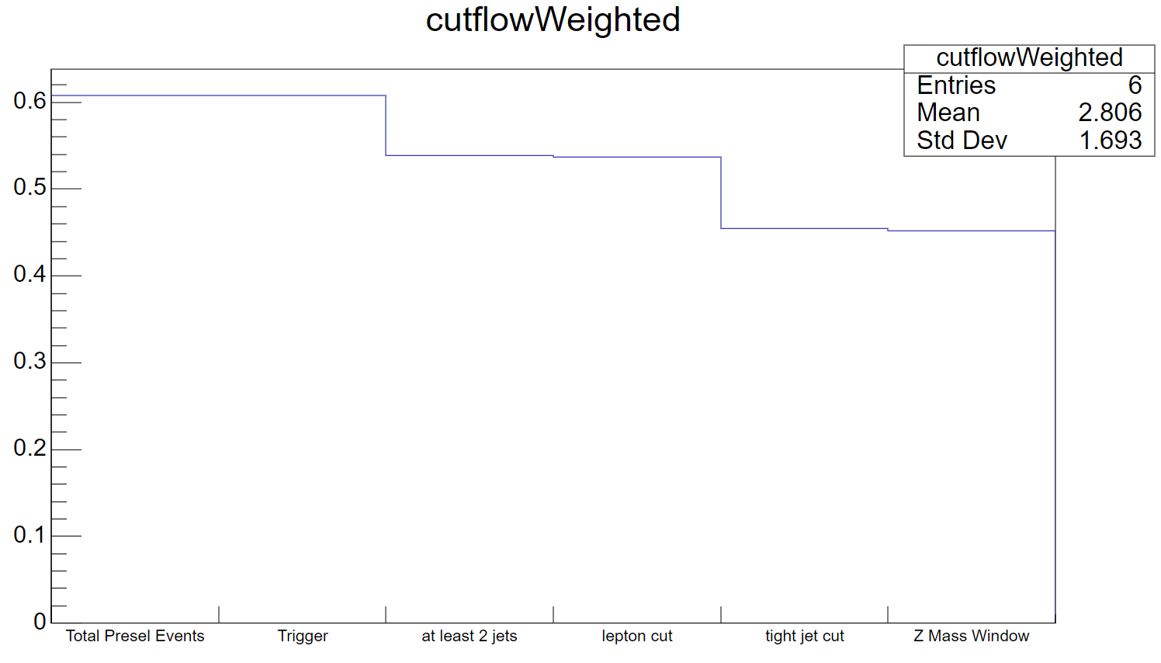
Cutflow(60GeV)
Weighted: Proportion of sumOfweights

Slide 6
Cutflow(30GeV)
Weighted: Proportion of sumOfweights

Slide 7
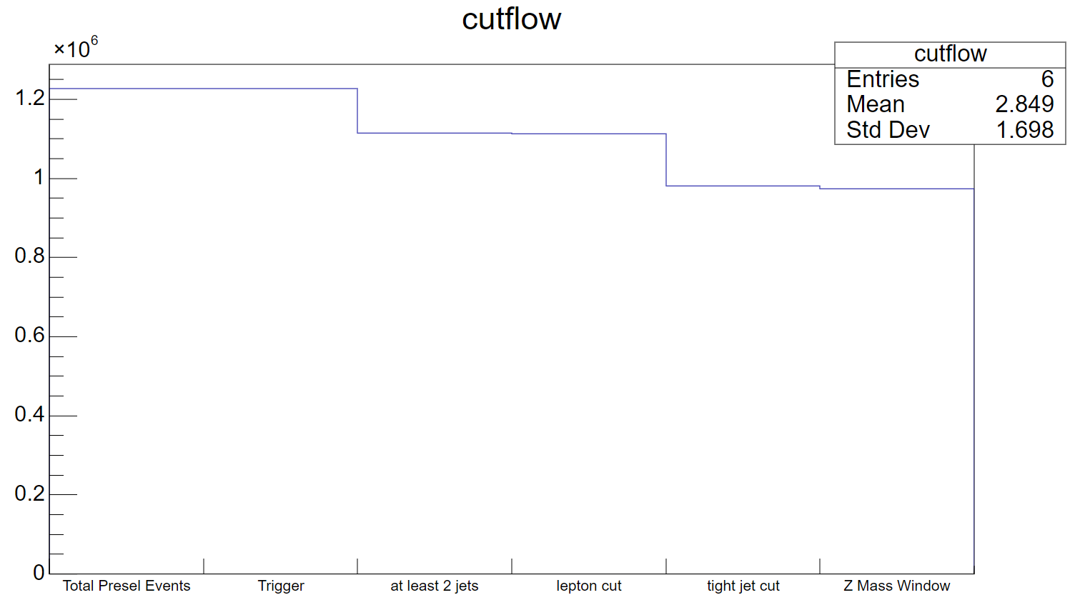
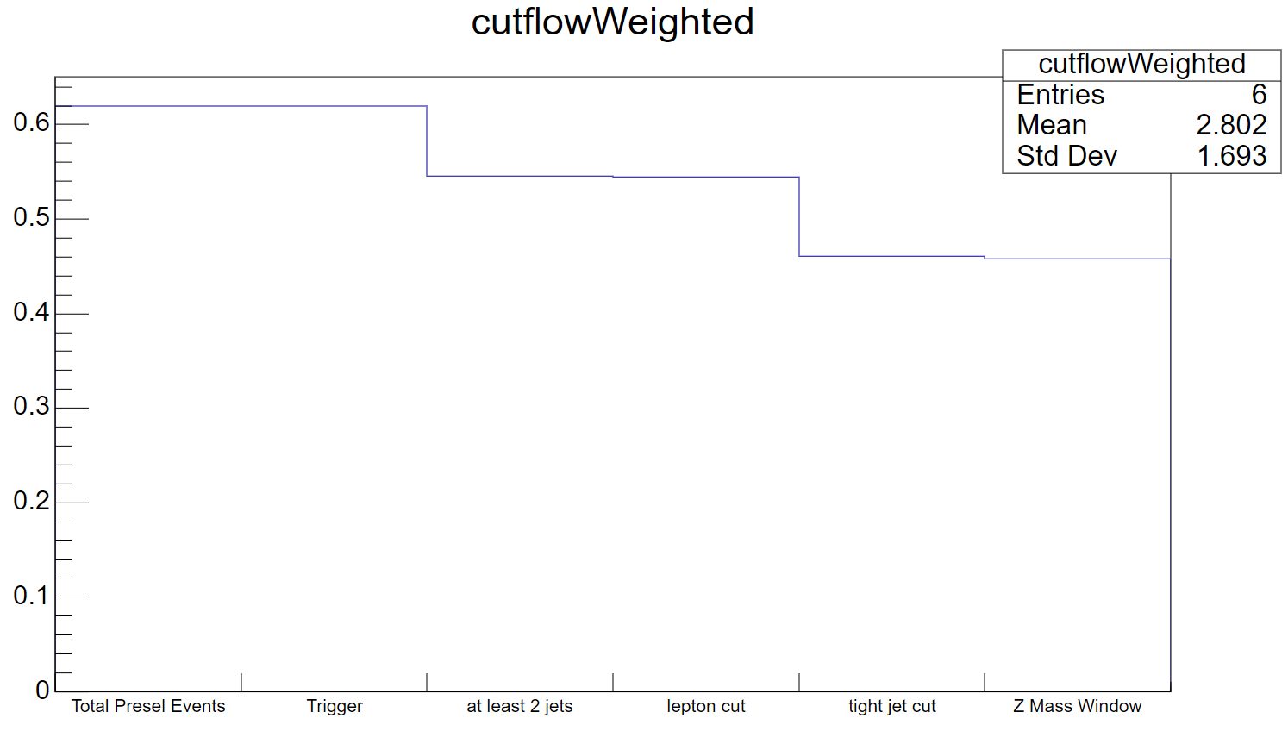
Cutflow(12GeV)
Weighted: Proportion of sumOfweights

Slide 8
Cutflow
Weighted: Proportion of sumOfweights
 | H2a4b a_mass 60GeV |  | H2a4b a_mass 30GeV |  | H2a4b a_mass 12GeV
Cut | entries | weighted | entries | weighted | entries | weighted
Total presell events | 1,189,105 | 0.6079 | 1,227,426 | 0.6197 | 1,218,941 | 0.6115
Trigger | 1,189,105 | 0.6079 | 1,227,426 | 0.6197 | 1,218,941 | 0.6115
At least 2 jets | 1,110,644 | 0.5385 | 1,114,777 | 0.5453 | 1,117,840 | 0.5408
Lepton cut | 1,108,197 | 0.5368 | 1,113,477 | 0.5443 | 1,115,308 | 0.5391
Tight jet cut | 988,809 | 0.4550 | 981,673 | 0.4607 | 983,110 | 0.4550
Z mass window | 980,949 | 0.4524 | 973,655 | 0.4581 | 975,177 | 0.4524

Slide 9
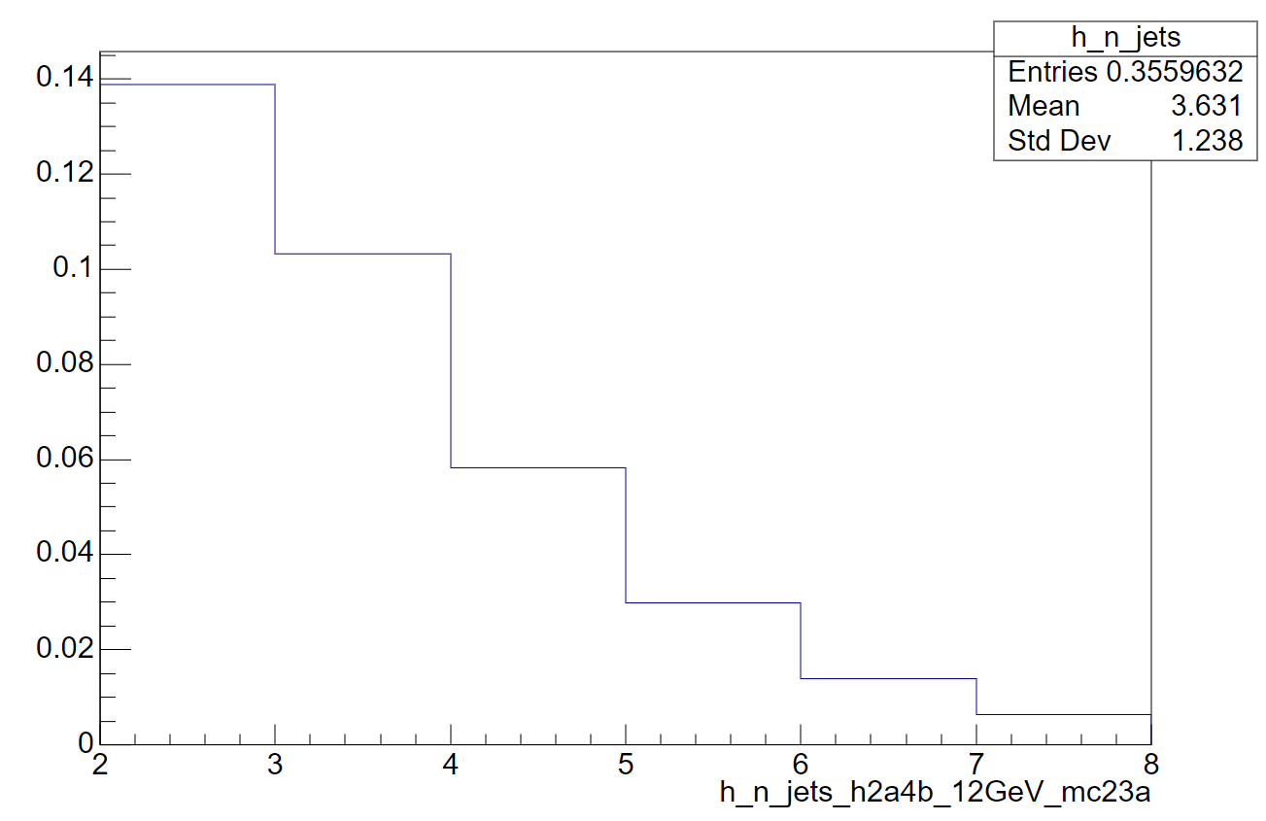
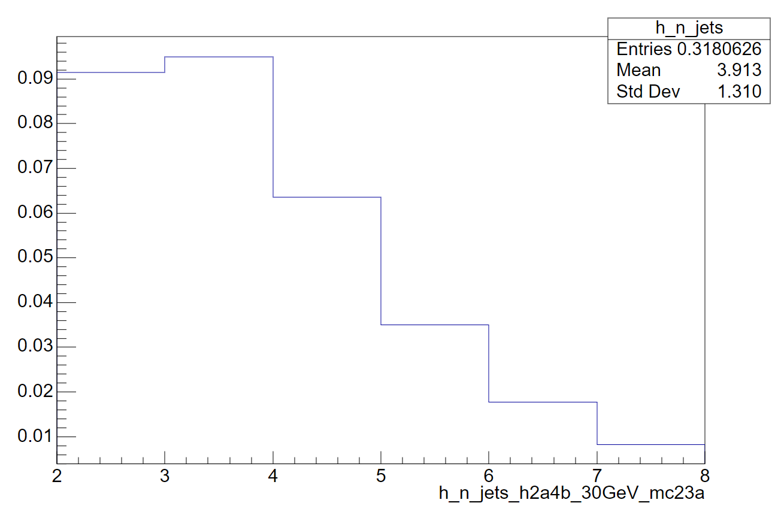
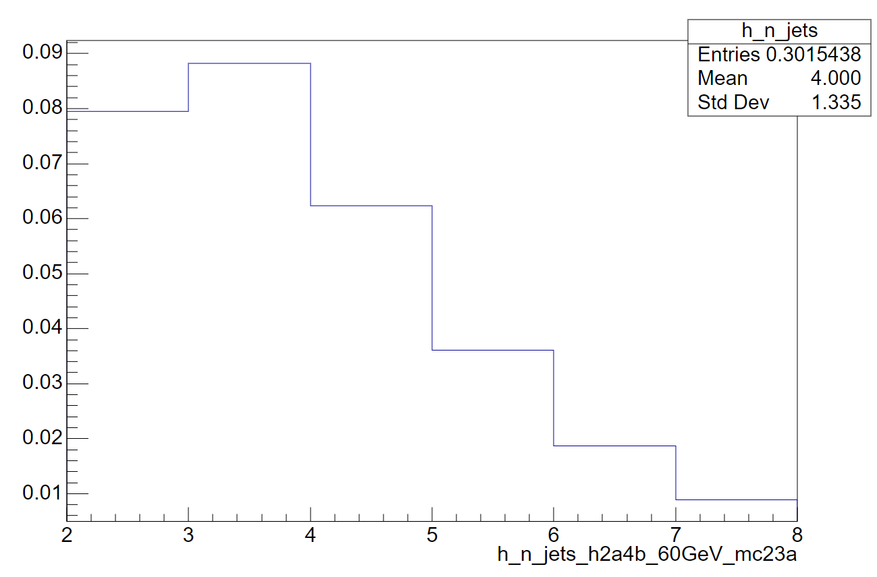
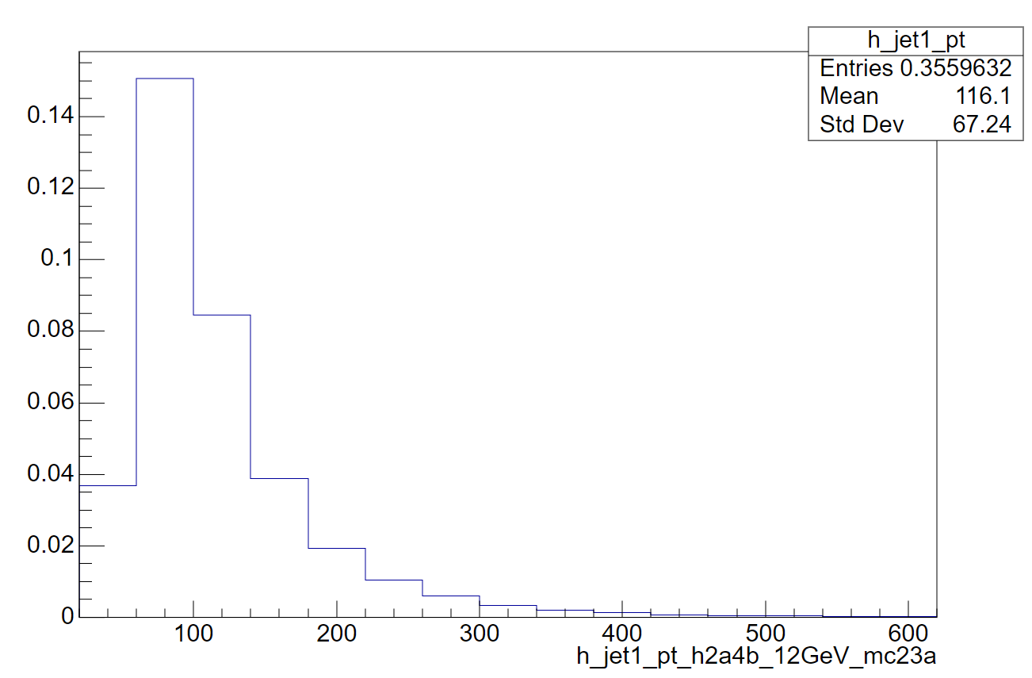
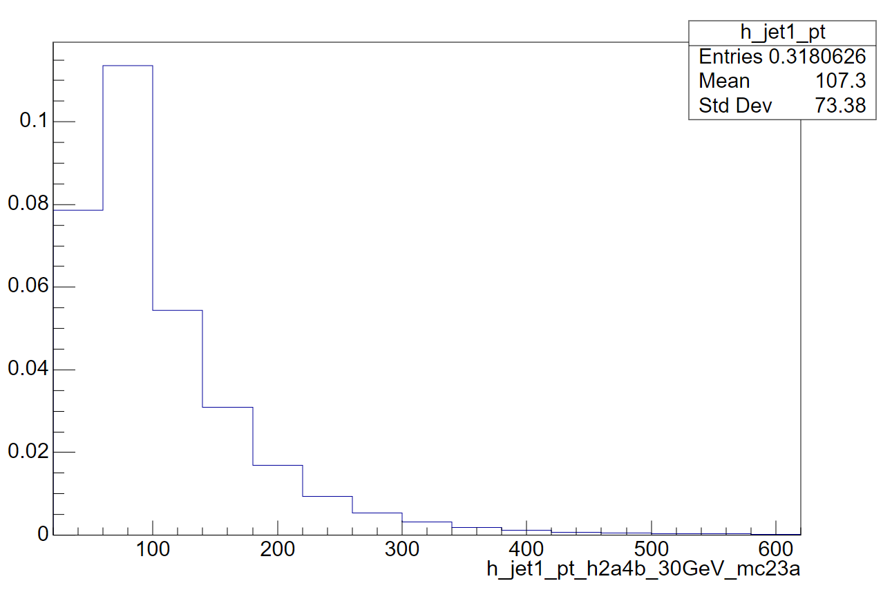
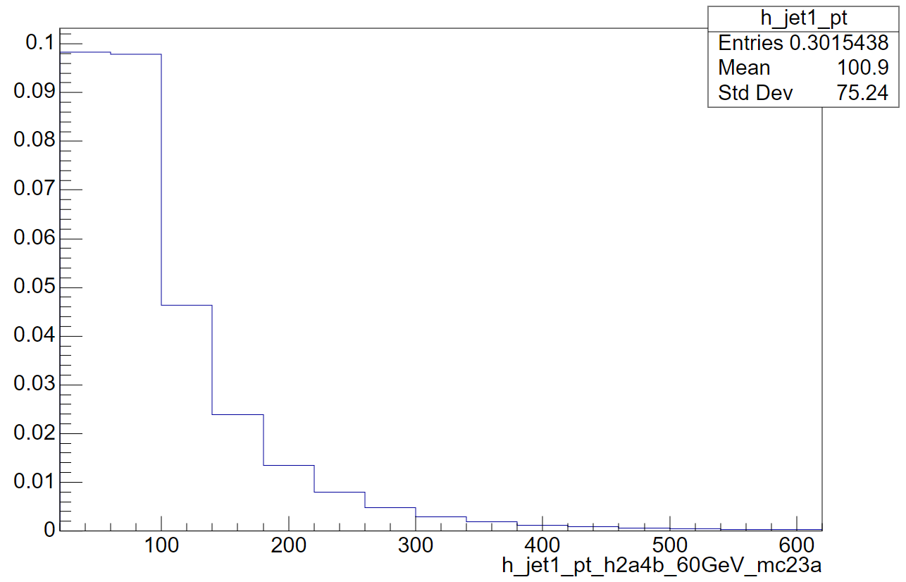
Jet kinematics

Slide 10
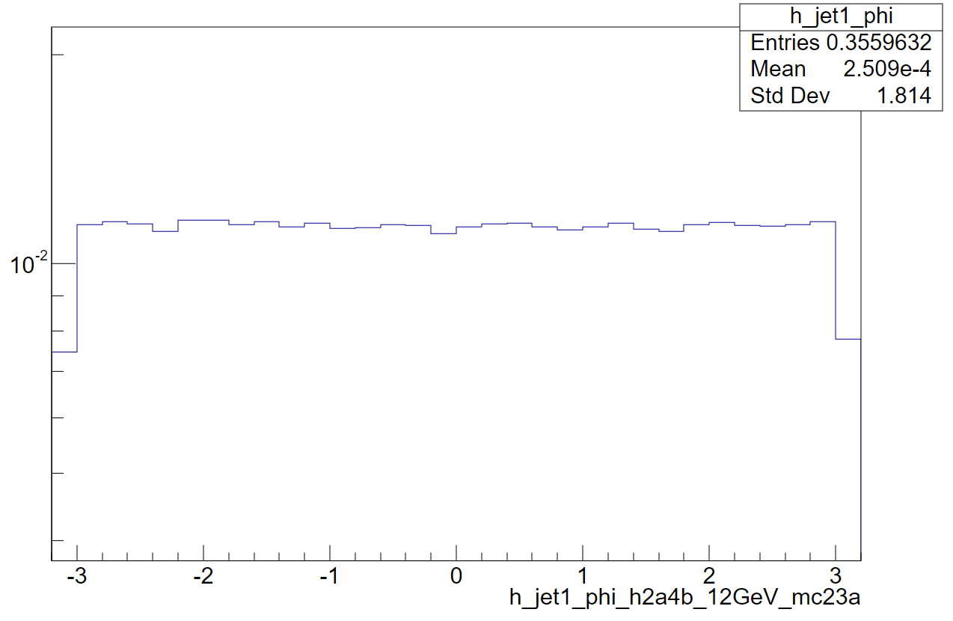
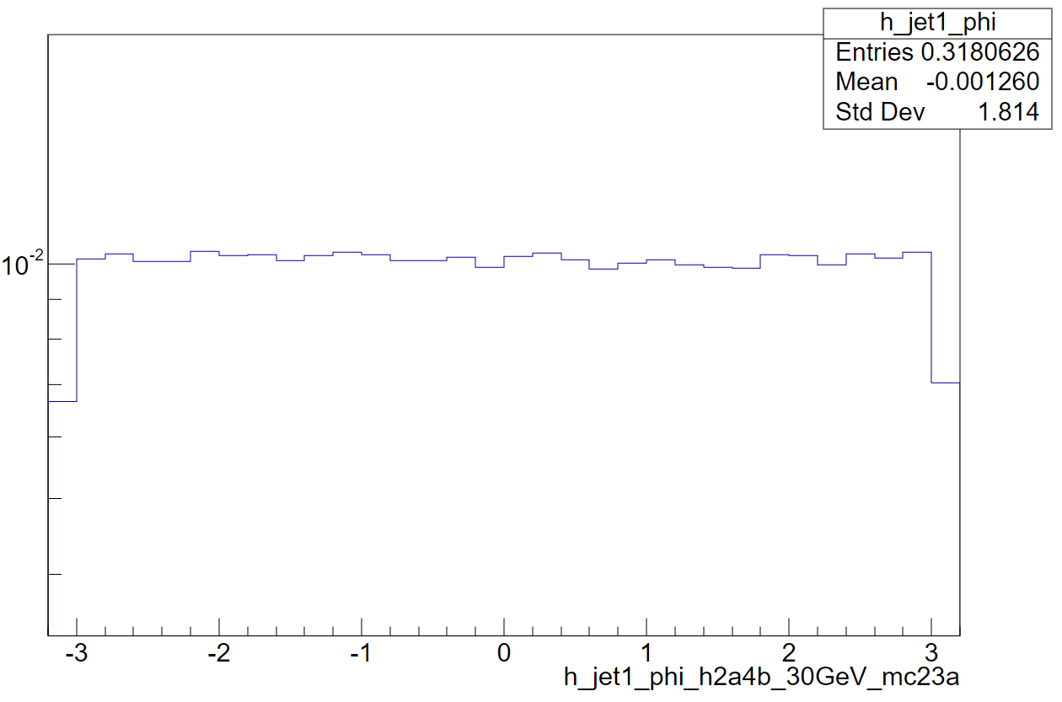
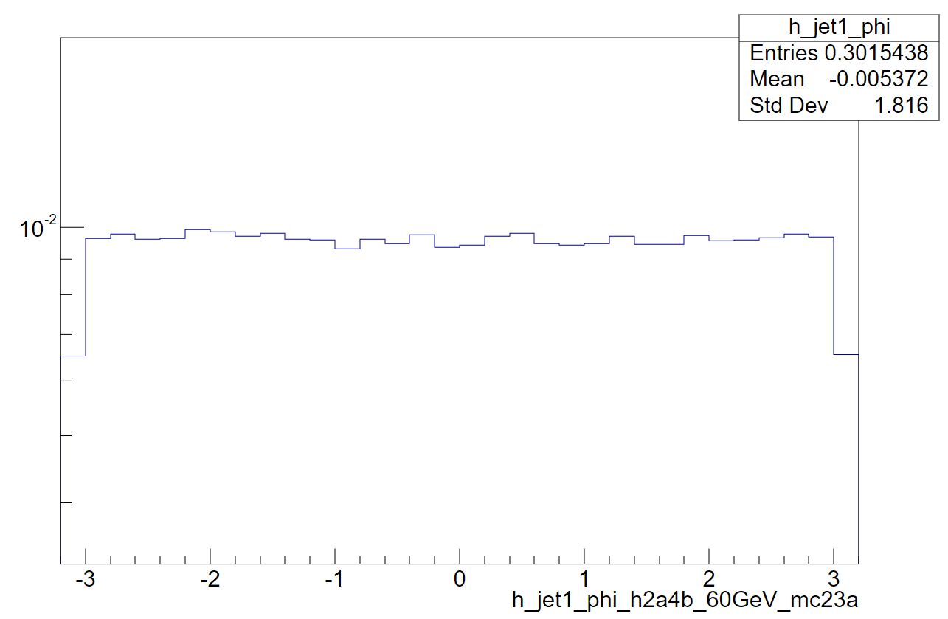
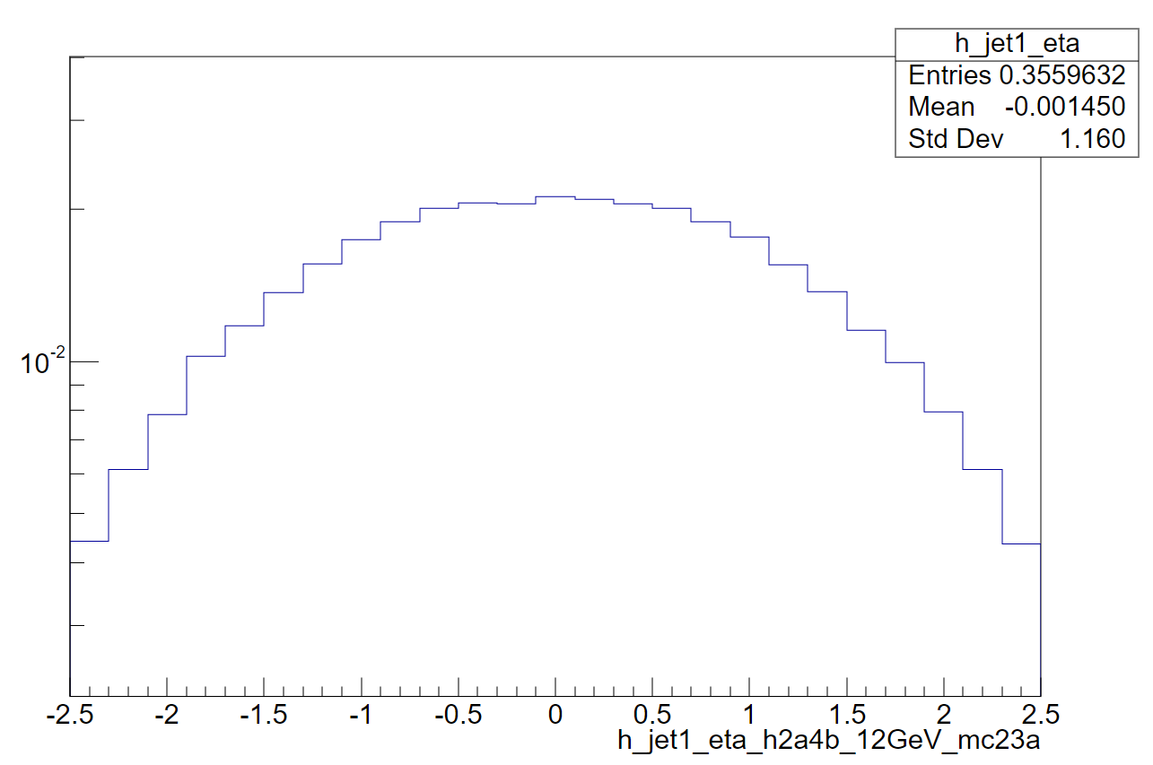
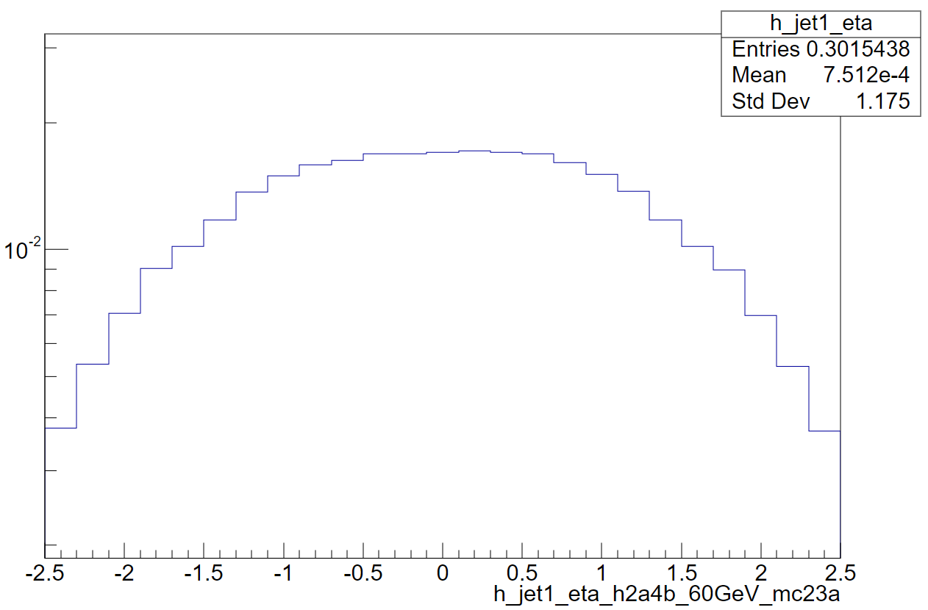
Jet kinematics

Slide 11
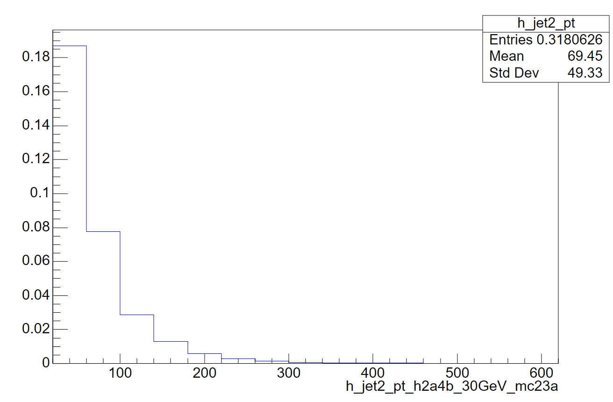
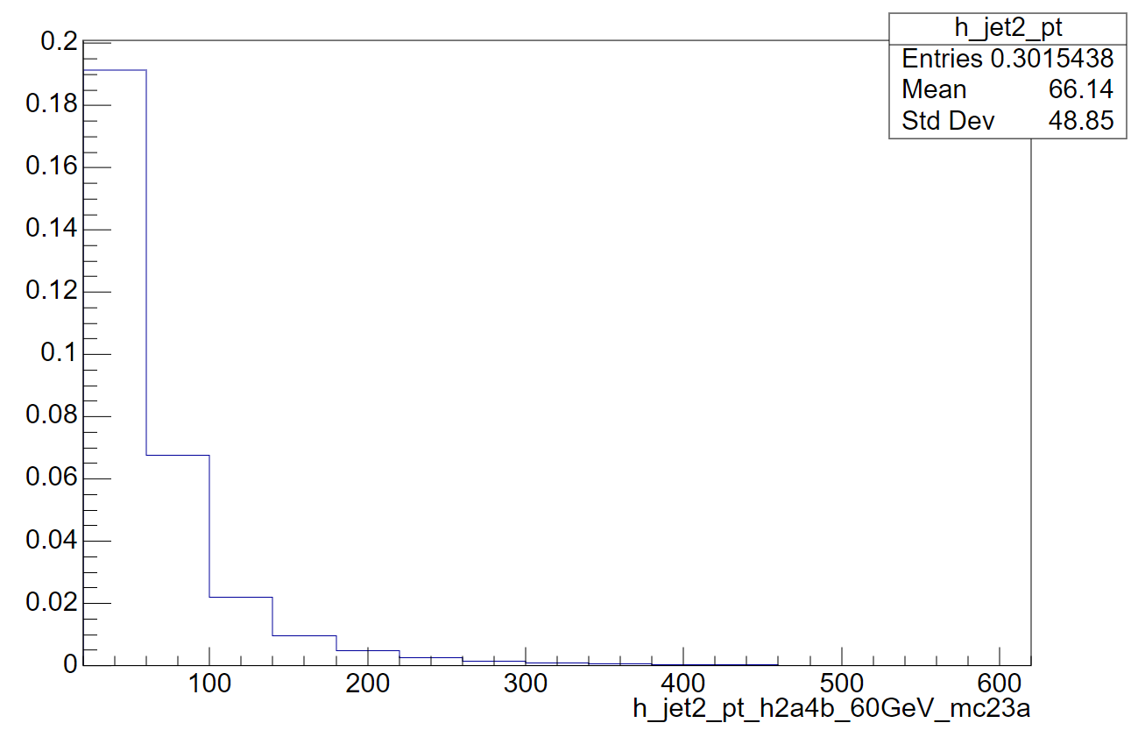
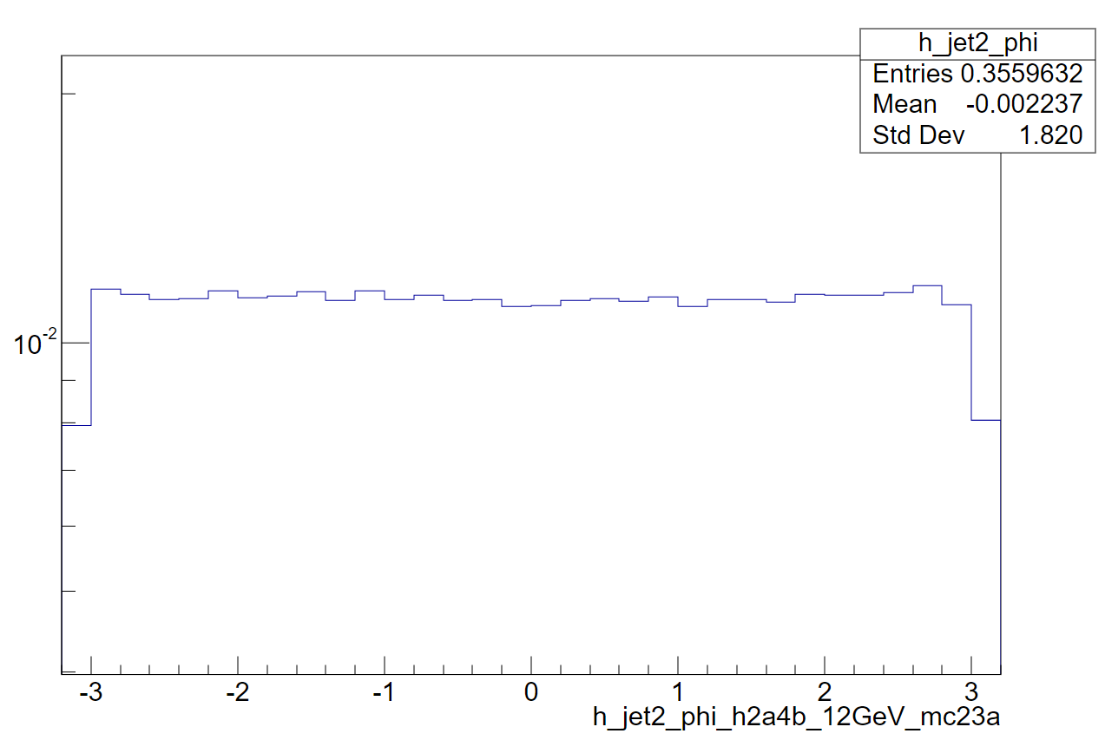
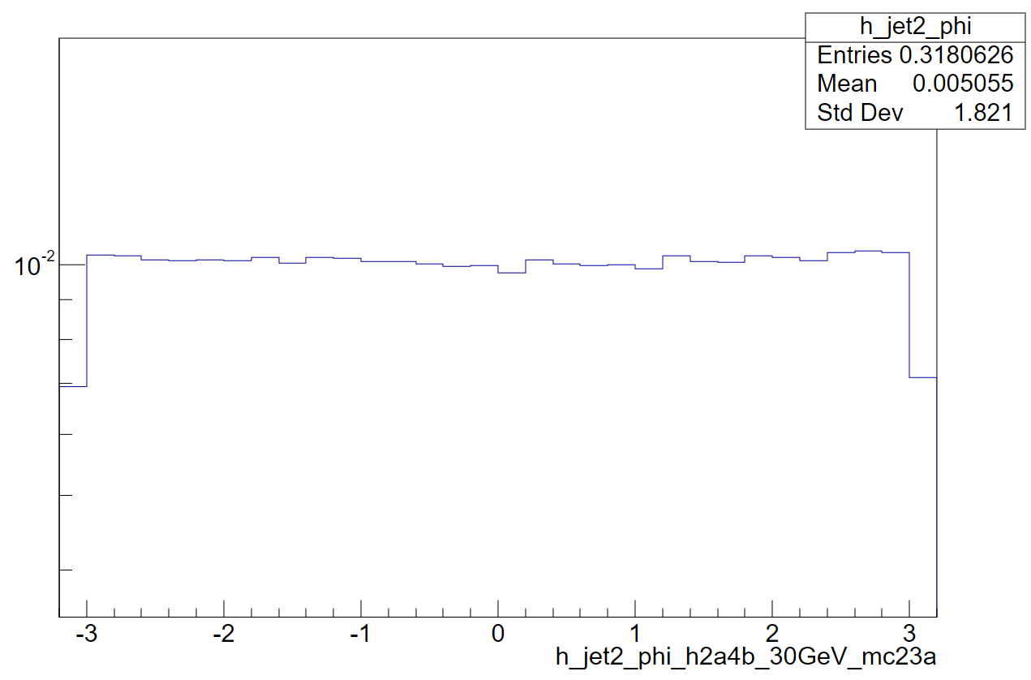
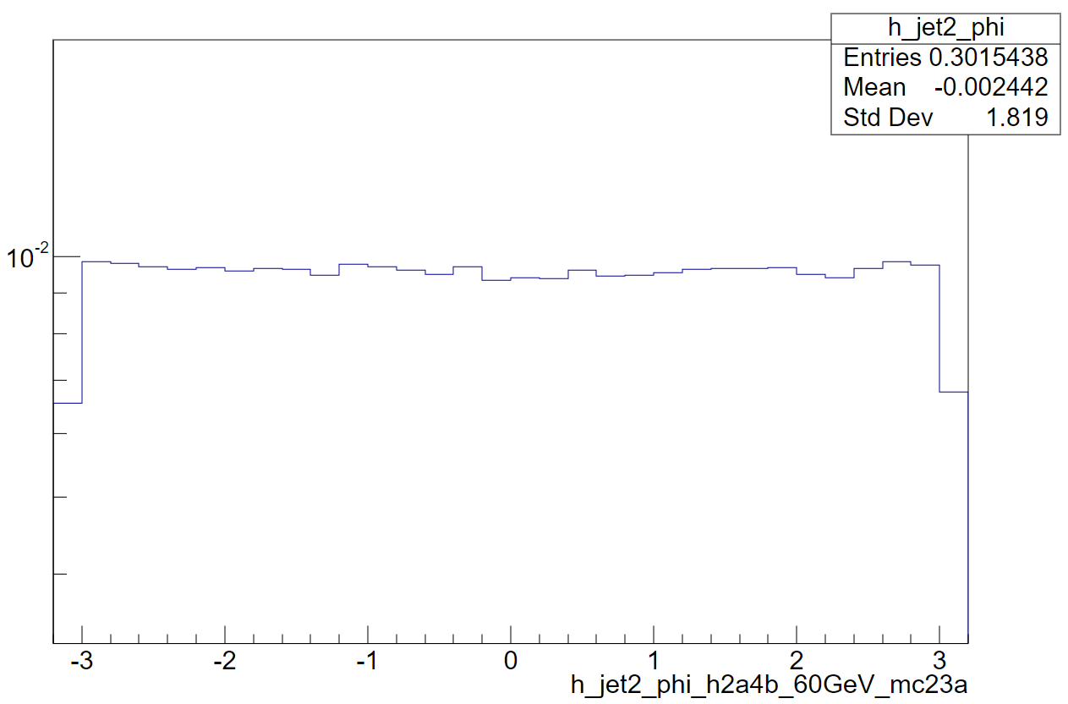
Jet kinematics

Slide 12
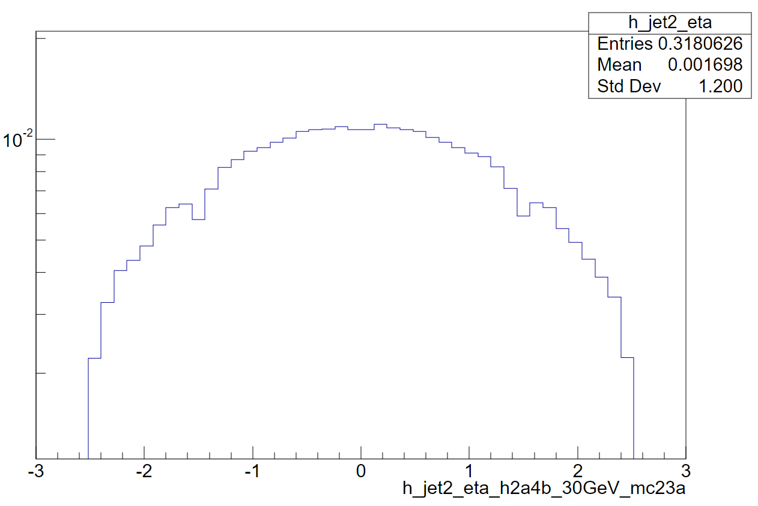
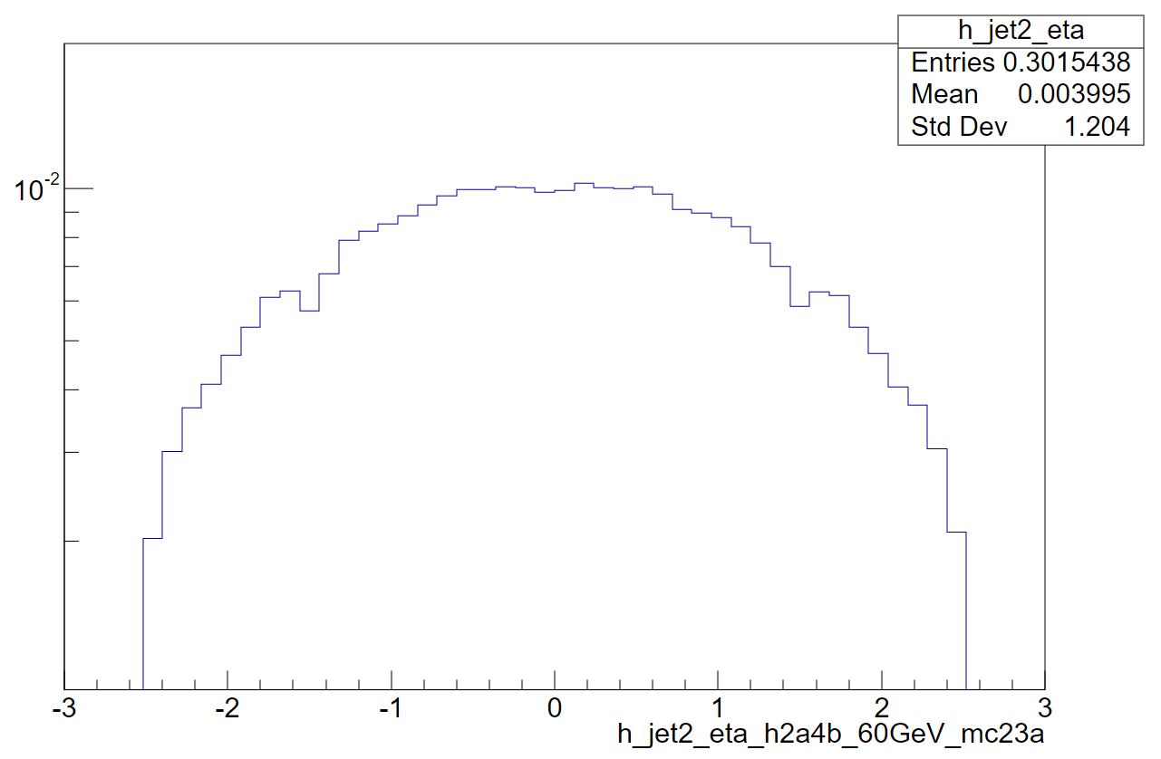
Jet kinematics

Slide 13
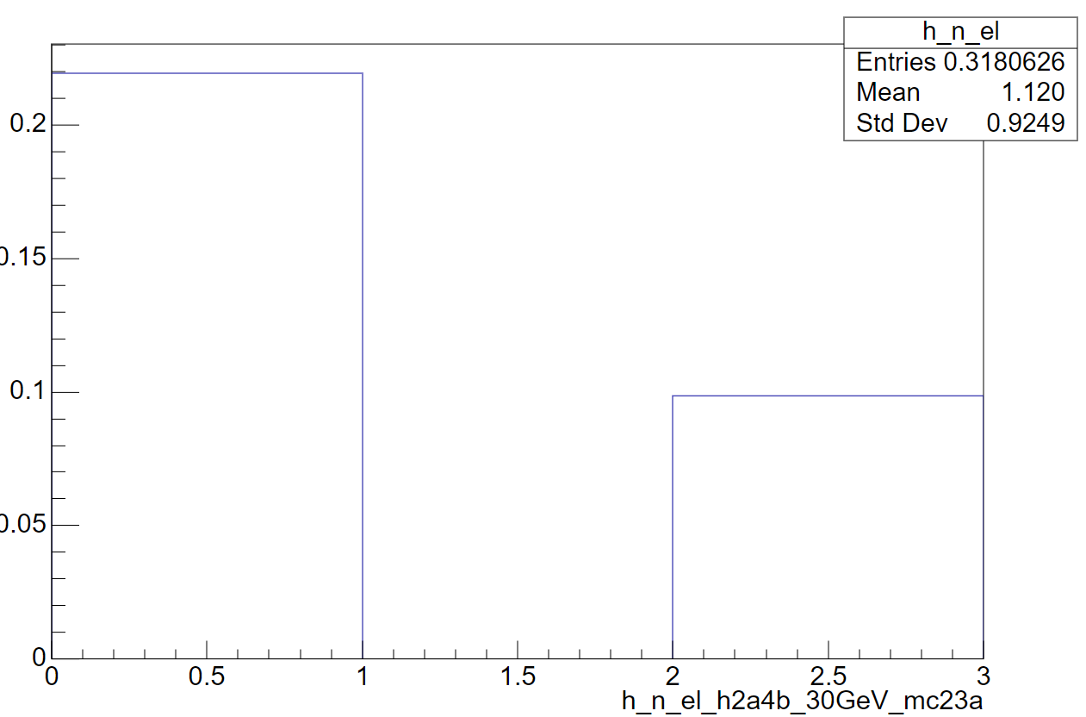
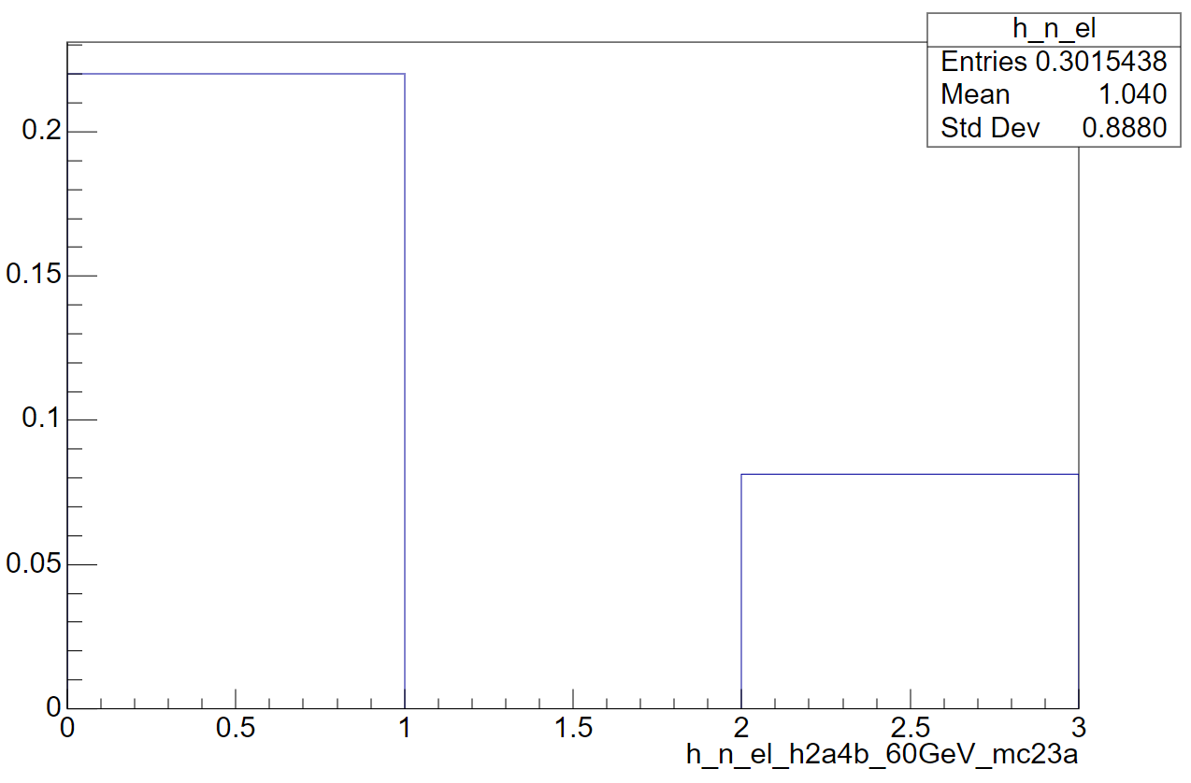
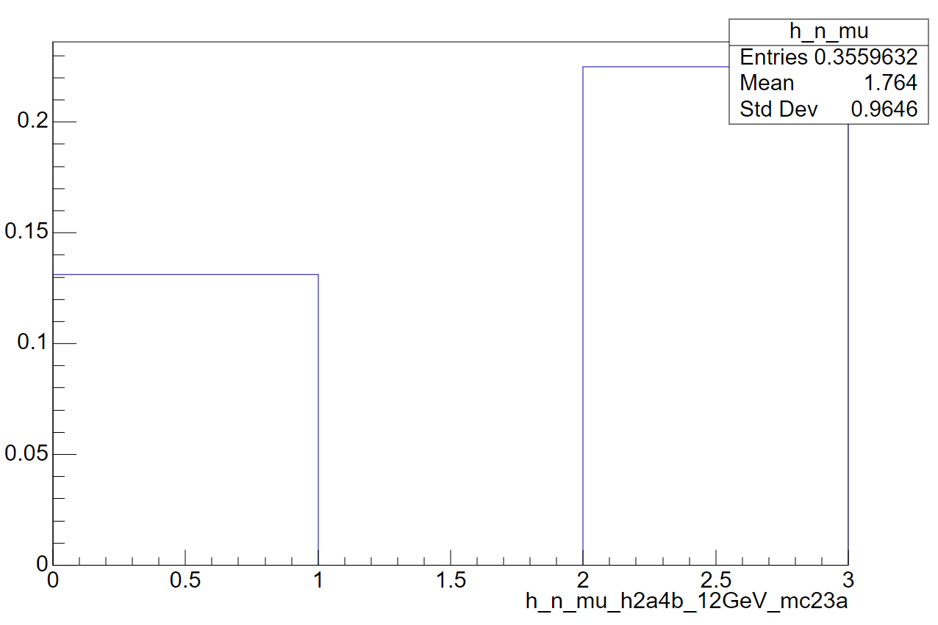
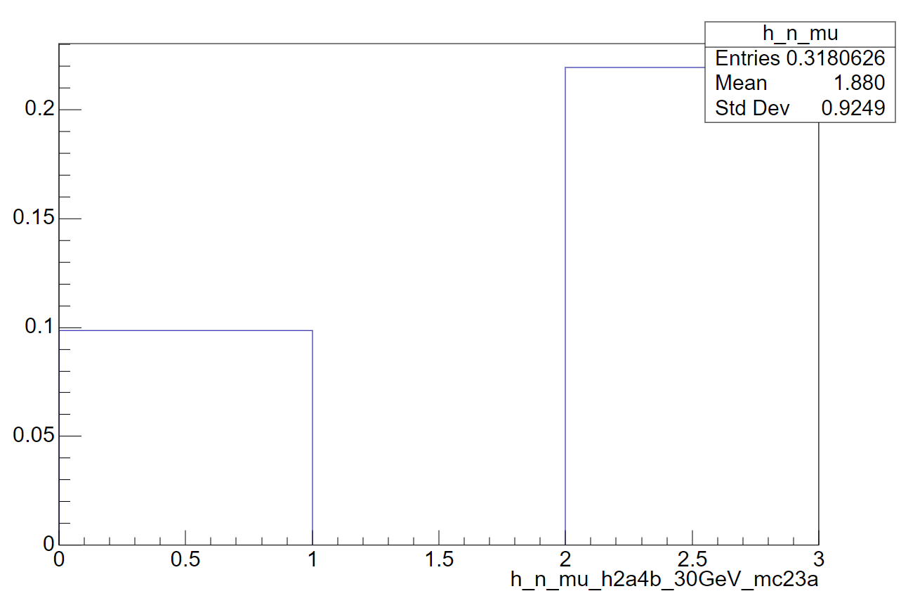
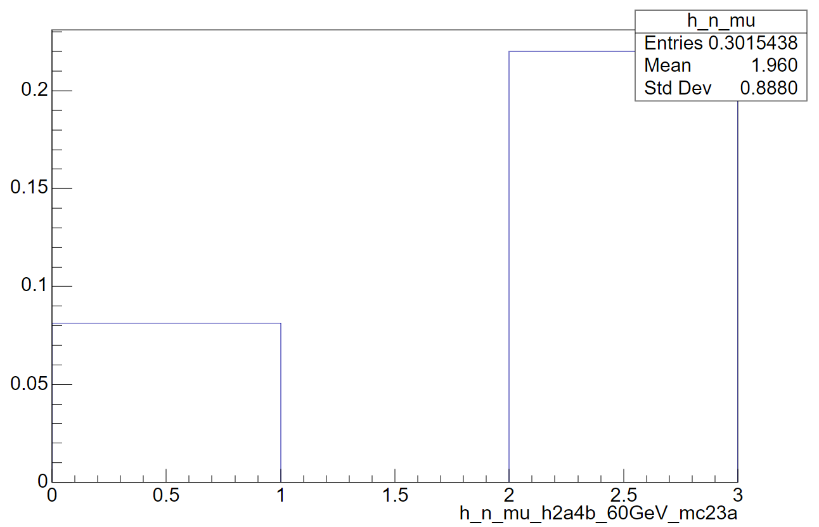
Lepton kinematics

Slide 14
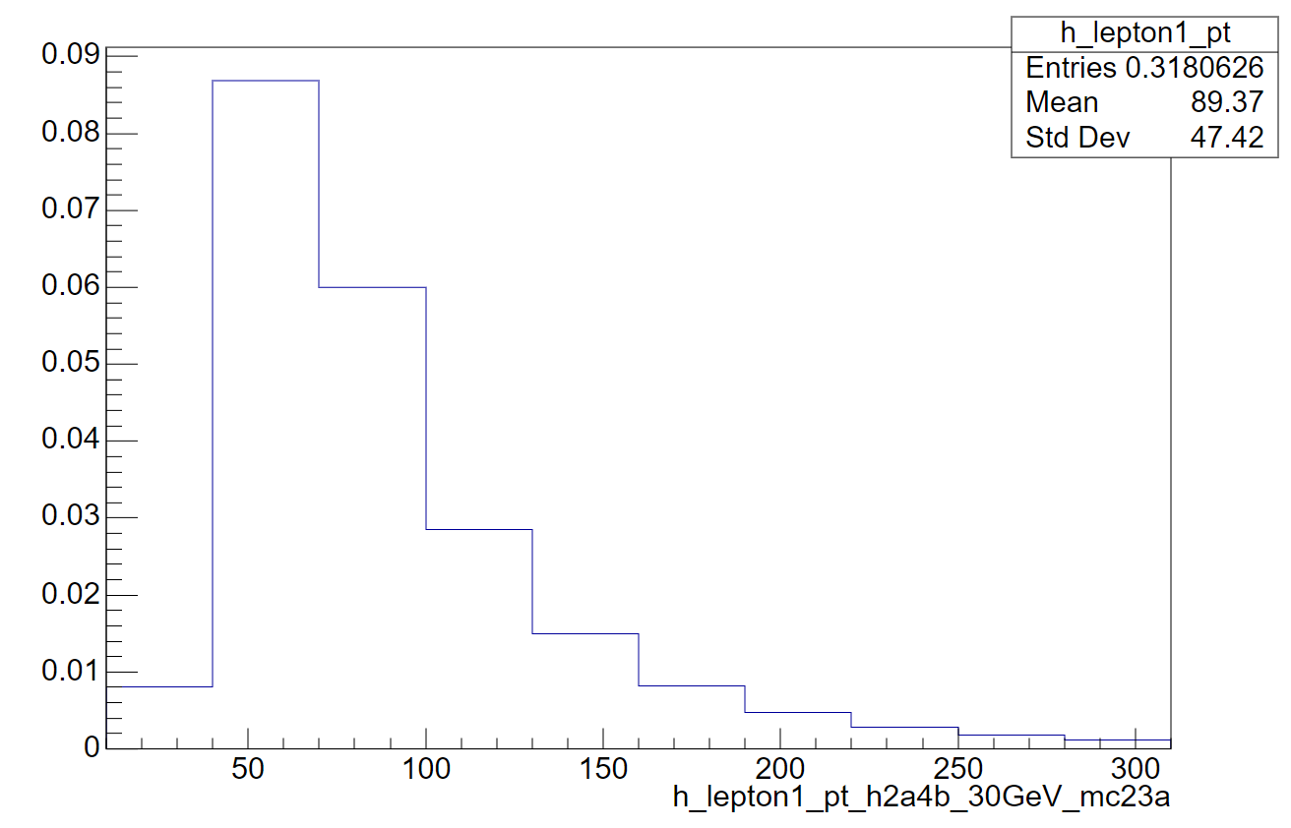
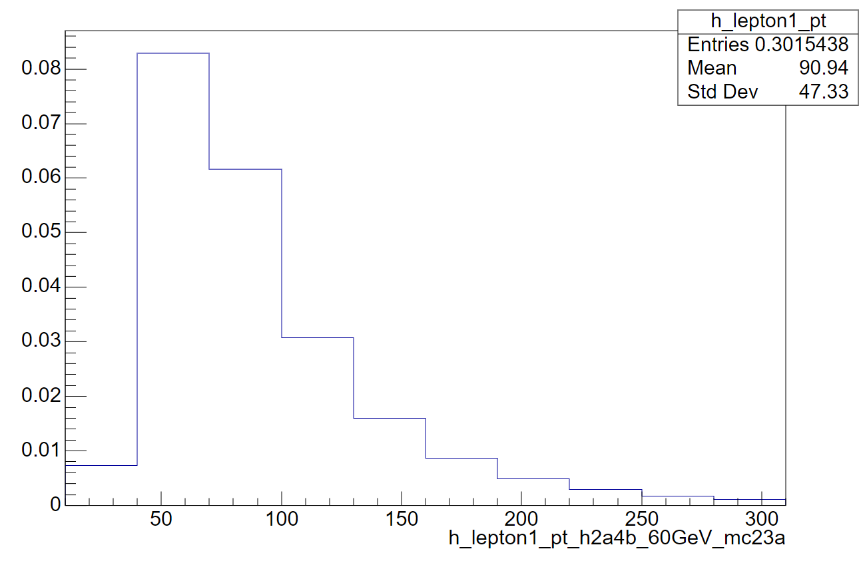
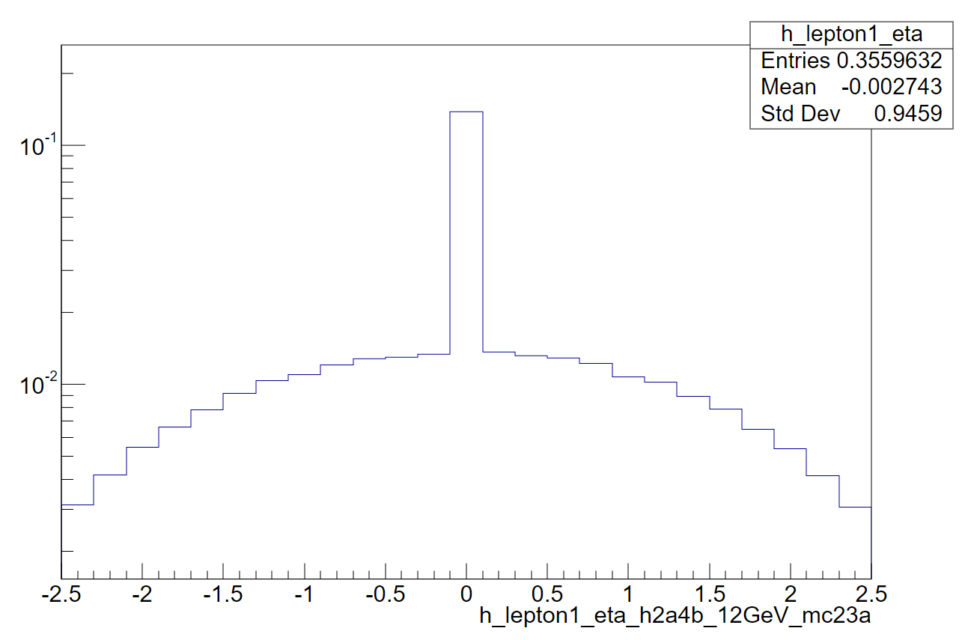
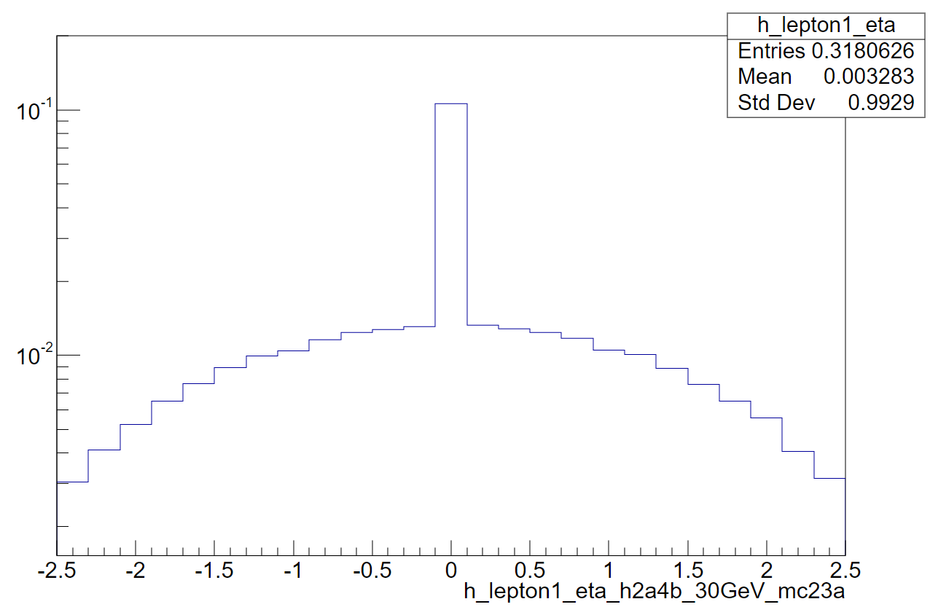
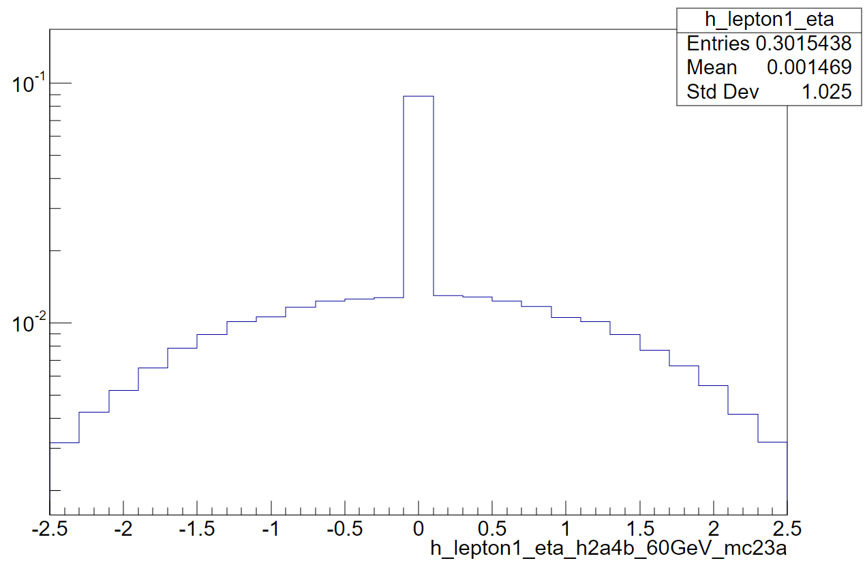
Lepton kinematics

Slide 15
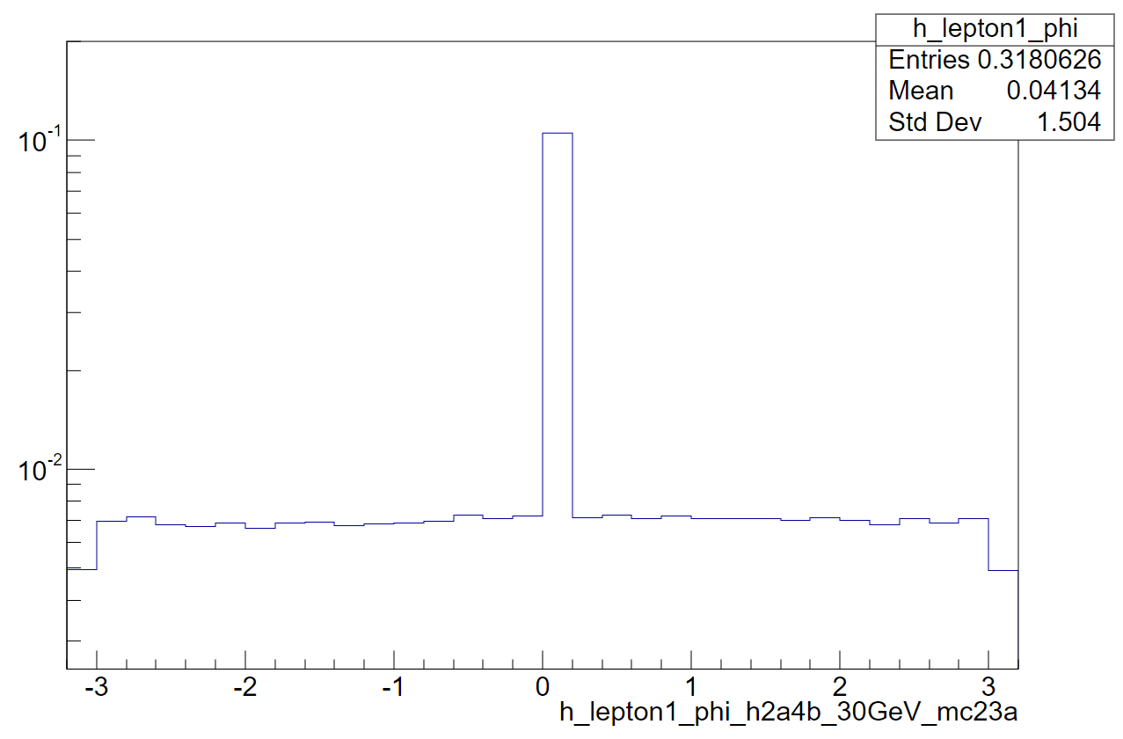
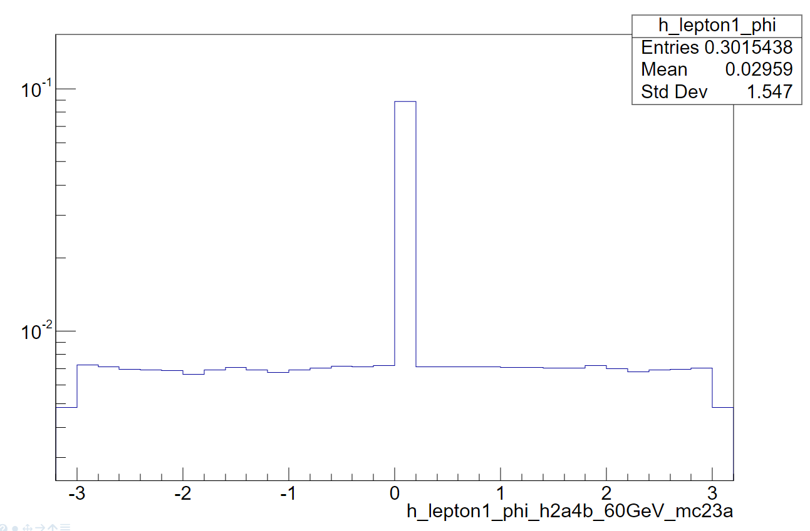
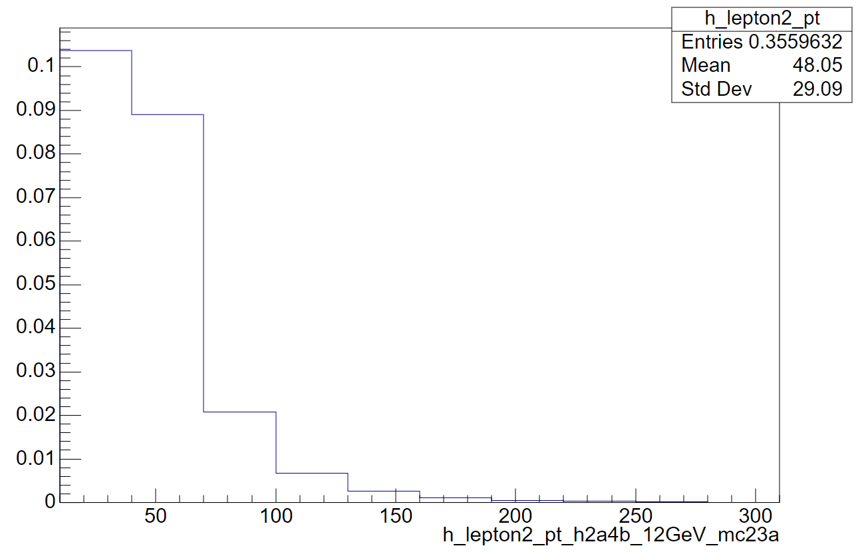
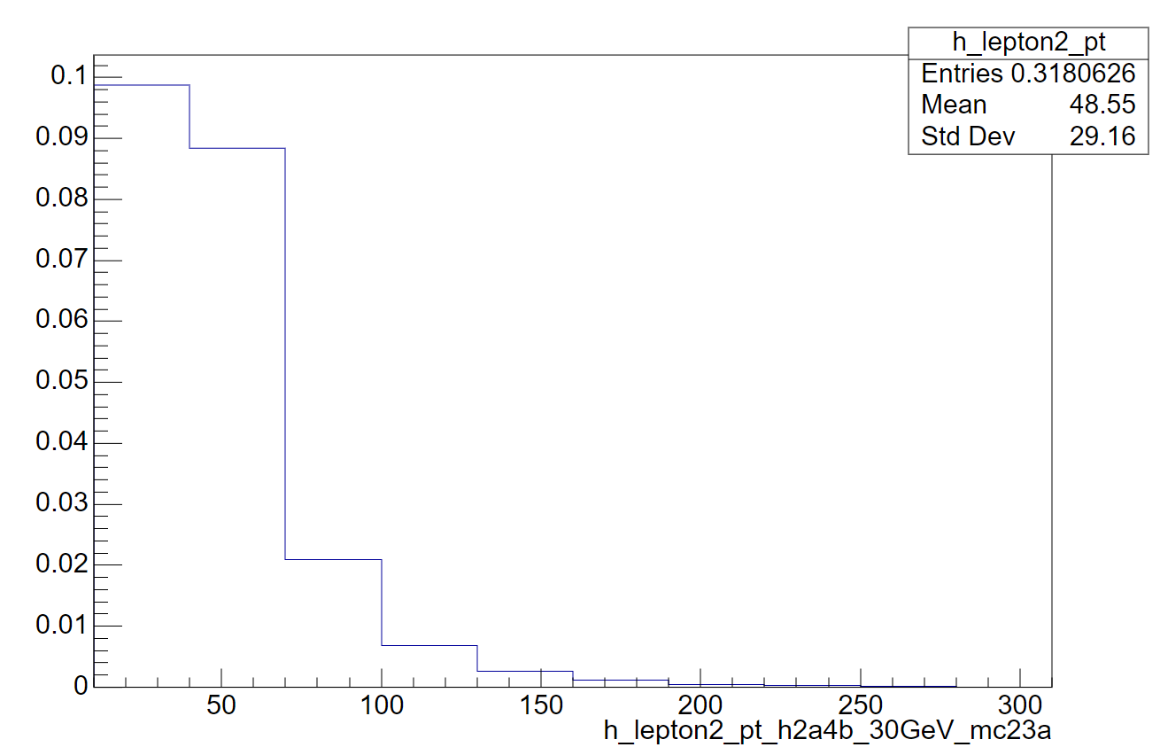
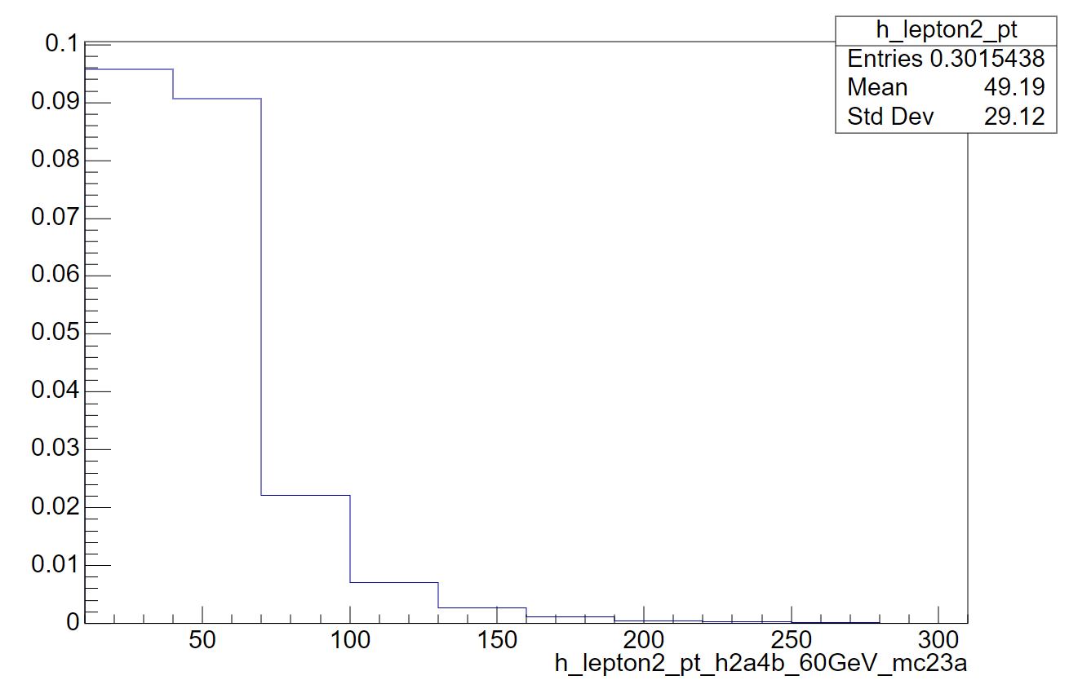
Lepton kinematics

Slide 16
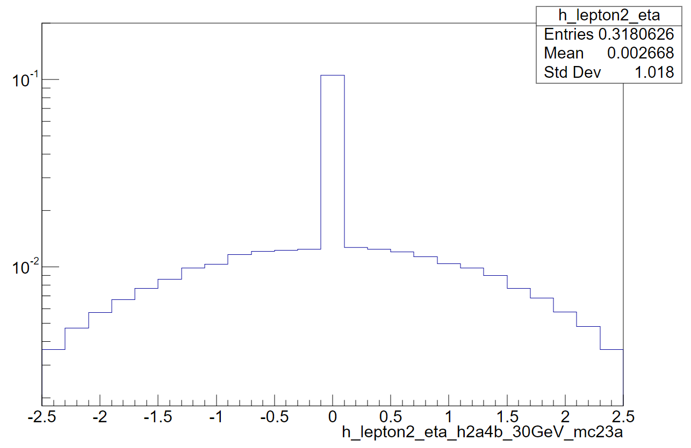
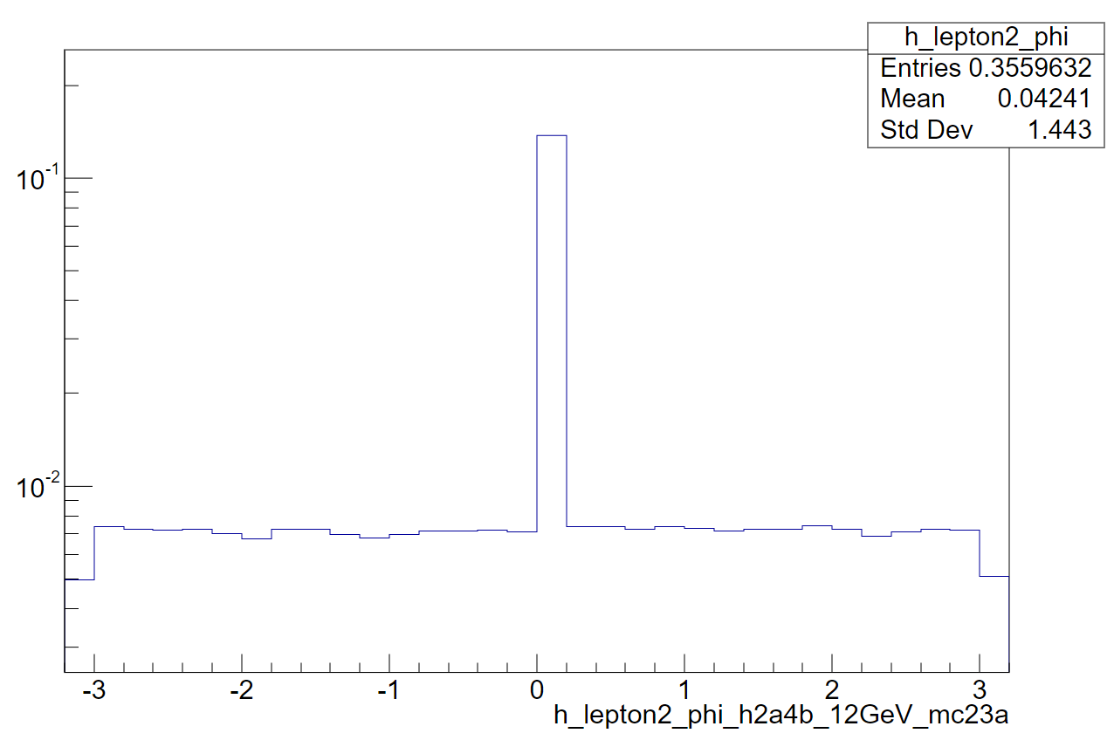
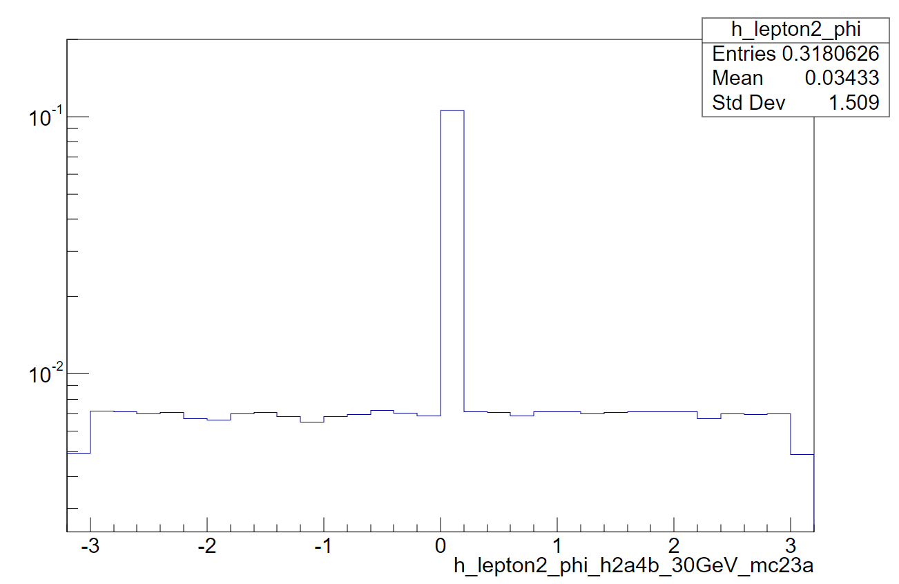
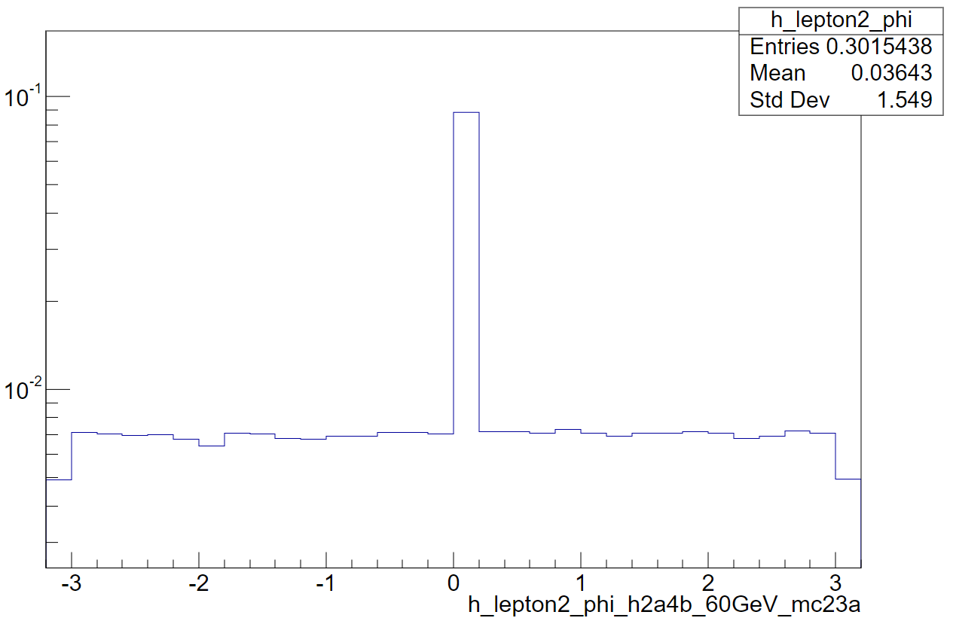
Lepton kinematics

Slide 17
Summary & Plans
Combine H2a4b anaylsis and mono-b/c anaylsis event preselection and get the cutflow
Get the final states kinematics
Jet:
The larger a mass , the more number of jets
pt < 300 GeV & a mass increase , jet pt decrease
Lepton:
pt < 300 GeV
Plans:
Plot 3 cases in one plot of variables and compare variables between different samples
Get the ntuple of bkg samples(ttbar)

