Slide 1
Computing and Open Data for future PandaX-xT
Xun Chen （谌勋）
TSUNG-DAO LEE INSTITUTE
PandaX-xT First Open Meeting
2025/4/10

Slide 2
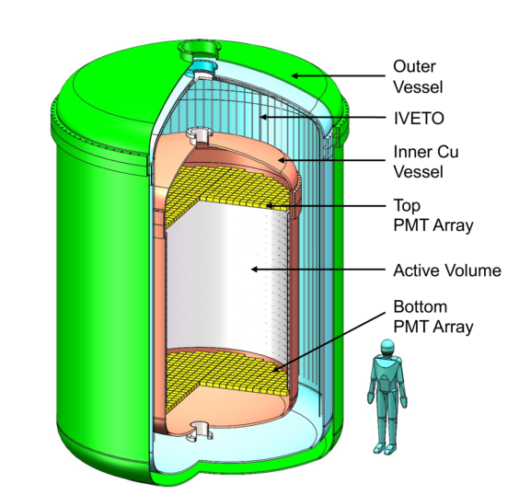
Outline
Data and Challenges
Computing Platforms
New data storage and new algorithms
Slow control
Open data
Summary

Slide 3
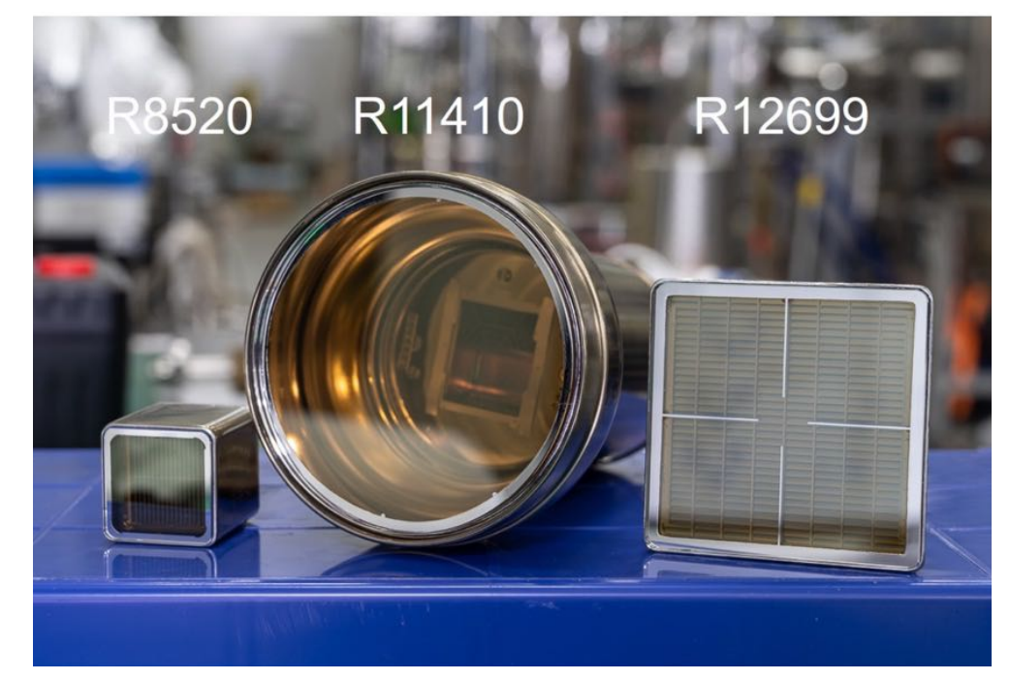
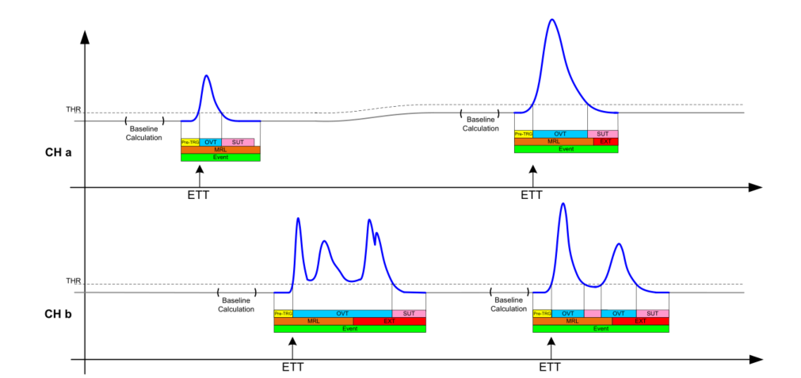
What data is recorded
Scintillation produced by interactions in liquid xenon is detected by PMT arrays operated in darkness.
Each PMT produces an analog voltage pulse proportional to the amount of detected light.
Readout signals are digitized into waveforms by fast electronics.
Waveforms with timestamp and channel information are recorded and stored.
digitizer

Slide 4
Challenges
500MHz sampling rate
~ 10⁴ channels
14 bit FADC
High data rate ~ 600 MB/s normally, 2-3GB/s for calibration
Large amount of readout channels
~ 10x data of PandaX-4T
10 PB/yr?
Data Storage write speed and capability
Data transfer network bandwidth
Data processing new algorithms
Money

Slide 5
Computing Platform
Laboratory
Chengdu Data Center
SJTU Network Center
Data Collection
Data Processing
Data Re-Processing
Temporary Storage
Data Analysis
Long-term Storage
Online Processing
Mid-term Storage
Simulation
Data Quality Monitoring
Stand-by Database
Simulation Database
Primary Database
Slow Control and Alerting
Analysis Database
Open Data

Slide 6
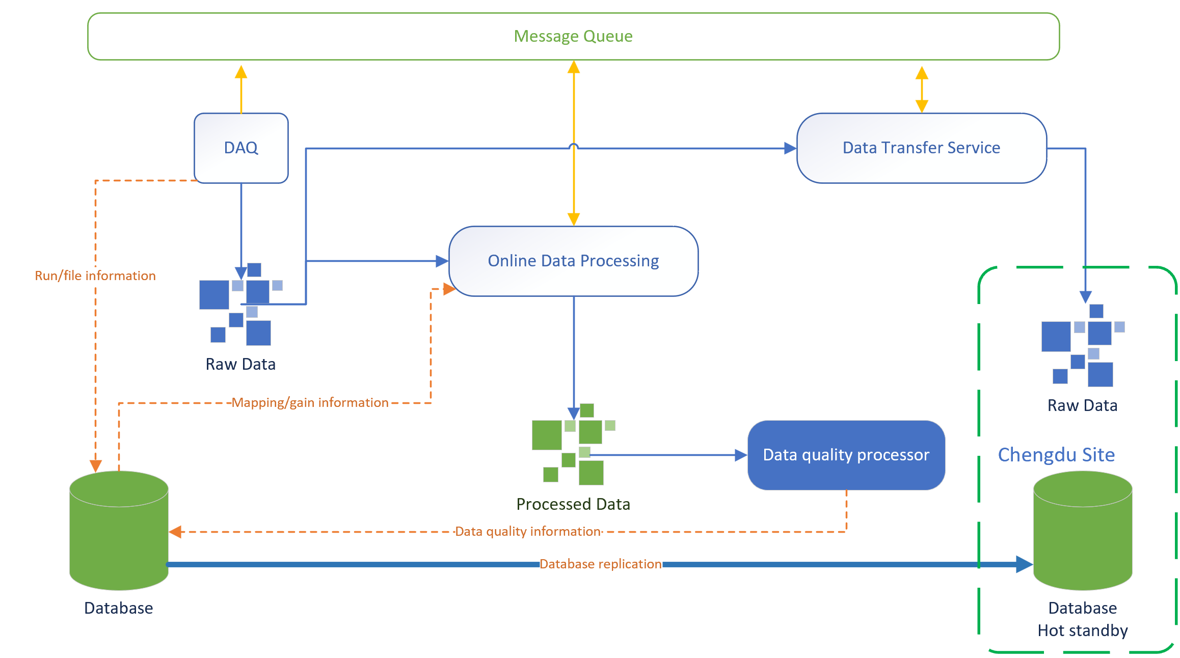
Inside the laboratory
Online processing
Automated
message queue
Database
Meta information
Data deletion
soon after transfer to Chengdu.
Network Bandwidth
Required: ~6 Gbps
Current: ~1.6 Gbps
1 dedicated 1Gbps (25k/M) + 1 normal enterprise 800 Mbps (2.8k/M)

Slide 7
Key update: raw data storage
source
source
source
Data collector
Current
signals from 10s to several minutes in a single file
Cons
Hard to write data into a single file when number of channels become large
Difficult for parallel processing
Plan
Splitting data into chunks organized by time and sources.
Update meta data database structure
Develop algorithms for parallel processing
data
data
data
source
source
source
data
data
data
data
data
data
data
data
data

Slide 8
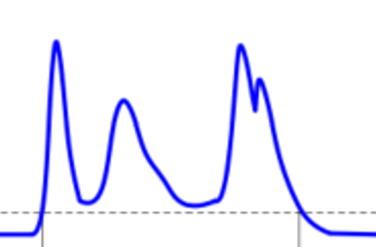
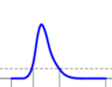
Data processing and reconstruction
Physics to data
Reconstruction to recover physics information
Voltage digitization
Waveform
Ionized electrons
Proportional scintillation
Particle scattering
recombination
Photoelectric effect
Excitations
Primary scintillation
Baseline subtraction and scaling with gain
Hit finding
waveform
Hit clustering
Physical event building
Signal Tagging
Signal building

Slide 9
Update of reconstruction
Previous implementation
File level parallelization
Linear within a file
Data format changed
Parallelization at different levels
New algorithms need to be developed
Waveform segment level parallelization
Time level
Baseline subtraction and scaling with gain
Hit finding
waveform
Hit clustering
Physical event building
Signal Tagging
Signal building
Time level
Signal level parallelization

Slide 10
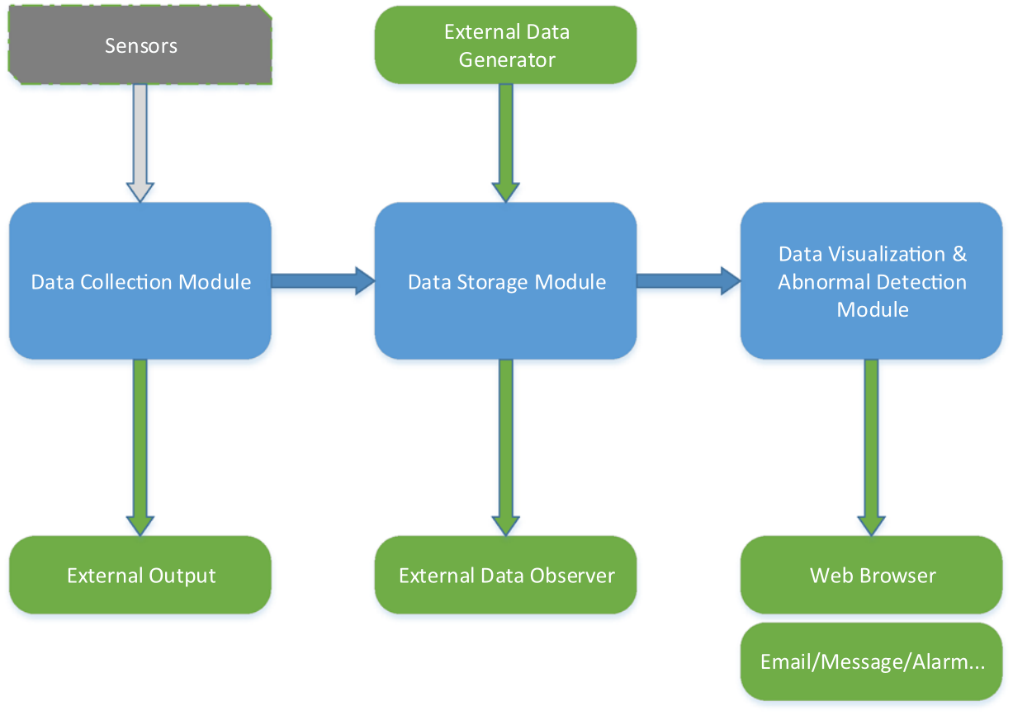
Slow control
Monitor the status of laboratory
Continue to use the framework in PandaX-4T
Python-based data collection
Data persistent in InfluxDB
Grafana interface
Custom alerting system for on-site and remote people
Improvement
More data sources
AI-based prediction and alerting

Slide 11
Open data
One of the major goal of PandaX-xT
Data levels – following the example of CERN
Level 3 – Data in tables, plots of published articles
Will be available together with the publication of papers
Can be accessed via the open data platform of SJTU https://scidata.sjtu.edu.cn
Level 2 – Selected data in the data sets used in plots/tables for publications
Can be used to interpret different models
Will be released after the publication of papers
Level 1 – Reconstructed data
Level 0 – Raw detector data (waveforms, trigger info)
Both levels are hard to use for people outside the collaboration
Will be released after the freezing of analysis

Slide 12
Open is not enough
Ultimate goal: the FAIR principle
Findable, Accessible, Interoperable and Reusable
Data preservation and management
New metadata information
Not limited to raw data, but applying to analysis data and simulation data
Software, analysis tools and documentation
Code repository
Tutorials and containers
Online analysis platform for model test with open data

Slide 13
Summary
The next generation of large-scale xenon detectors will bring significant computing challenges, including:
High-volume data storage
Increased network bandwidth demands
Complex processing and event reconstruction
Coordinated efforts will be essential to develop scalable solutions across these areas.
Furthermore, open data access will be a central goal for future experiments. Plans are underway to establish robust frameworks for data sharing, transparency, and community engagement.

