Slide 1
Status Report of Learning of Wγ Analysis
--Zhen Wang, Xi Wang

Slide 2
Brief list
Setup of analysis framework for WlnuGamVBS analysis
Monte Carlo data set samples
Preselection and some cut conditions transplanted from Wγγ production cross-section measurement
Some of the histogram results
Conclusion and next step

Slide 3
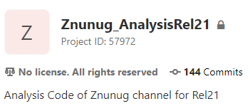
Setup of analysis framework
Utilize ZnunuGamVBS analysis framework to build WlnuGam analysis framework.
Using AnalysisBase/21.2.85 [cmake] with platform x86_64-centos7-gcc8-opt. (Xi talked about how we made this.)

Slide 4
Monte Carlo dataset samples for signal
~/HGam/source/ZnunuGamVBS_pack/data/mc16a.txt
mc16_13TeV.361273.MGPy8EG_NNPDF30LO_A14NNPDF23LO_Wenugamma2jEWK_Pty130.deriv.DAOD_EXOT6.e7307_s3126_r9364_p3654
mc16_13TeV.361274.MGPy8EG_NNPDF30LO_A14NNPDF23LO_Wmunugamma2jEWK_Pty130.deriv.DAOD_EXOT6.e7307_s3126_r9364_p3654
mc16_13TeV.361275.MGPy8EG_NNPDF30LO_A14NNPDF23LO_Wtaunugamma2jEWK_Pty130.deriv.DAOD_EXOT6.e7307_s3126_r9364_p3654

Slide 5
Monte Carlo dataset samples for background
Run as a trial
mc16_13TeV.364504.Sherpa_222_NNPDF30NNLO_eegamma_pty_140_E_CMS.deriv.DAOD_EXOT6.e5928_s3126_r9364_p3654
mc16_13TeV.364509.Sherpa_222_NNPDF30NNLO_mumugamma_pty_140_E_CMS.deriv.DAOD_EXOT6.e5928_s3126_r9364_p3654

Slide 6
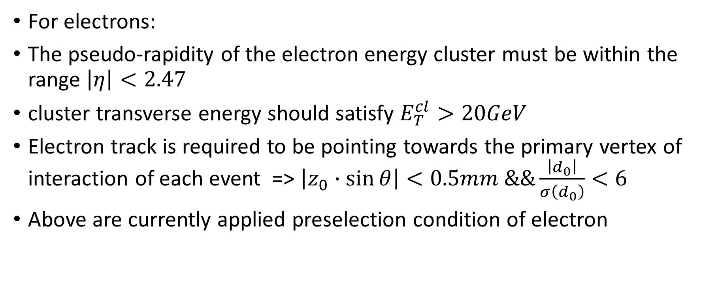
Preselection in the code
For electrons:
The pseudo-rapidity of the electron energy cluster must be within the range $\left|η\right|<2.47$
cluster transverse energy should satisfy $E_{T}^{cl}>20GeV$
Electron track is required to be pointing towards the primary vertex of interaction of each event => $\left|z_{0}∙\sin{θ}\right|<0.5mm \&\&\frac{\left|d_{0}\right|}{σ\left(d_{0}\right)}<6$
Above are currently applied preselection condition of electron

Slide 7
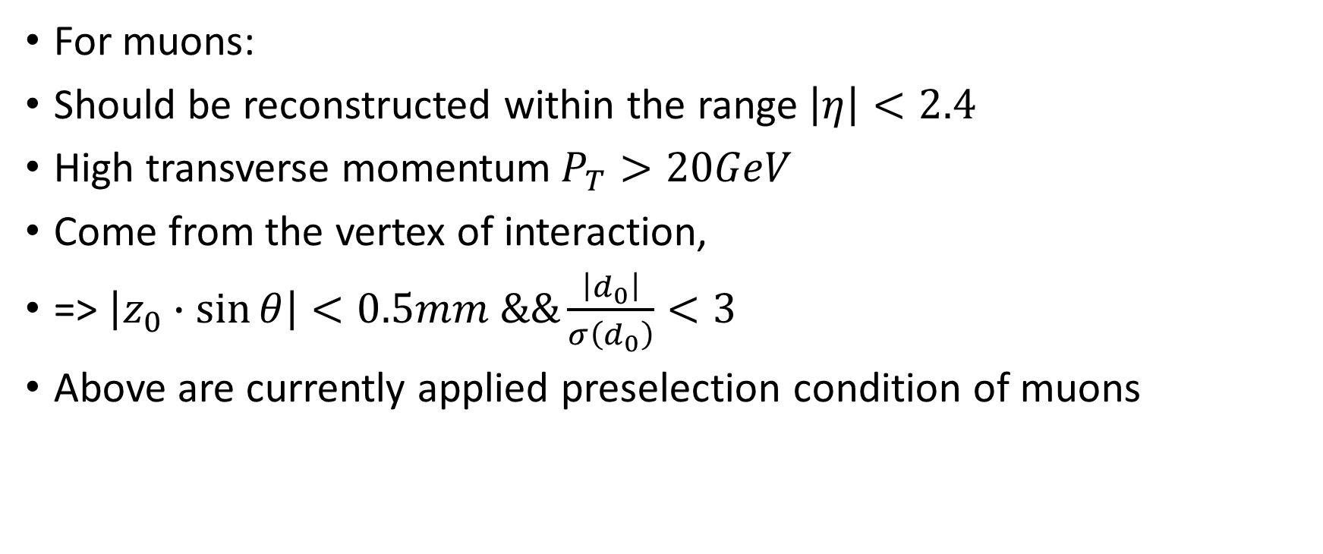
Preselection in the code
For muons:
Should be reconstructed within the range $\left|η\right|<2.4$
High transverse momentum$P_{T}>20GeV$
Come from the vertex of interaction,
=> $\left|z_{0}∙\sin{θ}\right|<0.5mm \&\&\frac{\left|d_{0}\right|}{σ\left(d_{0}\right)}<3$
Above are currently applied preselection condition of muons

Slide 8
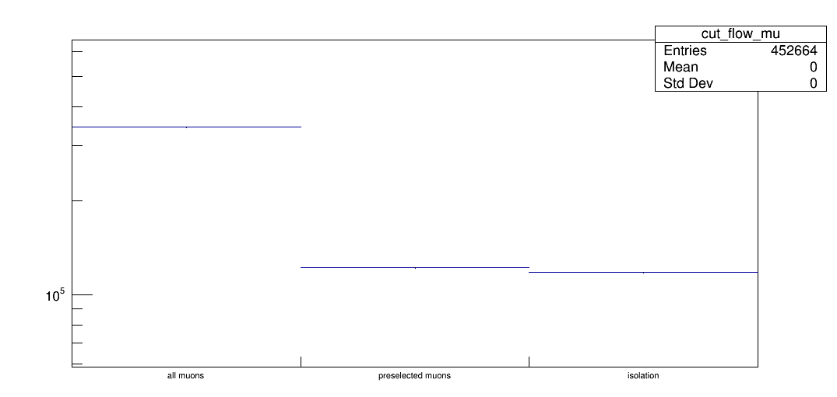
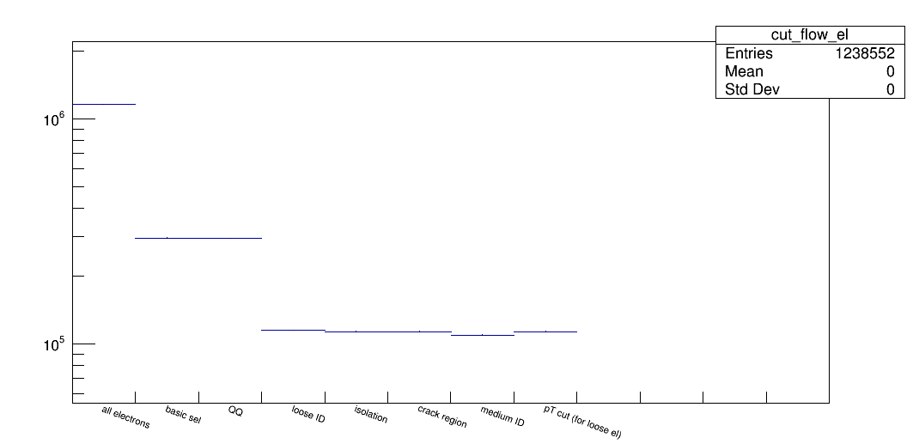
Number of muons from Wmunu sample
Cutflow
Number of electrons from Wenu sample

Slide 9
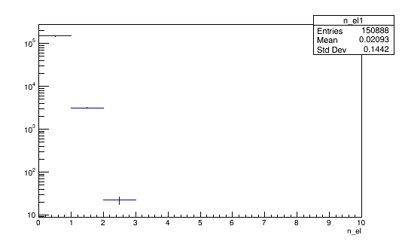
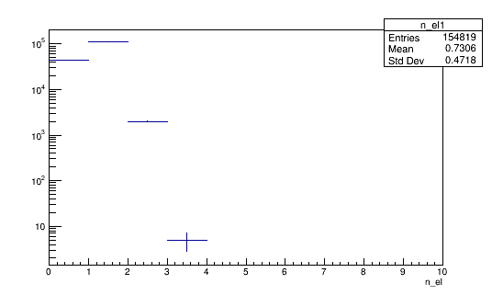
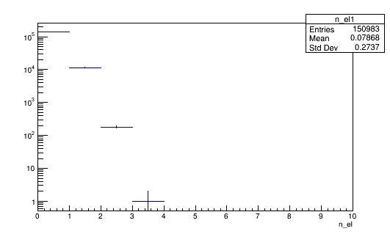
Number of Electrons in One Event after Selection
Wmunu
Preselection, OQ, PID, isolation cut, crack region cut, PID medium
Wenu
Wtaunu

Slide 10
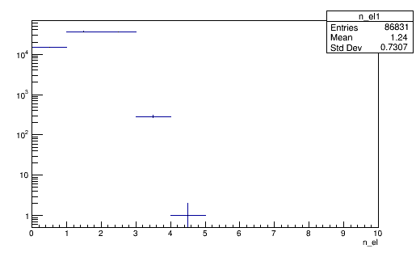
Number of Electrons in One Event after Selection
Preselection, OQ, PID, isolation cut, crack region cut, PID medium
eegamma sample
Pick out one electron events

Slide 11
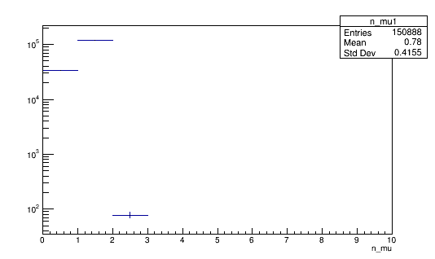
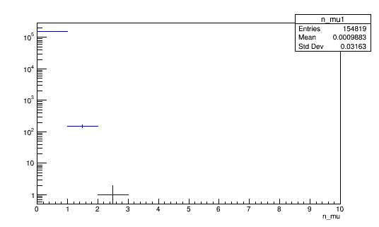
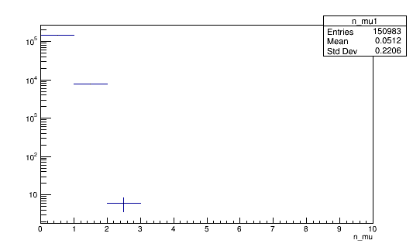
Number of Muons per Event after Selection
Wmunu
Preselection, Isolation cut
Wtaunu
Wenu

Slide 12
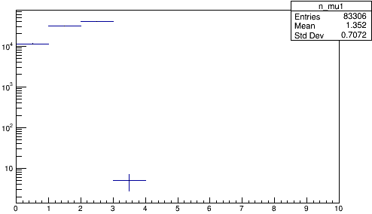
Number of Muons per Event after Selection
Preselection, Isolation cut
mumugamma sample

Slide 13
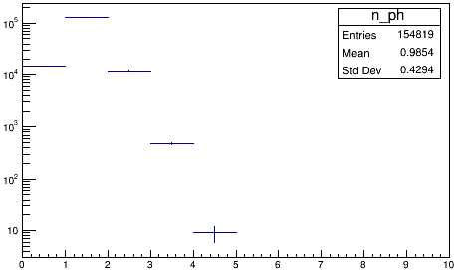
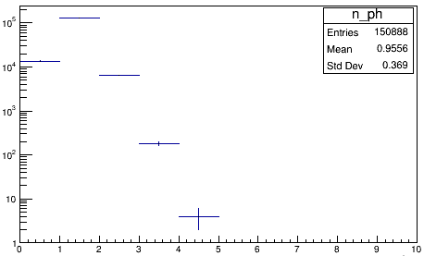
Number of photons
Clean PID
wenu sample
wmunu sample

Slide 14
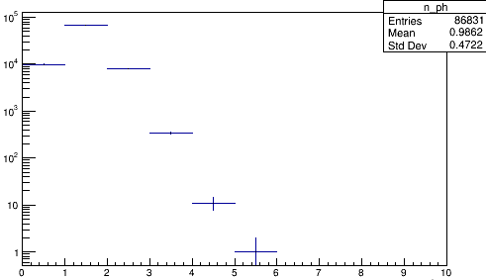
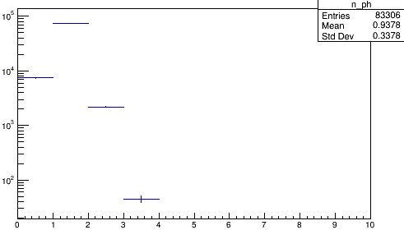
Number of photons
Clean PID
eegammawenu sample
mumugamma sample
Cannot see big difference between them, more study needed.

Slide 15
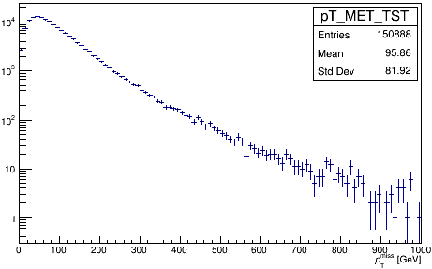
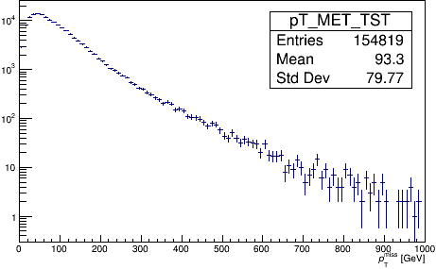
Missing Transverse Energy
Wmunu sample
Wenu sample
Thanks for Zirui’s help.

Slide 16
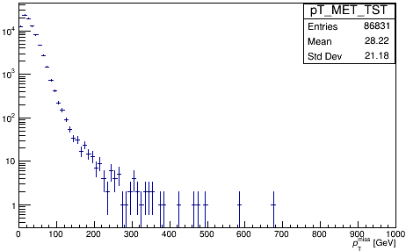
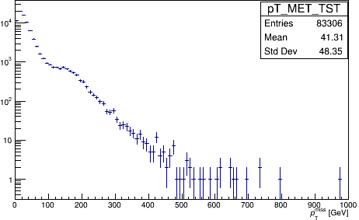
Missing Transverse Energy
eegamma sample
mumugamma sample
Difference is clear and we can optimize cut based on that

Slide 17
Conclusions and To Do
Apparently there are some single lepton events (enough or not?)
Some of the cut conditions mentioned in the Wγγ paper was not used in the code still learning
A lot more to learn transverse mass of two bodies?
how to reconstruct?

Slide 18
Conclusions and To Do optional
Run more signal and background events
Run some data collected
Make comparisons between MC modeling and real data
Optimize cut conditions by the power of resisting background

Slide 19
Thanks

Slide 20
Back up

Slide 21
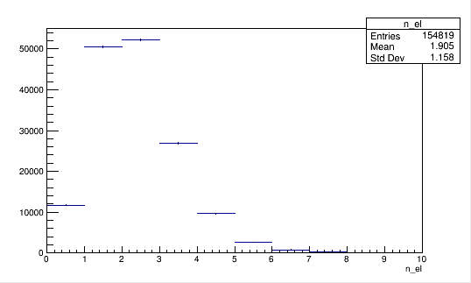
Histograms — wenu sample
Number of electrons
After preselection

Slide 22
Histograms — wenu sample
Number of electrons
After more selection
--OQ
--PID
--Isolation Cut
--crack region Cut
--PID medium

Slide 23
Histograms — wenu sample
Number of muons after
--Preselection
--Isolation Cut

Slide 24
Histograms — wmunu sample
Number of electrons after
--Preselection
--OQ
--PID
--Isolation Cut
--crack region Cut
--PID medium

Slide 25
Histograms — wmunu sample
Number of muons after
--Preselection
--Isolation Cut

Slide 26
Histograms — wtaunu sample
Number of electrons after
--Preselection
--OQ
--PID
--Isolation Cut
--crack region Cut
--PID medium

Slide 27
Histograms — wtaunu sample
Number of muons after
--Preselection
--Isolation Cut

