Slide 1

MedGraph with UFO model simulation
2020.11.23
Reporter：
Wu Yanda

Slide 2
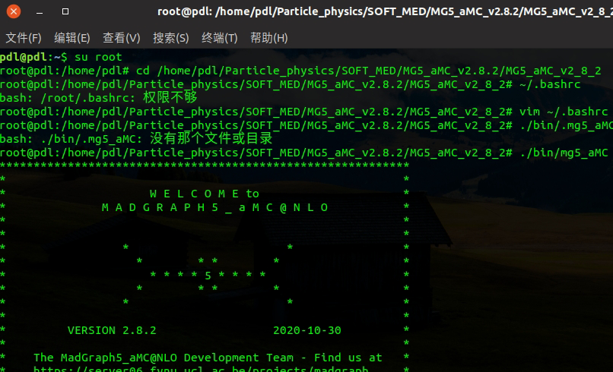
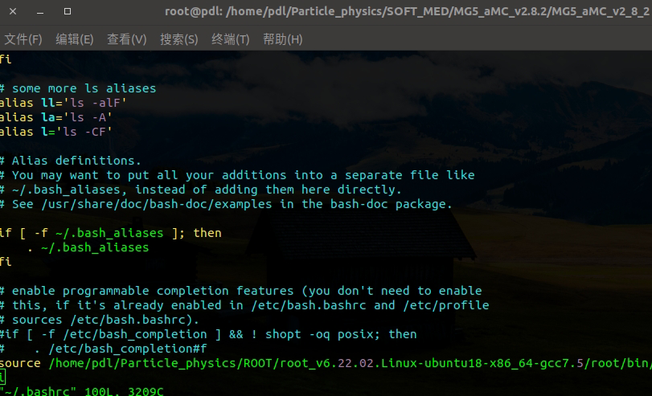
Simulation process
1. Set the MG5_aMC and ~/.bashrc

Slide 3
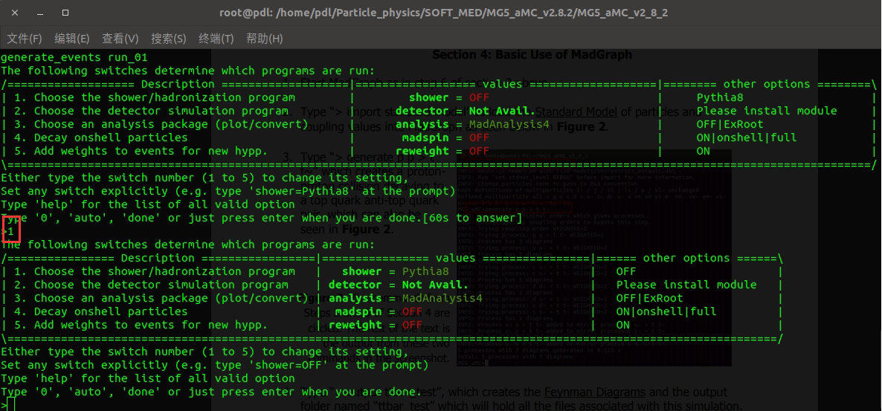
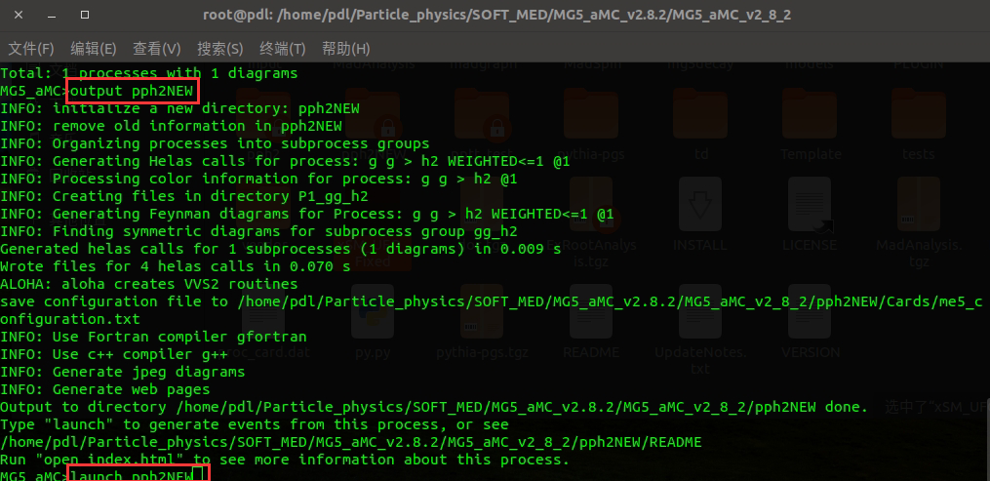
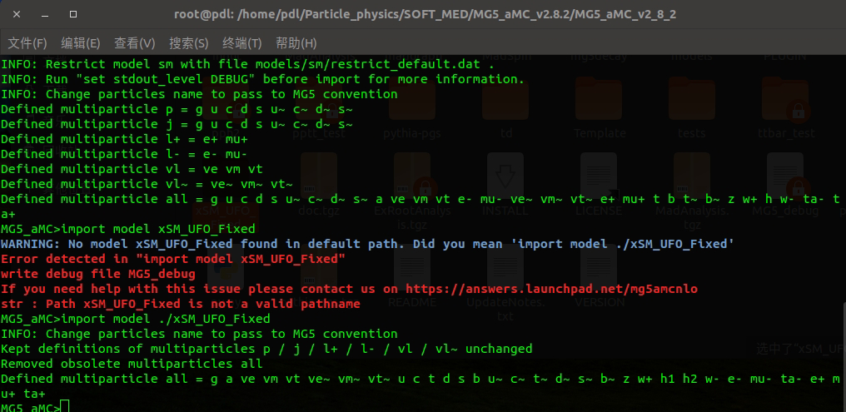
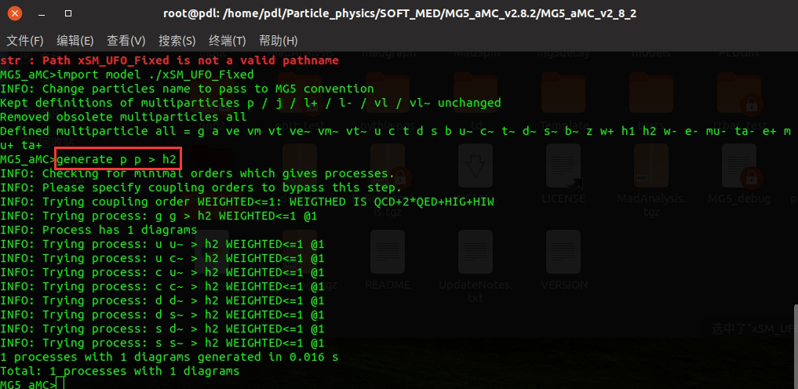
Simulation process
2. Import the UFO model and simulate p p > h2

Slide 4
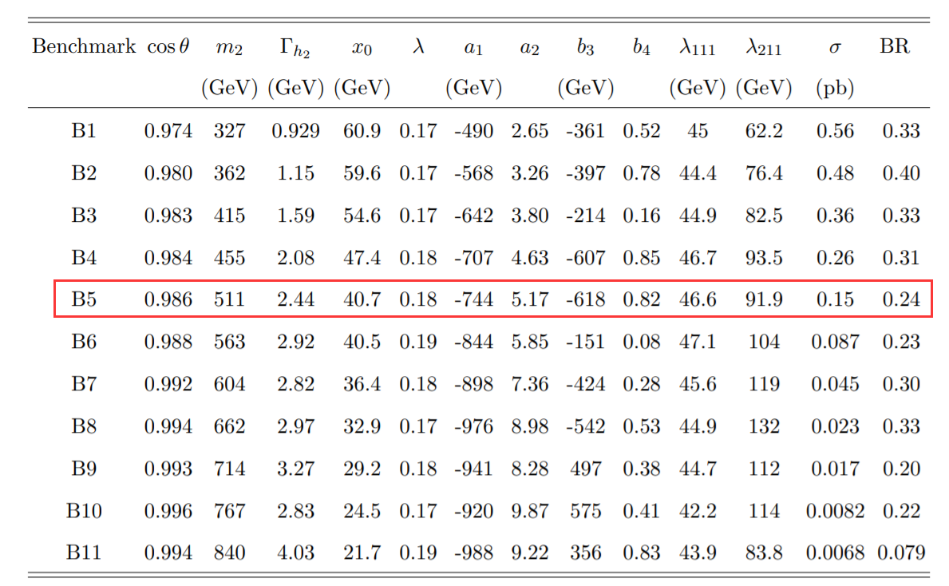
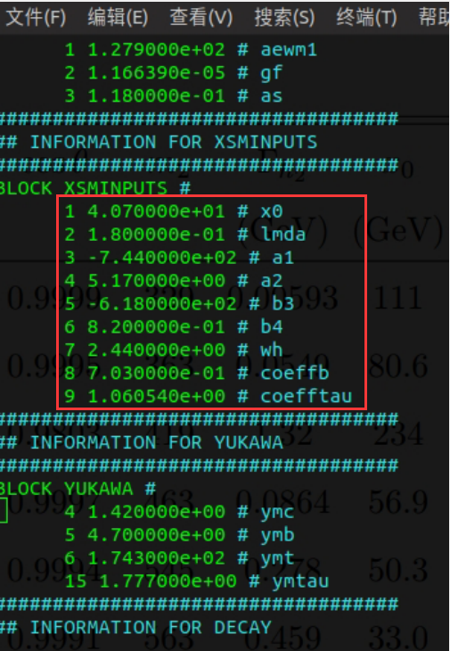
Simulation process
3. Replace the param_card.dat and change parameter in run_card.dat

Slide 5
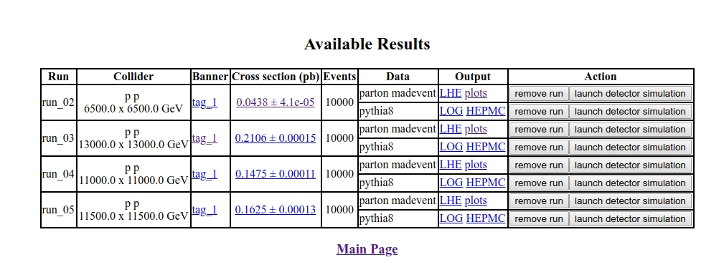
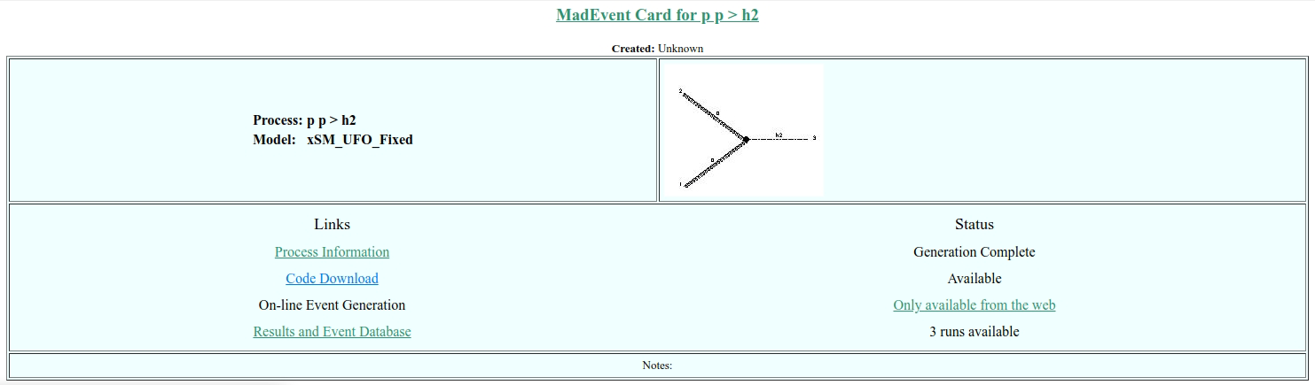
Simulation process
3. Replace the param_card.dat and change parameter in run_card.dat
Result:file:///home/pdl/Particle_physics/SOFT_MED/MG5_aMC_v2.8.2/MG5_aMC_v2_8_2/pph2NEW/index.html

Slide 6
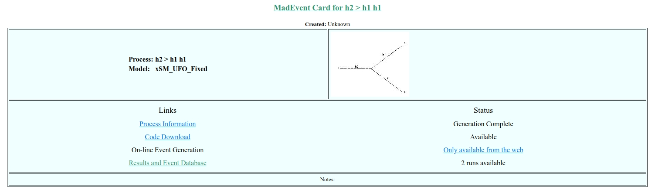
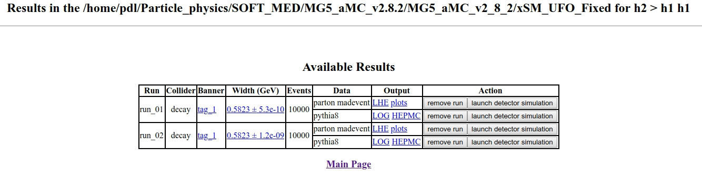
Simulation process
4. Simulate h2 > h1 h1

