Slide 1
H2a4b updates
--Zelin Yan

Slide 2
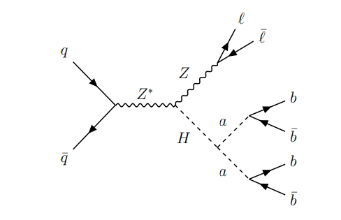
Analysis overview
Process:ZH,H→2a→4b,Z→ll
Compare different btag WP
GN2v01_FixedCutBEff_85
GN2v01_FixedCutBEff_77
GN2v01_FixedCutBEff_65
lepton-jet pair mass distribution to get rid of ttbar

Slide 3
Signal vs bkg
Easyjet event preselection
Jet：reco4PFlowJet; pt > 20GeV; |η| < 4.5; Btag_wp:GN2v01_FixedCutBEff_85/77/65
2-lep: singlep. Trigger + dilep. Trigger; exactly 2 leptons and anti-flavour;
Electron: ID: MediumLH; Iso：Tight_VarRad; pt > 10GeV; |η| < 2.47 & excluding 1.37 < |η| < 1.52
Muon: ID: Tight; Iso:PflowLoose_VarRad ; pt > 10GeV ; |η| < 2.5
Ntuple event preselection
Singlelep. Triggers + dilep. Triggers
At least 2 jets
Lepton Cut:
Exactly 2 leptons
Leading lep. pt > 27 GeV & sub-leading lep. pt > 10GeV
Electron: |η| < 2.47 & excluding 1.37 < |η| < 1.52
Muon: |η| < 2.5
Tight jet cut: pt > 20GeV ; |η| < 2.5 ; jet cleaning
Dilepton mass window: 85GeV < mll < 110GeV(tight)

Slide 4
Signal n_bjets vs n_jets:(n_bjets,n_jets)
12GeV | (0,2) | (0,3) | (0,≥4) | (1,2) | (1,3) | (1,≥4) | (2,2) | (2,3) | (2,≥4) | (3,3) | (3,≥4) | (≥4,≥4)
WP_85 | 0.01 | 0.01 | -- | 0.17 | 0.11 | 0.09 | 0.21 | 0.17 | 0.18 | -- | -- | --
WP_77 | 0.02 | 0.01 | 0.01 | 0.19 | 0.13 | 0.10 | 0.18 | 0.15 | 0.17 | -- | -- | --
WP_65 | 0.04 | 0.03 | 0.02 | 0.22 | 0.15 | 0.15 | 0.14 | 0.11 | 0.14 | -- | -- | --
30GeV | (0,2) | (0,3) | (0,≥4) | (1,2) | (1,3) | (1,≥4) | (2,2) | (2,3) | (2,≥4) | (3,3) | (3,≥4) | (≥4,≥4)
WP_85 | 0.03 | 0.02 | 0.02 | 0.14 | 0.12 | 0.12 | 0.12 | 0.12 | 0.16 | 0.04 | 0.07 | --
WP_77 | 0.04 | 0.03 | 0.03 | 0.15 | 0.13 | 0.15 | 0.10 | 0.11 | 0.13 | 0.03 | 0.06 | --
WP_65 | 0.07 | 0.06 | 0.06 | 0.16 | 0.14 | 0.17 | 0.07 | 0.08 | 0.13 | 0.02 | 0.04 | --
60GeV | (0,2) | (0,3) | (0,≥4) | (1,2) | (1,3) | (1,≥4) | (2,2) | (2,3) | (2,≥4) | (3,3) | (3,≥4) | (≥4,≥4)
WP_85 | 0.04 | 0.03 | 0.02 | 0.13 | 0.11 | 0.12 | 0.11 | 0.12 | 0.16 | 0.04 | 0.09 | 0.01
WP_77 | 0.05 | 0.04 | 0.04 | 0.13 | 0.12 | 0.15 | 0.09 | 0.10 | 0.17 | 0.03 | 0.07 | --
WP_65 | 0.08 | 0.06 | 0.07 | 0.14 | 0.14 | 0.18 | 0.06 | 0.08 | 0.13 | 0.02 | 0.04 | --

Slide 5
bkg n_bjets vs n_jets:(n_bjets,n_jets)
sin.lep. | (0,2) | (0,3) | (0,≥4) | (1,2) | (1,3) | (1,≥4) | (2,2) | (2,3) | (2,≥4) | (3,3) | (3,≥4) | (≥4,≥4)
WP_85 | 0.08 | 0.05 | 0.03 | 0.25 | 0.17 | 0.16 | 0.06 | 0.07 | 0.10 | -- | -- | --
WP_77 | 0.10 | 0.07 | 0.06 | 0.24 | 0.17 | 0.17 | 0.04 | 0.06 | 0.08 | -- | -- | --
WP_65 | 0.14 | 0.09 | 0.08 | 0.22 | 0.16 | 0.16 | 0.03 | 0.04 | 0.06 | -- | -- | --
ttbar | (0,2) | (0,3) | (0,≥4) | (1,2) | (1,3) | (1,≥4) | (2,2) | (2,3) | (2,≥4) | (3,3) | (3,≥4) | (≥4,≥4)
WP_85 | 0.03 | 0.02 | 0.03 | 0.12 | 0.12 | 0.16 | 0.10 | 0.13 | 0.25 | -- | -- | --
WP_77 | 0.04 | 0.04 | 0.04 | 0.12 | 0.14 | 0.21 | 0.08 | 0.11 | 0.20 | -- | -- | --
WP_65 | 0.06 | 0.06 | 0.08 | 0.13 | 0.14 | 0.23 | 0.06 | 0.08 | 0.14 | -- | -- | --
ttH | (0,2) | (0,3) | (0,≥4) | (1,2) | (1,3) | (1,≥4) | (2,2) | (2,3) | (2,≥4) | (3,3) | (3,≥4) | (≥4,≥4)
WP_85 | -- | 0.01 | 0.04 | 0.01 | 0.04 | 0.23 | 0.01 | 0.04 | 0.36 | 0.01 | 0.19 | 0.08
WP_77 | -- | 0.01 | 0.07 | 0.01 | 0.04 | 0.27 | 0.01 | 0.03 | 0.33 | 0.01 | 0.14 | 0.05
WP_65 | 0.01 | 0.02 | 0.11 | 0.01 | 0.04 | 0.35 | -- | 0.03 | 0.30 | 0.01 | 0.12 | 0.03

Slide 6
bkg n_bjets vs n_jets:(n_bjets,n_jets)
ttZqq | (0,2) | (0,3) | (0,≥4) | (1,2) | (1,3) | (1,≥4) | (2,2) | (2,3) | (2,≥4) | (3,3) | (3,≥4) | (≥4,≥4)
WP_85 | -- | 0.01 | 0.06 | 0.01 | 0.05 | 0.30 | 0.01 | 0.04 | 0.38 | -- | 0.11 | 0.03
WP_77 | -- | 0.02 | 0.09 | 0.01 | 0.06 | 0.35 | -- | 0.03 | 0.34 | -- | 0.07 | --
WP_65 | 0.01 | 0.03 | 0.15 | 0.01 | 0.05 | 0.43 | -- | 0.02 | 0.24 | -- | 0.04 | --
Z+jets | (0,2) | (0,3) | (0,≥4) | (1,2) | (1,3) | (1,≥4) | (2,2) | (2,3) | (2,≥4) | (3,3) | (3,≥4) | (≥4,≥4)
WP_85 | 0.49 | 0.23 | 0.17 | 0.05 | 0.03 | 0.02 | -- | -- | -- | -- | -- | --
WP_77 | 0.51 | 0.24 | 0.18 | 0.03 | 0.02 | 0.01 | -- | -- | -- | -- | -- | --
WP_65 | 0.52 | 0.24 | 0.19 | 0.02 | 0.01 | 0.01 | -- | -- | -- | -- | -- | --

Slide 7
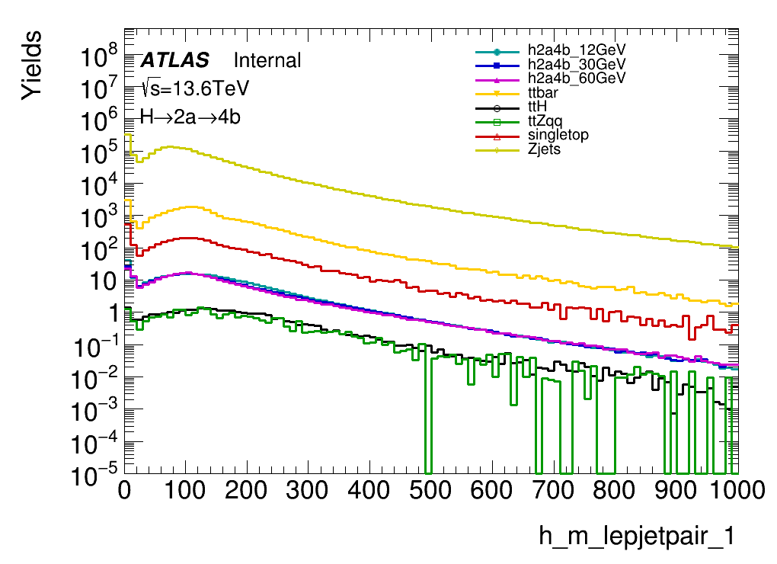
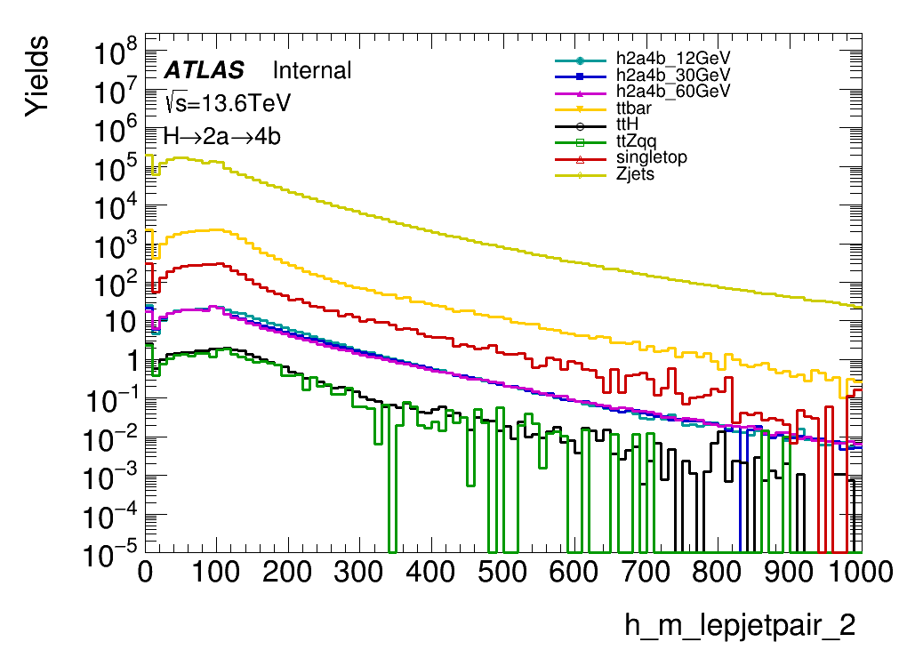
Lepton-jet pair mass distribution(normalized to xsc*lumi)

Slide 8
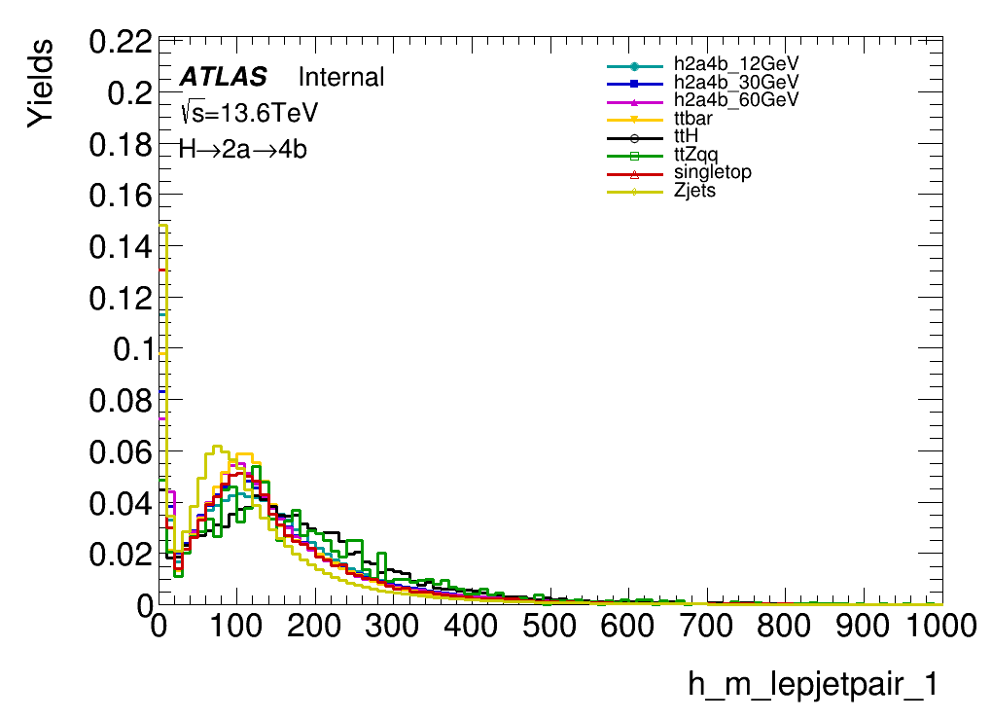
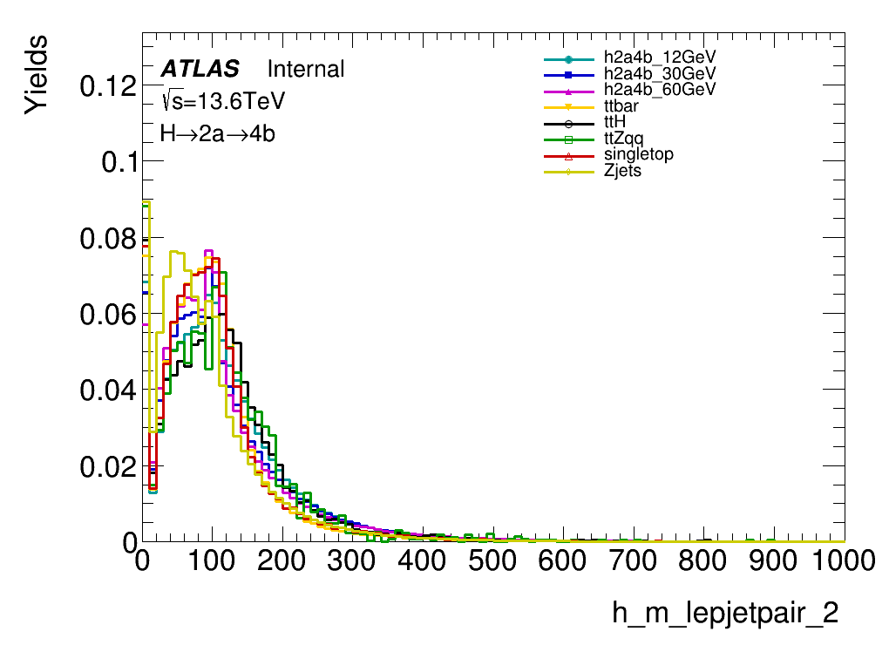
Lepton-jet pair mass distribution(normalized to 1)

Slide 9
Summary & Plans
n_bjets vs n_jets distribution are different in low mass and high mass signal
In jet-lepton pair mass reconstruction, ttbar are not significantly separated from singal samples and other bkg samples
Plans:
Use n_bjets vs n_jets of different btag_WP to define initial SRs & CRs
Reconstruct b-jets invariant mass distribution to see how well we can recover the higgs mass (also separate the signal from ttH, ttzqq).

