Slide 1
H2a4b updates
--Zelin Yan

Slide 2
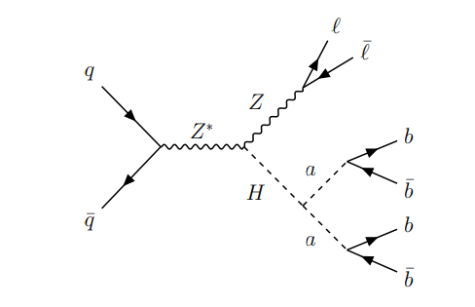
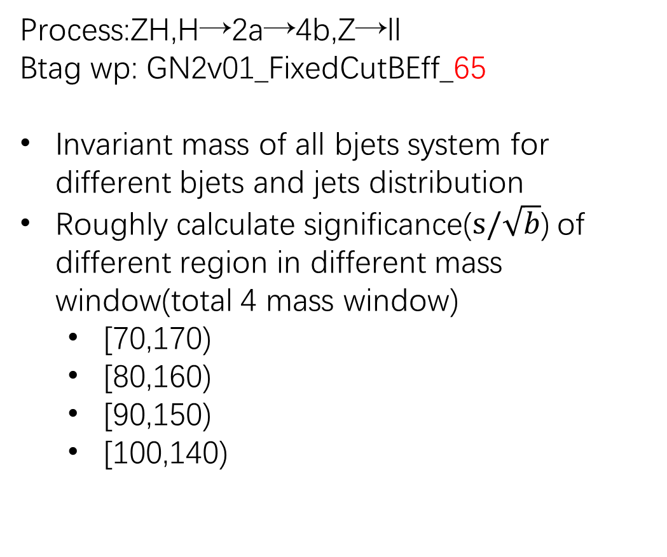
Analysis overview
Process:ZH,H→2a→4b,Z→ll
Btag wp: GN2v01_FixedCutBEff_65
Invariant mass of all bjets system for different bjets and jets distribution
Roughly calculate significance($s/\sqrt{b}$) of different region in different mass window(total 4 mass window)
[70,170)
[80,160)
[90,150)
[100,140)

Slide 3
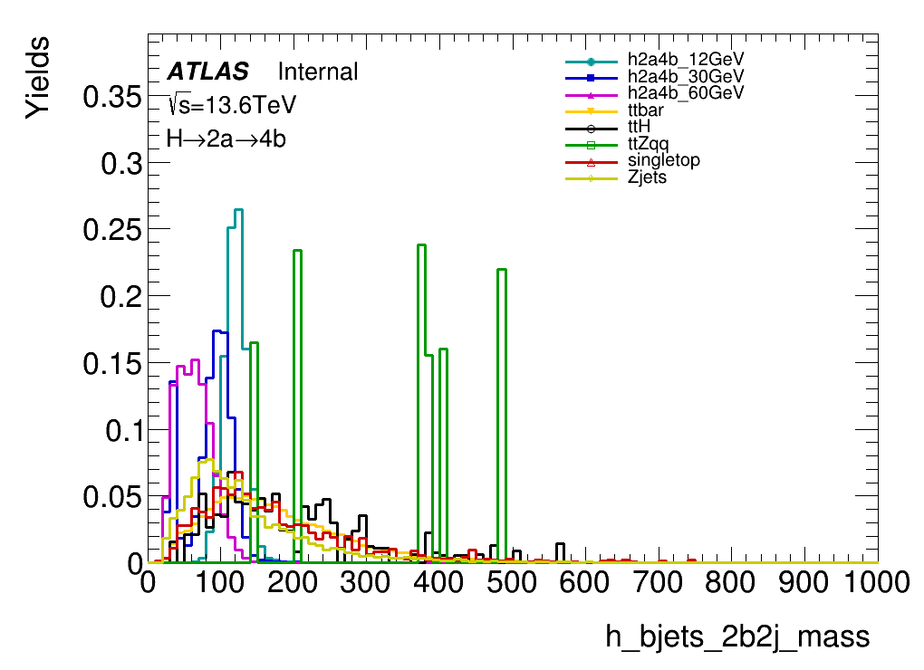
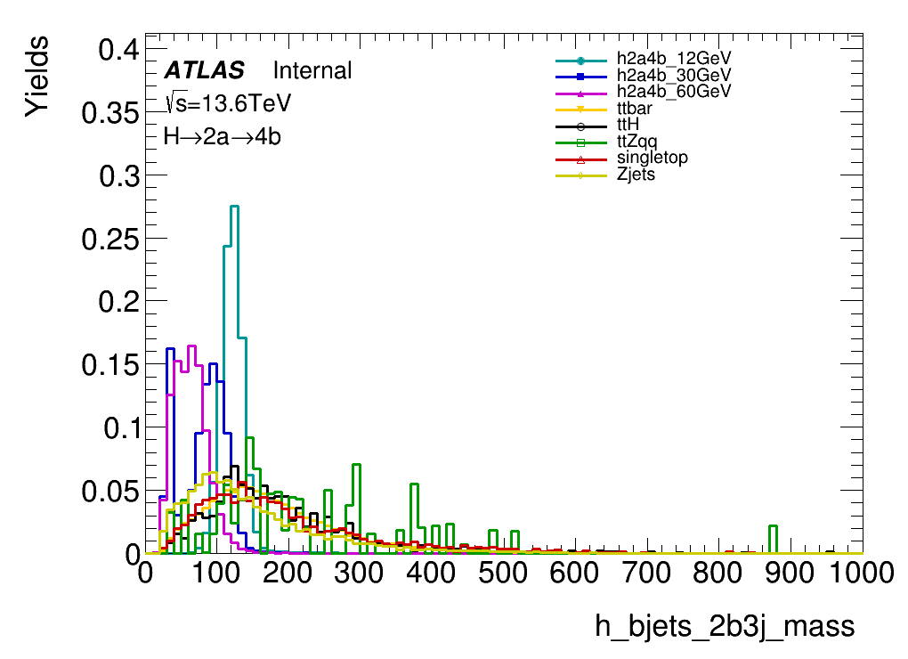
All bjets mass distribution in different region

Slide 4
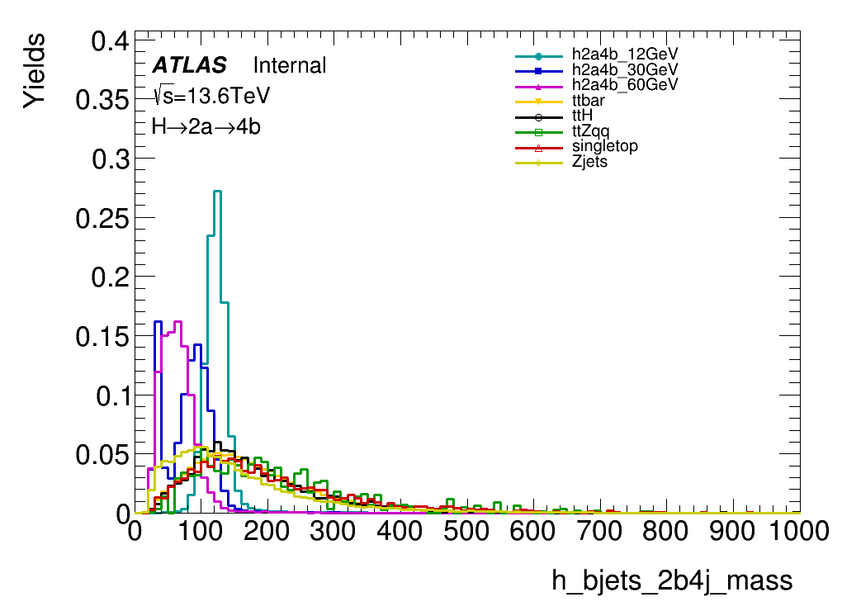
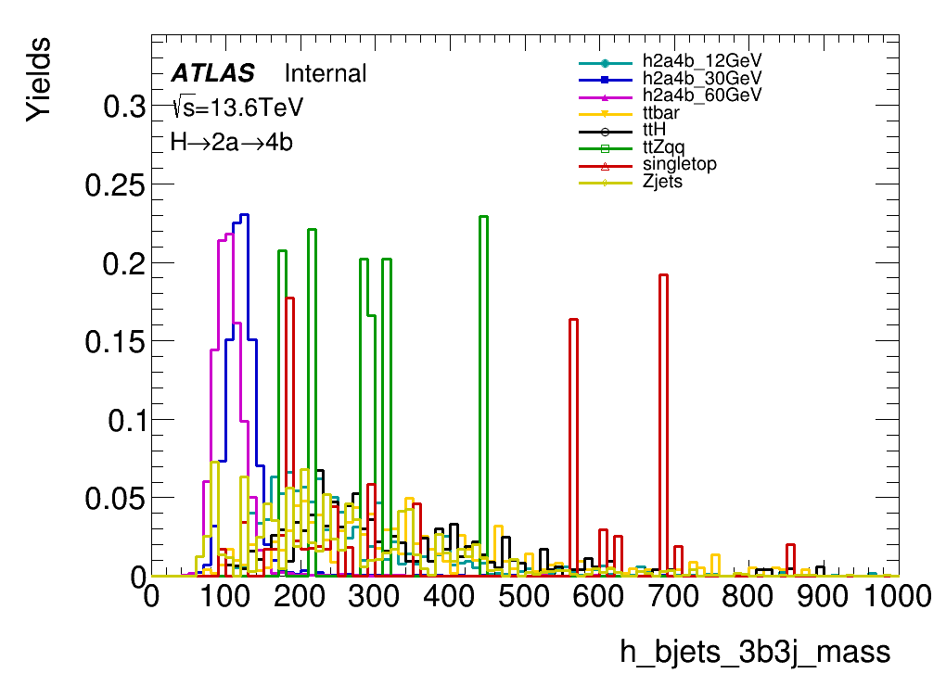
All bjets mass distribution in different region

Slide 5
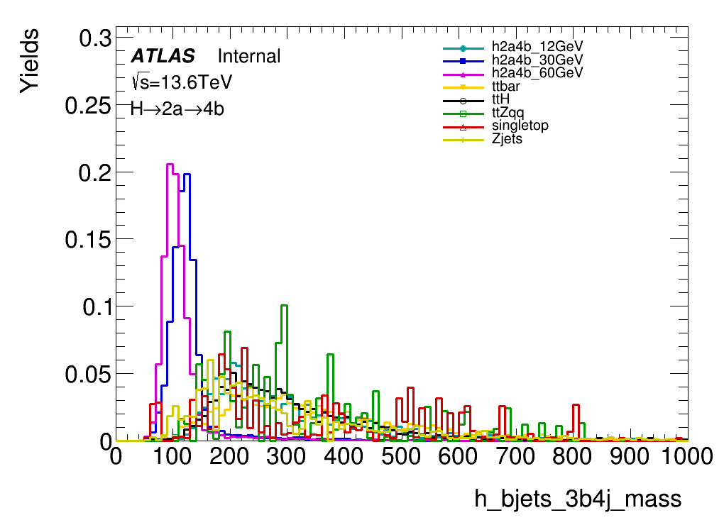
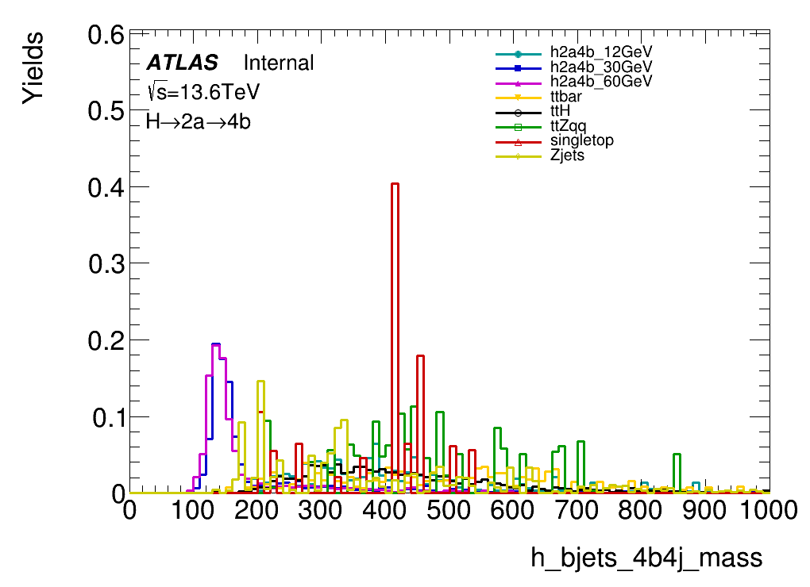
All bjets mass distribution in different region

Slide 6
Significance result in different region
[70,170) | 1b2j | 1b3j | 1b4j | 2b2j | 2b3j | 2b4j | 3b3j | 3b4j | 4b4j
12GeV | 0.044 | 0.031 | 0.025 | 0.727 | 0.659 | 0.663 | 0.018 | 0.022 | 0
30GeV | 0.093 | 0.067 | 0.046 | 0.228 | 0.284 | 0.393 | 1.162 | 1.39 | 1.396
60GeV | 0.179 | 0.135 | 0.091 | 0.088 | 0.132 | 0.214 | 1.042 | 1.487 | 1.697
[80,160) | 1b2j | 1b3j | 1b4j | 2b2j | 2b3j | 2b4j | 3b3j | 3b4j | 4b4j
12GeV | 0.055 | 0.039 | 0.032 | 0.799 | 0.718 | 0.722 | 0.013 | 0.016 | 0
30GeV | 0.102 | 0.073 | 0.054 | 0.225 | 0.268 | 0.366 | 1.289 | 1.548 | 1.778
60GeV | 0.157 | 0.12 | 0.082 | 0.062 | 0.086 | 0.144 | 1.101 | 1.598 | 2.239

Slide 7
Significance result in different region
[90,150) | 1b2j | 1b3j | 1b4j | 2b2j | 2b3j | 2b4j | 3b3j | 3b4j | 4b4j
12GeV | 0.065 | 0.049 | 0.038 | 0.887 | 0.792 | 0.795 | 0.013 | 0.012 | 0
30GeV | 0.106 | 0.081 | 0.06 | 0.205 | 0.235 | 0.318 | 1.655 | 1.646 | 2.841
60GeV | 0.118 | 0.101 | 0.069 | 0.04 | 0.053 | 0.089 | 1.249 | 1.522 | 4.026
[100,140) | 1b2j | 1b3j | 1b4j | 2b2j | 2b3j | 2b4j | 3b3j | 3b4j | 4b4j
12GeV | 0.077 | 0.065 | 0.043 | 0.934 | 0.849 | 0.849 | 0.009 | 0.007 | 0
30GeV | 0.113 | 0.096 | 0.057 | 0.164 | 0.189 | 0.252 | 1.668 | 1.71 | 1.782
60GeV | 0.103 | 0.093 | 0.053 | 0.025 | 0.033 | 0.055 | 1.043 | 1.328 | 2.816

Slide 8
Significance result in different mass window

Slide 9
Significance result in different mass window

Slide 10
Summary & Plans
For 12GeV, 2 bjets regions have higher significance while 3&4 bjets regions have higher significance in 30GeV and 60GeV cases.
In some events, 2bjets are reconstructed to singlet a(30GeV and 60GeV cases)
Plans
define SR & CR

Slide 11
Signal vs bkg
Easyjet event preselection
Jet：reco4PFlowJet; pt > 20GeV; |η| < 4.5; Btag_wp:GN2v01_FixedCutBEff_65
2-lep: singlep. Trigger + dilep. Trigger; exactly 2 leptons and anti-flavour;
Electron: ID: MediumLH; Iso：Tight_VarRad; pt > 10GeV; |η| < 2.47 & excluding 1.37 < |η| < 1.52
Muon: ID: Tight; Iso:PflowLoose_VarRad ; pt > 10GeV ; |η| < 2.5
Ntuple event preselection
Singlelep. Triggers + dilep. Triggers
At least 2 jets
Lepton Cut:
Exactly 2 leptons
Leading lep. pt > 27 GeV & sub-leading lep. pt > 10GeV
Electron: |η| < 2.47 & excluding 1.37 < |η| < 1.52
Muon: |η| < 2.5
Tight jet cut: pt > 20GeV ; |η| < 2.5 ; jet cleaning
Dilepton mass window: 85GeV < mll < 110GeV(tight)

Slide 12
Signal n_bjets vs n_jets:(n_bjets,n_jets)
12GeV | (0,2) | (0,3) | (0,≥4) | (1,2) | (1,3) | (1,≥4) | (2,2) | (2,3) | (2,≥4) | (3,3) | (3,≥4) | (≥4,≥4) | Total yields
WP_85 | 0.01 | 0.01 | -- | 0.17 | 0.11 | 0.09 | 0.21 | 0.17 | 0.18 | -- | -- | -- | 359
WP_77 | 0.02 | 0.01 | 0.01 | 0.19 | 0.13 | 0.10 | 0.18 | 0.15 | 0.17 | -- | -- | --
WP_65 | 0.04 | 0.03 | 0.02 | 0.22 | 0.15 | 0.15 | 0.14 | 0.11 | 0.14 | -- | -- | --
30GeV | (0,2) | (0,3) | (0,≥4) | (1,2) | (1,3) | (1,≥4) | (2,2) | (2,3) | (2,≥4) | (3,3) | (3,≥4) | (≥4,≥4) | Total yields
WP_85 | 0.03 | 0.02 | 0.02 | 0.14 | 0.12 | 0.12 | 0.12 | 0.12 | 0.16 | 0.04 | 0.07 | -- | 323
WP_77 | 0.04 | 0.03 | 0.03 | 0.15 | 0.13 | 0.15 | 0.10 | 0.11 | 0.13 | 0.03 | 0.06 | --
WP_65 | 0.07 | 0.06 | 0.06 | 0.16 | 0.14 | 0.17 | 0.07 | 0.08 | 0.13 | 0.02 | 0.04 | --
60GeV | (0,2) | (0,3) | (0,≥4) | (1,2) | (1,3) | (1,≥4) | (2,2) | (2,3) | (2,≥4) | (3,3) | (3,≥4) | (≥4,≥4) | Total yields
WP_85 | 0.04 | 0.03 | 0.02 | 0.13 | 0.11 | 0.12 | 0.11 | 0.12 | 0.16 | 0.04 | 0.09 | 0.01 | 307
WP_77 | 0.05 | 0.04 | 0.04 | 0.13 | 0.12 | 0.15 | 0.09 | 0.10 | 0.17 | 0.03 | 0.07 | --
WP_65 | 0.08 | 0.06 | 0.07 | 0.14 | 0.14 | 0.18 | 0.06 | 0.08 | 0.13 | 0.02 | 0.04 | --

Slide 13
bkg n_bjets vs n_jets:(n_bjets,n_jets)
sin.lep. | (0,2) | (0,3) | (0,≥4) | (1,2) | (1,3) | (1,≥4) | (2,2) | (2,3) | (2,≥4) | (3,3) | (3,≥4) | (≥4,≥4) | Total yields
WP_85 | 0.08 | 0.05 | 0.03 | 0.25 | 0.17 | 0.16 | 0.06 | 0.07 | 0.10 | -- | -- | -- | 3976
WP_77 | 0.10 | 0.07 | 0.06 | 0.24 | 0.17 | 0.17 | 0.04 | 0.06 | 0.08 | -- | -- | --
WP_65 | 0.14 | 0.09 | 0.08 | 0.22 | 0.16 | 0.16 | 0.03 | 0.04 | 0.06 | -- | -- | --
ttbar | (0,2) | (0,3) | (0,≥4) | (1,2) | (1,3) | (1,≥4) | (2,2) | (2,3) | (2,≥4) | (3,3) | (3,≥4) | (≥4,≥4) | Total yields
WP_85 | 0.03 | 0.02 | 0.03 | 0.12 | 0.12 | 0.16 | 0.10 | 0.13 | 0.25 | -- | -- | -- | 30855
WP_77 | 0.04 | 0.04 | 0.04 | 0.12 | 0.14 | 0.21 | 0.08 | 0.11 | 0.20 | -- | -- | --
WP_65 | 0.06 | 0.06 | 0.08 | 0.13 | 0.14 | 0.23 | 0.06 | 0.08 | 0.14 | -- | -- | --
ttH | (0,2) | (0,3) | (0,≥4) | (1,2) | (1,3) | (1,≥4) | (2,2) | (2,3) | (2,≥4) | (3,3) | (3,≥4) | (≥4,≥4) | Total yields
WP_85 | -- | 0.01 | 0.04 | 0.01 | 0.04 | 0.23 | 0.01 | 0.04 | 0.36 | 0.01 | 0.19 | 0.08 | 32
WP_77 | -- | 0.01 | 0.07 | 0.01 | 0.04 | 0.27 | 0.01 | 0.03 | 0.33 | 0.01 | 0.14 | 0.05
WP_65 | 0.01 | 0.02 | 0.11 | 0.01 | 0.04 | 0.35 | -- | 0.03 | 0.30 | 0.01 | 0.12 | 0.03

Slide 14
bkg n_bjets vs n_jets:(n_bjets,n_jets)
ttZqq | (0,2) | (0,3) | (0,≥4) | (1,2) | (1,3) | (1,≥4) | (2,2) | (2,3) | (2,≥4) | (3,3) | (3,≥4) | (≥4,≥4) | Total yields
WP_85 | -- | 0.01 | 0.06 | 0.01 | 0.05 | 0.30 | 0.01 | 0.04 | 0.38 | -- | 0.11 | 0.03 | 26
WP_77 | -- | 0.02 | 0.09 | 0.01 | 0.06 | 0.35 | -- | 0.03 | 0.34 | -- | 0.07 | --
WP_65 | 0.01 | 0.03 | 0.15 | 0.01 | 0.05 | 0.43 | -- | 0.02 | 0.24 | -- | 0.04 | --
Z+jets | (0,2) | (0,3) | (0,≥4) | (1,2) | (1,3) | (1,≥4) | (2,2) | (2,3) | (2,≥4) | (3,3) | (3,≥4) | (≥4,≥4) | Total yields
WP_85 | 0.49 | 0.23 | 0.17 | 0.05 | 0.03 | 0.02 | -- | -- | -- | -- | -- | -- | 2.1M
WP_77 | 0.51 | 0.24 | 0.18 | 0.03 | 0.02 | 0.01 | -- | -- | -- | -- | -- | --
WP_65 | 0.52 | 0.24 | 0.19 | 0.02 | 0.01 | 0.01 | -- | -- | -- | -- | -- | --

Slide 15
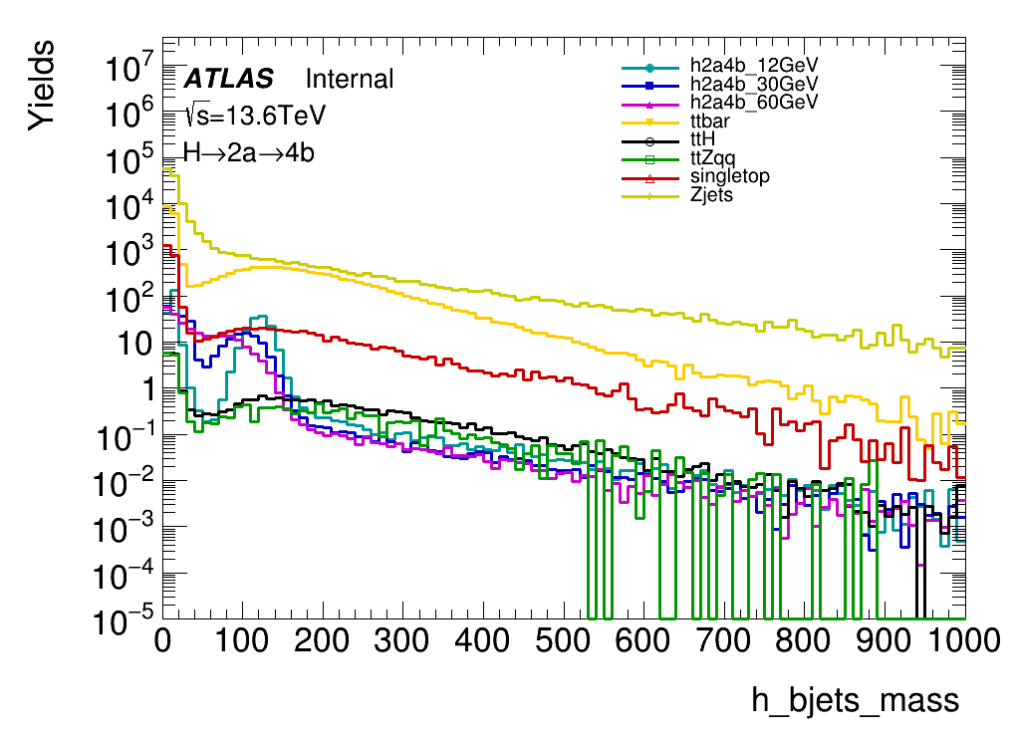
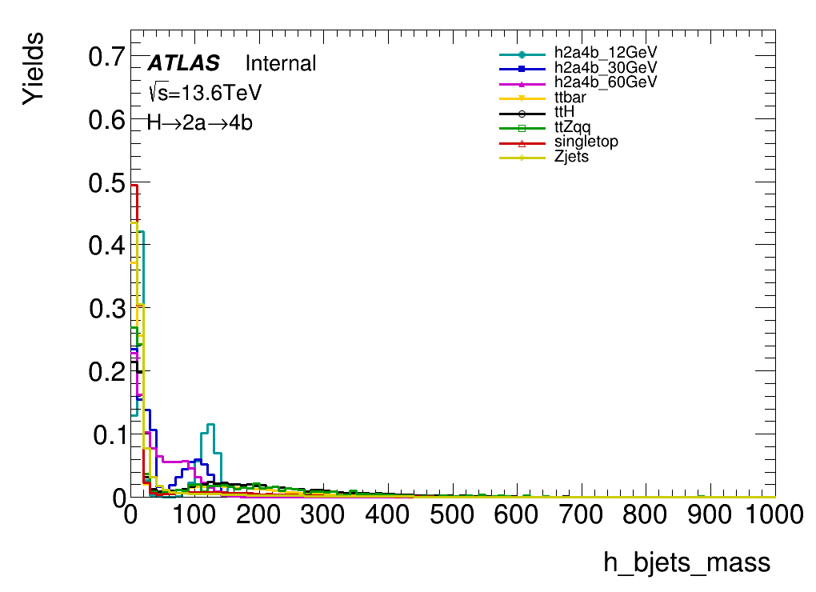
Invariant mass distribution of all b-jets system
btag:GN2v01_FixedCutBEff_65

Slide 16
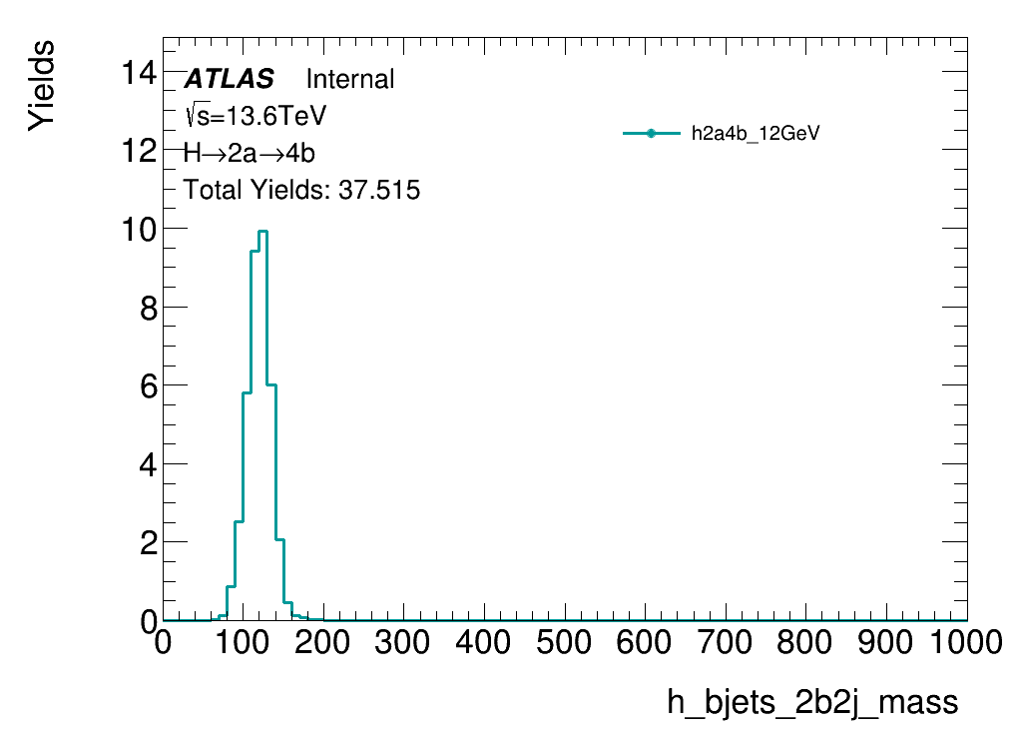
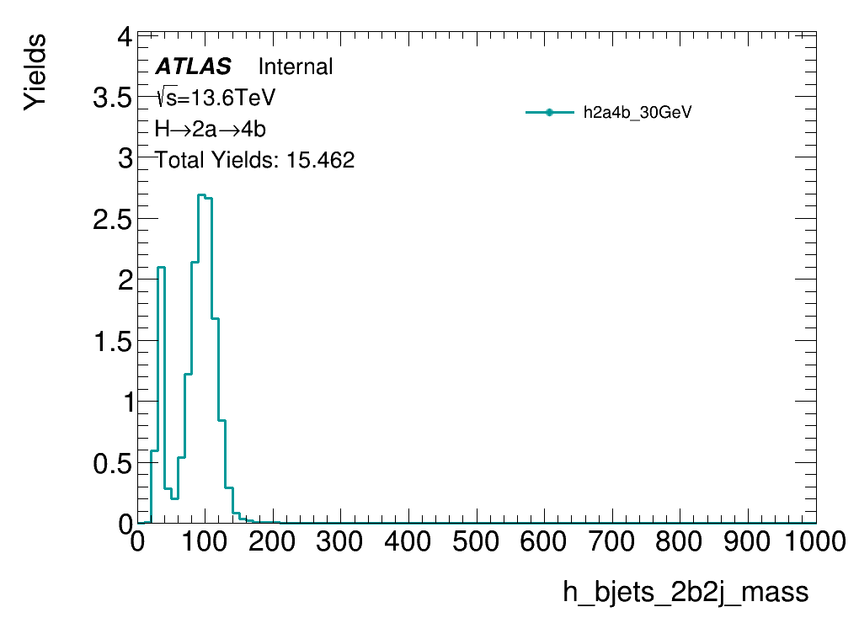
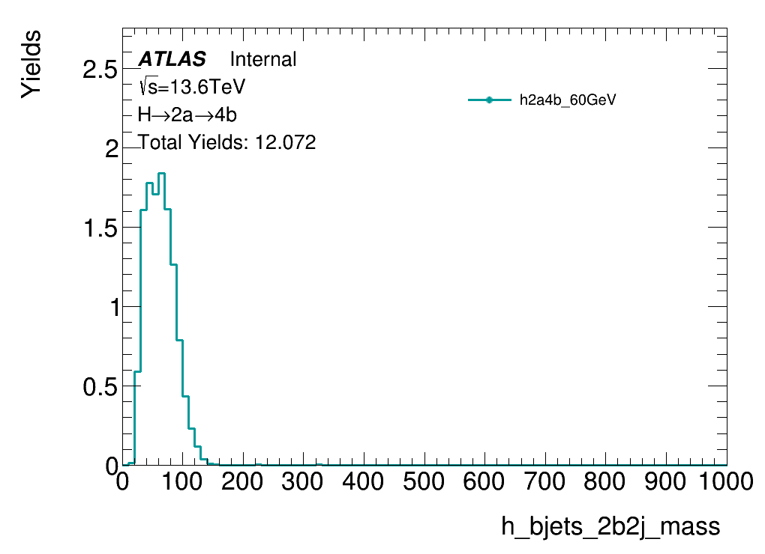
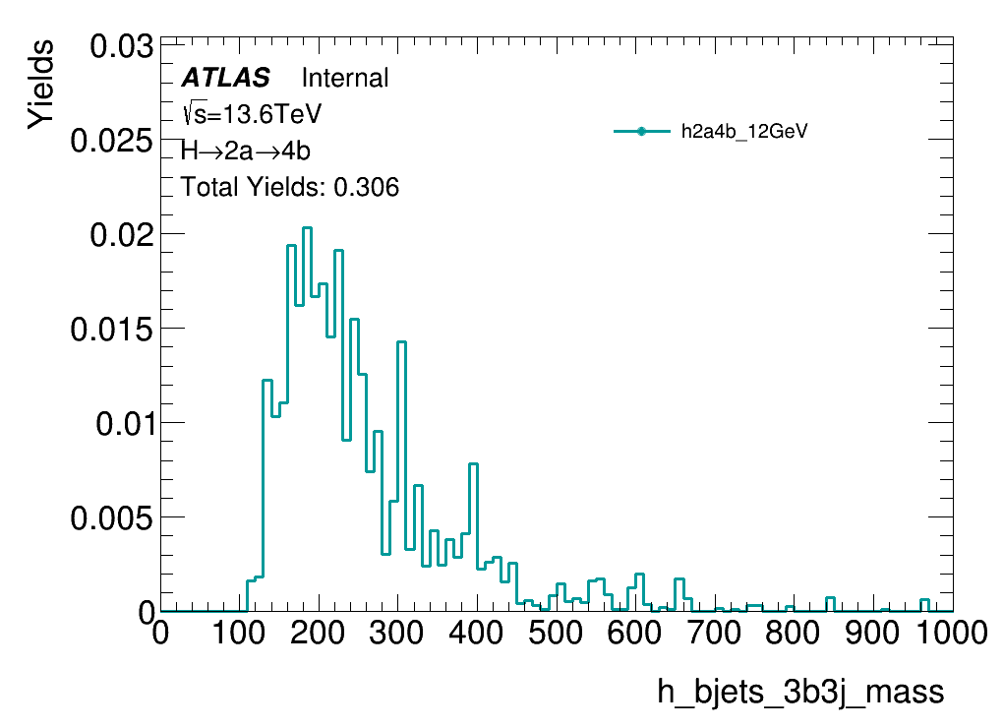
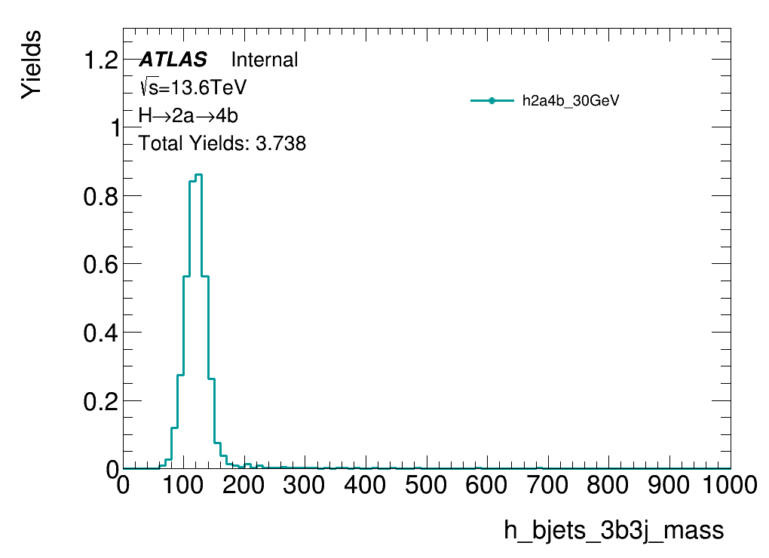
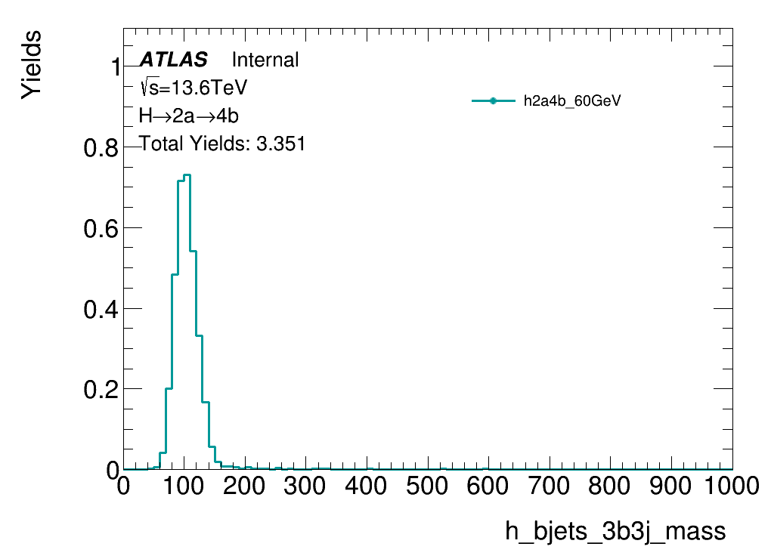
Signal in high significance region

Slide 17
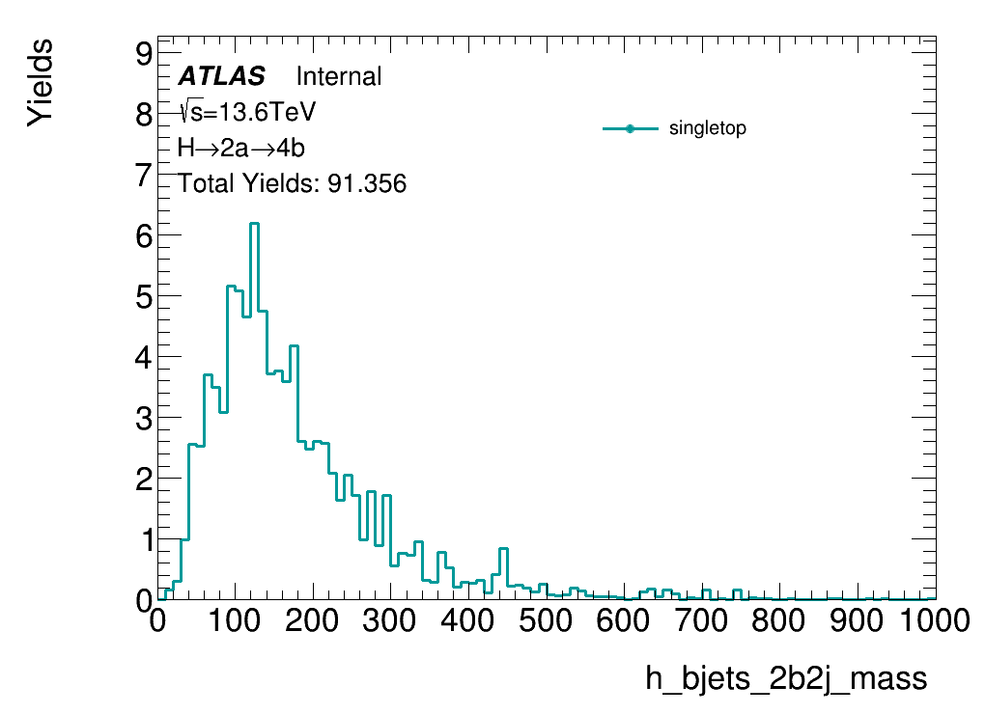
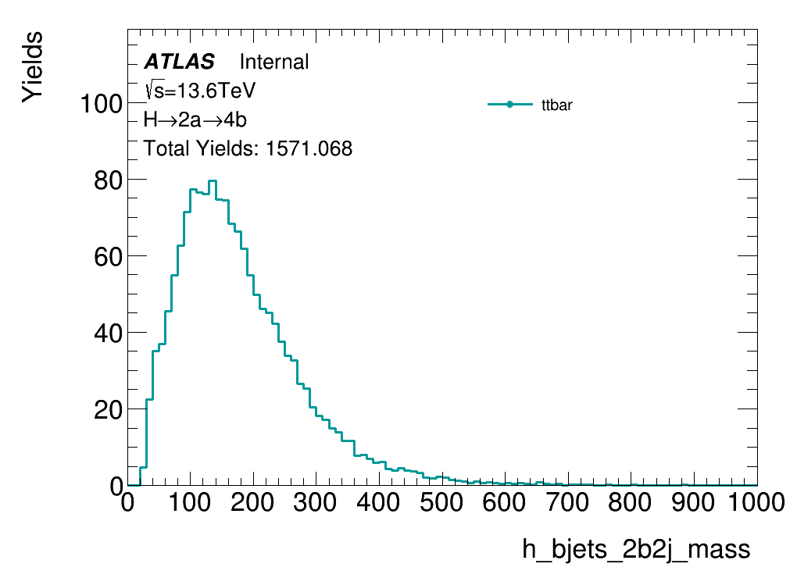
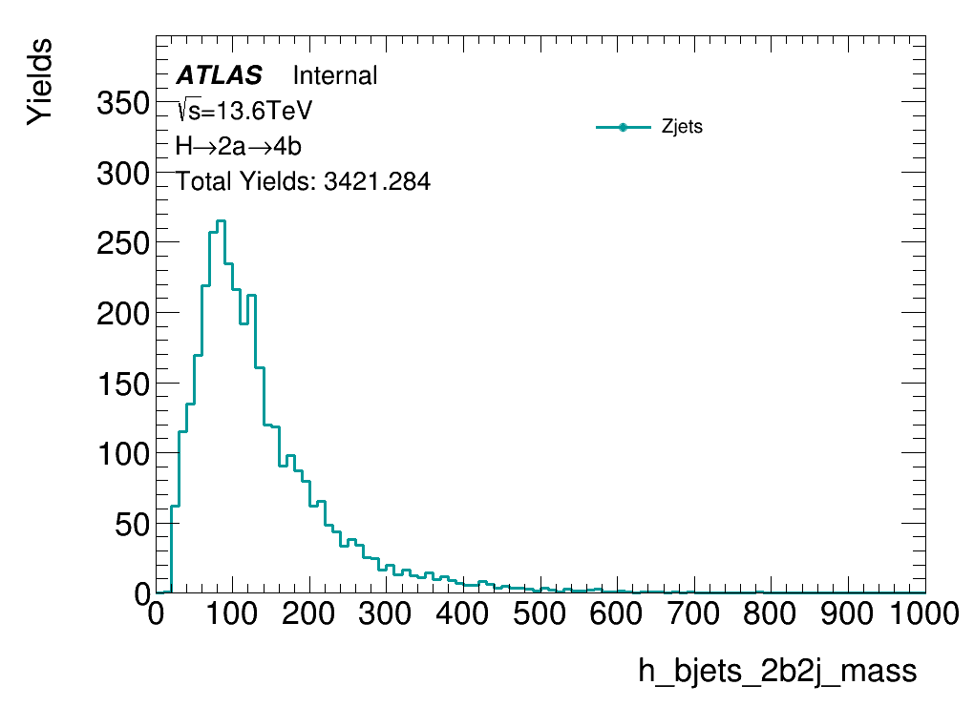
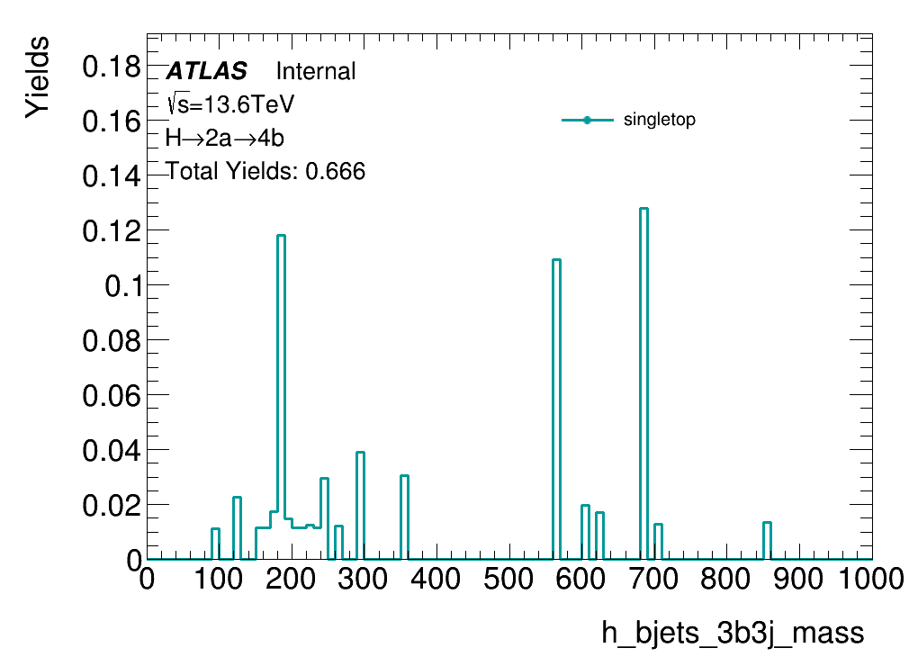
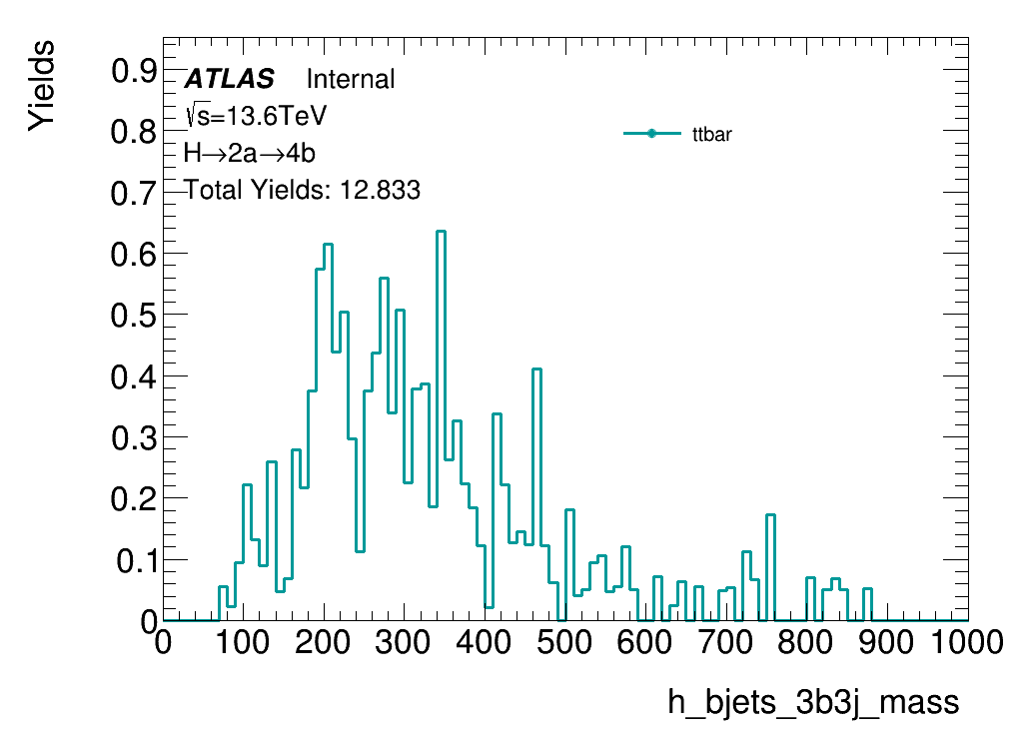
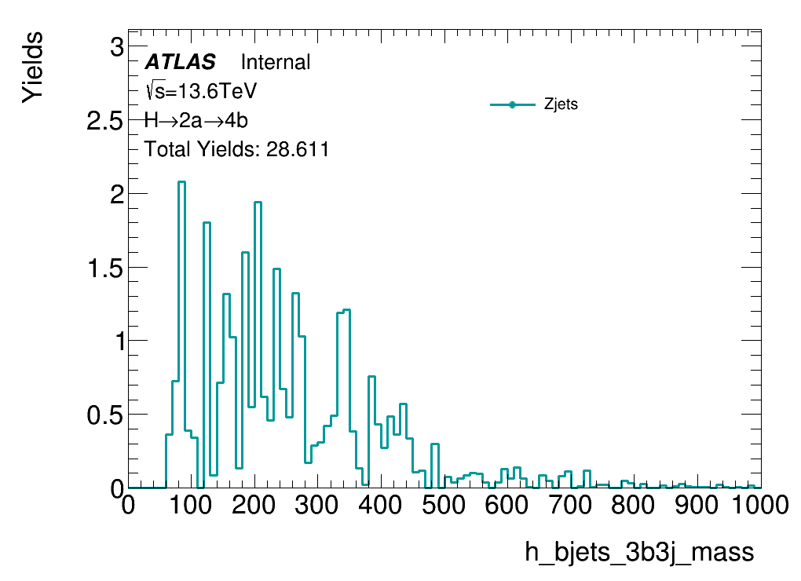
bkg in high significance region

