Slide 1

Based on arXiv:2406.02527, arXiv:2506.19822, in collaboration with Gui-Jun Ding and Jun-Nan Lu
中国科学技术大学
University of Science and Technology of China
Non-holomorphic Modular Flavor Symmetry
Bu-Yao Qu (瞿步瑶)
University of Science and Technology of China
Dark Matter and Neutrino Focus Week, TDLI, 23 August 2025

Slide 2
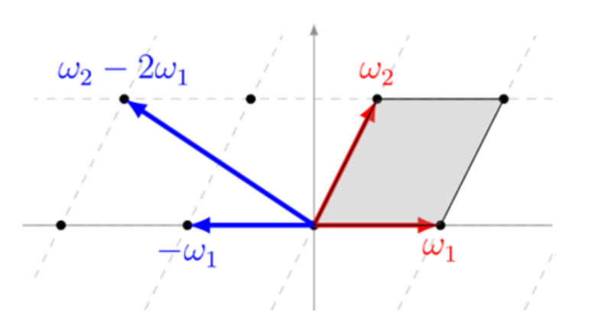
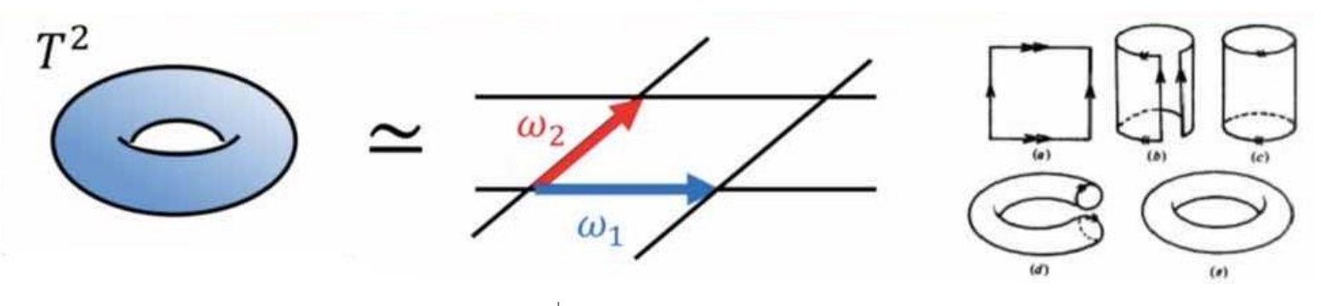
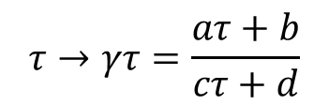
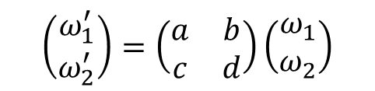
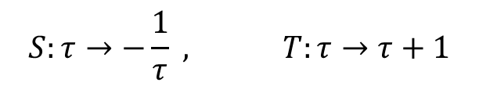
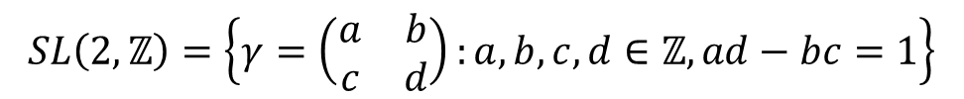
Modular invariant SUSY theory
Modular symmetry $SL\left(2,ℤ\right)$ is the geometrical symmetry of the torus $T^{2}$
Torus $T^{2}≅ℂ/Λ_{(ω_{1},ω_{2})}$, lattice $Λ_{(ω_{1},ω_{2})}=n_{1}ω_{1}+n_{2}ω_{2}$
Up to rotation and dilations, the shape of a torus is parameterized by $τ=ω_{2}/ω_{1}$, $Imτ>0$
$$\left(\begin{matrix}ω_{1}^{′} \\ ω_{2}^{′}\end{matrix}\right)=\left(\begin{matrix}a & b \\ c & d\end{matrix}\right)\left(\begin{matrix}ω_{1} \\ ω_{2}\end{matrix}\right)$$
$$τ→γτ=\frac{aτ+b}{cτ+d}$$
$$SL\left(2,ℤ\right)=\left\{γ=\left(\begin{matrix}a & b \\ c & d\end{matrix}\right):a,b,c,d∈ℤ,ad−bc=1\right\}$$
modular group generators:
$$S:τ→−\frac{1}{τ} , T:τ→τ+1$$

Slide 3
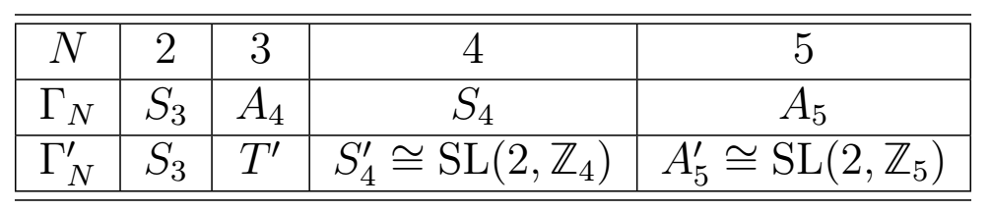

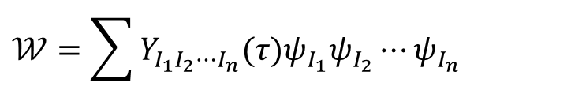


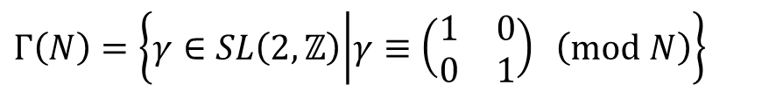
The field transformation
$$ψ→{\left(cτ+d\right)}^{−k}ρ(γ)ψ$$
weight $k∈ℤ$
$ρ$ is unitary representation of $Γ_{N}$ or $Γ_{N}^{′}$
Finite modular groups
$$Γ\left(N\right)=\left\{γ∈SL\left(2,ℤ\right) | γ≡\left(\begin{matrix}1 & 0 \\ 0 & 1\end{matrix}\right) \left(mod N\right)\right\}$$
$Γ_{N}=SL\left(2,ℤ\right)/±Γ\left(N\right)$, $Γ_{N}^{′}=SL\left(2,ℤ\right)/Γ\left(N\right)$
Superpotential
$$𝒲=\sum{Y_{I_{1}I_{2}⋯I_{n}}(τ)ψ_{I_{1}}ψ_{I_{2}}⋯ψ_{I_{n}}}$$
Modular invariance requires
$$Y_{I_{1}I_{2}⋯I_{n}}\left(τ\right)→Y_{I_{1}I_{2}⋯I_{n}}\left(γτ\right)={\left(cτ+d\right)}^{k_{Y}}ρ_{Y}(γ)Y_{I_{1}I_{2}⋯I_{n}}(τ)$$
$k_{Y}=k_{I_{1}}+k_{I_{2}}+⋯+k_{I_{n}}$, $ρ_{Y}⊗ρ_{I_{1}}⊗⋯⊗ρ_{I_{n}}⊃1$
Yukawa couplings are modular forms $Y_{I_{1}I_{2}⋯I_{n}}\left(τ\right)$

Slide 4
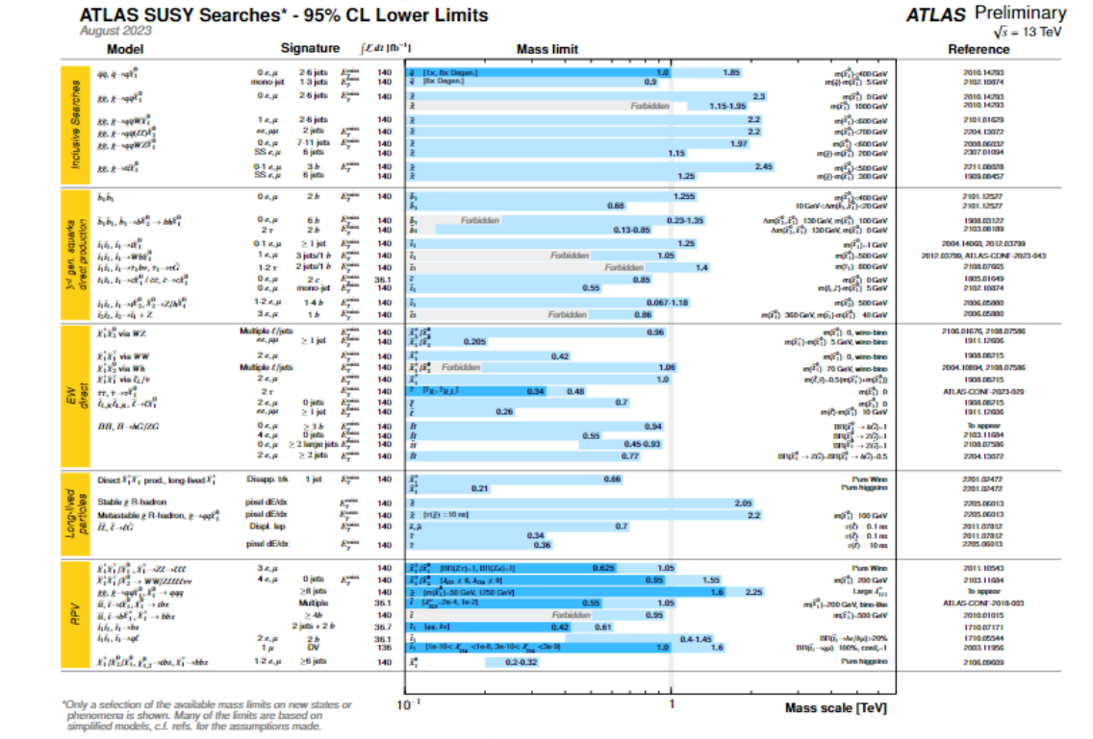
Modular symmetry requires SUSY to protect holomorphicity of modular form
SUSY
holomorphicity
$Y(τ)$: Yukawa couplings are modular forms of level N
Low energy SUSY is not observed so far!
SUSY
non-holomorphicity
??? Finite choice of modular function $Y(τ,\overline{τ})$

Slide 5
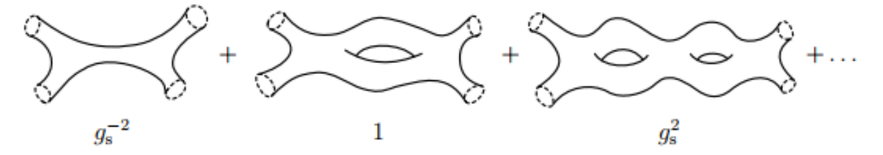

Harmonic condition replacing holomorphicity
From top-down, the effective interactions in the low energy expansion are non-holomorphic automorphic functions satisfying harmonic eigenvalue equations.
{modular forms} $⊆$ {automorphic forms}
Automorphic forms with single modulus $τ$ are harmonic Maaß forms
Modularity: $Y\left(γτ\right)={\left(cτ+d\right)}^{k}Y\left(τ\right), γ∈Γ(N)$
Harmonic condition: $Δ_{k}Y\left(τ\right)=0, Δ_{k}=−4y^{2}\frac{∂}{∂τ}\frac{∂}{∂\overline{τ}}+2iky\frac{∂}{∂\overline{τ}}$
Growth condition: $Y\left(τ\right)=𝒪\left(y^{α}\right), y→+∞$

Slide 6



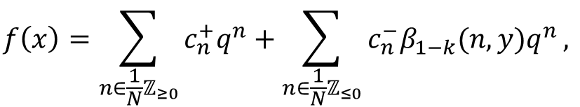


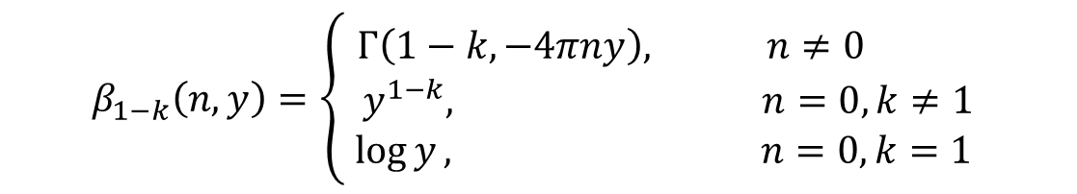

Fourier expansion:
$$f\left(x\right)=\sum_{n∈\frac{1}{N}ℤ_{≥0}}^{ }{c_{n}^{+}q^{n}}+\sum_{n∈\frac{1}{N}ℤ_{≤0}}^{ }{c_{n}^{−}β_{1−k}(n,y)q^{n}},$$
$$q=e^{2πiτ}$$
holomorphic
non-holomorphic
$$β_{1−k}\left(n,y\right)=\left\{\begin{aligned}Γ\left(1−k,−4πny\right), n≠0 \\ { y}^{1−k}, n=0, k≠1 \\ \log{y}, n=0, k=1\end{aligned}\right.$$
Product of modular forms is modular form
$$Y_{1}, Y_{2}∈M_{k}(Γ)$$
$$Y_{1}Y_{2}∈M_{k}(Γ)$$
Product of harmonic Maaß forms generally is not harmonic Maaß form
$$Y_{1}, Y_{2}∈H_{k}(Γ)$$
$$Δ_{k}Y_{1}Y_{2}≠0$$
$$Y_{1}Y_{2}∉H_{k}(Γ)$$

Slide 7
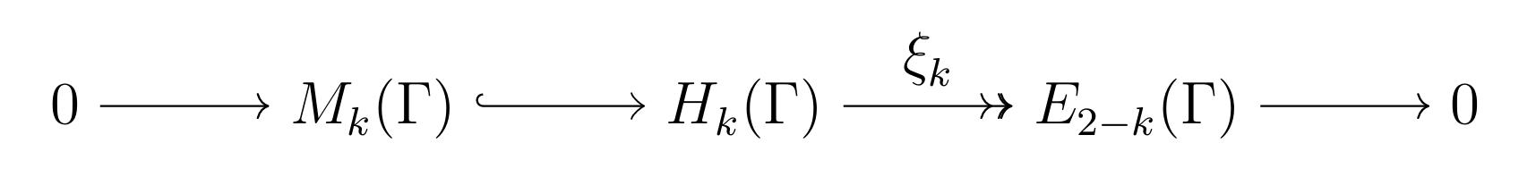
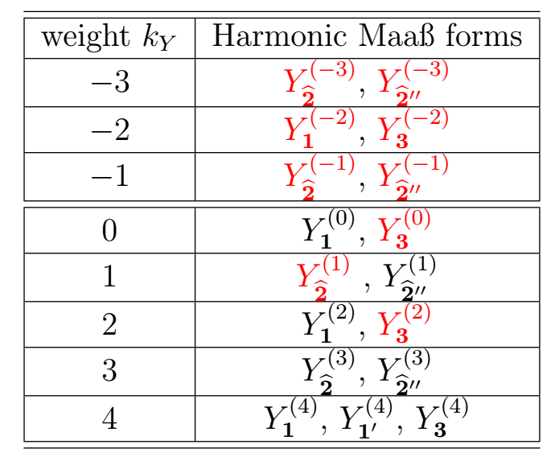

Weight $k$ harmonic Maaß forms are related with modular forms of weight $2−k$ by a differential operator $ξ_{k}=2iy^{k}\overline{\frac{∂}{∂\overline{τ}}}$
Modularity
$$ξ_{k}Y_{r}^{\left(k\right)}\left(γτ\right)={(cτ+d)}^{2−k}ρ_{r}^{∗}{(γ)ξ}_{k}Y_{r}^{\left(k\right)}\left(τ\right)$$
Harmonic Maaß forms for level $N=3$,

Slide 8

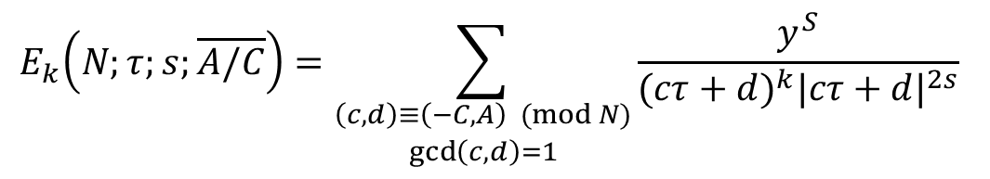

Non-holomorphic Eisenstein series
Non-holomorphic Eisenstein series of level $N$weight $k$:
$$E_{k}\left(N;τ;s;\overline{A/C}\right)=\sum_{\begin{aligned}\left(c,d\right)≡\left(−C,A\right) (mod N) \\ \gcd\left(c,d\right)=1\end{aligned}}{\frac{y^{S}}{{(cτ+d)}^{k}{|cτ+d|}^{2s}}}$$
Modular transformation:
$$E_{k}\left(N;γτ;s;\overline{A/C}\right)={(cτ+d)}^{k}E_{k}\left(N;τ;s;\overline{γ^{−1}A/C}\right)$$
Harmonic condition:
$$Δ_{k}E_{k}\left(N;τ;s;\overline{A/C}\right)=−s(s+k−1)E_{k}\left(N;τ;s;\overline{A/C}\right)$$
$A, C$ are coprime
$1:1$ correspondence of $A/C$ and cusps of $Γ(N)$
dim $H_{k}\left(Γ\left(N\right)\right)=\#\{cusps of Γ\left(N\right)\}$

Slide 9
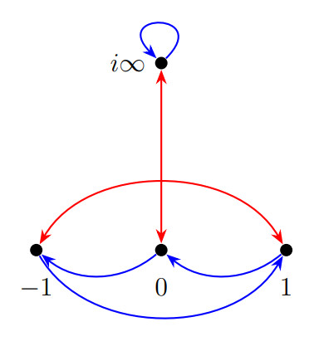
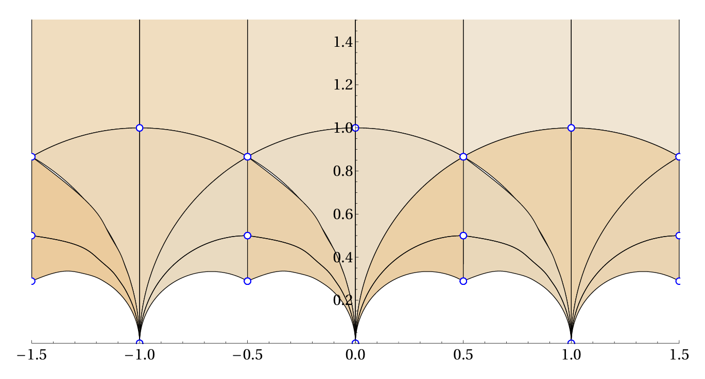
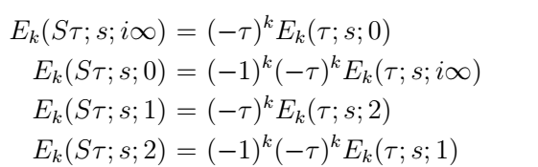
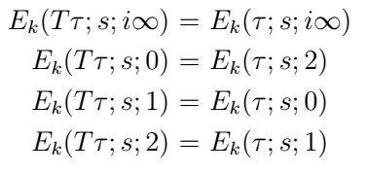


Cusps are the $Γ(N)$-equivalence class of the rational number $ℚ∪\{i∞\}$
Cusps of $Γ\left(3\right)$: $𝒞\left(3\right)=\{−1, 0, 1,i∞\}$
[figures from 2008.05329]
$S$ transformation:
$T$ transformation:

Slide 10
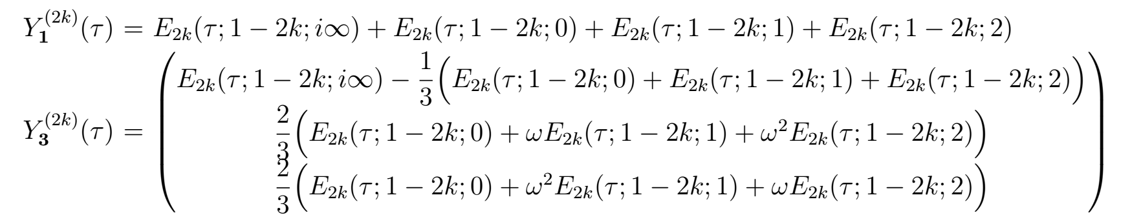
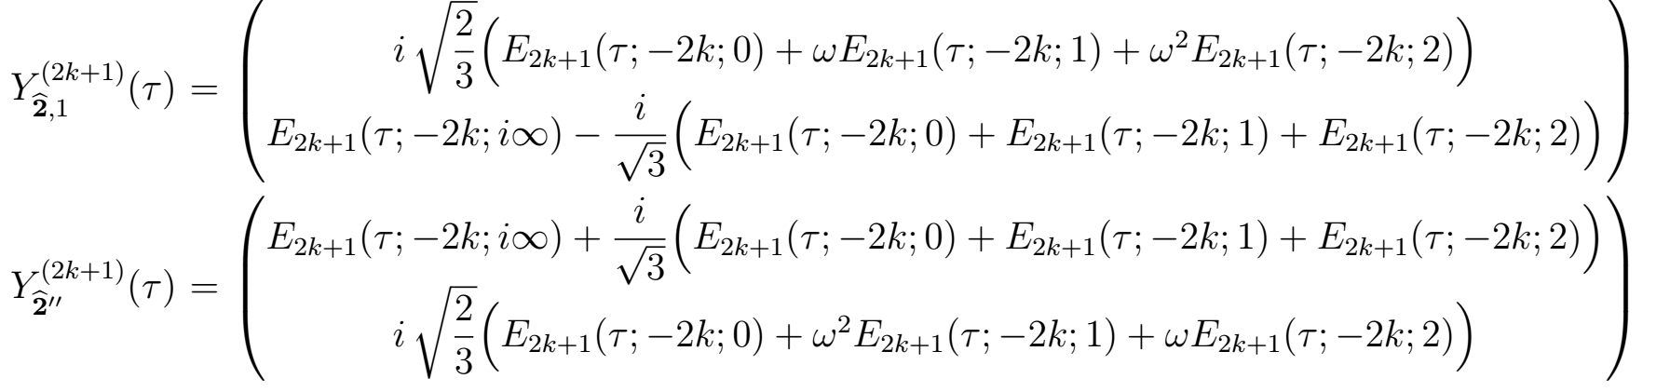
Even weight:
Odd weight:

Slide 11
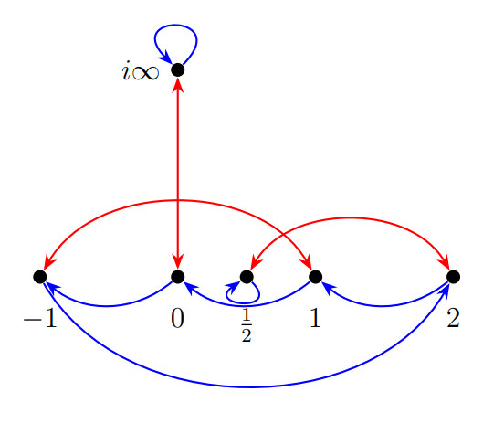
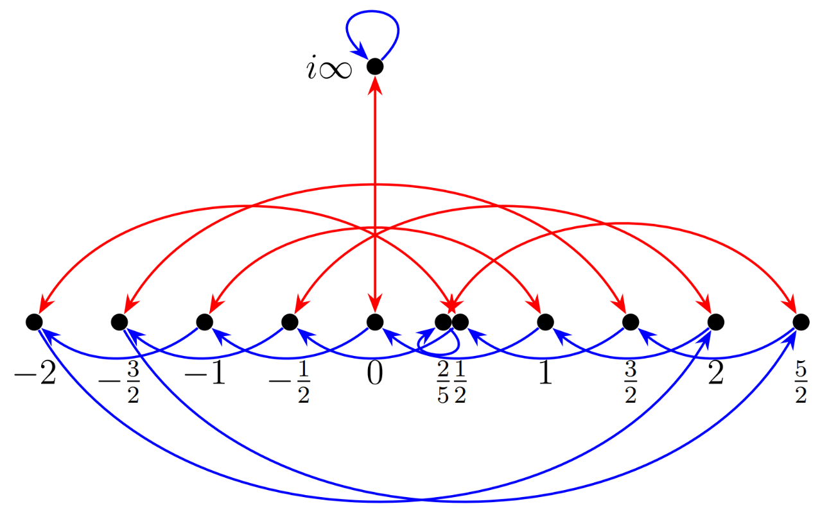

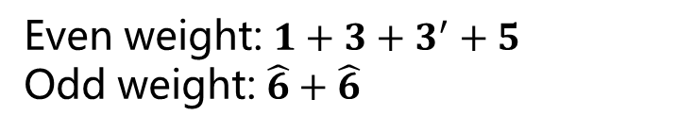
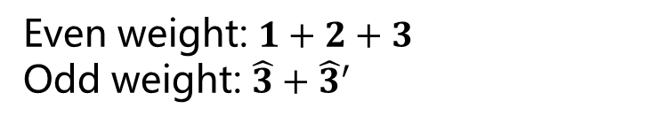


Level $N=4$, $Γ_{4}^{′}≅S_{4}^{′}$
Level $N=5\text{,} Γ_{5}^{′}≅A_{5}^{′}$
$𝒞\left(4\right)=\{−1, 0, 1, 2,\frac{1}{2},i∞\}$
$𝒞\left(5\right)=\{−2, −1, 0, 1, 2,− \frac{3}{2},−\frac{1}{2},\frac{1}{2},\frac{3}{2},\frac{5}{2},\frac{2}{5},i∞\}$
Even weight: $1+2+3$
Odd weight: $\hat{3}+{\hat{3}}^{′}$
Even weight: $1+3+3^{′}+5$
Odd weight: $\hat{6}+\hat{6}$

Slide 12
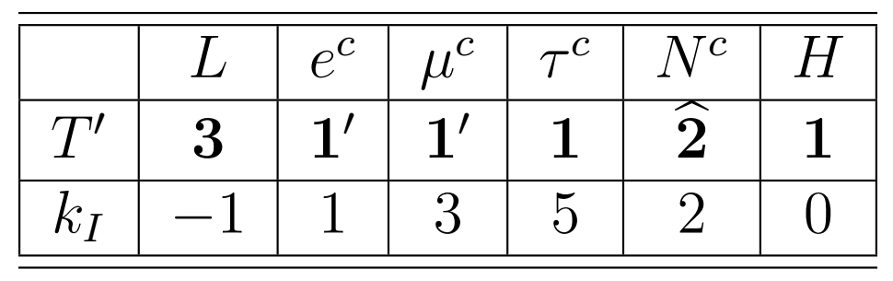
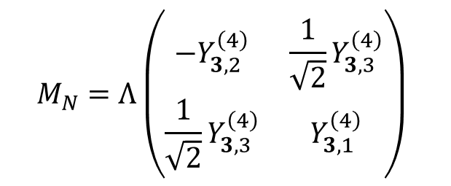
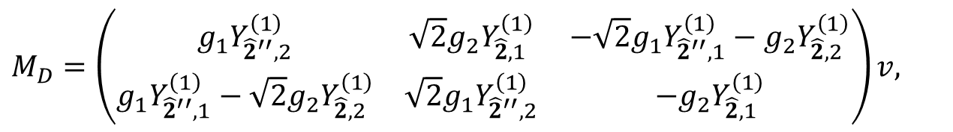
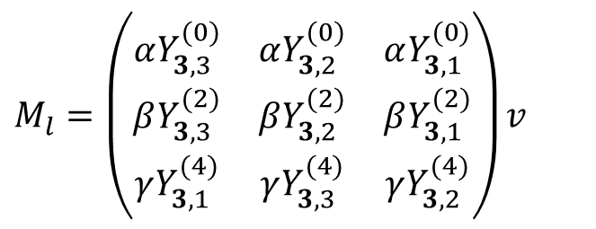
An example model based on $T′$ modular symmetry
Charged leptons
$$−ℒ_{l}^{Y}=α{\left(e^{c}LY_{3}^{\left(0\right)}H^{∗}\right)}_{1}+β{\left(μ^{c}LY_{3}^{\left(2\right)}H^{∗}\right)}_{1}+γ{\left(τ^{c}LY_{3}^{\left(4\right)}H^{∗}\right)}_{1}+h.c.$$
$$M_{l}=\left(\begin{matrix}αY_{3,3}^{(0)} & αY_{3,2}^{(0)} & αY_{3,1}^{(0)} \\ βY_{3,3}^{(2)} & βY_{3,2}^{(2)} & βY_{3,1}^{(2)} \\ γY_{3,1}^{(4)} & γY_{3,3}^{(4)} & γY_{3,2}^{(4)}\end{matrix}\right)v$$
Neutrino masses: seesaw mechanism with 2 RHN
$$−ℒ_{ν}=g_{1}{\left(N^{c}LHY_{{\hat{2}}^{′′}}^{\left(1\right)}\right)}_{1}+g_{2}{\left(N^{c}LHY_{\hat{2}}^{\left(1\right)}\right)}_{1}+\frac{1}{2}Λ{\left(N^{c}N^{c}Y_{3}^{\left(4\right)}\right)}_{1}+h.c.$$
$$M_{N}=Λ\left(\begin{matrix}−Y_{3,2}^{\left(4\right)} & \frac{1}{\sqrt{2}}Y_{3,3}^{\left(4\right)} \\ \frac{1}{\sqrt{2}}Y_{3,3}^{\left(4\right)} & Y_{3,1}^{\left(4\right)}\end{matrix}\right)$$
$$M_{D}=\left(\begin{matrix}g_{1}Y_{{\hat{2}}^{′′},2}^{\left(1\right)} & \sqrt{2}{g_{2}Y}_{\hat{2},1}^{\left(1\right)} & −\sqrt{2}g_{1}Y_{{\hat{2}}^{′′},1}^{\left(1\right)}−{g_{2}Y}_{\hat{2},2}^{\left(1\right)} \\ g_{1}Y_{{\hat{2}}^{′′},1}^{\left(1\right)}−\sqrt{2}{g_{2}Y}_{\hat{2},2}^{\left(1\right)} & \sqrt{2}g_{1}Y_{{\hat{2}}^{′′},2}^{\left(1\right)} & −{g_{2}Y}_{\hat{2},1}^{\left(1\right)}\end{matrix}\right)v,$$

Slide 13
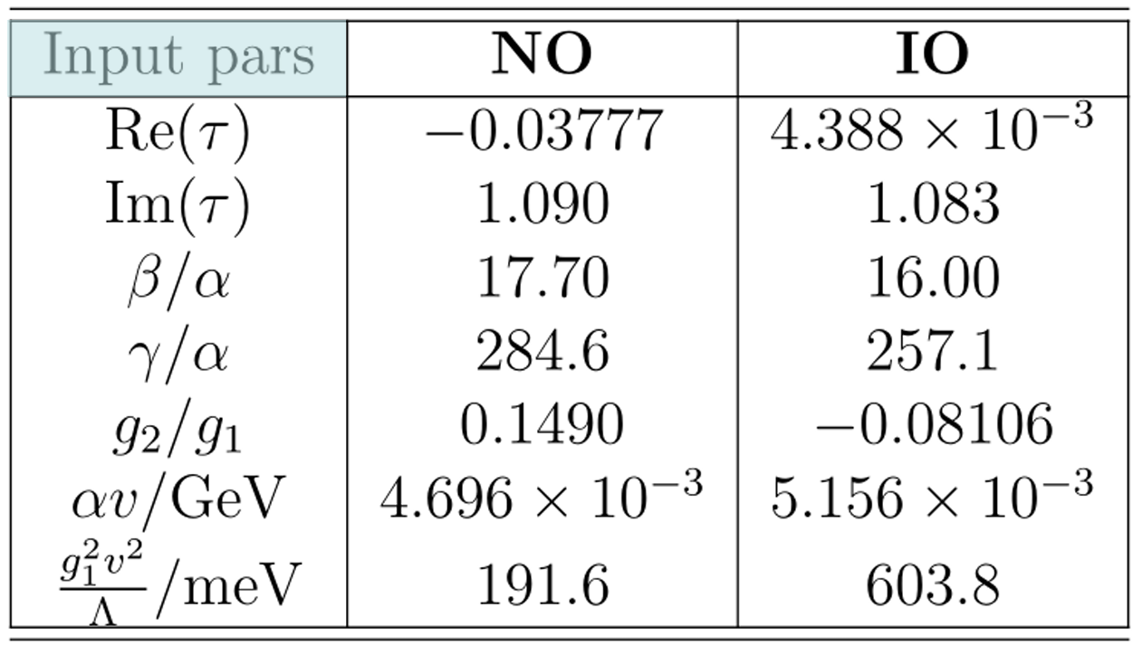
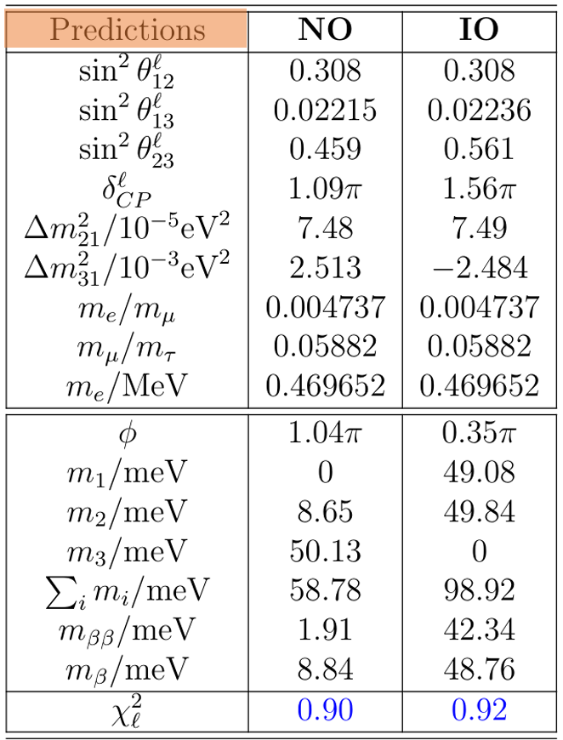
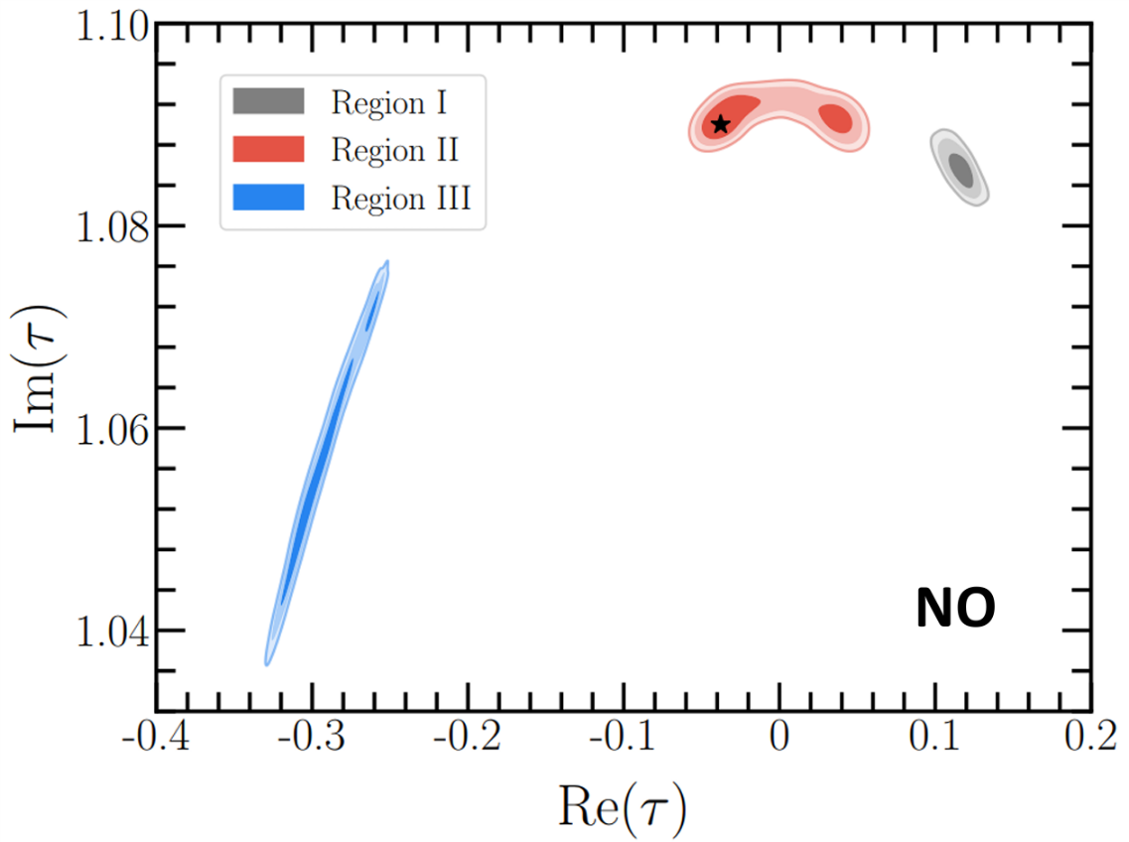

Slide 14
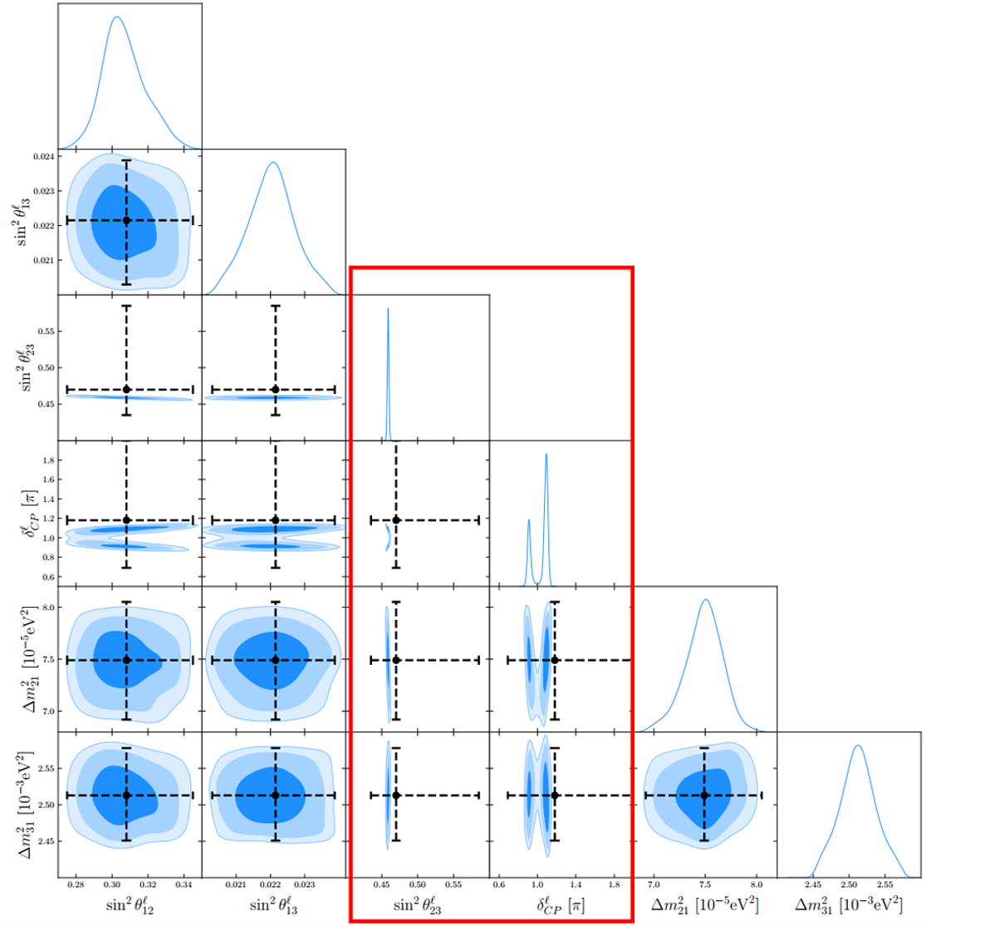
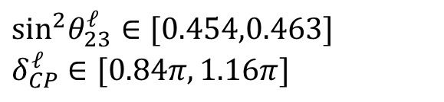
Sharp prediction for $θ_{23}^{ℓ}$ and Dirac CP phase $δ_{CP}^{ℓ}$
$$\sin^{2}θ_{23}^{ℓ}∈[0.454,0.463]$$
$$δ_{CP}^{ℓ}∈[0.84π,1.16π]$$

Slide 15
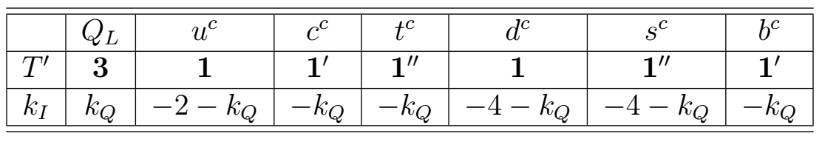
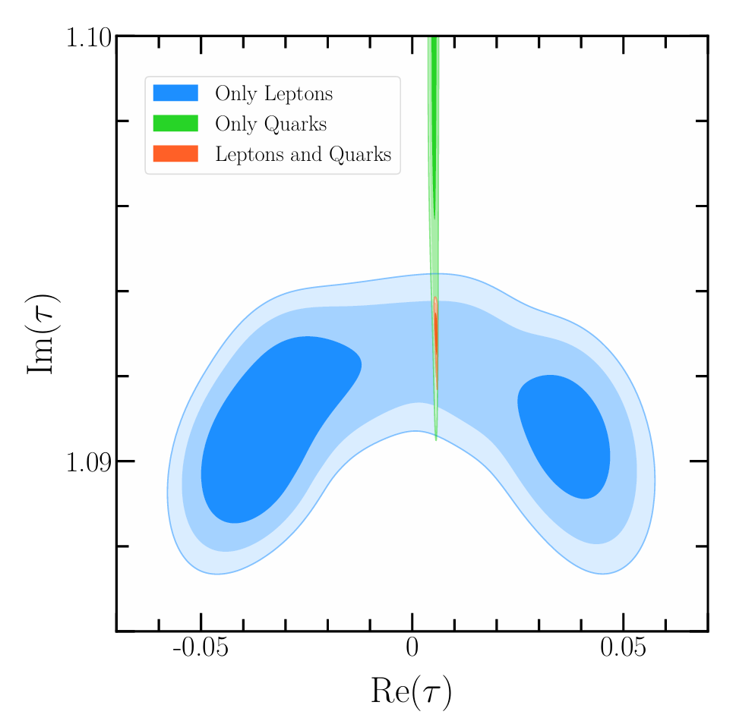
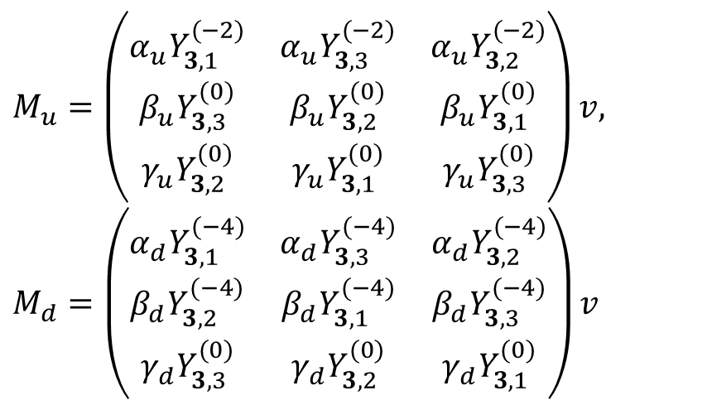
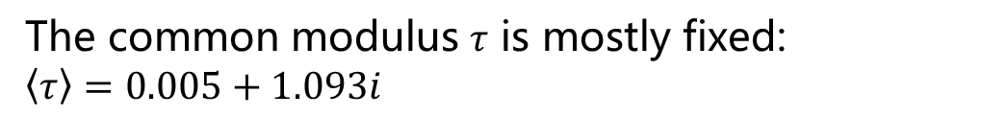
Quark sector
Quark mass matrices:
$$M_{u}=\left(\begin{matrix}α_{u}Y_{3,1}^{(−2)} & α_{u}Y_{3,3}^{(−2)} & α_{u}Y_{3,2}^{(−2)} \\ β_{u}Y_{3,3}^{(0)} & β_{u}Y_{3,2}^{(0)} & β_{u}Y_{3,1}^{(0)} \\ γ_{u}Y_{3,2}^{(0)} & γ_{u}Y_{3,1}^{(0)} & γ_{u}Y_{3,3}^{(0)}\end{matrix}\right)v,$$
$$M_{d}=\left(\begin{matrix}α_{d}Y_{3,1}^{(−4)} & α_{d}Y_{3,3}^{(−4)} & α_{d}Y_{3,2}^{(−4)} \\ β_{d}Y_{3,2}^{(−4)} & β_{d}Y_{3,1}^{(−4)} & β_{d}Y_{3,3}^{(−4)} \\ γ_{d}Y_{3,3}^{(0)} & γ_{d}Y_{3,2}^{(0)} & γ_{d}Y_{3,1}^{(0)}\end{matrix}\right)v$$
The common modulus $τ$ is mostly fixed:
$$\left\langle τ\right\rangle =0.005+1.093i$$
The neutrino spectrum can only be NO after combined with quark sector.

Slide 16
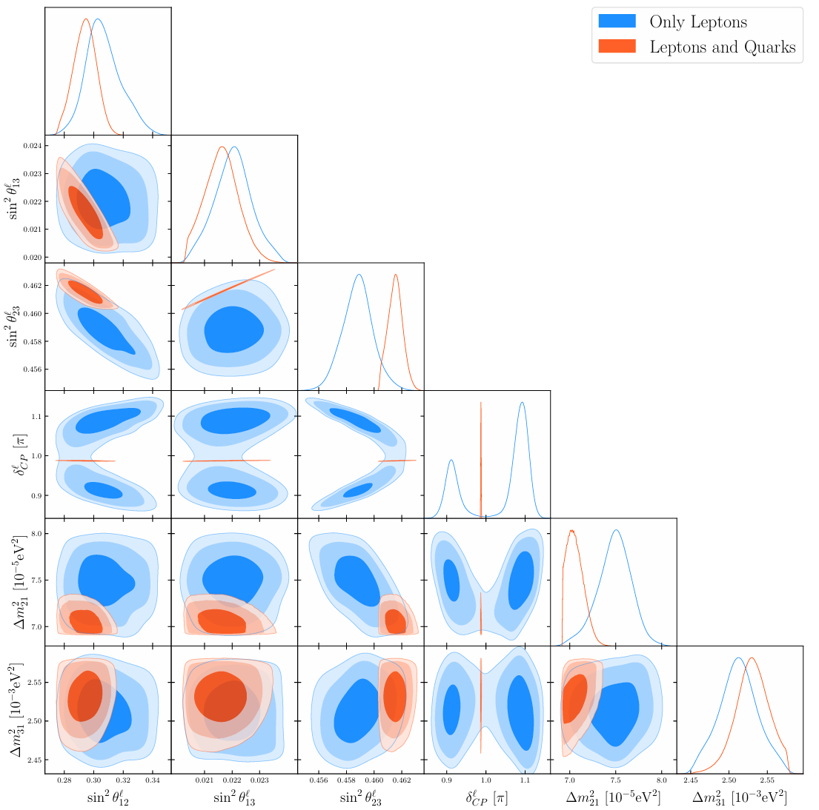
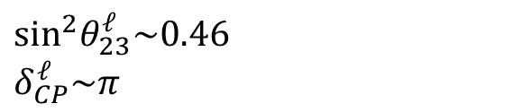
Only NO neutrino mass is viable after quark sector is combined:
$$\sin^{2}θ_{23}^{ℓ}\sim 0.46$$
$$δ_{CP}^{ℓ}\sim π$$

Slide 17
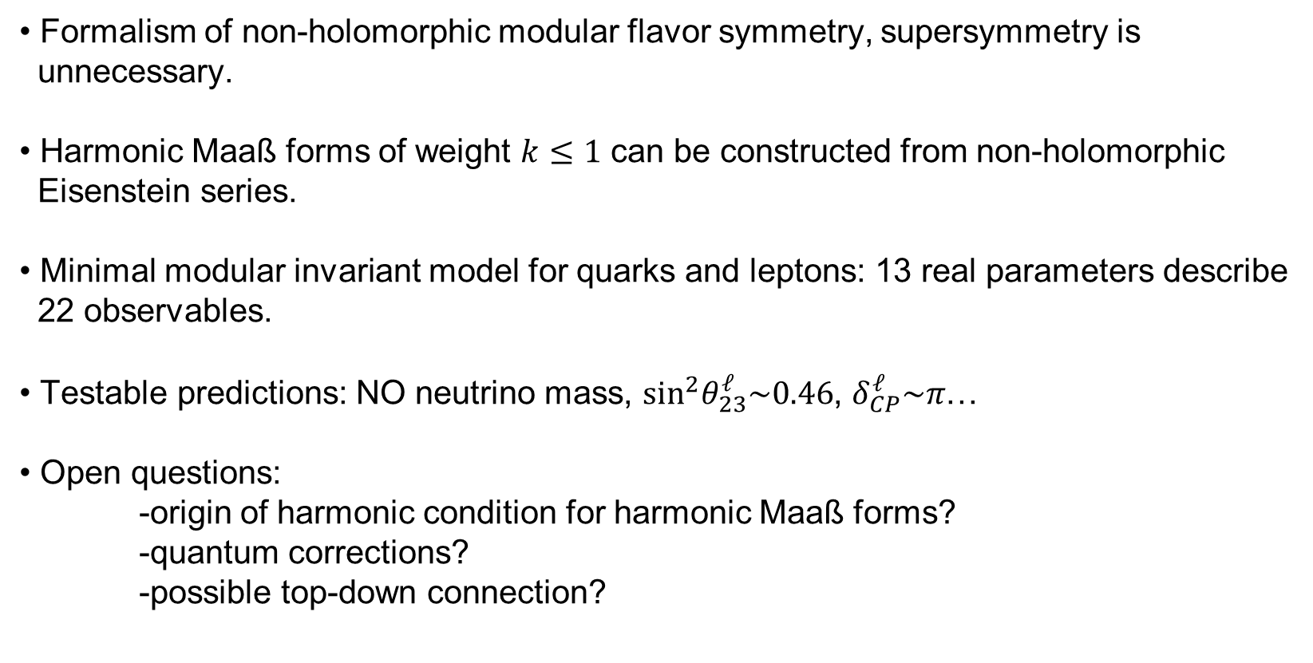
Summary and outlook
Formalism of non-holomorphic modular flavor symmetry, supersymmetry is
unnecessary.
Harmonic Maaß forms of weight $k≤1$ can be constructed from non-holomorphic
Eisenstein series.
Minimal modular invariant model for quarks and leptons: 13 real parameters describe
22 observables.
Testable predictions: NO neutrino mass, $\sin^{2}θ_{23}^{ℓ}\sim 0.46$, $δ_{CP}^{ℓ}\sim π$…
Open questions:
-origin of harmonic condition for harmonic Maaß forms?
-quantum corrections?
-possible top-down connection?

Slide 18
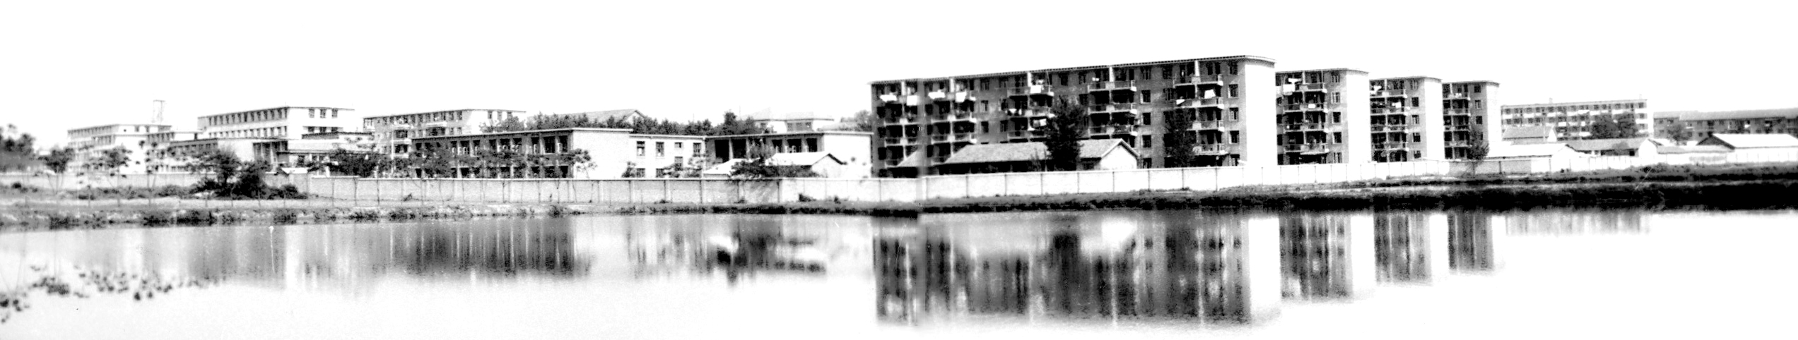

中国科学技术大学
University of Science and Technology of China
Thank you!

