Slide 1
CosmoTransitions theory & program study
Yanda Wu
2020.02.02

Slide 2
Outline
Carroll L. Wainwright, CosmoTransitions: Computing Cosmological Phase Transition Temperatures and Bubble Profiles with Multiple Fields
Structure：
1. Bubble profiles
2. Phase structures
3. Structures of program
4. Example

Slide 3

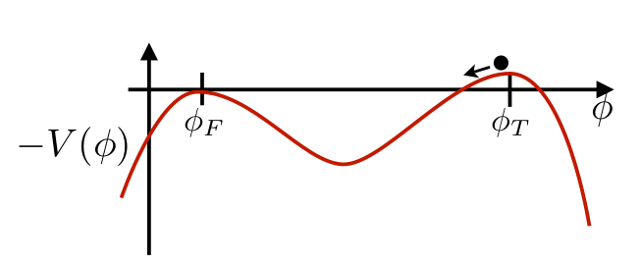
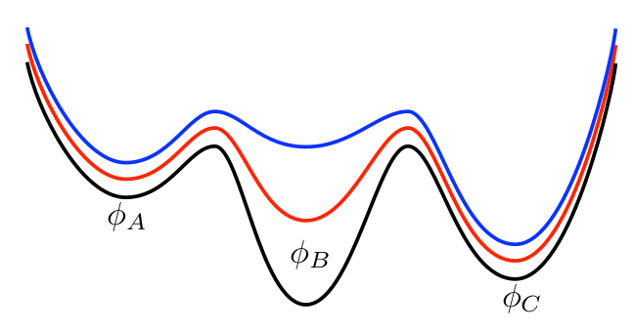
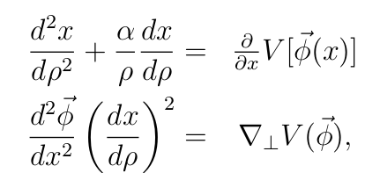

Bubble profiles
Bubble’s equations of motion:
1. One-dimensional solution (overshoot/undershoot)
Find the initial placement of the particle near ture vacua -- tunneling1D.bubbleProfile
2. Multi-dimensional solution
describes the forces parallel to the track and thus determine the particle’s speed
describes the normal force N that track must exert on the particle to keep it from falling off
For the right path, N=0
pathDrformation.py

Slide 4

Phase structures
At what temperatures, the various phase exist?
Theory: spontaneously
broken symmetries:
Zero-temperature phase
High-temperature phase symmetry-restoring phase
If these phase coexistence at some temperature
There is likely a first-order phase transitions between them
Find the location of the minima as a function of temperature:
M: a singular matrix, indicates a rapid change in the minimun caused by either the disappearance of the phase or a second -order phase transitions
1. Nelder-Mead downhill simplex method -- to find the local minimum at particular temperature
transitionFinder.traceMinimun
2. Use the equation above to find how the minimum changes

Slide 5
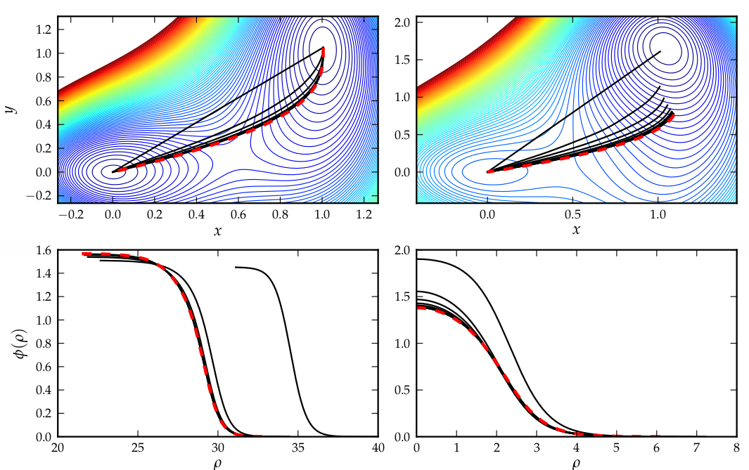

Example
Simple potential
small(0.02) phases are nearly degenerate and any tunneling between them will be thin-walled
$$δ$$
large(0.4) thick-walled

Slide 6

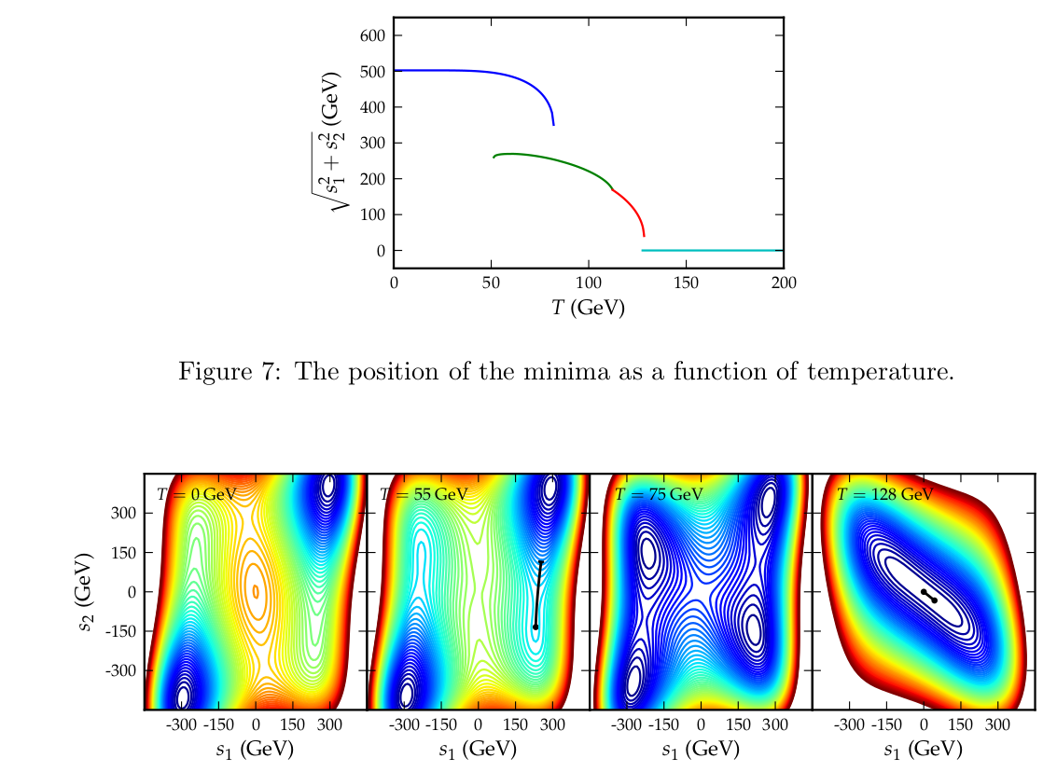
Example
Another potential

