Slide 1
Constructing Massive Vector amplitudes
Junmou Chen (Jinan University)
at Tsung-Dao Lee Institute

Slide 2
Table of Content
1. Introduction
2. Consistent conditions for Amplitudes
3.Constructing 3-point and 4-point amplitudes
4. Conclusion

Slide 3
Traditional View of QFT
1. Introduction
Step 1: Starting from Lagrangian of classic fields
Step 2: Quantization&LSZ -> S-matrix
Step 3: Feynman rules for computing amplitudes
Problem:
1. The concept of field is often redundant, especially for gauge theory
2. S-matrix is more directly related to observable.
Modern View
1. Starting from S-matrix/Amplitudes
2. Lorentz symmetry and unitarity
3. Fix amplitudes.
4. Extract the underlying theory

Slide 4
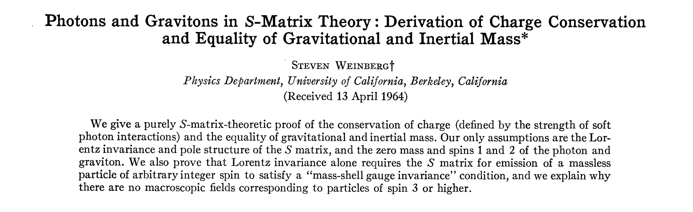
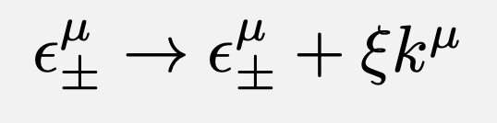

Modern View Beginning
S. Weinberg, Phys.Rev. 135 (1964) B1049-B1056
Particle as unitarity irreducible representation of Lorentz group
Massless spin-1 particle transforms as
Leading to
1. Ward identity/on-shell gauge symmetry:
2. Charge conservation(equivalent principle for spin-2)
3. No non-trivial interactions for spin > 2

Slide 5
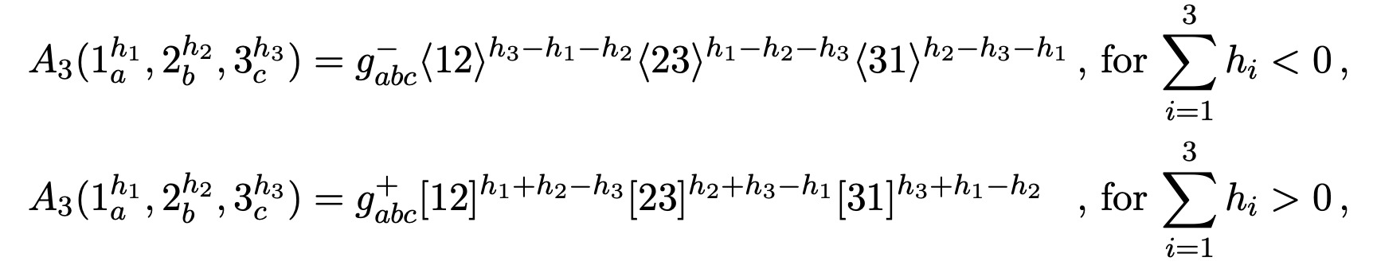
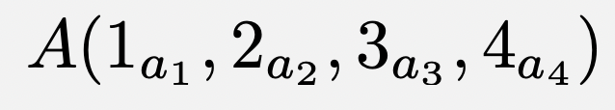
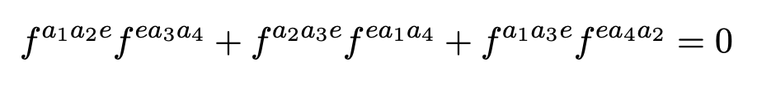
Modern View: Yang-Mills
Lorentz sym -> little group scaling
Unitarity&locality -> Consistent factorization for
Key: Lorentz sym&Unitarity&locality encoded in amplitudes
Other conclusions: equivalence principle for spin-2; no non-trivial S-matrix for spin > 2; etc
Jacob identity
Construct Yang-Mills theory

Slide 6
Modern View: Massive-1
J. M. Cornwall, D. N. Levin, and G. Tiktopoulos, Phys. Rev. Lett. 30, 1268 (1973)
J. M. Cornwall, D. N. Levin, and G. Tiktopoulos,Phys. Rev. D 10, 1145 (1974),
C.H. Llewellyn Smith, Phys.Lett.B 46 (1973) 233-236
Earliest similar attempts for massive amplitudes started in 1970s
Basic method: perturbative unitarity
write down all possible Lagrangian terms for interactions with massive vector bosons and scalars
Perturbative unitarity constrains the couplings
Result: gauge theory with spontaneous symmetry breaking.

Slide 7
Modern View: Massive-2
E. Conde and A. Marzolla, 1601.08113
S. Y. Choi and J. H. Jeong, 2111.08236
N. Arkani-Hamed, T.-C. Huang, and Y.-t. Huang, 1709.04891
After spinor formalism
Classify all 3-point amplitudes
match with massless limits(UV/IR)
Construct 4-point amplitudes
apply perturbative unitarity
obtain gauge theories with Higgs mechanism
Generally corresponds to the method with Lagrangian
3-point
4-point
B. Bachu and etc. 2305.02502&1912.04334
D. Liu and Z. Yin, 2204.13119
H.-Y. Lai, D. Liu, and J. Terning, 2312.11621

Slide 8
Motivation for Massive Case
Status quo: the main method is still perturbative unitarity, the same as in 50 years ago
Problem: the core of Higgs mechanism not taken into account:
Goldstone eaten by gauge boson(at least for 4-point )
3-point amplitudes are relative complete
4-point requires computation off-shell(energy increasing)
Why additional degree of freedom from massless?
Precise cancellation indicates symmetry, what symmetry?

Slide 9
2. Consistent Conditions for Massive Amplitudes

Slide 10
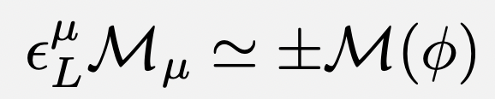

Condition-1: gauge symmetry
Gauge symmetry reflected in massive amplitude as Goldstone equivalence
The precise form: massive gauge symmetry/Ward identity
First condition for amplitudes for massive vector bosons: on-shell gauge symmetry(O.G.S).

Slide 11

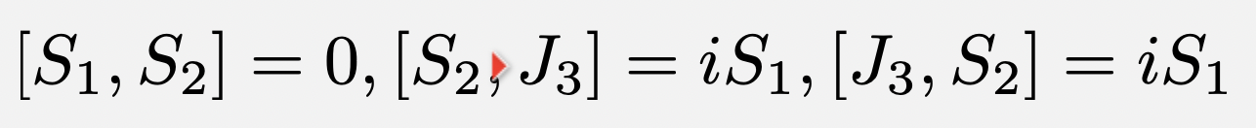
Physical origin of OGS
Massless: on-shell gauge symmetry origins from Lorentz symmetry of spin-1 particle.
Can we trace massive gauge symmetry to Lorentz symmetry too?
Hint: massless particle can be seen as infinite energy limit of massive particle
Particle is unitary irreducible representation of Lorentz group.
Lorentz transformation reduces to the littel group
SO(3) for massive; ISO(2) for massless
The latter can be otained from the former by group contraction
SO(3) Lie Algebra
ISO(2) Lie Algebra

Slide 12
Physical origin of OGS
Conclusion: There is continution between massive and massless particle by Lorentz symmetry.
The number of degrees of freedom should be the same for massive and massless particle(Lorentz covariant without E.O.M) of the same spin.
Problem for spin-1 particle: doesn’t massive particle have an additional longitudinal pol.?
How to resolve the parodox?

Slide 13
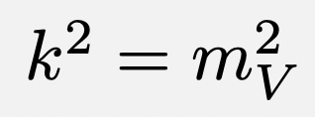

Physical origin of OGS: Solution
The vector representation of Lorentz group can mix with another scalar, which is the most general case.
Condition, the mass spectrum remains degenerate in mass spectrum, so that they remains one particle
Their polarization vectors satisfies
with

Slide 14

Physical origin of OGS: degrees of freedom
No. of degrees of freedom
Condition-1:
Total degrees of freedom: 4+1-2=3
spin-1 before mixing: 4
spin-0: 1
fixes 1 d.o.f
Invariant under
Condition-2: gauge symmetry, a redundancy.
fixes another d.o.f(e.g. light-cone gauge)

Slide 15
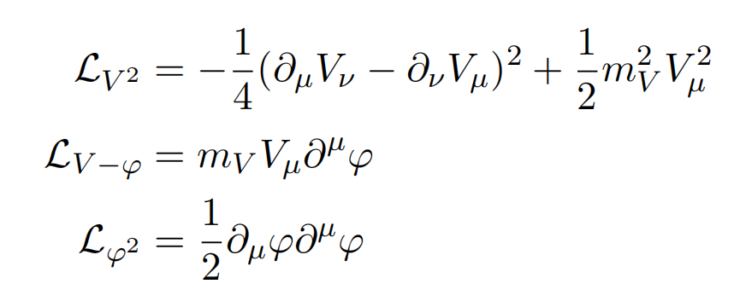
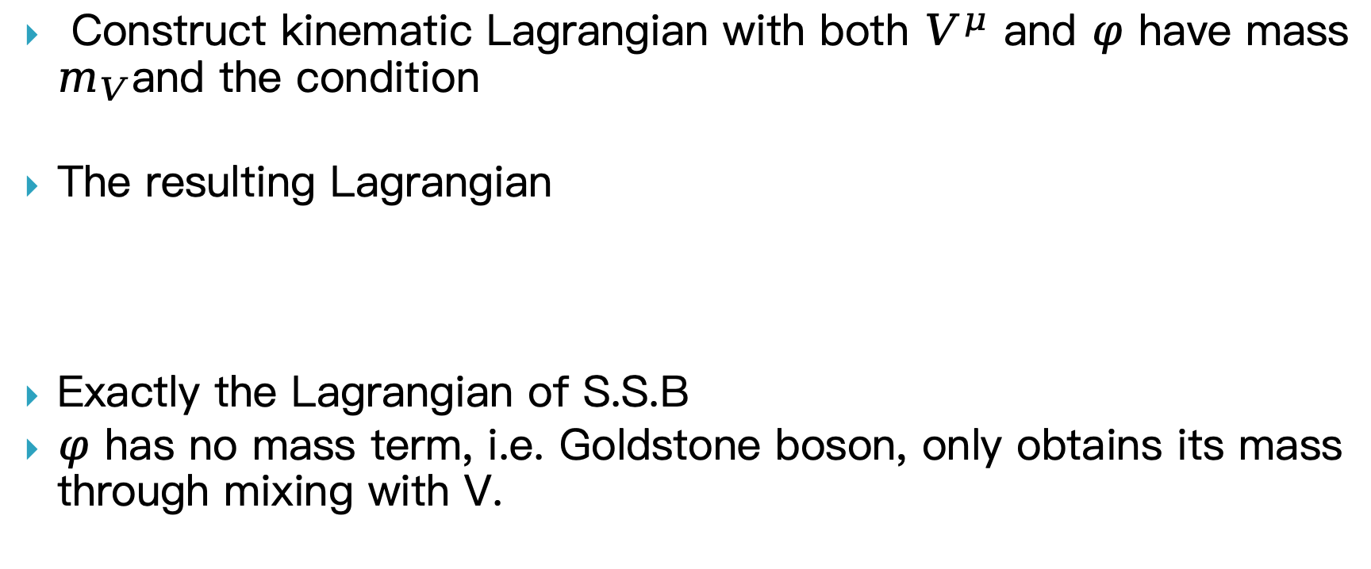
Physical origin of OGS: Lagrangian
Construct kinematic Lagrangian with both $V^{μ}$ and $φ$ have mass $m_{V}$and the condition
The resulting Lagrangian
Exactly the Lagrangian of S.S.B
$φ$ has no mass term, i.e. Goldstone boson, only obtains its mass through mixing with V.

Slide 16
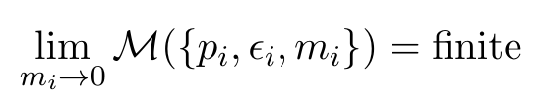
Consistent Condition-2: Elementary Particle
It’s crucial to differentiate Higgs mechanism, which particles are elementary, from Composite Higgs scenario.
Elementary particle:couplings remain constant at high energy(tree)
Composite particle: couplings blow up at high energy(in EFT)
Strong massive-massless continuation: the amplitude remains finite as one of the particle goes to massless.
This selects amplitudes of elementary particles

Slide 17
3. Constructing Massive Amplitudes

Slide 18
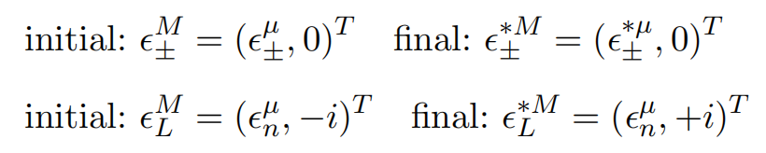


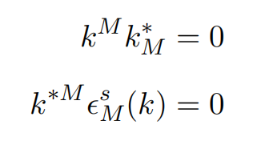
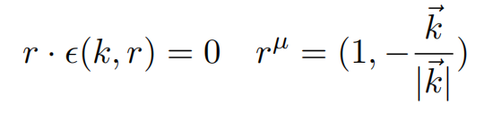
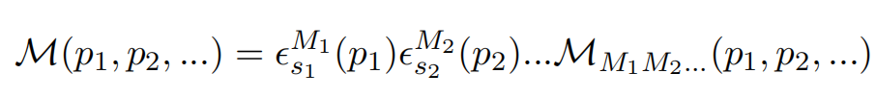

5-component formalism for amplitudes
Combine gauge and Goldstone components, define 5-components field/polarization vector:
Gauge conditions
Massive vector boson amplitudes written as:
On-shell gauge symmetry(OGS)
on-shell condition
gauge condition

Slide 19
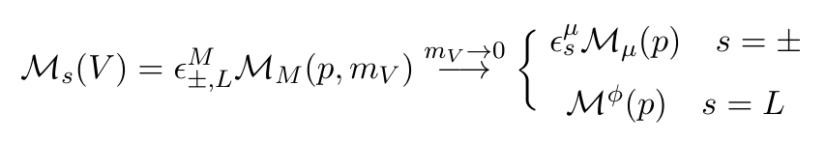
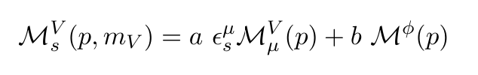
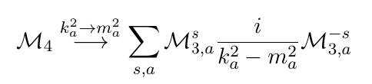
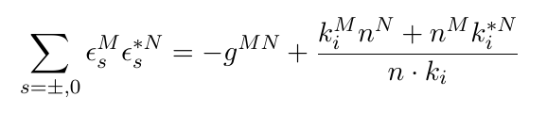


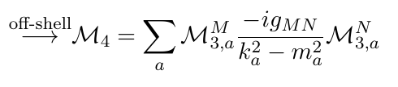
Methods of Constructing Amplitudes
Construct massive amplitudes from massless limits
Fix parameters with on-shell gauge symmetry& strong massive-massless continuation
3-point amplitudes -> 4-point amplitudes
Finally
No complexification of momenta
Off-shell continuation
O.G.S

Slide 20










Construct 3-point: massless
Masslss gauge symmetry
Massless
“Massless” SVV
Doesn’t satisfy O.S.G
Should be considered as part of massive SVV
dim=1(tree level)
Massless VVV
OSG->
OSG&Boson sym:
Boson sym.

Slide 21









Construct Massive SSV
Amplitude of SSV
O.S.G.
Massive-massless continuation
Spccial case:
if
Particle masses have the same origin
No dynamic Goldstone(Stueckelberg theory)

Slide 22
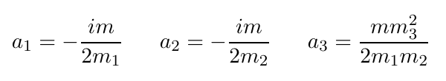
Construct Massive SVV
General amplitude of SVV
O.S.G gives
Massive-massless continuation

Slide 23
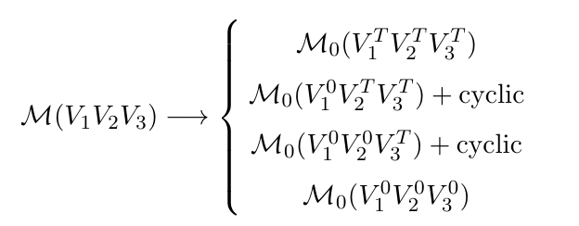
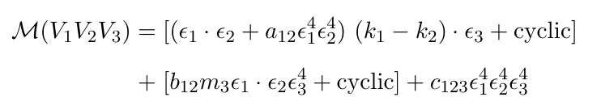
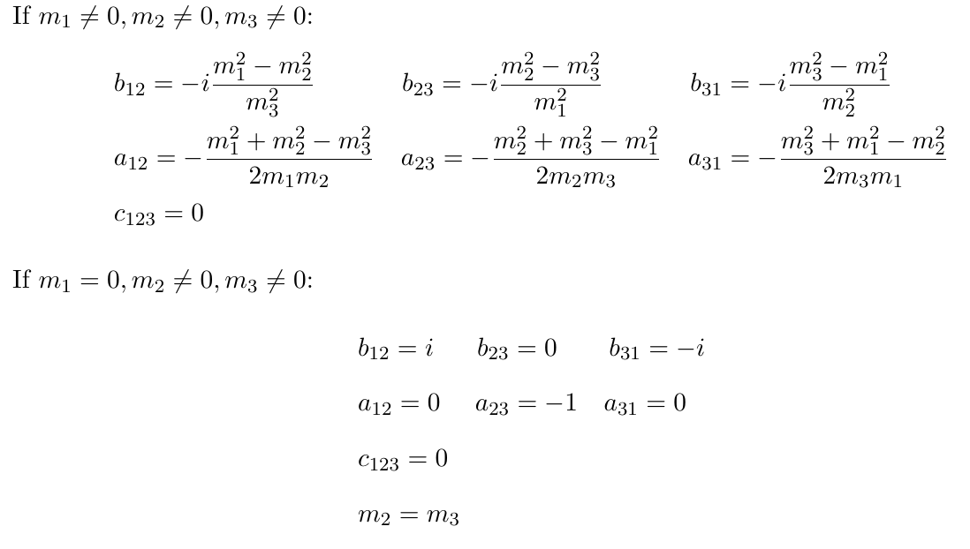
Construct Massive VVV
O.S.G. gives
1.
2.
New
3.

Slide 24

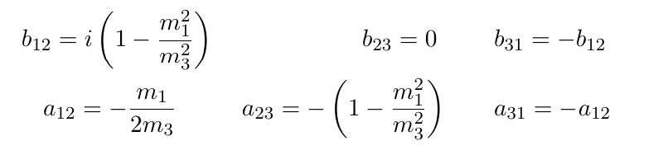



Construct Massive VVV: Special cases
Take two masses to be equal:
Parameterization:
WWZ
SM
WWA

Slide 25
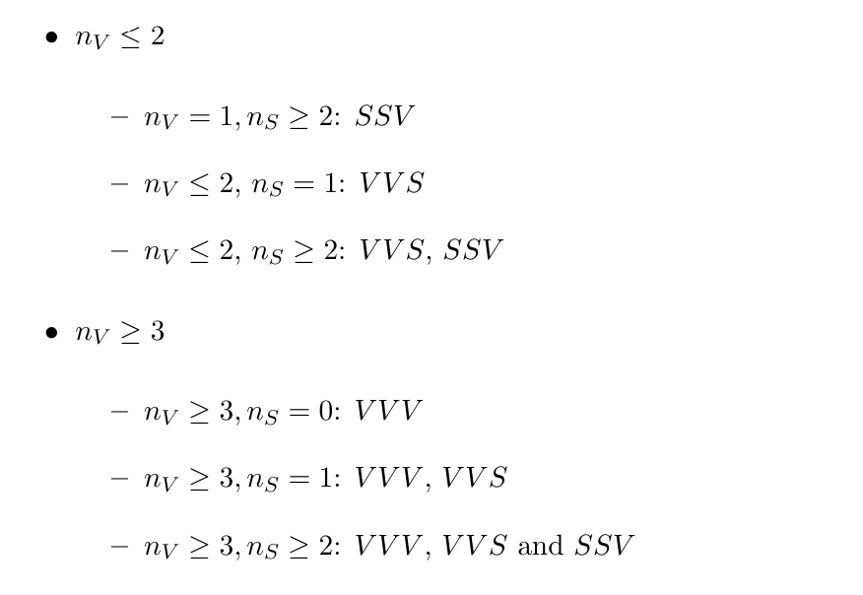
Construct 4-point Amplitude
Classify amplitudes by number of scalars and vector bosons
4-point
VVVV, VVSS;
VVVV,VVSS;

Slide 26

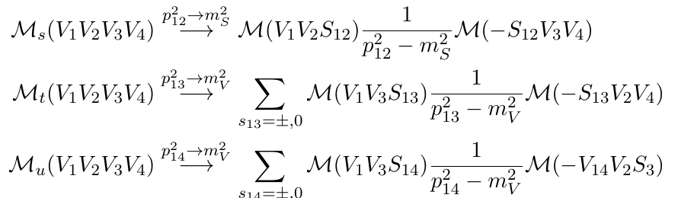
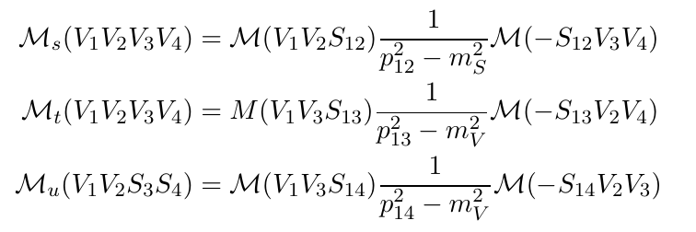
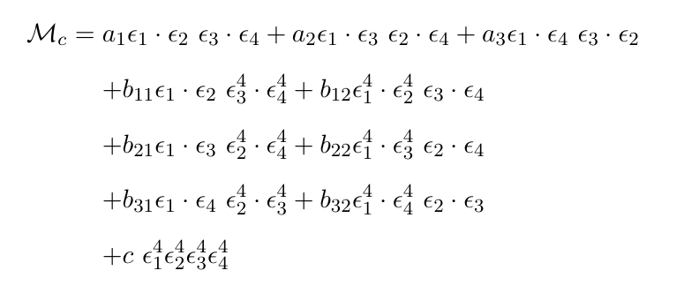
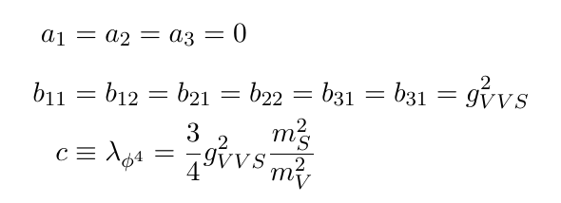


$n_{V}≤2$: VVVV from VVS
Set $n_{V}=1, n_{S}=1$
OSG
all couplings fixed by masses (up to an overall coupling)

Slide 27

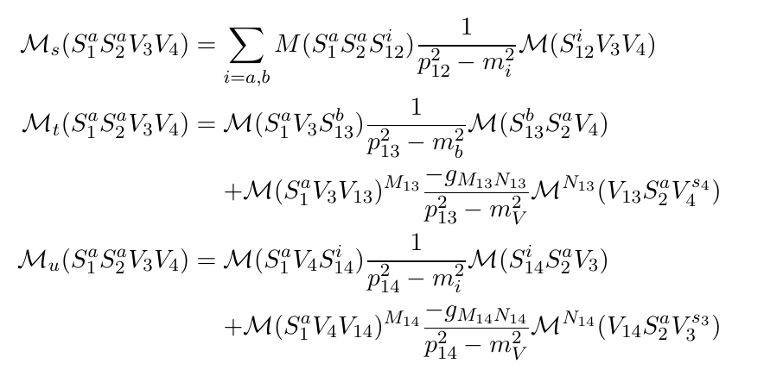


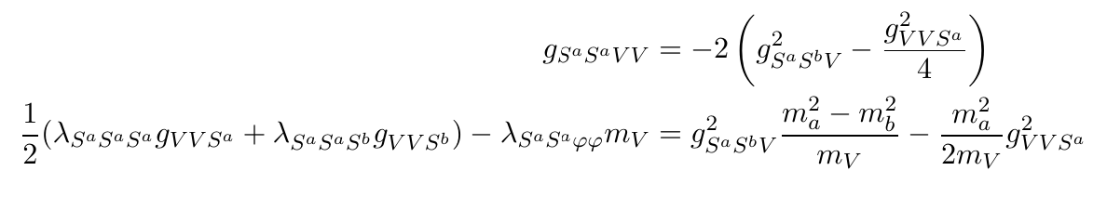

$n_{V}≤2$: VVSS from VVS and SSS

Slide 28

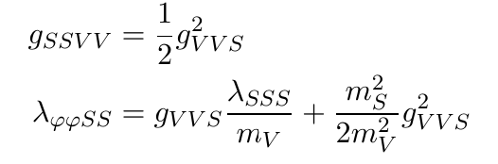




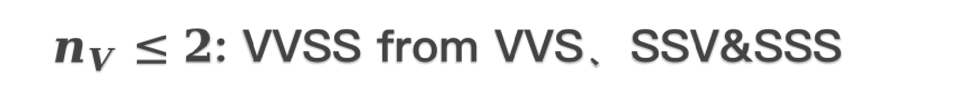
$n_{V}≤2$: VVSS from VVS、SSV&SSS
Limit-1:
scalar self-couplings not fixed
Limit-2:
The general case: U(1) version of SHDM
needs more conditions(e.g. mixing) to fix the parameters
obtain
Scalar QED
obtain
Stueckelberg theory
Combined with 3-point:

Slide 29

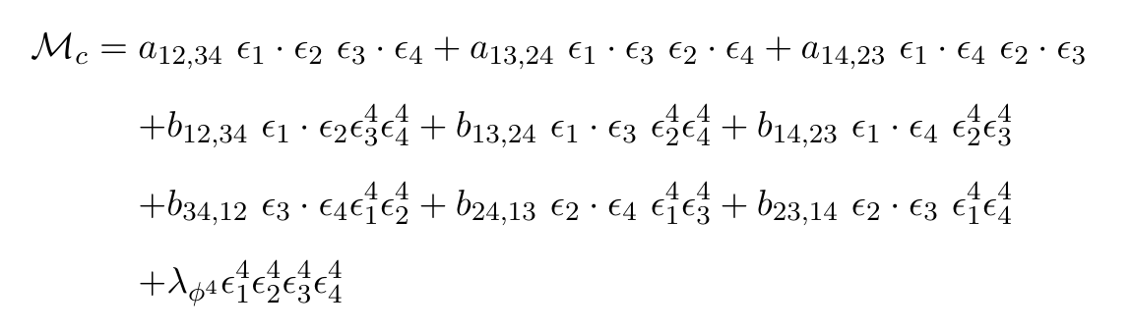


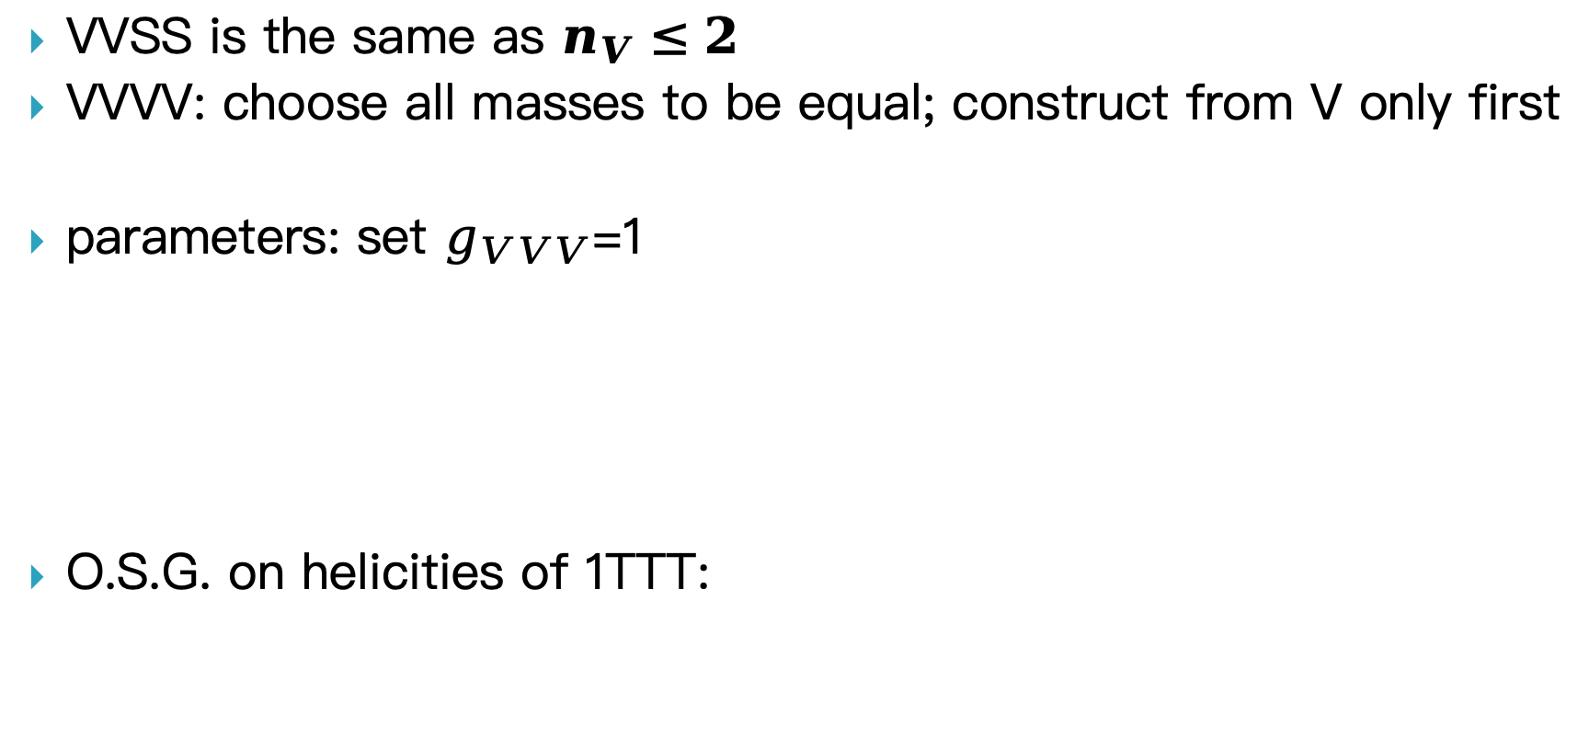
$n_{V}>2$: VVVV
VVSS is the same as $n_{V}≤2$
VVVV: choose all masses to be equal; construct from V only first
parameters: set $g_{VVV}$=1
O.S.G. on helicities of 1TTT:
Massless Yang-Mills theory

Slide 30
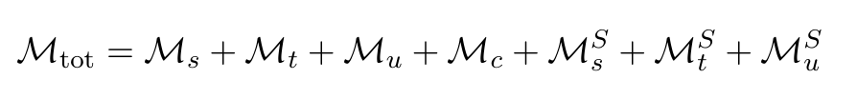
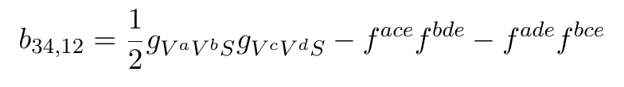
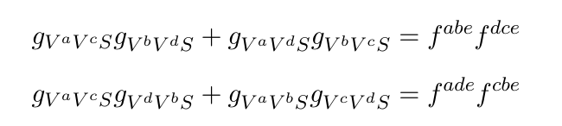
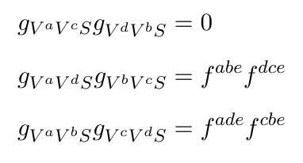


$n_{V}>2$: VVVV
1LLT: no-solution for O.S.G (vector boson only)
Solution: add a scalar
Then applying O.S.G on 1LTT
1LLT:
$b_{ij,kl}$ by permutation
solution
only possible if:
“color” number cannot be diagonal basis

Slide 31



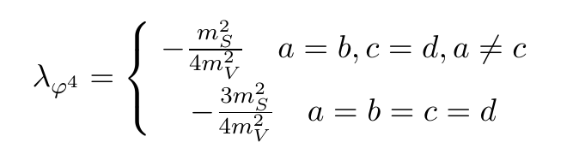
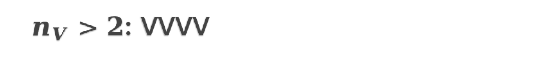
$n_{V}>2$: VVVV
General Solution
e.g. SU(2),
Finally, Apply O.S.G. on 1LLL
All couplings are fixed by masses, except for scalar self-couplings
for
No diagonal basis, instead
only planar diagrams contribute.

Slide 32
Conclusion
We propose two consistent conditions to construct amplitudes with elementary massive vector bosons and scalars.
We construct possible 3-point&4-point amplitudes, including Goldstone-related.
All couplings can be fixed by particle masses, except for scalar self-couplings
Underlying theories:
On-shell gauge symmetry(from Lorentz symmetry)
strong massive-massless continuation
Gauge theory with S.S.B. (e.g. Higgs mechanism)
Stuckelberg mechanism: no dynamic Goldstone

