Slide 1
LED Calibration of EBU
——Liu Danning
2019.08.21

Slide 2
Outline
EBU(Ecal basic unit) single layer structure
LED Calibration
Crosstalk analysis
Conclusion

Slide 3
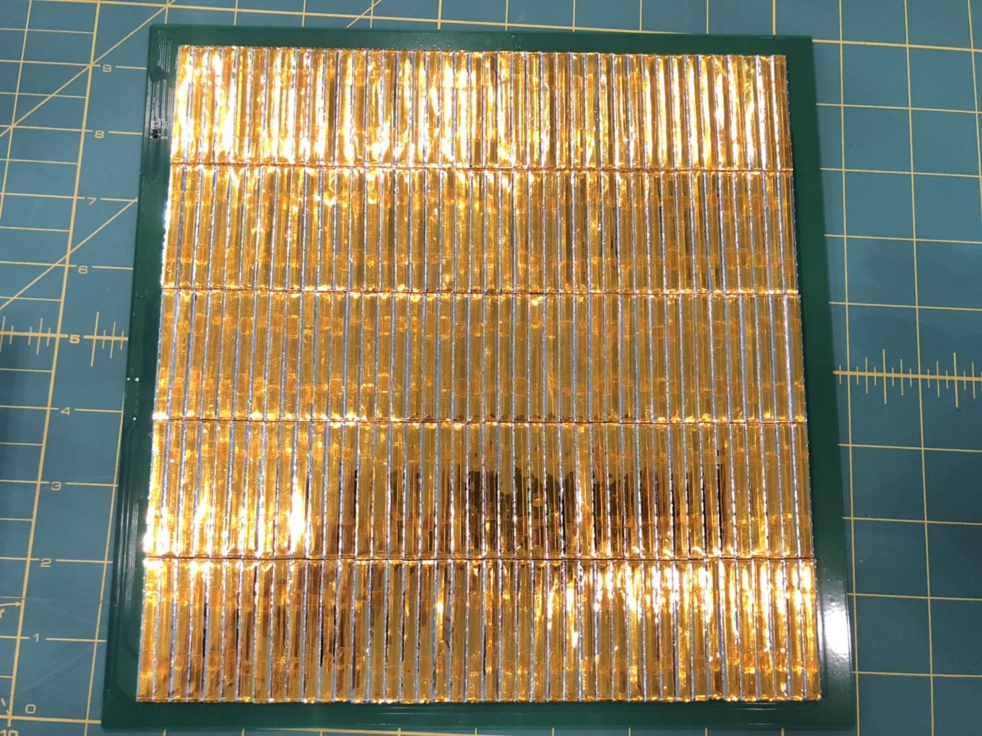
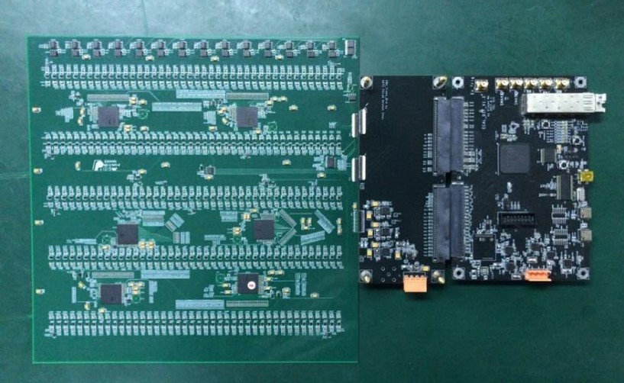
EBU single layer structure
Scintillator Side
Electronics side
210 channels readout with 6 SP2E chips
LED calibration can achieve
Total thickness is controlled under 6mm(<1mm deviation) excluding DIF board

Slide 4
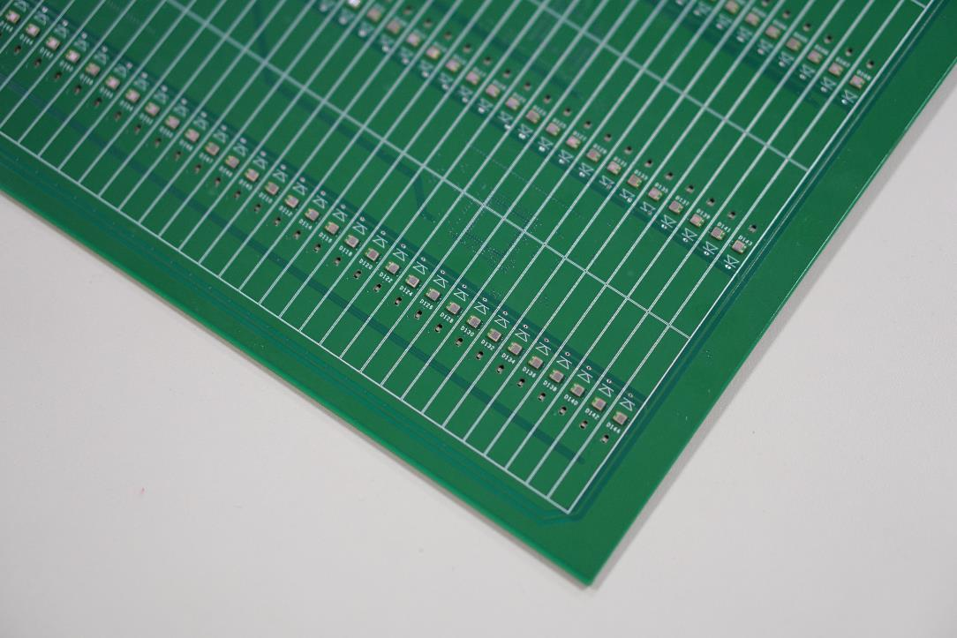
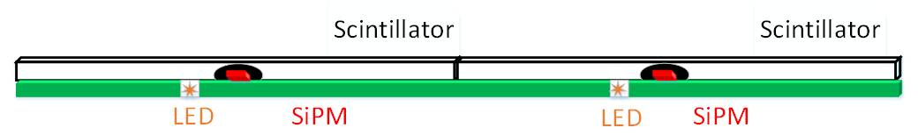
LED Calibration
Check all channel SiPM response
Gain: SiPM single photon electron spectrum
Define linearity range of High gain mode
The ratios of High gain versus Low gain

Slide 5
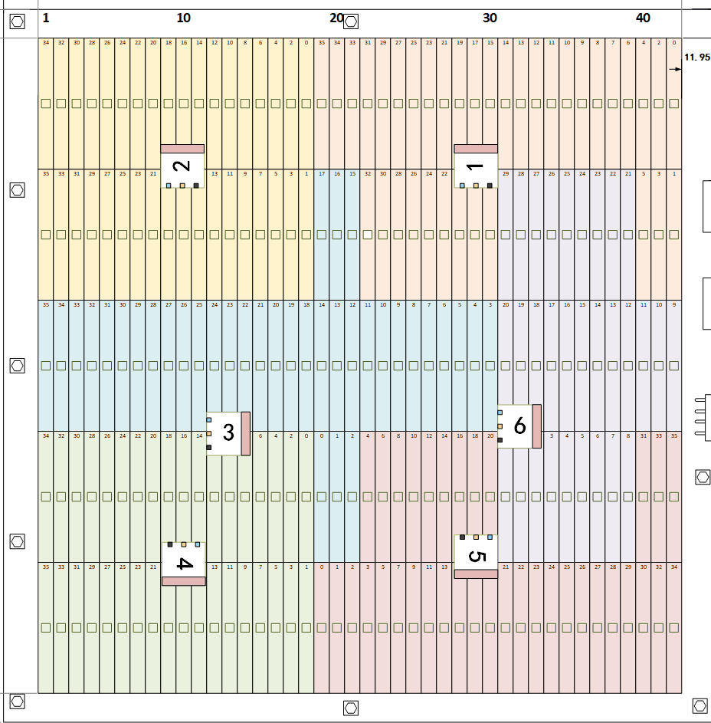
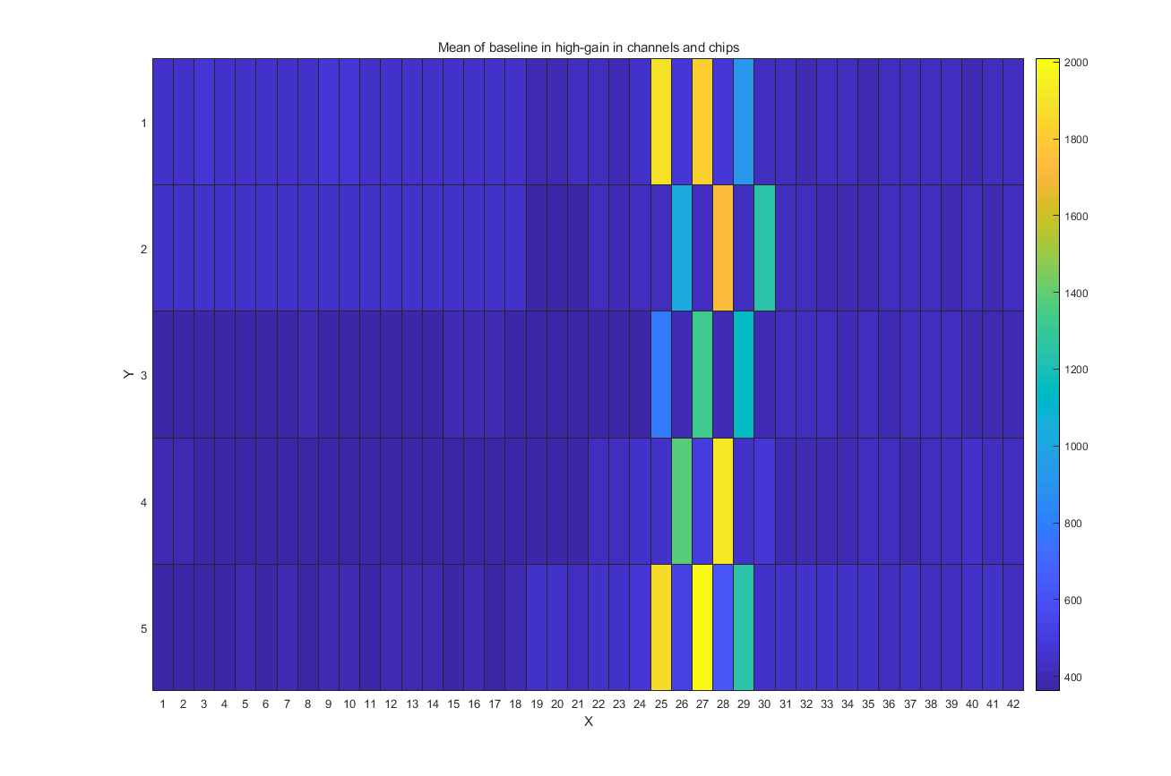
LED Calibration
210 channels on the EBU
Divided into 14 groups
Each group has 15 channels
layout of 6 chips in EBU

Slide 6
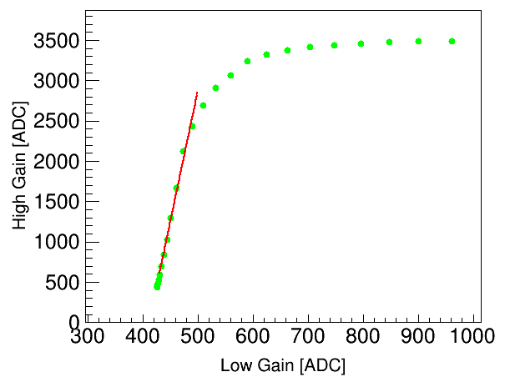
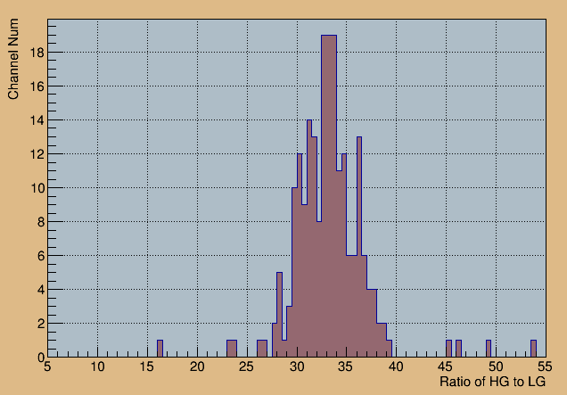
LED Calibration
Calibration the ratio of high gain and low gain mode
210 channels have response with LED voltage increase
The ratio distribution in a wide range

Slide 7
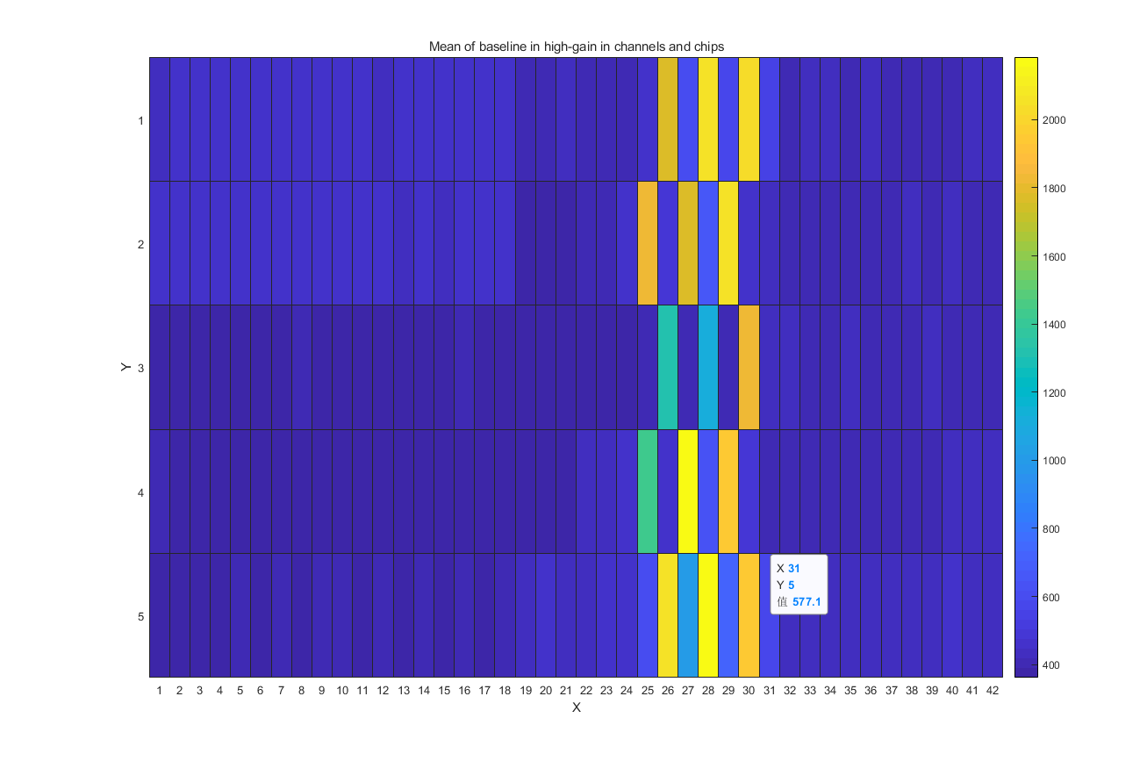
Crosstalk analysis
What is crosstalk?
Responses to signals between adjacent channels
Crosstalk sketch map

Slide 8
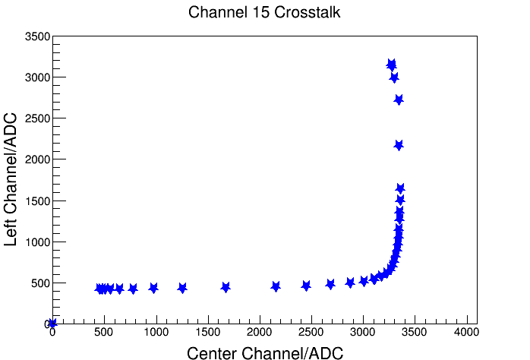
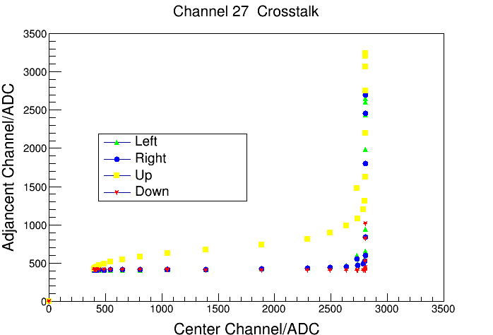
Crosstalk analysis
crosstalk with left channel
Crosstalk with four adjacent channels
The slopes from top to the bottom are 2%,1.4%,17%,0.2%

Slide 9
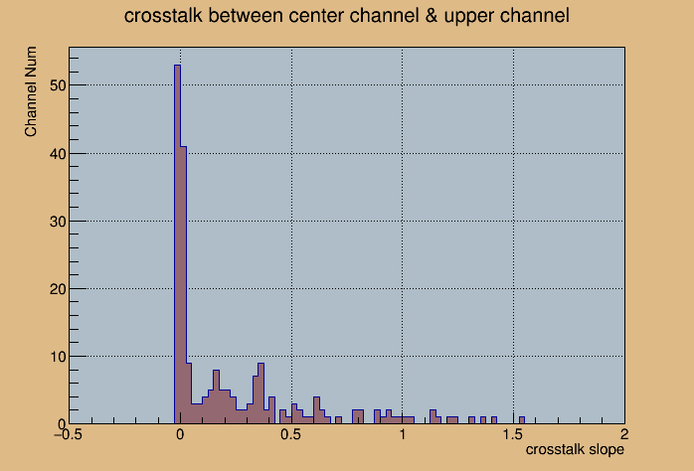
Crosstalk analysis
Most channels have little response to the center light channel
From the tail we can know that crosstalk in some channels is obvious
The slope of crosstalk with 210 channels

Slide 10
Conclusion
210 channels respond to LED
In most channels, the ratio of high gain and low gain focus on near 35
The linearity range of High Gain is 2500ADC
Crosstalk between center channel and upper channel is more obvious

Slide 11
Conclusion
210 channels respond to LED
In most channels, the ratio of high gain and low gain focus on near 35
The linearity range of High Gain is 2500ADC
Crosstalk between center channel and upper channel is more obvious
Thank you

