Slide 1
New Ideas on Indirect Probes of Axions
Huangyu Xiao, University of Chicago

Slide 2
Axion Dark Matter
Well motivated dark matter candidate. Proposed to solve the strong CP problem.
Can also be motivated from string theory (string axiverse), with a broad range of mass (axion-like particles)
In this talk, I will cover both axion-like particles and the QCD axion.

Slide 3
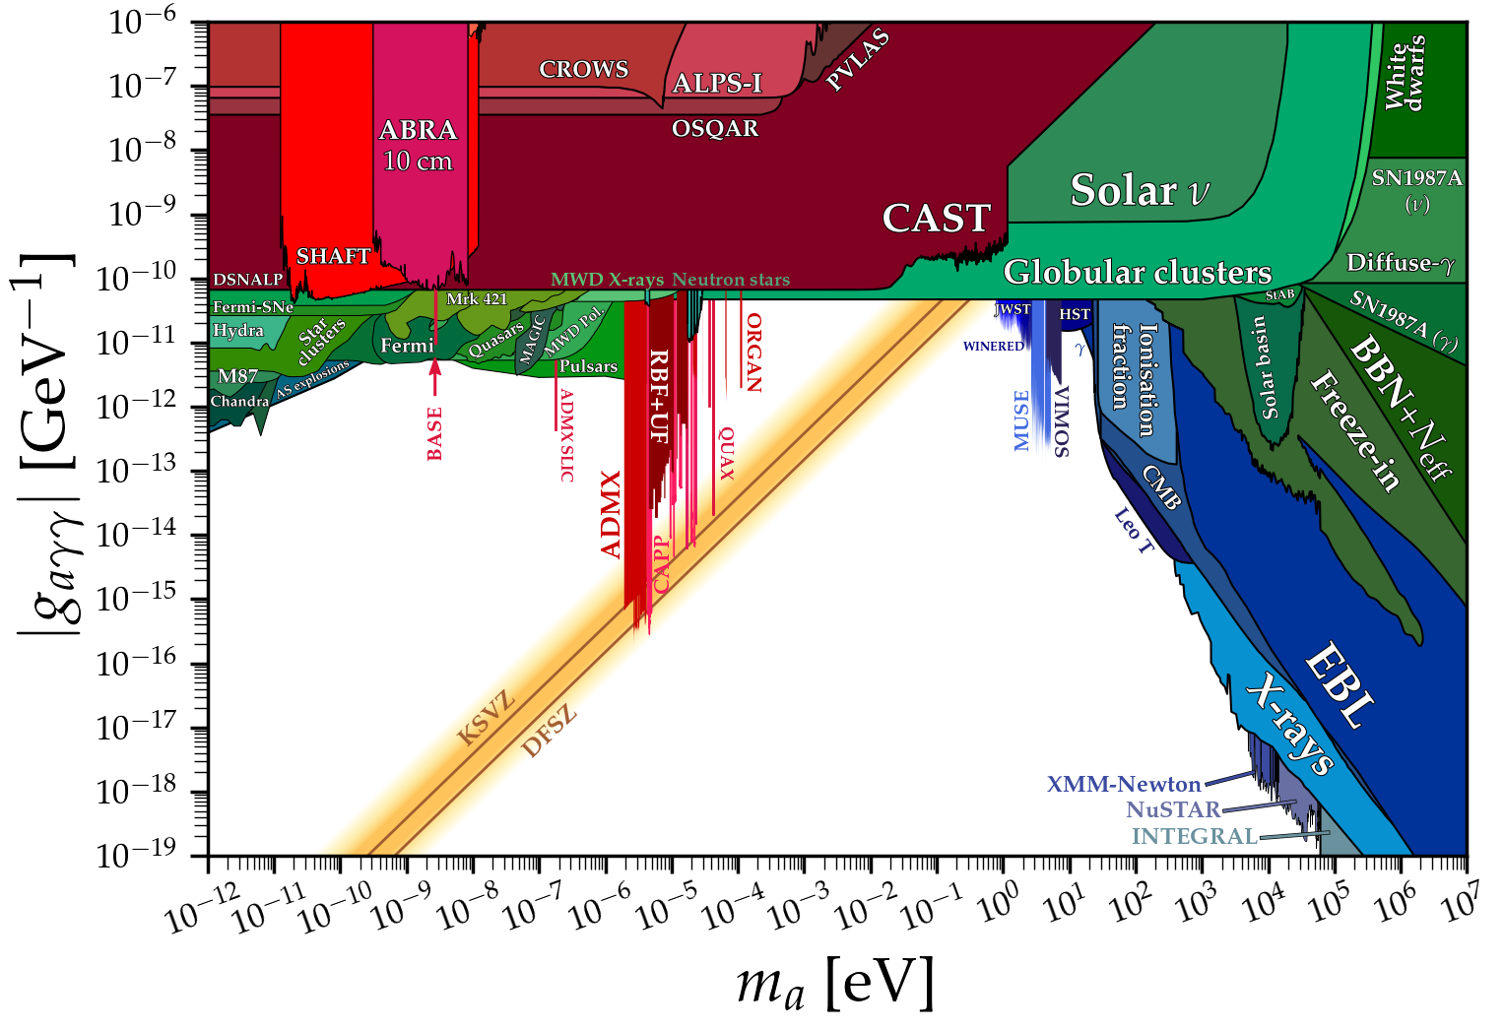
Current Status
Direct detection experiments can reach very weak couplings, but cannot cover a broad range of mass.
Astrophysical bounds can cover a broad range of mass, not only sensitive to strong couplings.
We need new ideas to probe more parameter space!

Slide 4
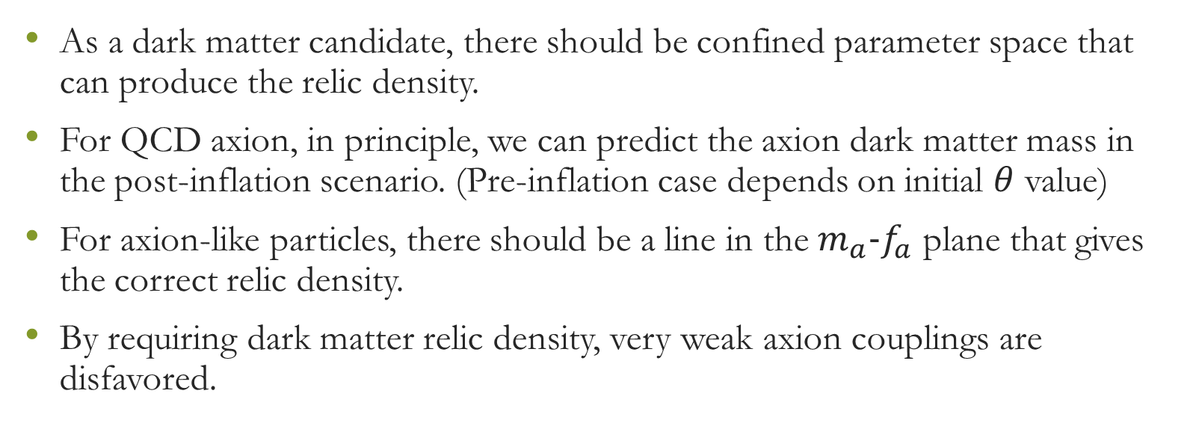
Axion as Dark Matter Target
As a dark matter candidate, there should be confined parameter space that can produce the relic density.
For QCD axion, in principle, we can predict the axion dark matter mass in the post-inflation scenario. (Pre-inflation case depends on initial $θ$ value)
For axion-like particles, there should be a line in the $m_{a}-f_{a}$ plane that gives the correct relic density.
By requiring dark matter relic density, very weak axion couplings are disfavored.

Slide 5
New Ideas and Proposals
Free-streaming effect from axions (ALP)
Polarization measurement on black holes (ALP)
Signals of collapsing axion stars (ALP)
Gravitational signatures of axion miniclusters (Both ALP and QCD axion)

Slide 6
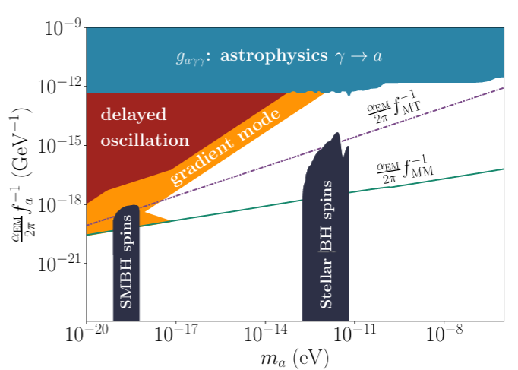
Axion Free-Streaming
Overproduction of axion relic density generically requires nonzero axion modes. Due to the wave nature of axions, it leads to either free-streaming effect or enhanced isocurvature perturbations. This leads to Universal axion bound.
(K. Harigaya, W. Hu, R. Liu, HX, 2025)

Slide 7
Axion Free-Streaming
We categorize generic scenarios of axion abundance enhanced into
Delayed oscillation (trapped axion field)
Gradient Mode (kinetic misalignment mechanism)
In the trapping case, gradient modes will still be produced from parametric resonance.

Slide 8
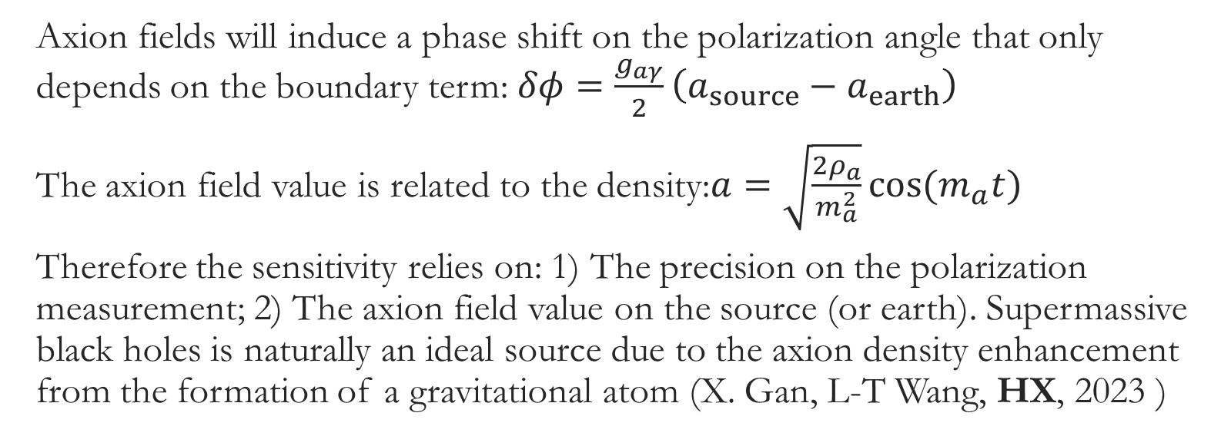
Cosmic birefringence and polarization searches for axions
Axion fields will induce a phase shift on the polarization angle that only depends on the boundary term: $δφ=\frac{g_{aγ}}{2}\left(a_{source}−a_{earth}\right)$
The axion field value is related to the density:$a=\sqrt{\frac{2ρ_{a}}{m_{a}^{2}}}cos(m_{a}t)$
Therefore the sensitivity relies on: 1) The precision on the polarization measurement; 2) The axion field value on the source (or earth). Supermassive black holes is naturally an ideal source due to the axion density enhancement from the formation of a gravitational atom (X. Gan, L-T Wang, HX, 2023 )

Slide 9
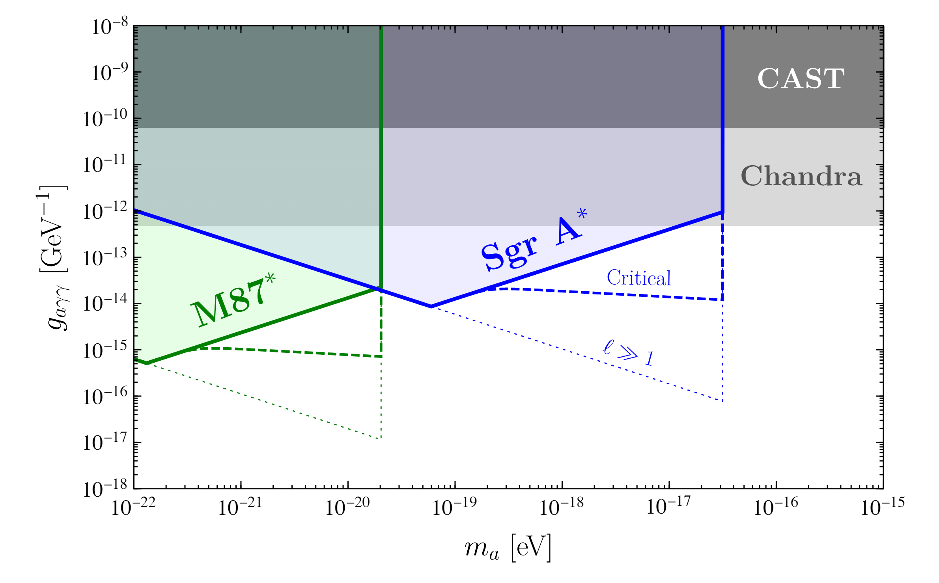
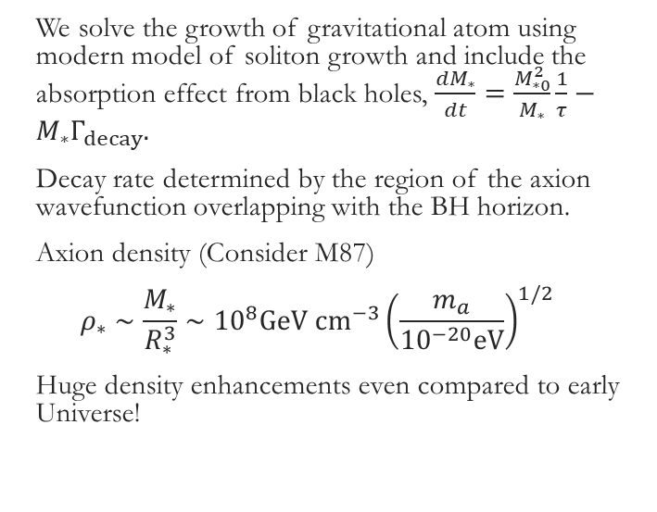
Black hole Polarimetry
We solve the growth of gravitational atom using modern model of soliton growth and include the absorption effect from black holes, $\frac{dM_{∗}}{dt}=\frac{M_{∗0}^{2}}{M_{∗}}\frac{1}{τ}−M_{∗}Γ_{decay}.$
Decay rate determined by the region of the axion wavefunction overlapping with the BH horizon.
Axion density (Consider M87)
$$ρ_{∗}∼\frac{M_{∗}}{R_{∗}^{3}}∼{10}^{8}GeV cm^{−3}{\left(\frac{m_{a}}{{10}^{−20}eV}\right)}^{1/2}$$
Huge density enhancements even compared to early Universe!

Slide 10
Collapsing Axion Stars
Axion Stars are balanced by kinetic pressure. There self-couplings are attractive. When axion stars are too dense, they collapse and emit relativistic axions (or visible photon).
Our visible star explosions will not change cosmology. It can only convert matter to radiation up to the nuclear binding energy. The baryon number is conserved in this case.
However, the axion number is not conserved due to the quartic self-interaction. Therefore it is potentially very constraining by cosmological observations.

Slide 11
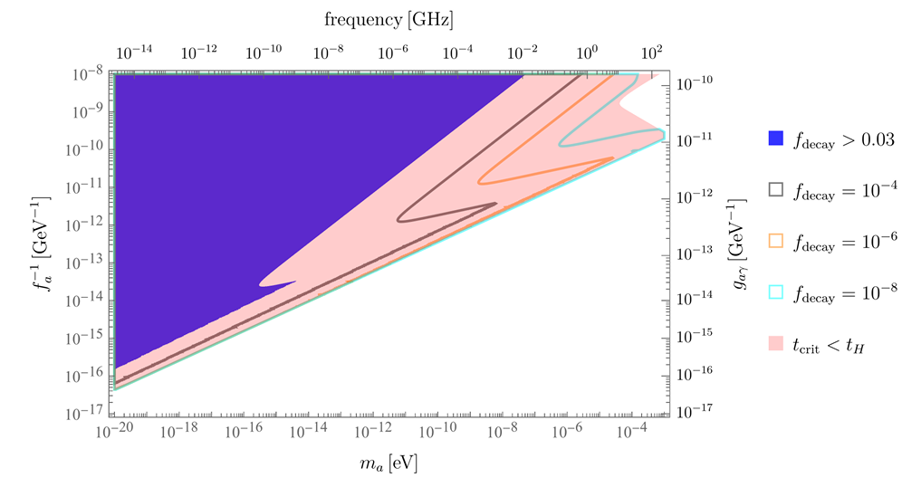
Collapsing Axion Stars
Post-inflation axions generically lead to the formation of axion stars due to the nonzero modes.
Axion star formation rate can be so efficient that collapsing axion stars can deplete a significant fraction of dark matter mass (P.J. Fox, N. Weiner, HX, 2023).
It can also lead to interesting radio signals through quenched parametric resonance. (P.J. Fox, N. Weiner, HX, 2025).

Slide 12
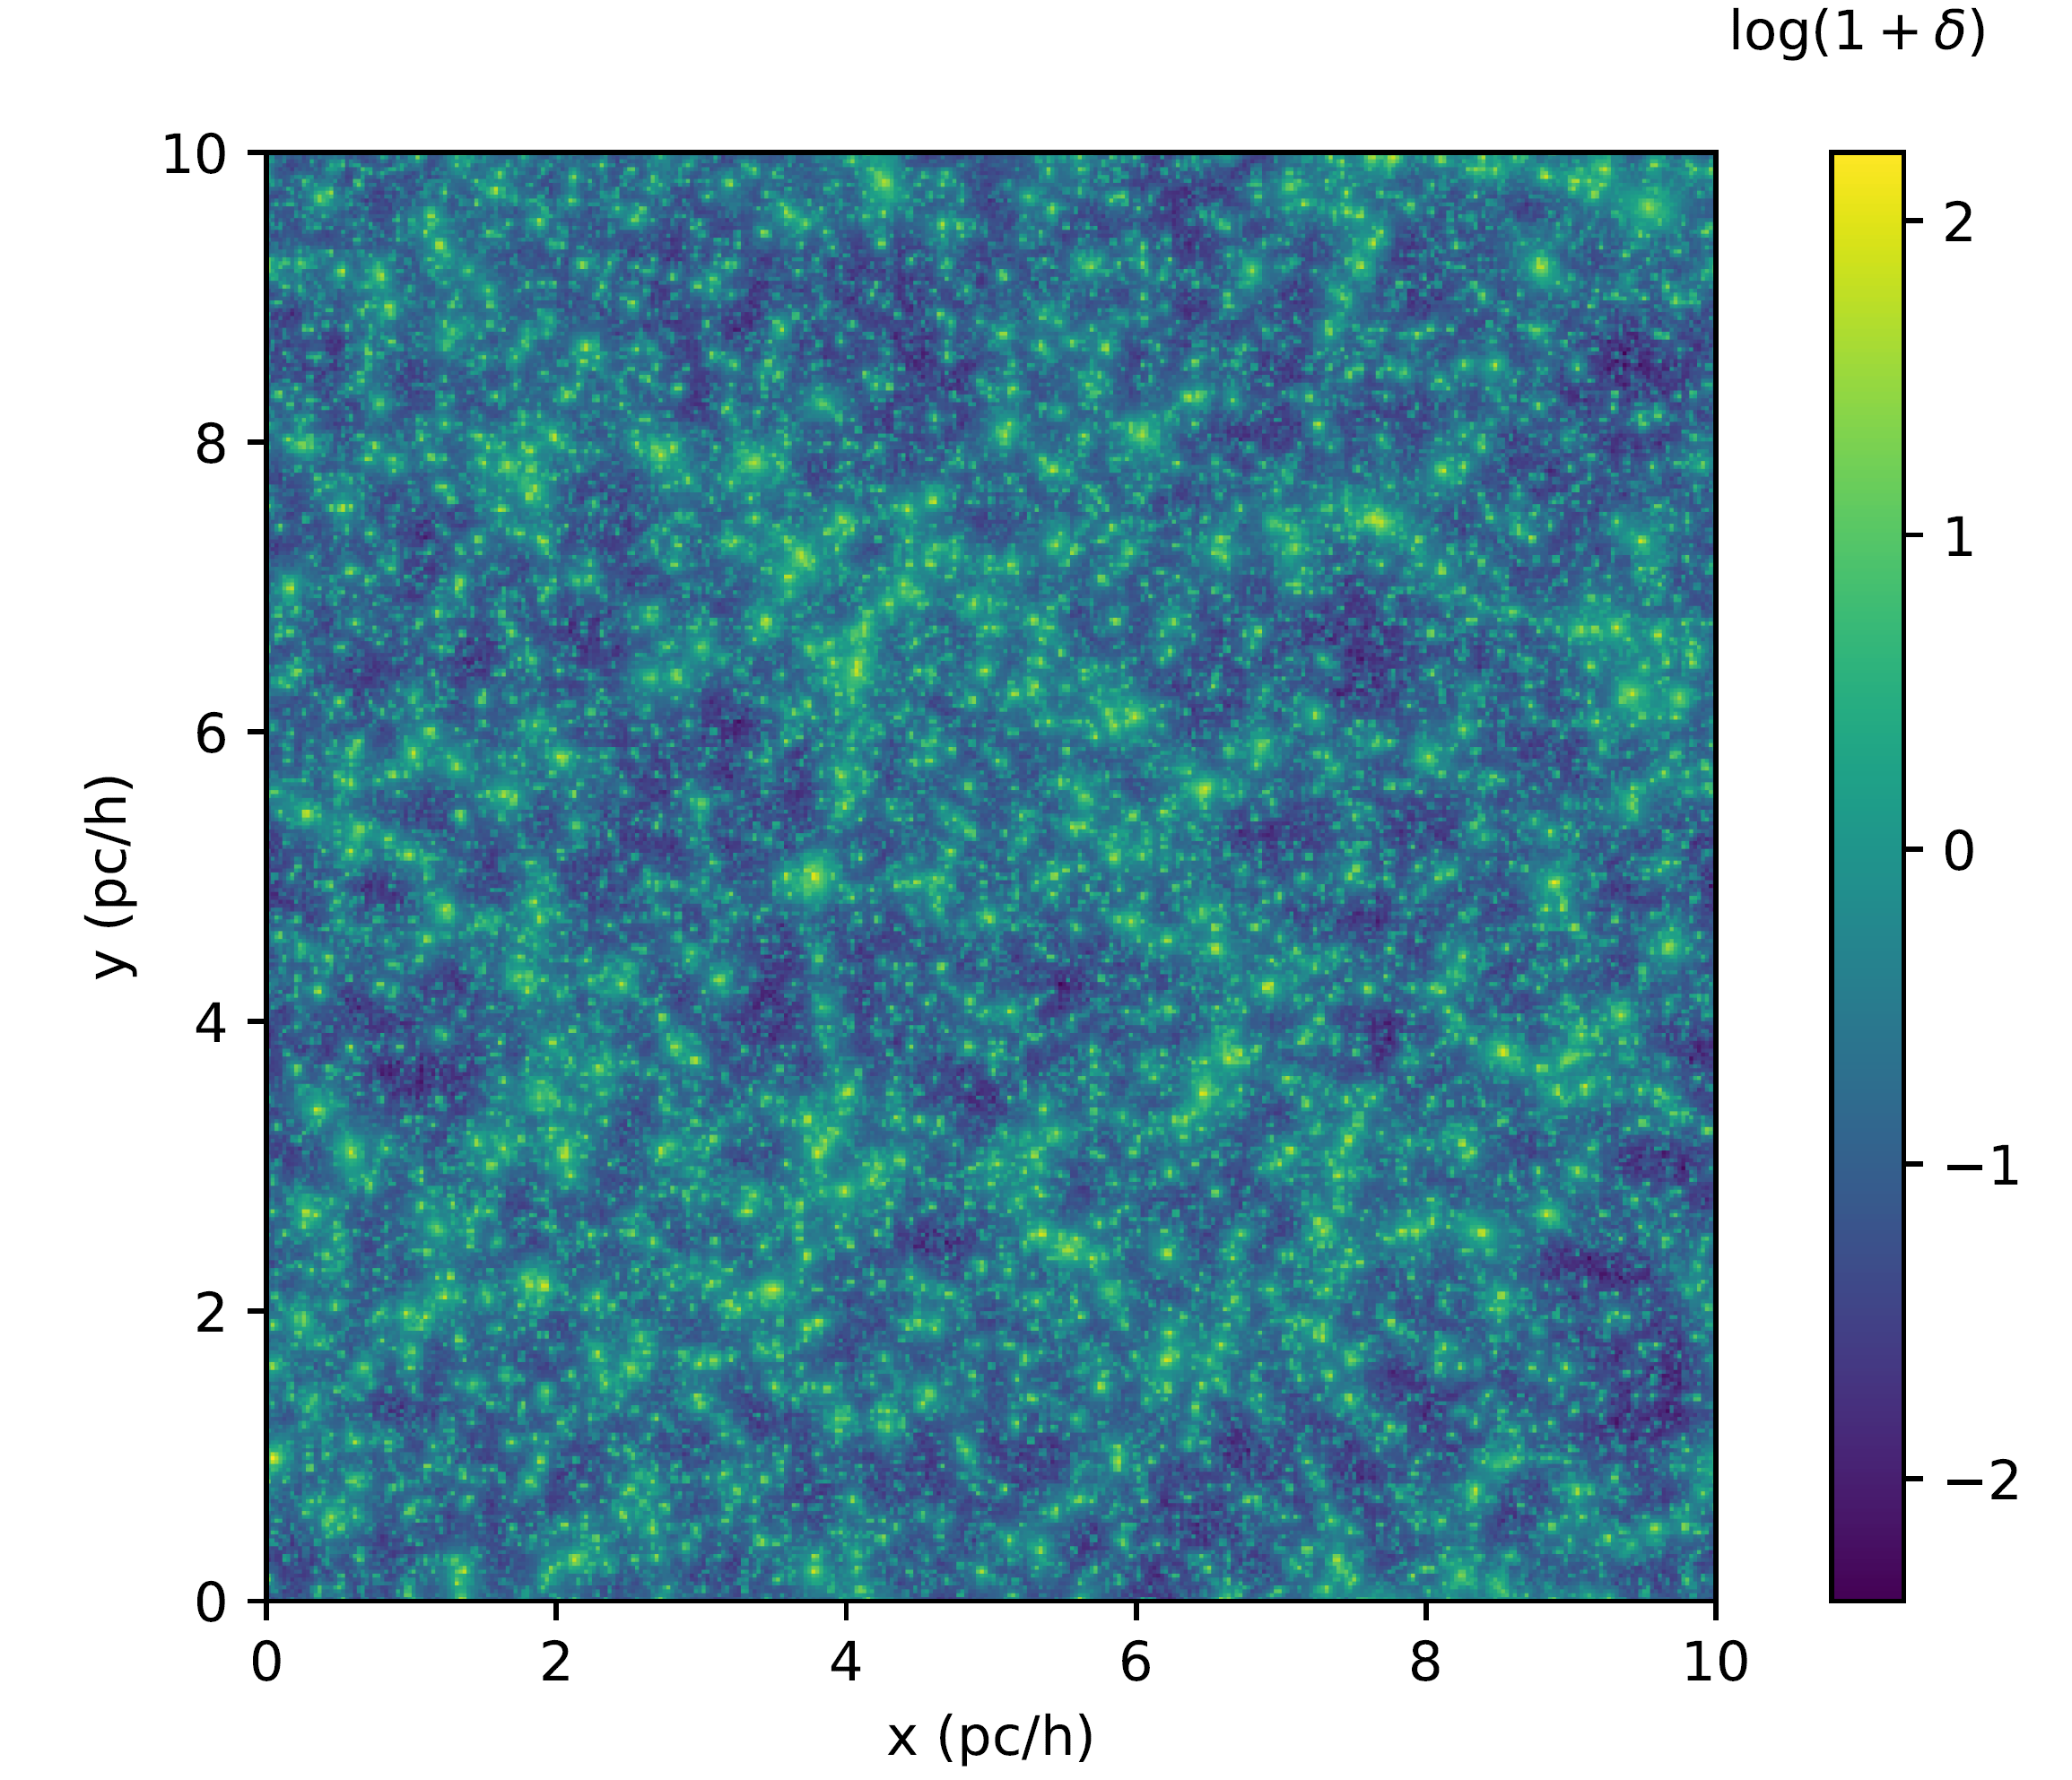
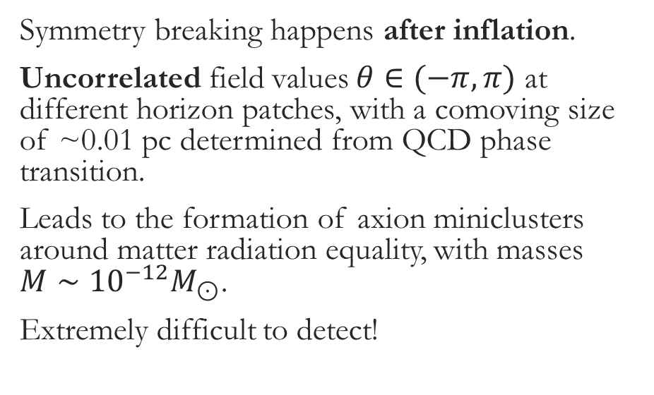
Axion Miniclusters
Symmetry breaking happens after inflation.
Uncorrelated field values $θ∈(−π, π)$ at different horizon patches, with a comoving size of ~0.01 pc determined from QCD phase transition.
Leads to the formation of axion miniclusters around matter radiation equality, with masses $M∼{10}^{−12}M_{⊙}$.
Extremely difficult to detect!
HX, I. Williams, M. McQuinn, 2021

Slide 13
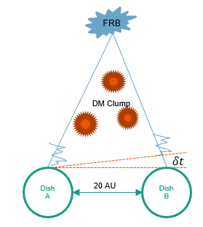
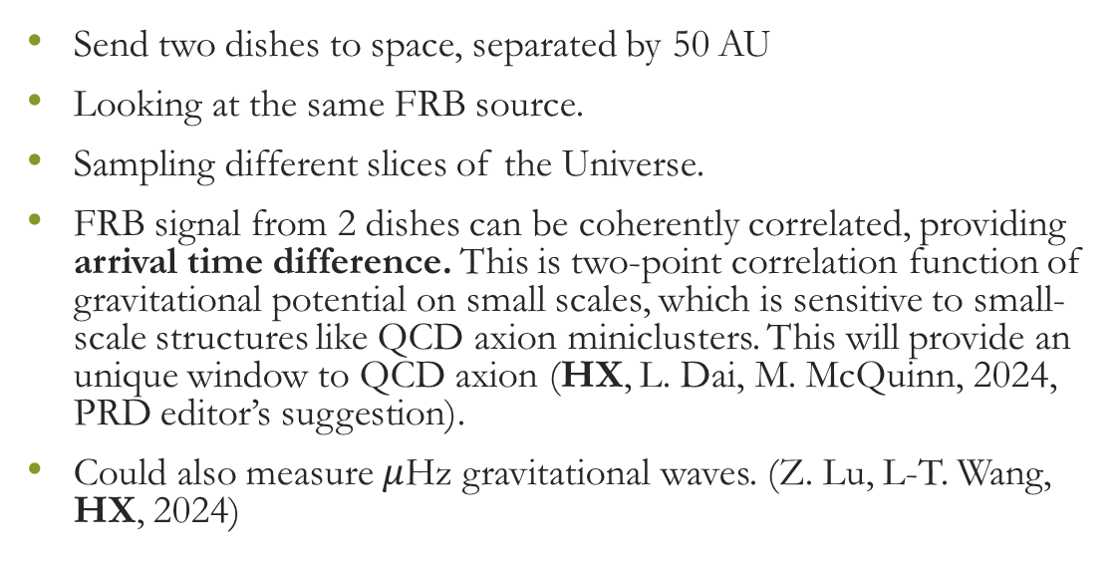
Fast Radio Bursts Timing Detecting QCD Axion Miniclusters
Send two dishes to space, separated by 50 AU
Looking at the same FRB source.
Sampling different slices of the Universe.
FRB signal from 2 dishes can be coherently correlated, providing arrival time difference. This is two-point correlation function of gravitational potential on small scales, which is sensitive to small-scale structures like QCD axion miniclusters. This will provide an unique window to QCD axion (HX, L. Dai, M. McQuinn, 2024, PRD editor’s suggestion).
Could also measure $μ$Hz gravitational waves. (Z. Lu, L-T. Wang, HX, 2024)

Slide 14
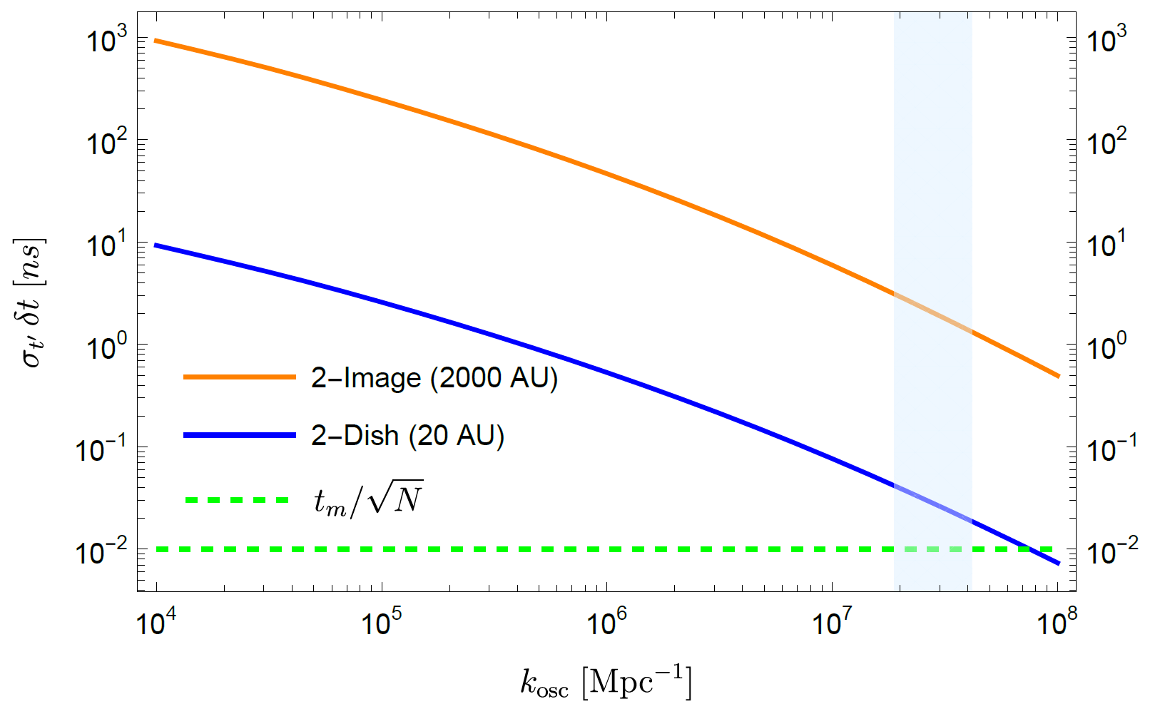
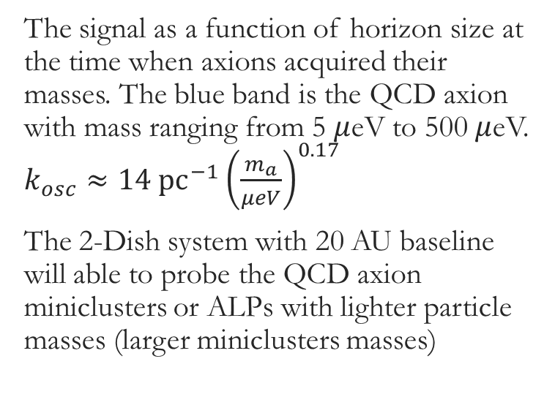
Fast Radio Bursts Timing Detecting QCD Axion Miniclusters
The signal as a function of horizon size at the time when axions acquired their masses. The blue band is the QCD axion with mass ranging from 5 $μ$eV to 500 $μ$eV. $k_{osc}≈14 pc^{−1}{\left(\frac{m_{a}}{μeV}\right)}^{0.17}$
The 2-Dish system with 20 AU baseline will able to probe the QCD axion miniclusters or ALPs with lighter particle masses (larger miniclusters masses)

Slide 15
Conclusion
Axion Searches can be very different from other dark matter searches. Its wave feature can give unique dynamics.
New Ideas, with theoretical considerations on axion dynamics, and observations from large scale structure, black holes, fast radio bursts, can greatly enhance our chance of discovering axions.

