Slide 1
Exotic Higgs decay to 4b final states at CEPC

Slide 2
Jet flavor tagging
PrimeTagSvc leverages the Particle Transformer to provide detailed flavor identification for particle jets
Takes a collection of Particle Flow Objects (PFOs) corresponding to a single jet and return a probability distribution over various quark and gluon flavors
We used the model trained on a sample of ZH events, where Z decays to neutrinos.
Training the model with our sample with JOI will cost lots of time and computing resource

Slide 3
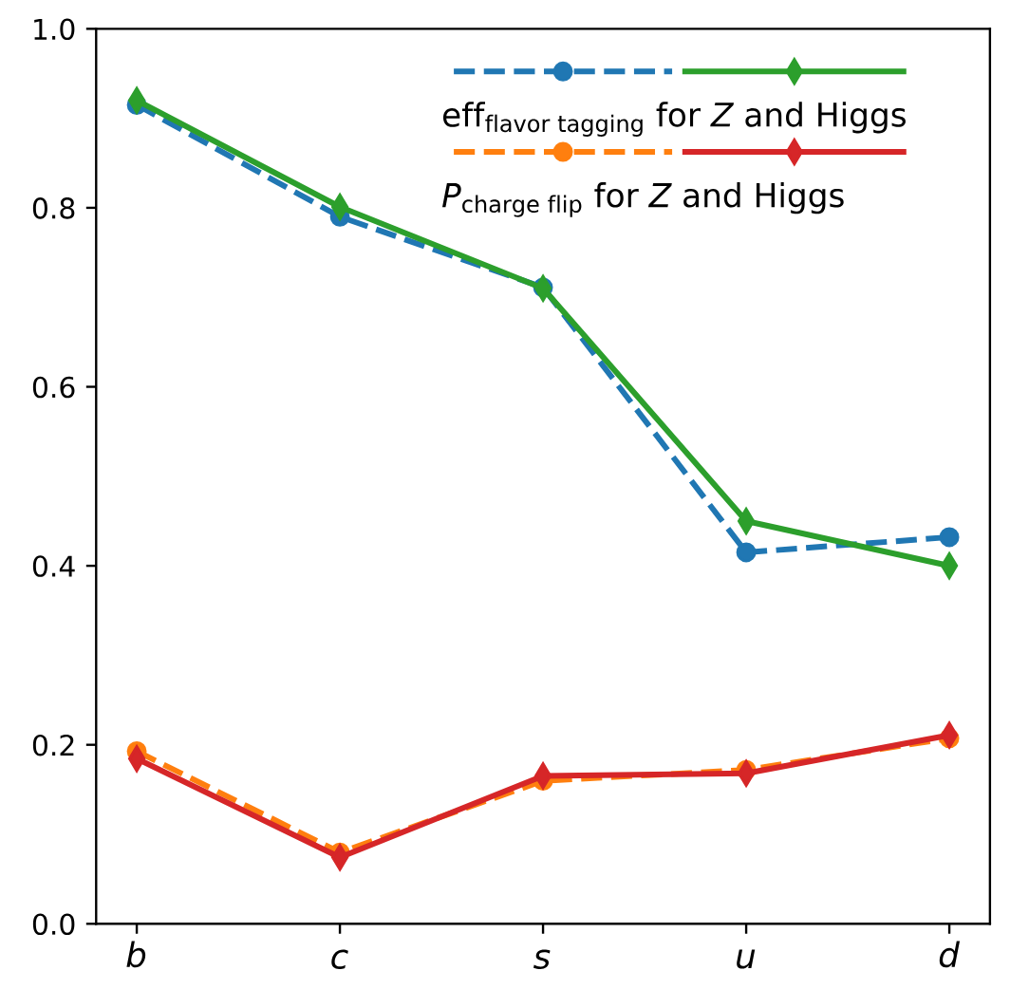
Jet flavor tagging efficiency
PRL 132, 221802 (2024)
The b-tagging efficiency is 95%
Mistagging rate of 1% for other flavors
Can be extrapolated for other processes

Slide 4
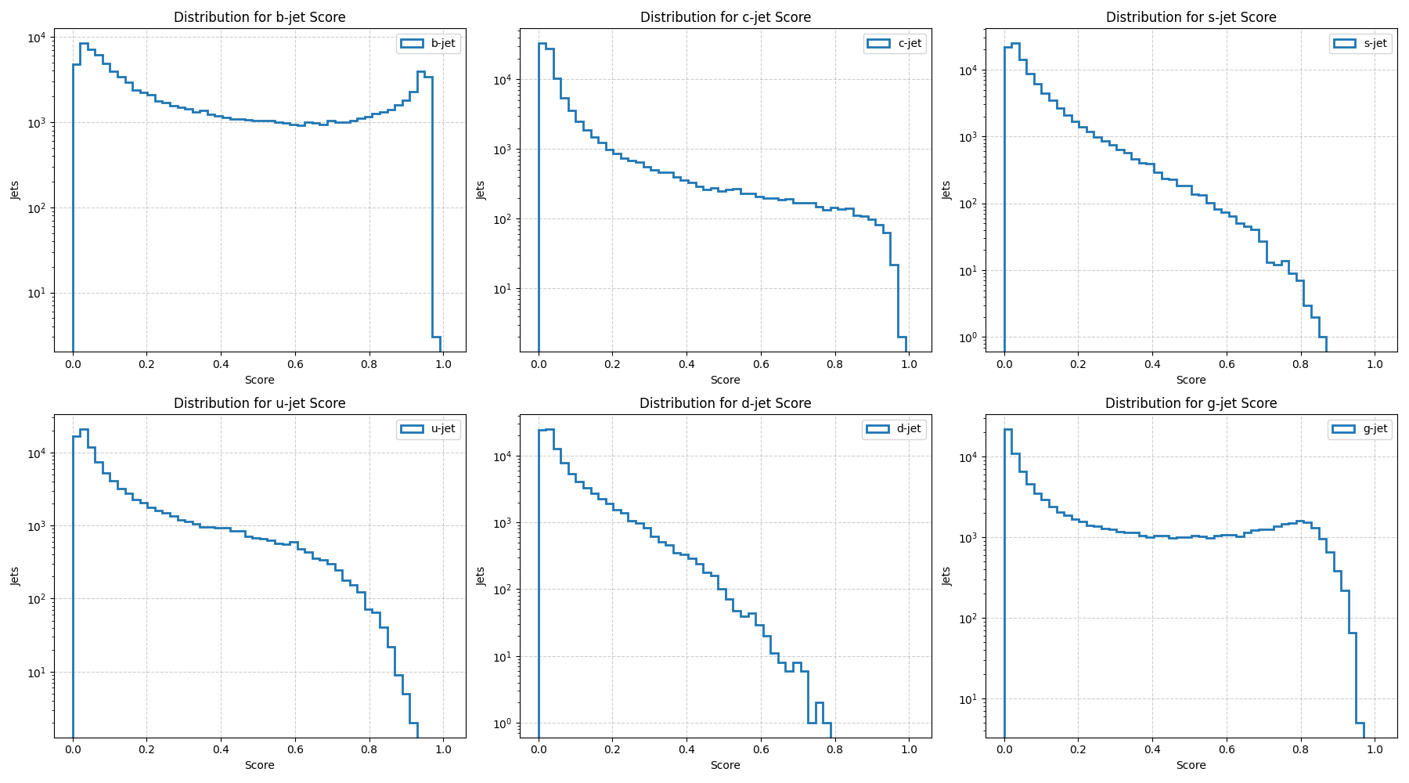
Score distribution

Slide 5
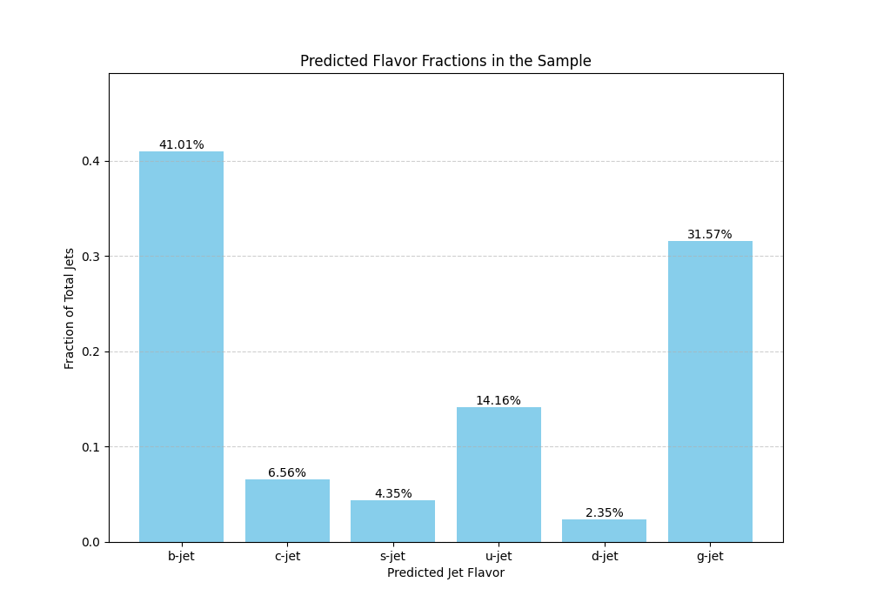
Jet flavor fraction

Slide 6
Next step
Compare the jet kinematics between this study and previous one
Use BDT to separate signal process from background processes
Estimate the upper limit on the signal cross section using profile likelihood ratio according to the BDT score
In the future:
Train the ParT from scratch
Also, compare with CSI and foundation model

