Slide 1




LQCDMaster in Action
A Pion Two-Point Correlator Example
Shanghai Jiao Tong University: Wei Wang, Hao-Fei Gao, Jin-Xin Tan*, Mu-Hua Zhang
Beihang University: Qi-An Zhang
South China Normal University: Jun Hua
September 12, 2026
* Speaker

Slide 2
Pion Two-Point Correlators with LQCDMaster

Slide 3
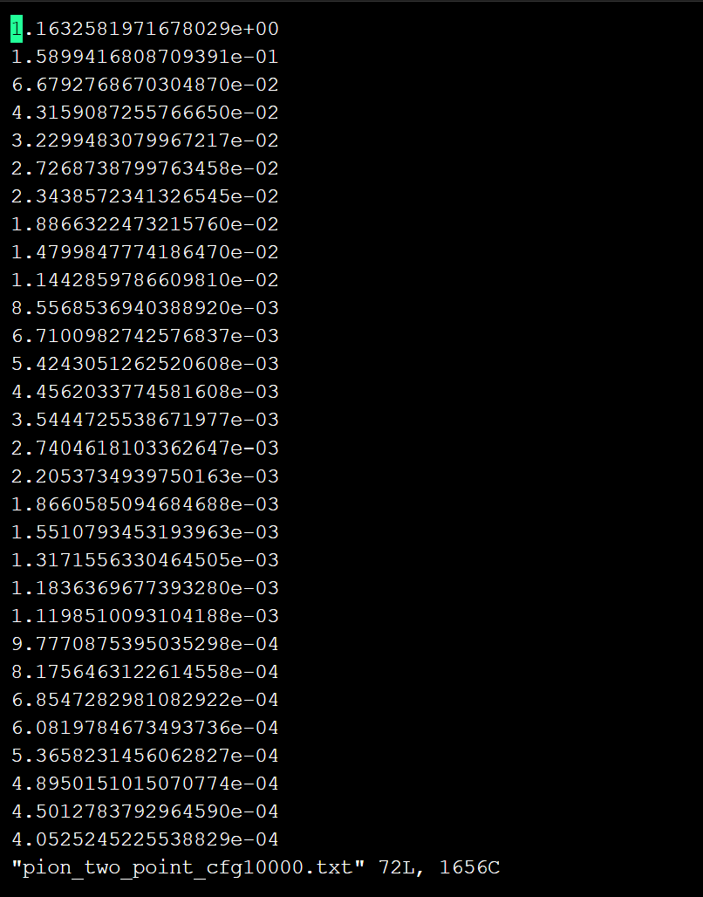
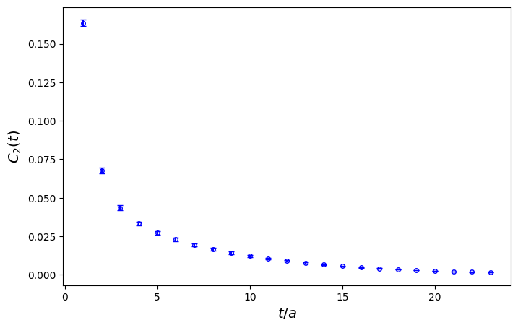
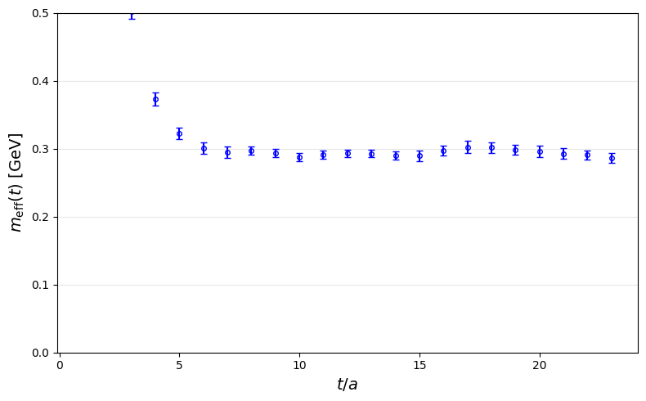
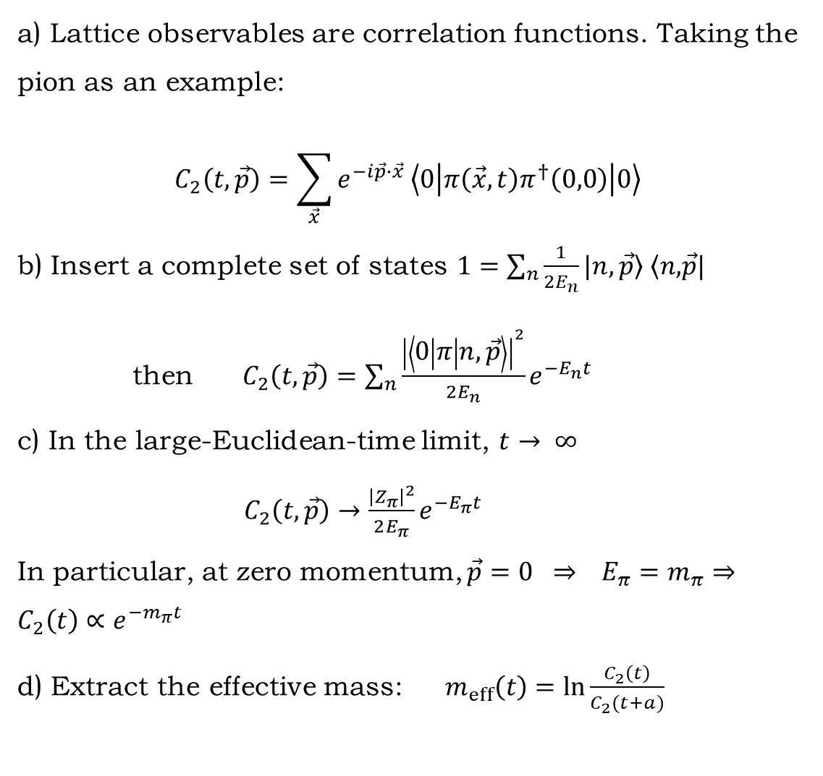
Spectral Decomposition of the Two-Point Correlator and Effective Mass
a) Lattice observables are correlation functions. Taking the pion as an example:
$$C_{2}\left(t,\vec{p}\right)=\sum_{\vec{x}}{e^{−i\vec{p}∙\vec{x} }\left\langle 0 | π\left(\vec{x},t\right)π^{†}\left(0,0\right) | 0\right\rangle }$$
b) Insert a complete set of states $1=\sum_{n}{\frac{1}{2E_{n}}\left.|n,\vec{p}\right\rangle \left\langle n,\right.\vec{p}|}$
then $C_{2}\left(t,\vec{p}\right)=\sum_{n}{\frac{{\left|\left\langle 0 | π | n,\vec{p}\right\rangle \right|}^{2}}{2E_{n}}e^{−E_{n}t}}$
c) In the large-Euclidean-time limit, $t→ ∞$
$C_{2}\left(t,\vec{p}\right)→\frac{{\left|Z_{π}\right|}^{2}}{2E_{π}}e^{−E_{π}t}$
In particular, at zero momentum, $\vec{p}=0 ⇒ E_{π}=m_{π}⇒C_{2}\left(t\right)∝e^{−m_{π}t}$
d) Extract the effective mass: $m_{eff}\left(t\right)=\ln{\frac{C_{2}\left(t\right)}{C_{2}(t+a)}}$
2–point correlation function
effective mass

Slide 4



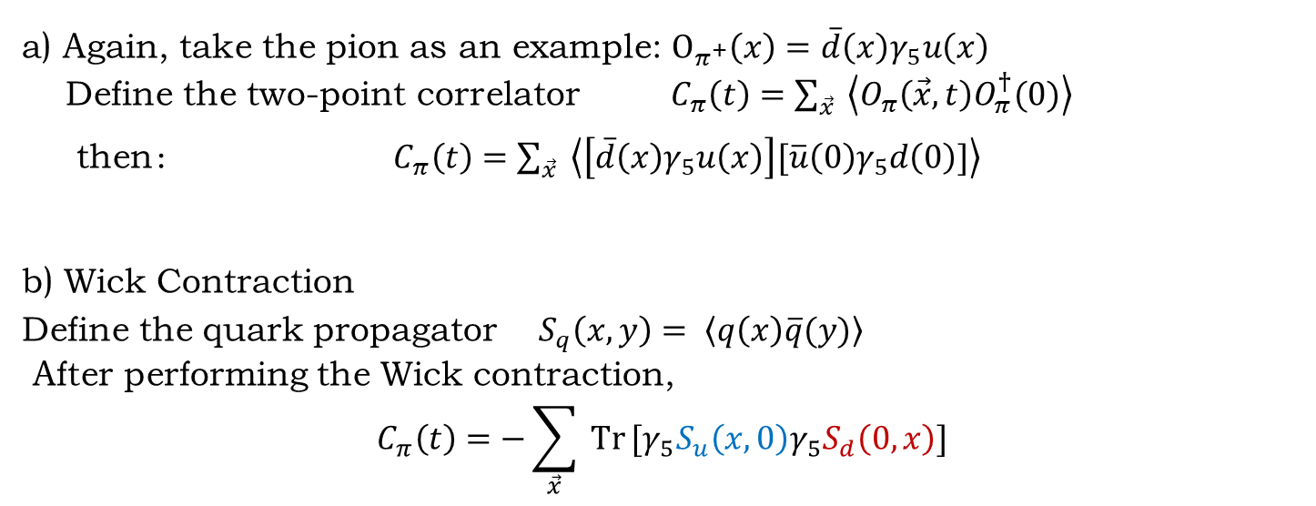



Wick Contraction of the Two-Point Correlator
a) Again, take the pion as an example: $O_{π^{+}}\left(x\right)=\overline{d}\left(x\right)γ_{5}u\left(x\right)$
Define the two-point correlator $C_{π}\left(t\right)=\sum_{\vec{x}}{ \left\langle O_{π}\left(\vec{x},t\right)O_{π}^{†}(0)\right\rangle }$
then： $C_{π}\left(t\right)=\sum_{\vec{x}}{ \left\langle \left[\overline{d}\left(x\right)γ_{5}u\left(x\right)\right][\overline{u}\left(0\right)γ_{5}d\left(0\right)]\right\rangle }$
b) Wick Contraction
Define the quark propagator $S_{q}\left(x,y\right)= \left\langle q\left(x\right)\overline{q}(y)\right\rangle$
After performing the Wick contraction,
$$C_{π}\left(t\right)=−\sum_{\vec{x}}{ Tr}[γ_{5}S_{u}\left(x,0\right)γ_{5}S_{d}\left(0,x\right)]$$
$$\overline{u}$$
$$u$$
$$d$$
$$\overline{d}$$
$$(0,0)$$
$$\left(\vec{x},t\right)$$

Slide 5
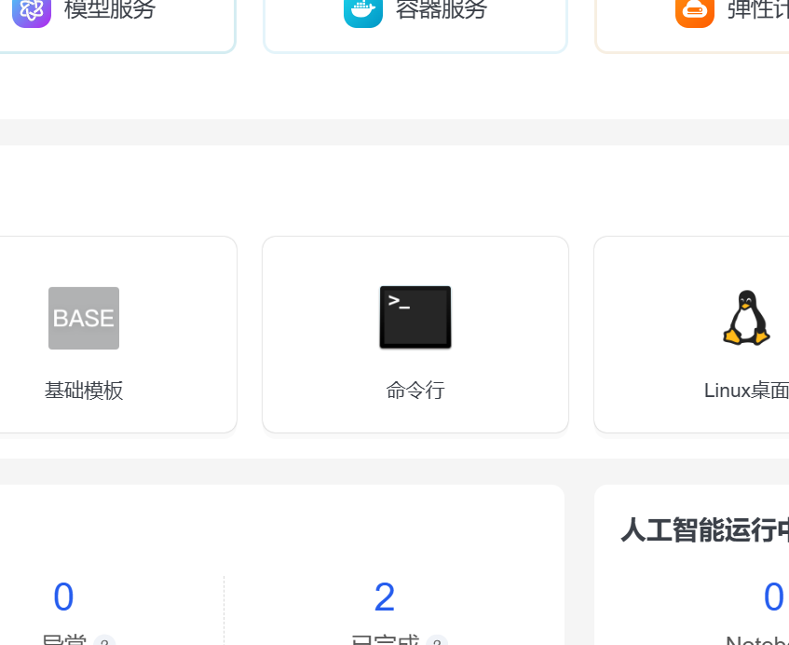
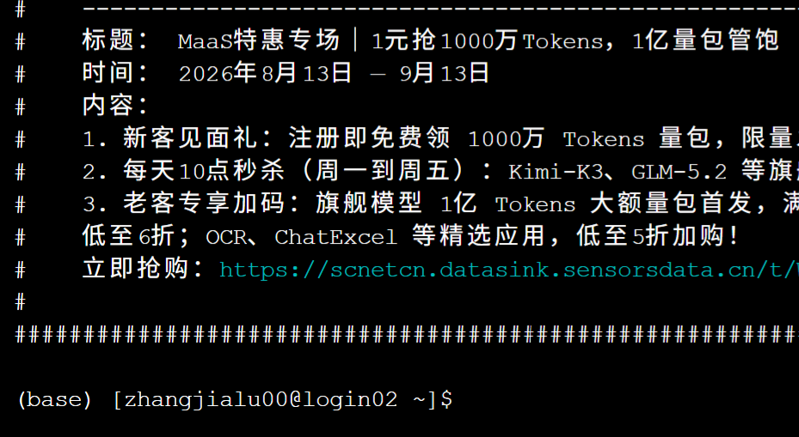
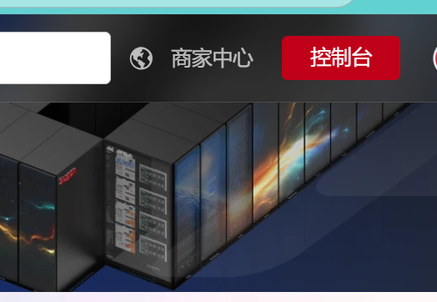
Hands-on 1: Log In to the Kunshan Supercomputing Platform
Open the Kunshan Supercomputing Platform: https://www.scnet.cn/sso/login
Select account login and enter the username and password sent by email.
Click Console in the upper-right corner, then click Command Line in the center of the page.

Slide 6
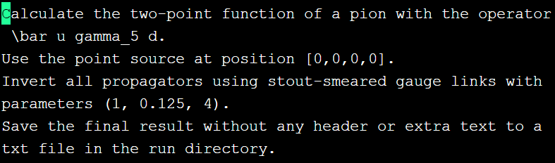
Hands-on 2: Set Up and Run LQCDMaster
Go to the shared directory: cd LQCD/
Create your own working directory: mkdir Tanjinxin (replace Tanjinxin with your directory name)
List the contents of the current directory: ls

Slide 7
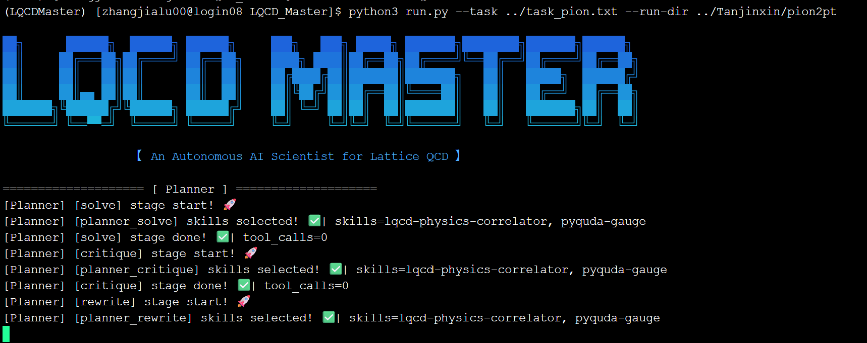
Hands-on 2: Set Up and Run LQCDMaster
Go to the LQCDMaster directory: cd LQCD_Master/
Run the LQCDMaster script in this directory:
Command: python3 run.py --task ../task_pion.txt --run-dir ../Tanjinxin/pion2pt --non-interactive

Slide 8
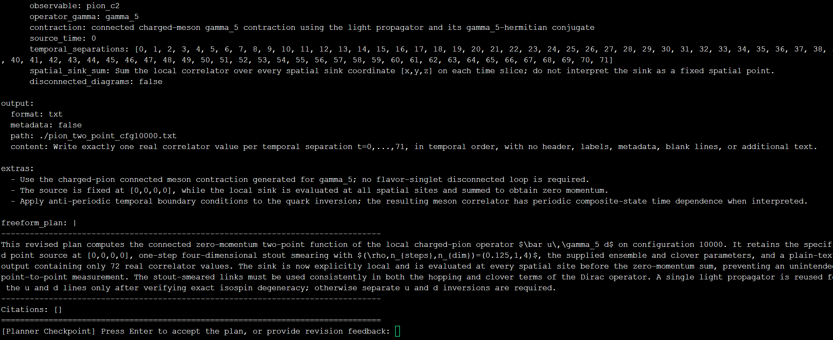
Hands-on 3: Checkpoints and Feedback
After LQCDMaster runs for a while, the Planner presents a computational plan for review. Enter revision requests and press Enter, or press Enter directly to approve the plan.

Slide 9
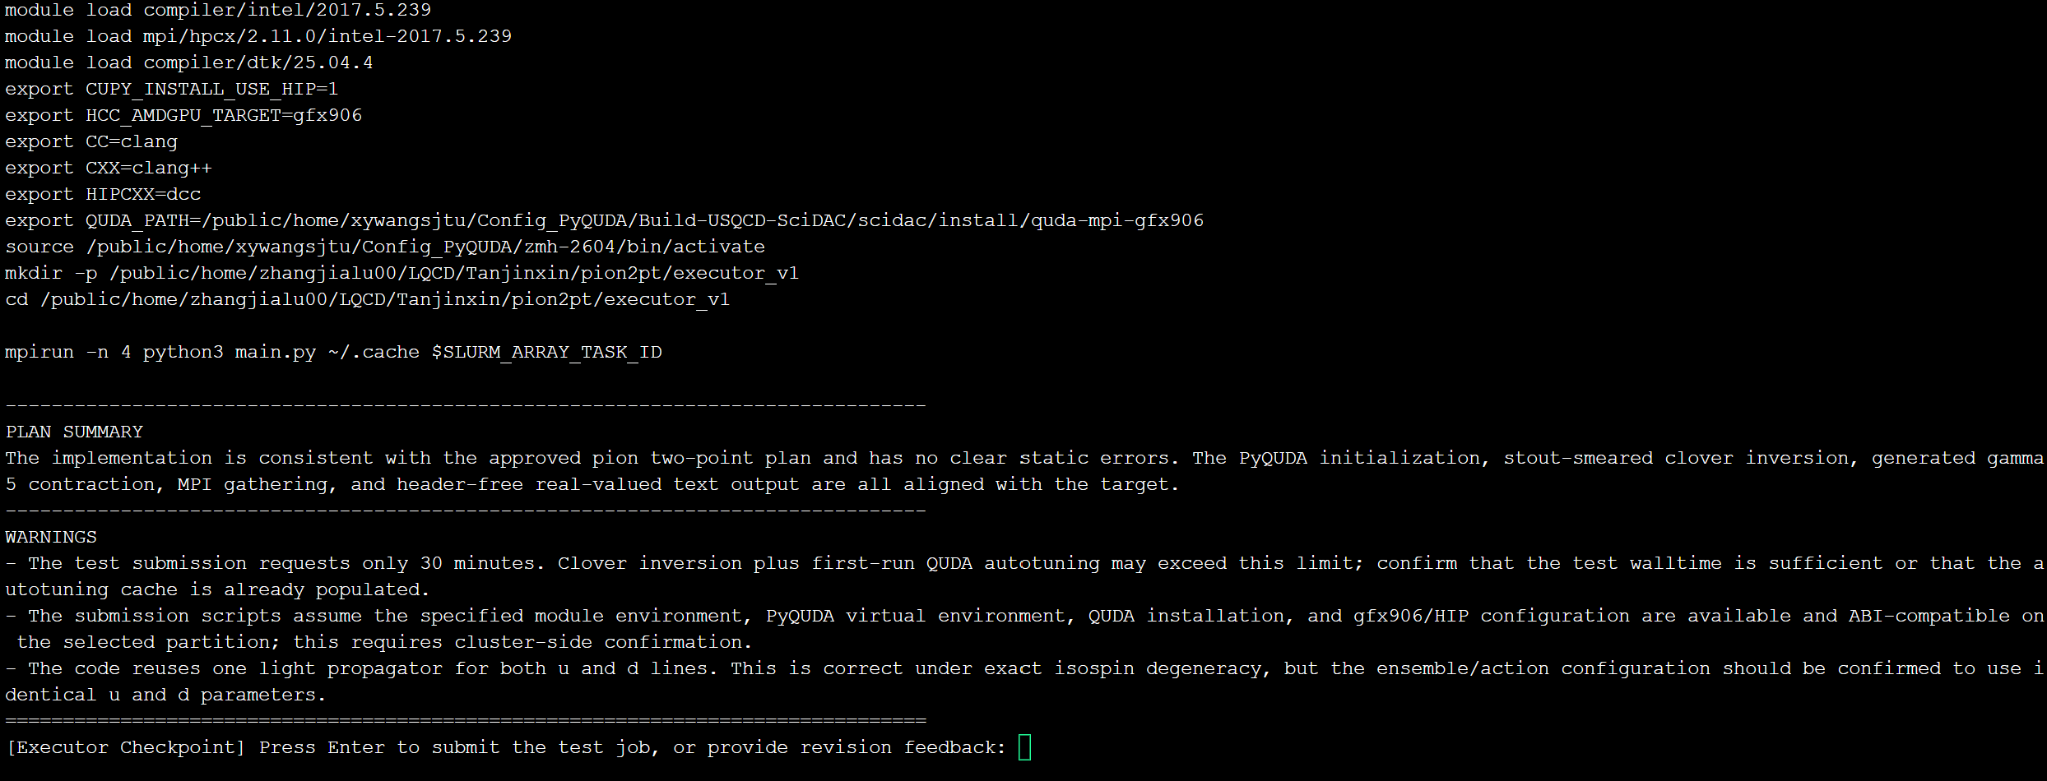
Hands-on 3: Checkpoints and Feedback
b) The Executor then presents the PyQUDA code for the lattice calculation. Enter revision requests and press Enter, or press Enter directly to approve the code. LQCDMaster then submits the job to the compute cluster.

Slide 10
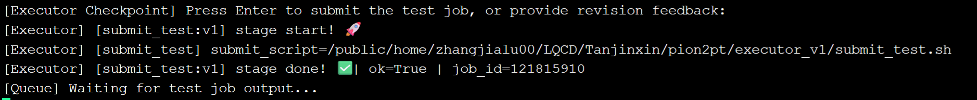
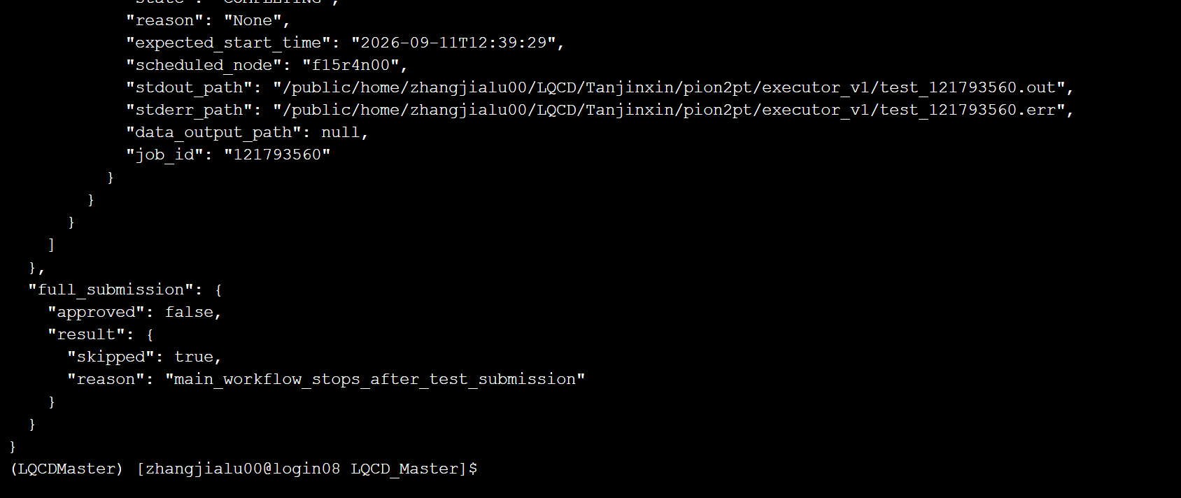
Hands-on 4: Wait for the Results
a) After approval, LQCDMaster submits the job and reports its job ID for monitoring.
b) When the cluster job finishes, LQCDMaster prints the run log and output path.
Notes:
Return to the lattice-QCD discussion.

Slide 11
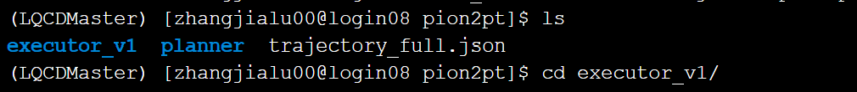
Hands-on 5: Inspect the Results
Go to your working directory: cd ../Tanjinxin/pion2pt/
List its contents: ls
Open the executor directory: cd executor_v1
List its contents: ls
Open the two-point correlator data file: vi pion_two_point_cfg10000.txt
(Type :q to exit.)

Slide 12
Installing LQCDMaster

Slide 13
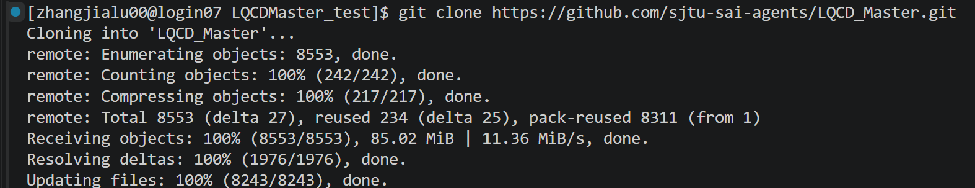
Installing LQCDMaster
Prerequisite: PyQUDA is installed. Repository: https://github.com/CLQCD/PyQUDA.git
With Git installed, run: git clone https://github.com/sjtu-sai-agents/LQCD_Master.git
Wait for the download to finish.
Create a virtual environment with Conda: conda create -n LQCDMaster_test python=3.9
Activate the environment: conda activate LQCDMaster_test

Slide 14
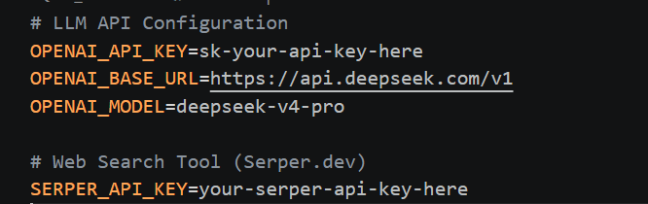

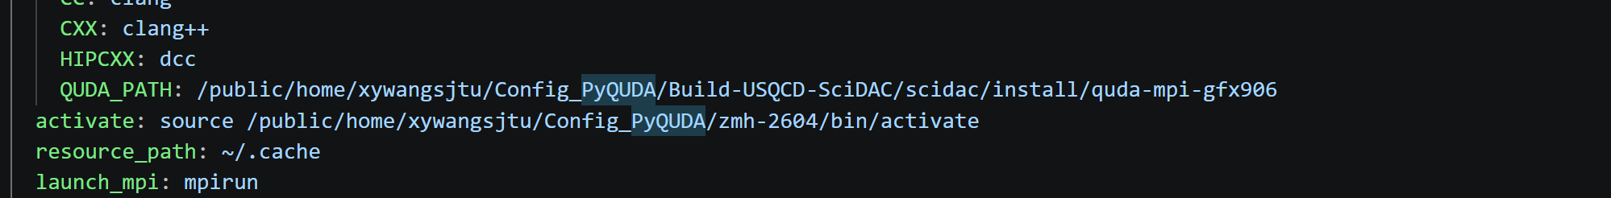
Installing LQCDMaster
Copy .env.template to .env, then enter your API key.
In the LQCDMaster directory, install the dependencies: pip install -r requirements.txt
Edit configs to set the ensemble, gauge path and PyQUDA environment.
Run LQCDMaster as shown in the hands-on slides.

Slide 15
Advanced Topics
Lattice Workflow and Implementation Details

Slide 16
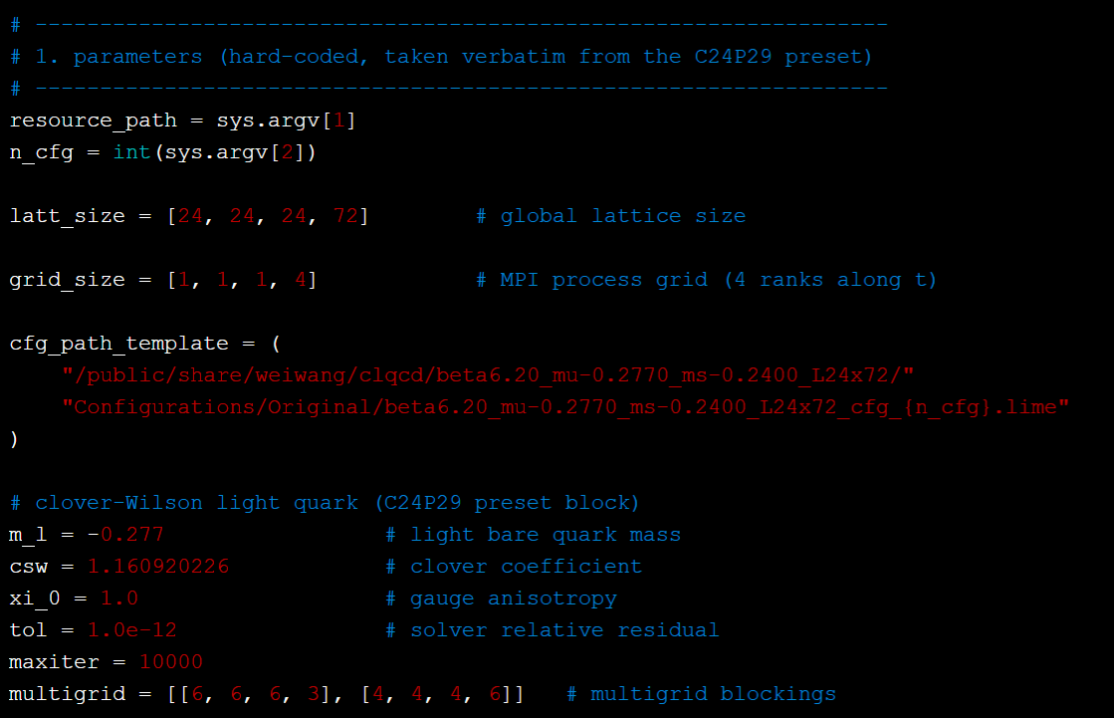
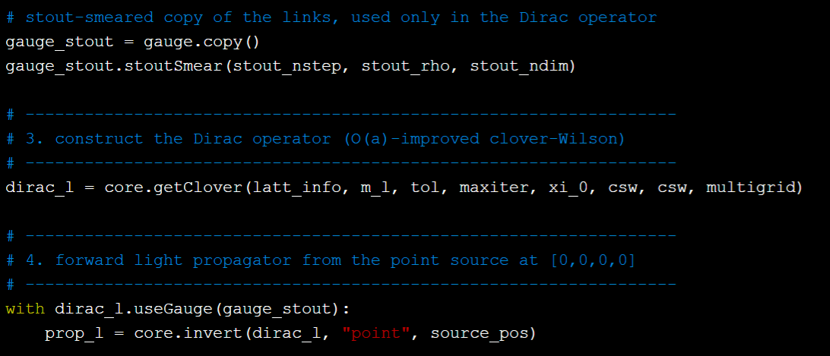
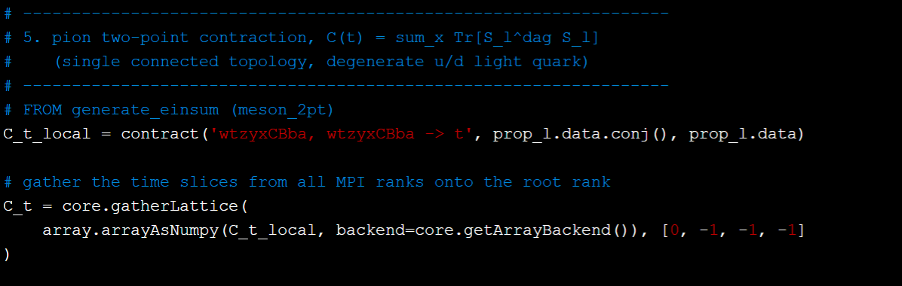
Autonomous Code Generation with LQCDMaster
During execution, LQCDMaster generates the PyQUDA code at
/public/home/zhangjialu00/LQCD/Tanjinxin/pion2pt/executor_v1/main.py
The script implements the complete workflow for computing the pion two-point correlator:
1. Set ensemble parameters
2. Solve the propagator
3. Wick contractions for the 2pt correlator

