Slide 1
Jet clustering problems
Xuliang Zhu

Slide 2
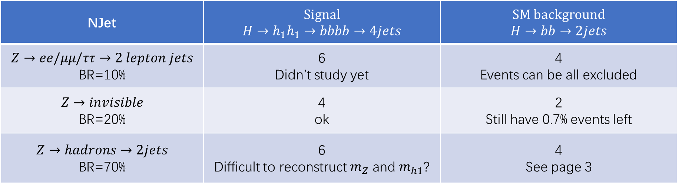
NJets in different channels
Column: H final states
Rows: Z final states, classify by different number of jets.
NJet | Signal $H→h_{1}h_{1}→bbbb→4jets$ | SM background $$H→bb→2jets$$
$$Z→ee/μμ/ττ→2 lepton jets$$ BR=10% | 6 Didn’t study yet | 4 Events can be all excluded
$$Z→invisible$$ BR=20% | 4 ok | 2 Still have 0.7% events left
$$Z→hadrons→2jets$$ BR=70% | 6 Difficult to reconstruct $m_{Z}$ and $m_{h1}$? | 4 See page 3

Slide 3
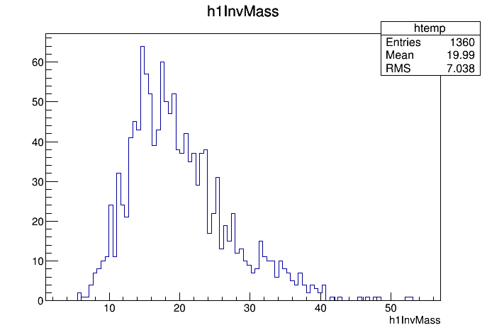
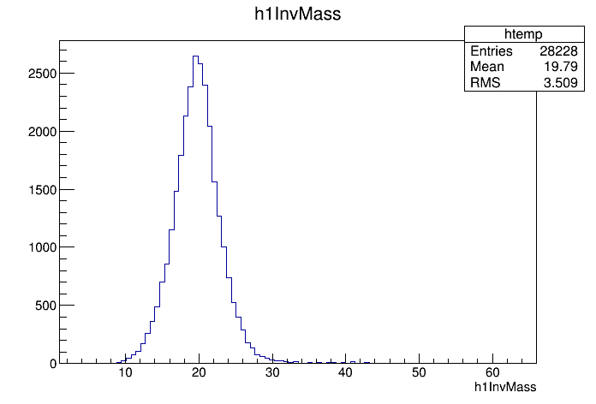

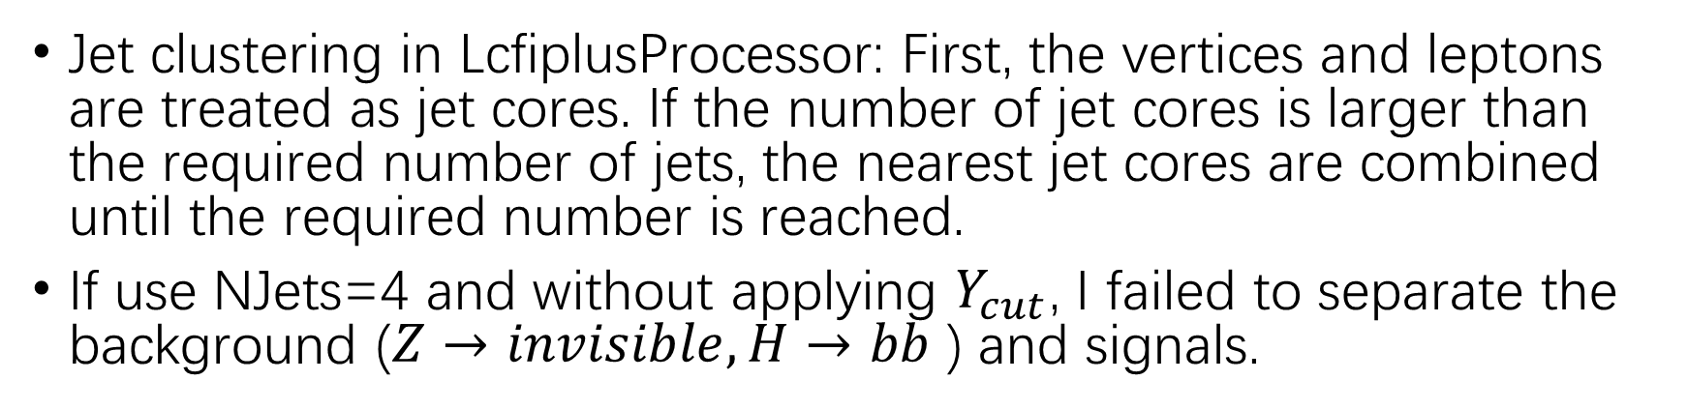
$Z→invisible, H→bb$
Jet clustering in LcfiplusProcessor: First, the vertices and leptons are treated as jet cores. If the number of jet cores is larger than the required number of jets, the nearest jet cores are combined until the required number is reached.
If use NJets=4 and without applying $Y_{cut}$, I failed to separate the background ($Z→invisible, H→bb$ ) and signals.
h1InvMass$(Z→invisible, H→bb)$
h1InvMass$(Z→invisible, H→bbbb, m_{1}=20GeV)$

Slide 4

Modified Durham distance
$$Y_{ij}=\frac{2\min{{\left(E_{i},E_{j}\right)}^{2}(1−\cos{θ_{ij}})}}{Q^{2}}+α$$
$Q^{2}$ is constant for all events, which is the center-of-mass energy.
$α$ is 100 if both jets have cores and 0 for others.

Slide 5
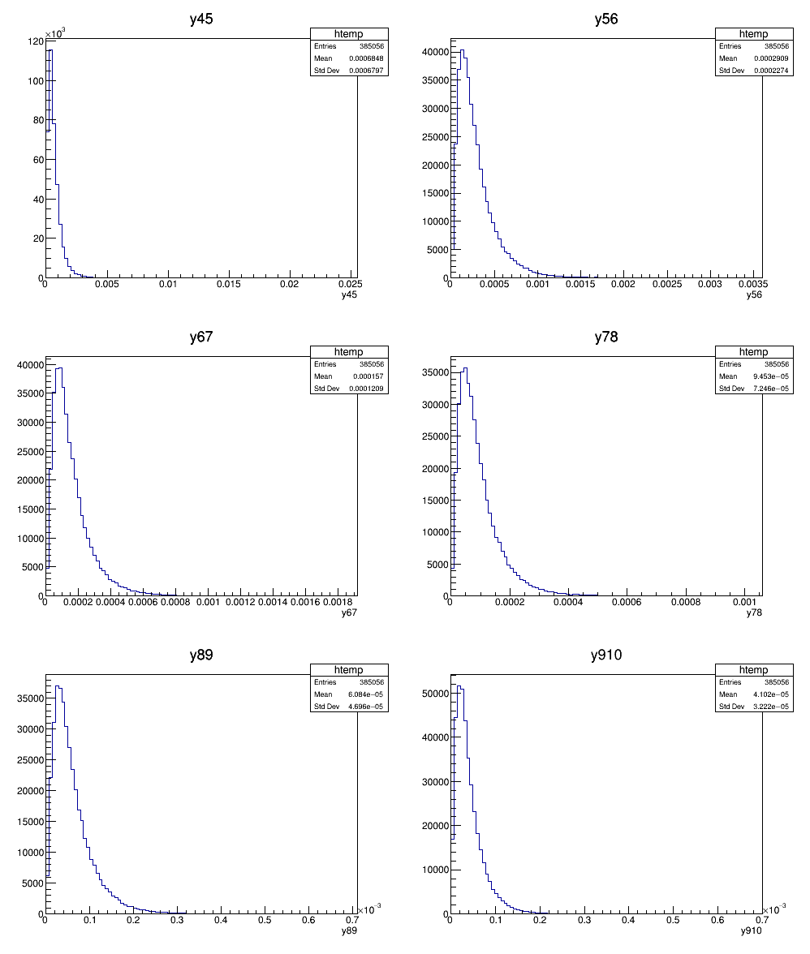
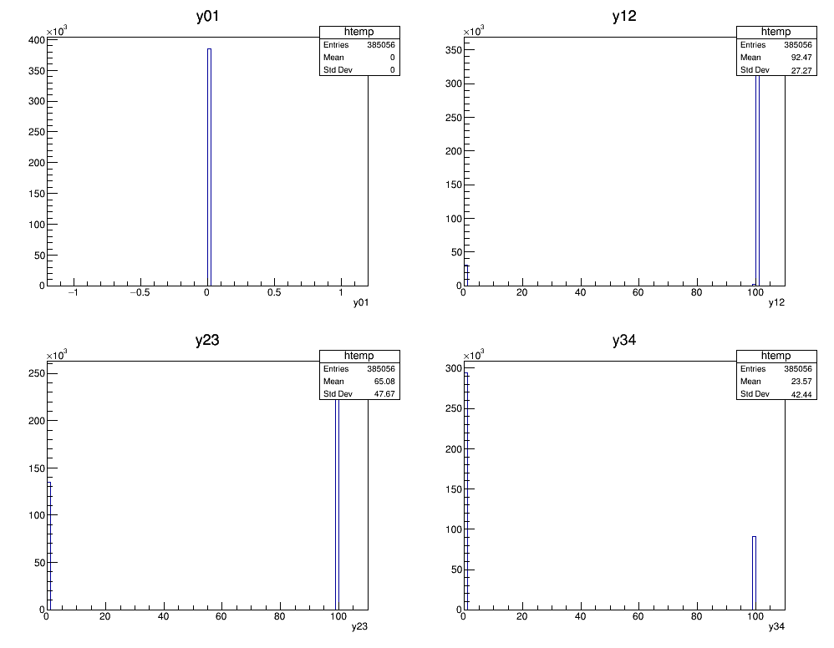
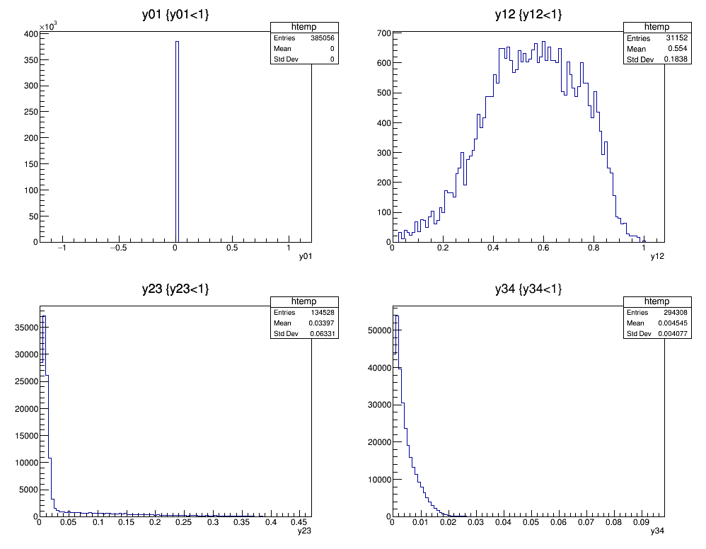
$Z→invisible, H→bbbb$

Slide 6
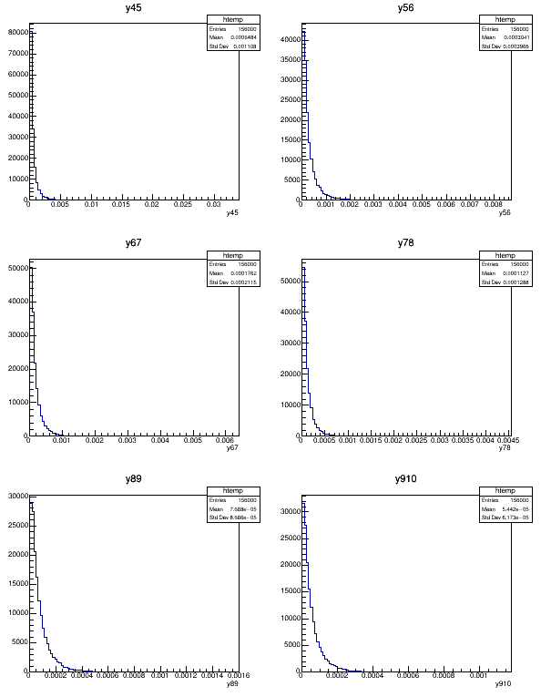
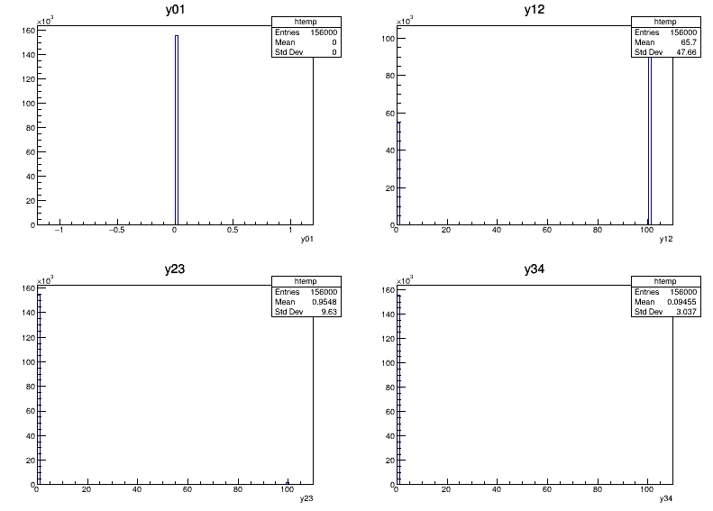
$Z→invisible,H→bb$

Slide 7
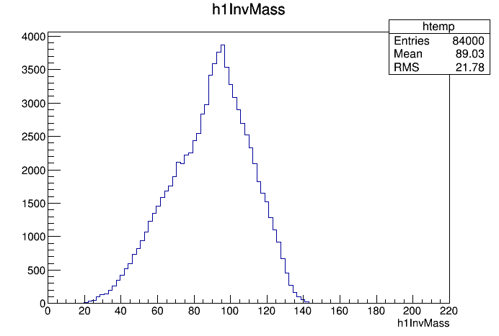
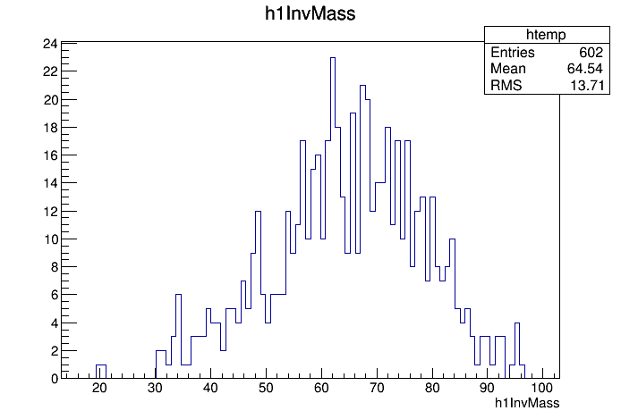

$Z→qq, H→bb$
NJetsRequested=4
Cut off: $E_{jet}<5GeV, δm>2GeV, ΔR_{jj}>2$
0.7% events left after cut.
h1InvMass, no cut
h1InvMass, apply cut

Slide 8

To-do
Observe $Y_{ij}$ of $Z→invisible, H→bb$ ,and apply $Y_{cut}$.
Write a processor for $Z→ll,H→h_{1}h_{1}→bbbb$.

