Slide 1
TMVAMulticlass
09/23/2021
Jialin Li

Slide 2
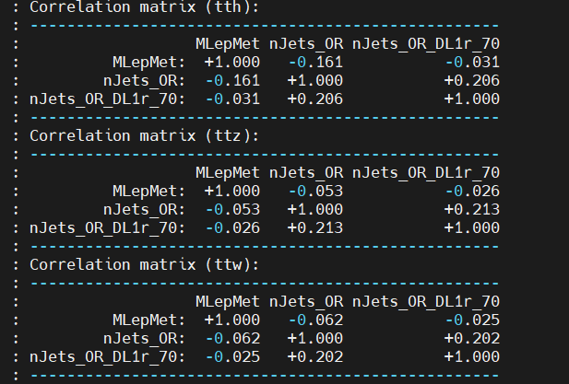
Training method
Method:BDTG
Signal:ttH
Background:ttZ,ttW,ttbar
Variables:jets,b-jets,MlepMet(sqrt(E^2-Px^2-Py^2-Pz^2))

Slide 3
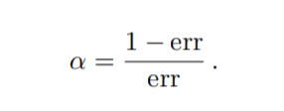
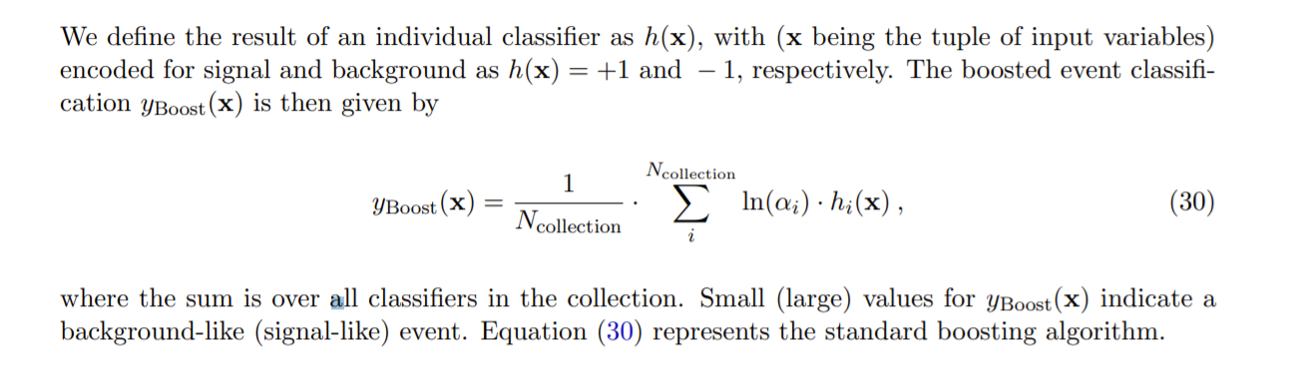
Backup
BDT

Slide 4
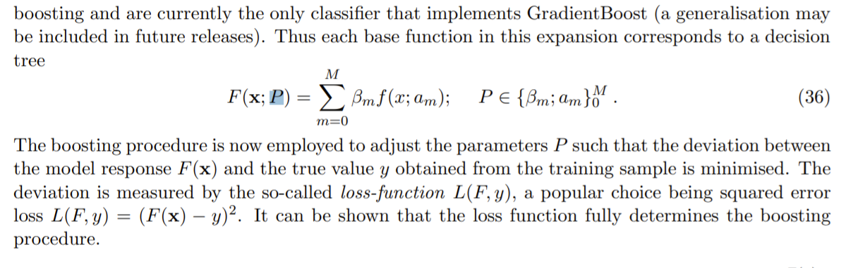
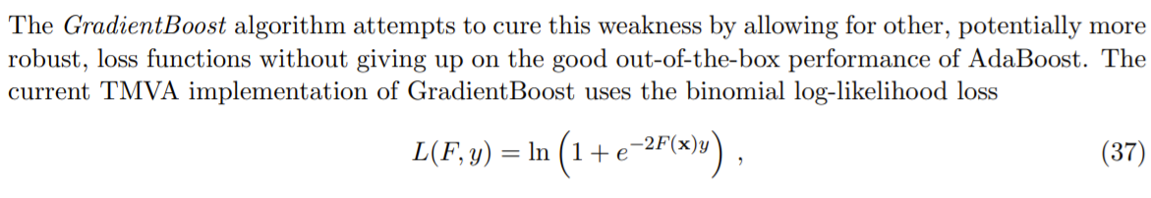
BDTG

