Slide 1
ITEMS
Study eekt algorithm. Understand the exact definition of yij
Submit jobs with different (3-4) njet configurations and verify that the results are consistent
Collect information about the CEPC ZH analysis from the other groups
Find the jet energy limitation of CEPC from experts

Slide 2
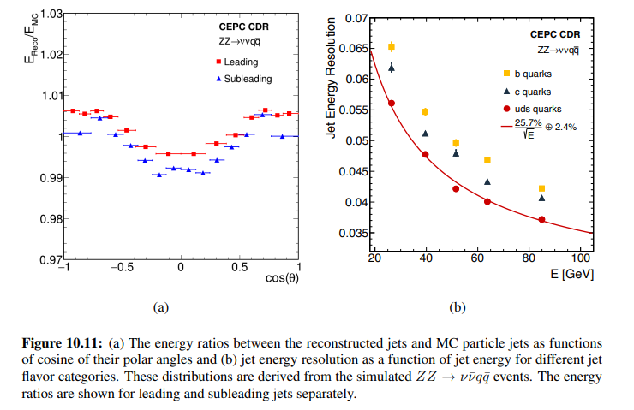
Jet Energy Limitation
http://cepc.ihep.ac.cn/CEPC_CDR_Vol2_Physics-Detector.pdf : P307 10.2.4 Jets
Gang : No such limitation for energy of jets, but low energy jet should have a bad resolution and will affect the analysis.
A sub-percent level jet energy scale precision and a jet energy resolution of 3–5% for the jet energy range of 20–100 GeV should be achievable.

Slide 3
Kt jet Algorithms
For each pair of particles i, j work out the kt distance
Repeat the step to find the smallest one among $d_{ij}$s until no particles left
Definition of yij

