Slide 1
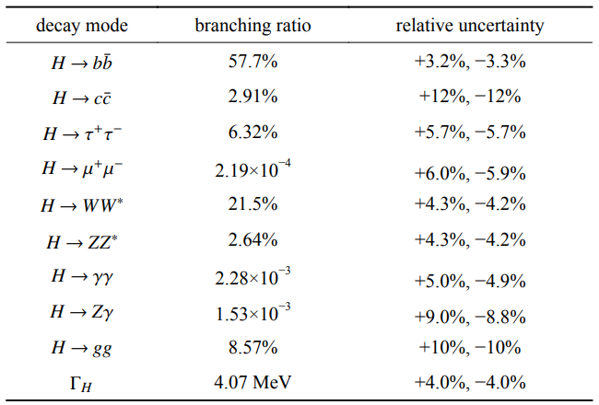
H->bb/cc/gg Motivation Part
Chinese Physics C Vol. 44, No. 1 (2020) 013001
The masses of the fermions M_{f} in the SM are proportional to their Yukawa couplings h to the Higgs field: M = vh/sqrt(2).Thus measuring the Yukawa couplings between the Higgs boson and the SM fermions is essential to understand the origin of the fermions' masses.
Deviation of these couplings from SM prediction would indicate new physics.
Analysis goal : Measurement of H->bb H->gg H->cc branching fraction in the CEPC experiment.
https://iopscience.iop.org/article/10.1088/1674-1137/43/4/043002/pdf

Slide 2
H->bb/cc/gg Paper Event Selection Part 1
Signal : 2 SFOS leptons + 2 jets (llH with H->bb/cc/gg)
Background :
1.Irreducible : Semileptonic ZZ process (Z1->ll,Z2->qq)
2.Reducible : All the other backgrounds with different final states (hadronic/leptonic WW,hadronic ZZ,llH with other final states, other higgs production process,lepton pair or quark pair)
Cuts:
1.lep_energy > 20 GeV, extra isolated lepton veto √
2.Polar angle of lepton pair system : |Cos(𝜃)|<0.71(0.81) for ee(𝜇𝜇) √
3.Angle between the two isolation tracks : Cosφ>-0.93(-0.74) for ee(𝜇𝜇) √
4.M_{ll} in Z mass window (77.5~104.5) GeV √
5.Polar angle |Cos(𝜃)|<0.96 for jets,jet contains 20 particles at least, each with energy no less than 0.4 GeV (against fake jets from photons or leptons).Mjj should be (75~150) to reject irreducible backgrounds. √
6.Higgs mass window is defined by requiring M_{ll,recoil} between (124~140) GeV √

Slide 3
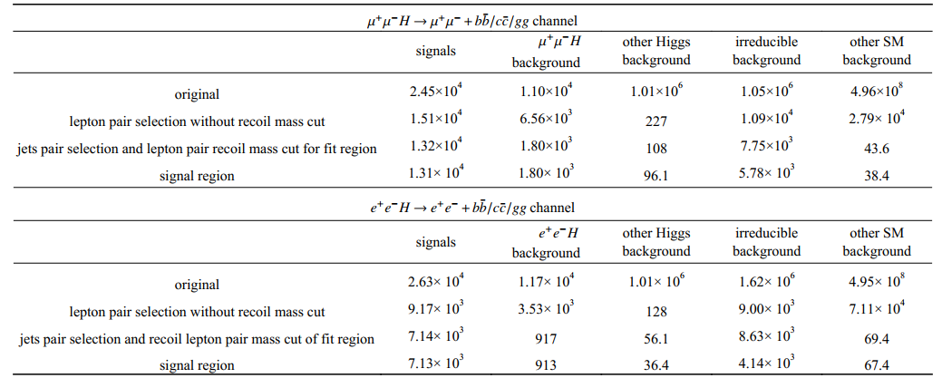
H->bb/cc/gg Paper Selection Part 2
Event yield of cutflow

Slide 4
H->bb/cc/gg Paper Fit Part 1
A unbinned likelihood fit is performed on three variables : M_{ll,recoil},X_{B},X_{C} simultaneously.
With the overall likelihood function constructed as :
L the likeness of two individual jets
The RooFit package is implemented to perform an unbinned likelihood fit to the weighted events

Slide 5
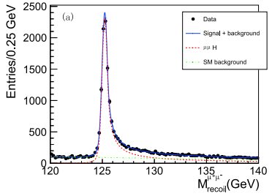
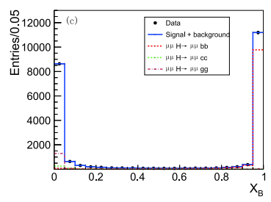
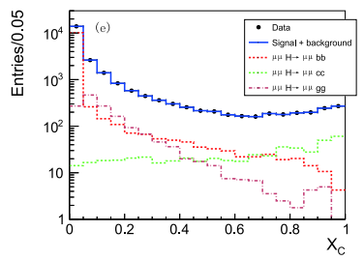
H->bb/cc/gg Paper Fit Part 2
Projection on M_{ll,recoil}, X_{B}, X_{C} .
The model describes the data very well

Slide 6
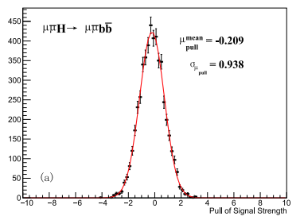
H->bb/cc/gg Paper Uncertainty Part 1
Statistical: 10000 toy MC according to Poisson distribution.
Modelling of M_{ll} distribution: Fit to signal and background dataset respectively.
Fixed background: Set H->WW* H->ZZ* yields 5% higher and lower. Vary non-ZZ backgrounds by ±100%.
Event selection: Extra lepton veto efficiency, jet mass pair resolution

Slide 7
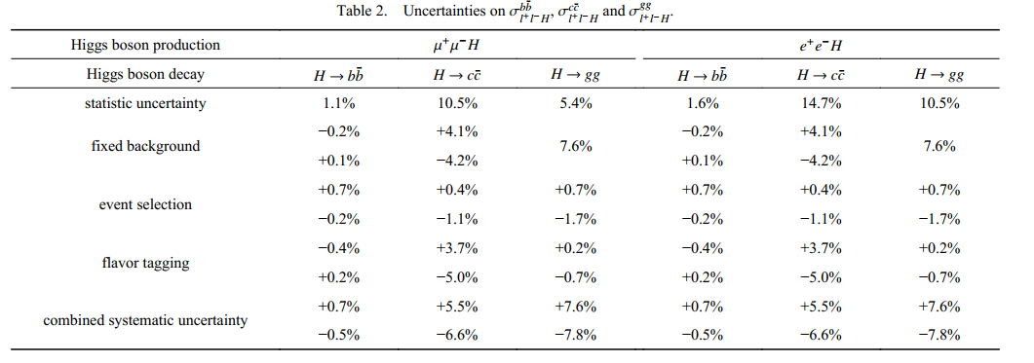
H->bb/cc/gg Paper Uncertainty Part 2
Uncertainty Summary

Slide 8
Current Status
Modified Yu Bai’s reco-xml to our case, 4jet, 2lep
Backgrounds :
Inclusive Higgs sample , other 4 fermions background
Signal and Background all done for electron channel.
Could start to analyze the electron channel once all done
Need to generate muon channel as well.

