Slide 1
To do last time
Need to add opening angle of jets from a, lep_Pxyze, energy of a.Explain opening angle at CEPC (Gang)
Make plots of opening angles.
Verify the signal sample (Added the BR of a->bb)
Strategy for combination of bjets (difference in a mass, …)

Slide 2
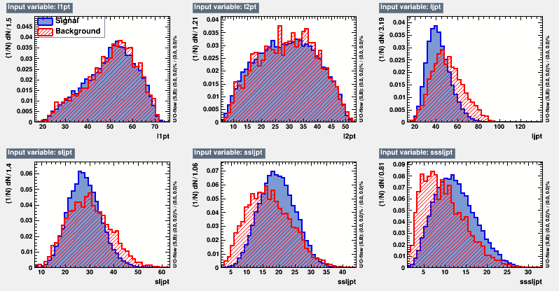
Variable Distribution

Slide 3
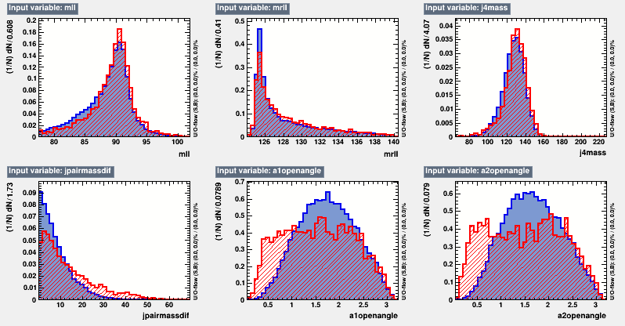
Variable Distribution

Slide 4
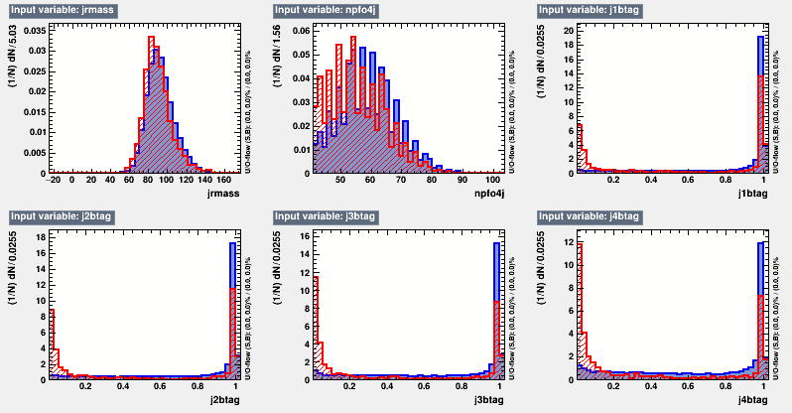
Variable Distribution

Slide 5
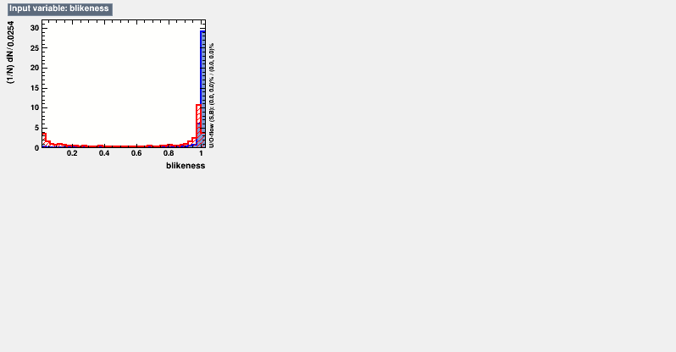
Variable Distribution

Slide 6
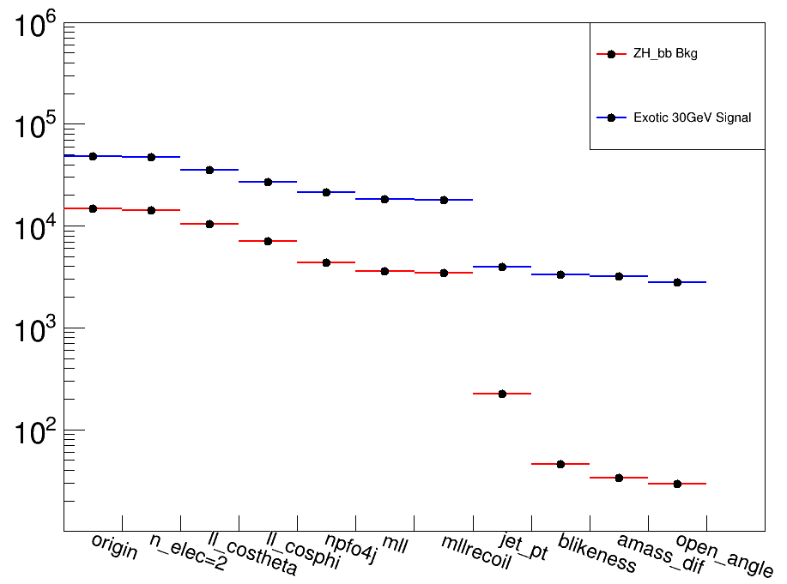
Kinetic Distribution and Cutflow
Origin : After reco-xml from CEPC framework
n_elec : Extra lepton veto
ll_costheta : Polar angle of ll system
ll_cosphi : Separation angle between two tracks
mll : 77.5~104.5
mrecoil_ll : 124~140
b_likeness : L_{b1}*L_{b2}*L_{b3}*L_{b4} / (L_{b1}*L_{b2}*L_{b3}*L_{b4} + (1-L_{b1})*(1-L_{b2})*(1-L_{b3})*(1-L_{b4}))

Slide 7
Kinetic Distribution and Cutflow
npfo4j : number of particles in the 4 jets each with energy larger than 0.4 GeV
jet_pt : ljpt, sljpt, ssljpt, sssljpt
amass_dif : mass difference between the two reconstructed exotic particle a
open_angle : opening angle between the two jets of the exotic paritcle a
Cut Set | npfo4j | ljpt,sljpt | ssljpt,sssljpt | amass_dif | Cos(angle) | blikeness
Cut 1 | >40 | <45,<35 | >15,>8 | <20 | <0.8 | >0.98

Slide 8
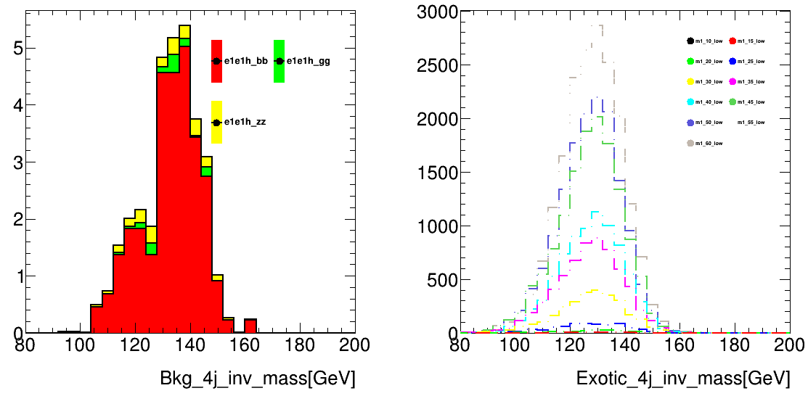
Kinetic Distribution and Cutflow
Distribution of 4j invariant mass after all the cuts.
Dominant background is from ZH_bb process

Slide 9
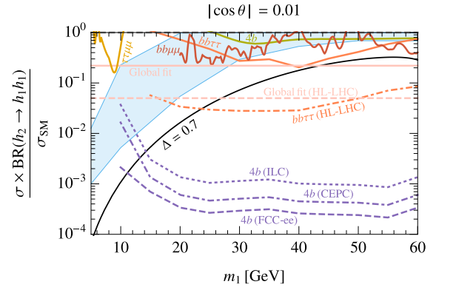
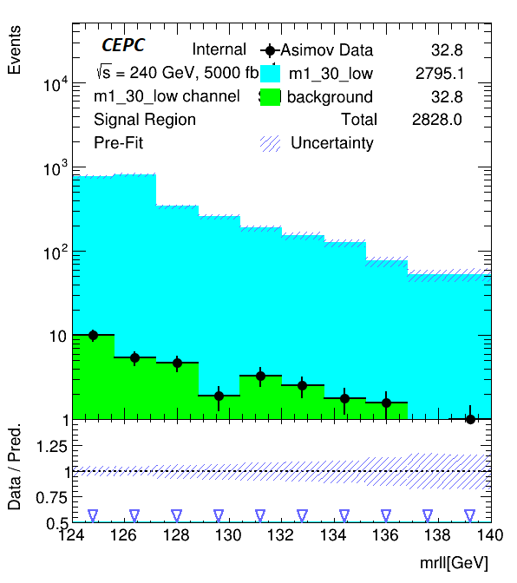
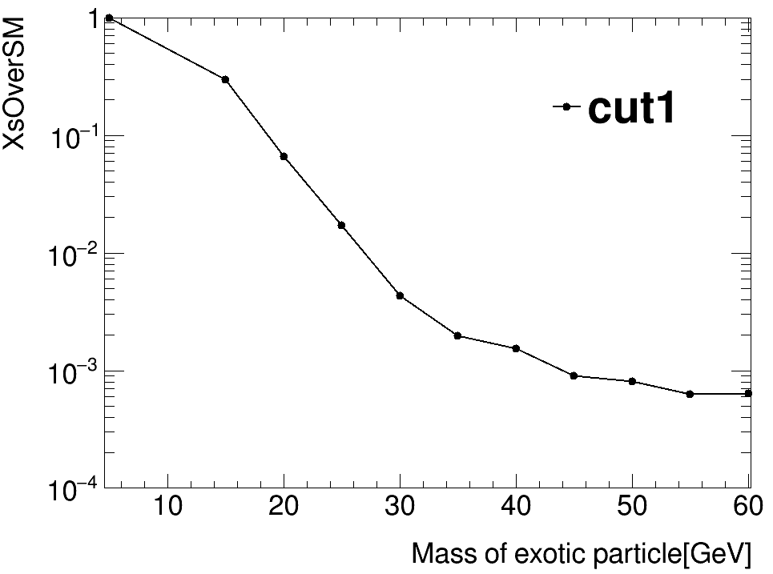
TRExFitter as Limit Setting Framework
Settings :
Variable : m_recoil_ll
Signal Sample : Exotic decay signal at different mass point after selection
Bkg Sample : All the background event after selection
Data : Asimov data with all bkg samples
Limits at different mass points

Slide 10
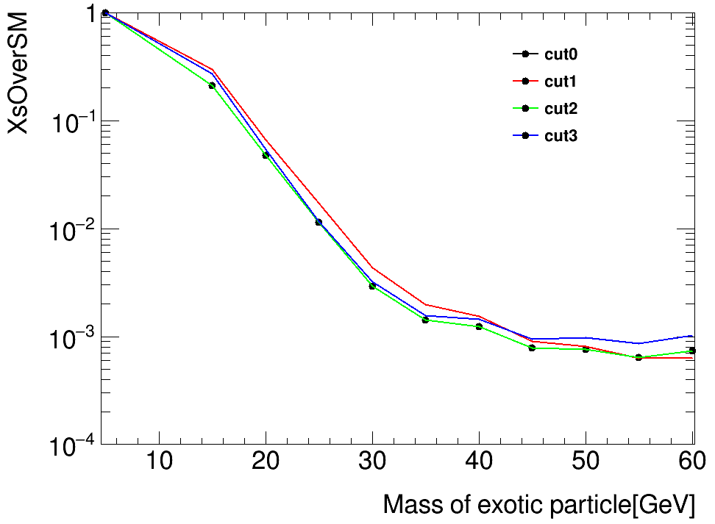
Uncertainty due to Event Selection
Cut Set | npfo4j | ljpt,sljpt | ssljpt,sssljpt | amass_dif | Cos(angle) | blikeness
Cut 0 | >50 | <40,<30 | >20,>10 | <10 | <0.7 | >0.99
Cut 1 | >40 | <45,<35 | >15,>8 | <20 | <0.8 | >0.98
Cut 2 | >35 | <60,<45 | >10,>5 | <40 | <0.8 | >0.98
Cut 3 | >35 | - | - | <40 | <0.8 | >0.95
Randomly changed cuts, need to classify those uncertainties and do detail study.

Slide 11
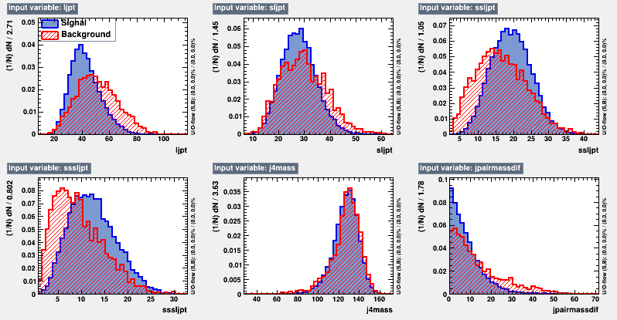
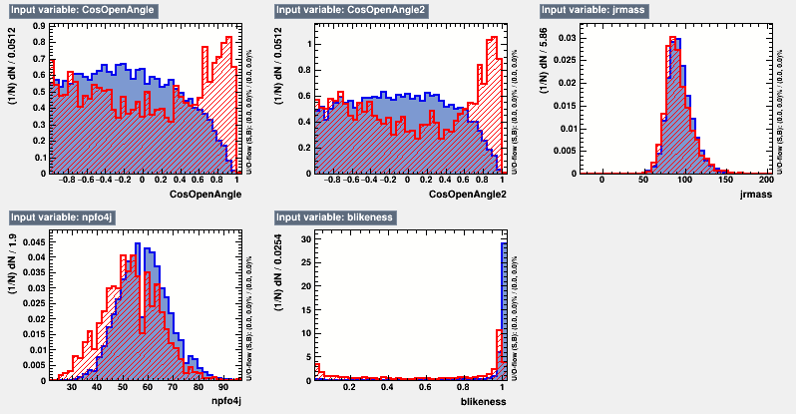
BDT Implementation
Using variables beyond the baseline cuts.
Trained bkg and signal events with basic cuts (b-likeness>0.01) applied.

Slide 12
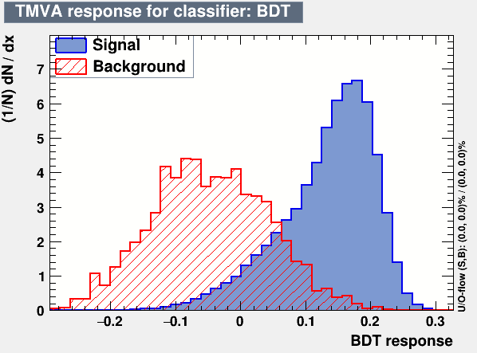
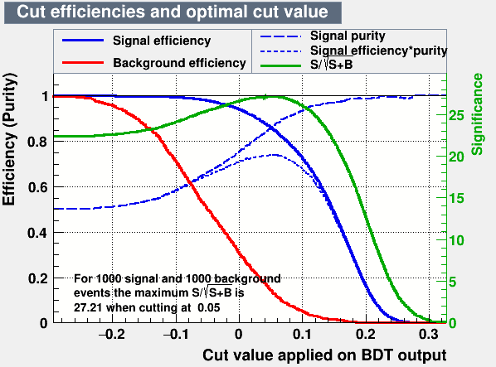
BDT Implementation
Classifier output distribution

Slide 13
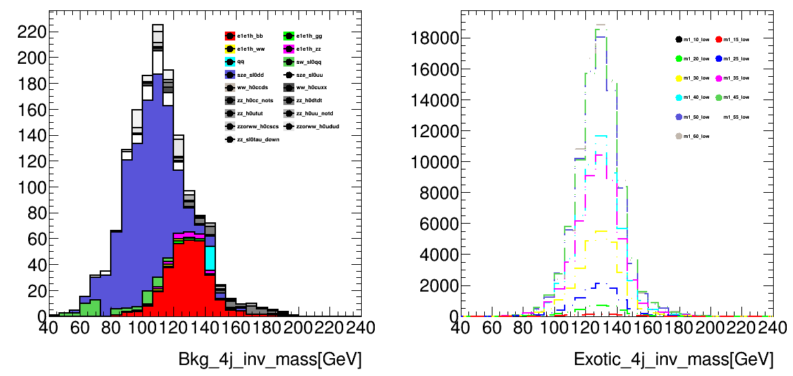
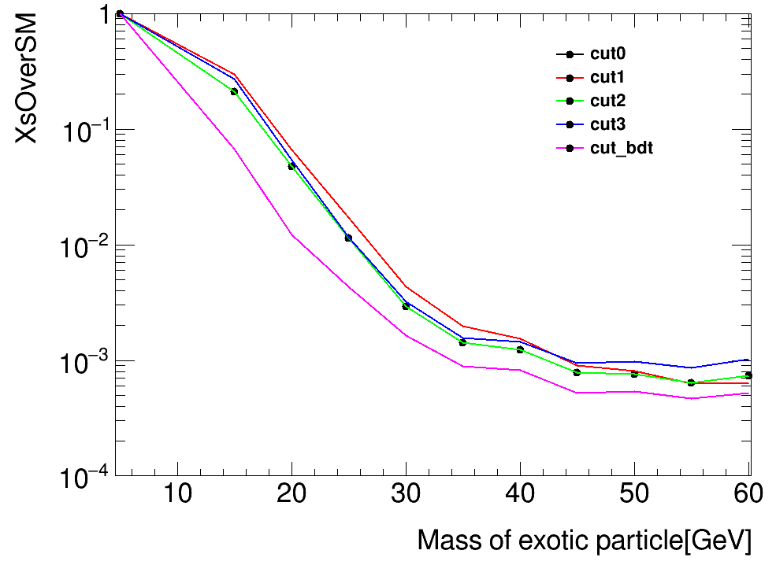
BDT Implementation
Limit setting with BDT cut at 0.05
BDT gives better limits than cut based results.

Slide 14
Current Status
Complete the uncertainty study of electron channel:
Statistical, fixed background, event selection, …
Try pyhf to do limit setting or sensitivity study ?

Slide 15
Plans
H->bb/cc/gg(Bai Yu) : Chinese Physics C Vol. 44, No. 1 (2020) 013001
Extend the range for the m_recoil_ll
Optimization of cuts targeting different mass point signals
BDT optimization targeting different mass point signals (parametrized training)

