Slide 1
Exotic Higgs Decay Search
-- Zhen Wang, Xuliang Zhu, Shih-Chieh Hsu, Elham Khoda, Shu Li, Yuwen Zhang

Slide 2
Physics Motivation
We are interested in the electroweak phase transition in models with a relatively light real singlet scalar S coupled to the Standard Model-like Higgs field.
Could be parametrized as :
With mass eigenstates as :
h1 : singlet-like
h2 : Standard Model-like Higgs
arXiv:1911.10210

Slide 3
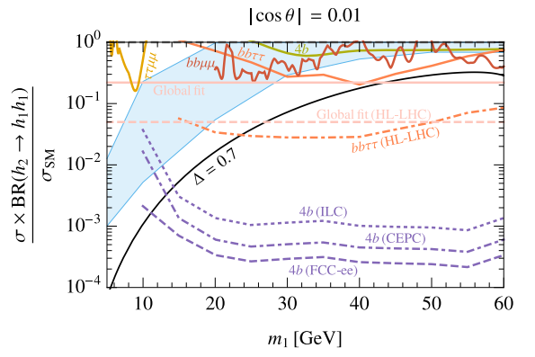
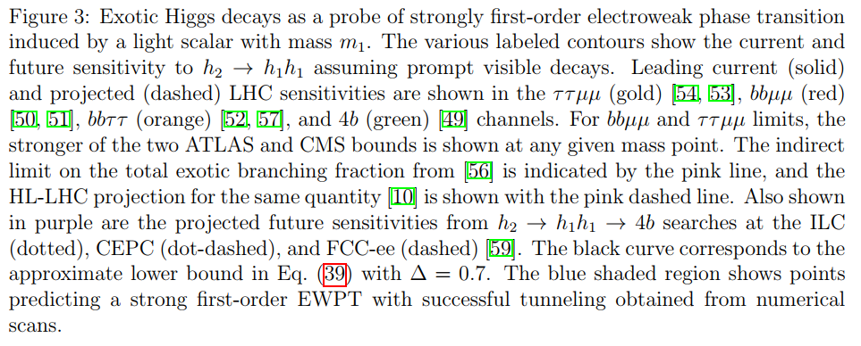
Theoretical Prospects
arXiv:1911.10210

Slide 4
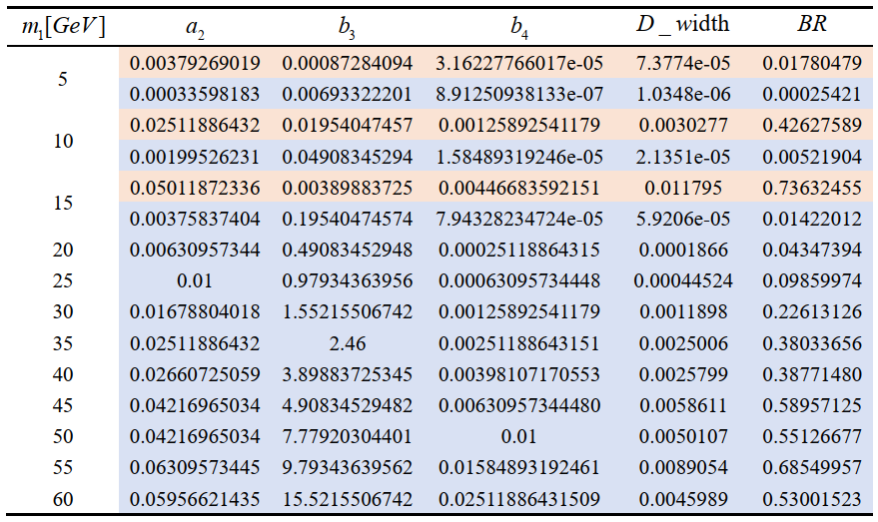
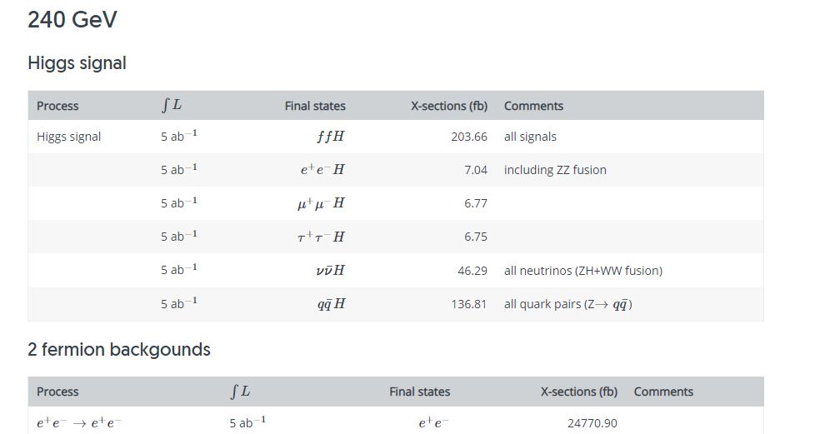
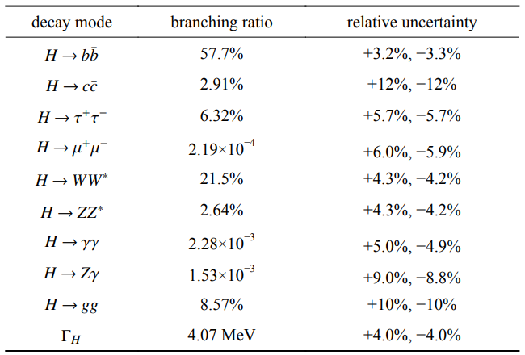
Sample Production
Thanks to Yanda Wu
Signal : 50000 events per mass point from 5 to 60 GeV for electron and muon channel separately
Bkg : 2-Fermion, 4-Fermion, eeH, mmH as our background.
CEPC Existing Samples
Lxslc7 : /cefs/data/DstData/CEPC240/CEPC_v4_update
Precision Higgs physics at the CEPC

Slide 5
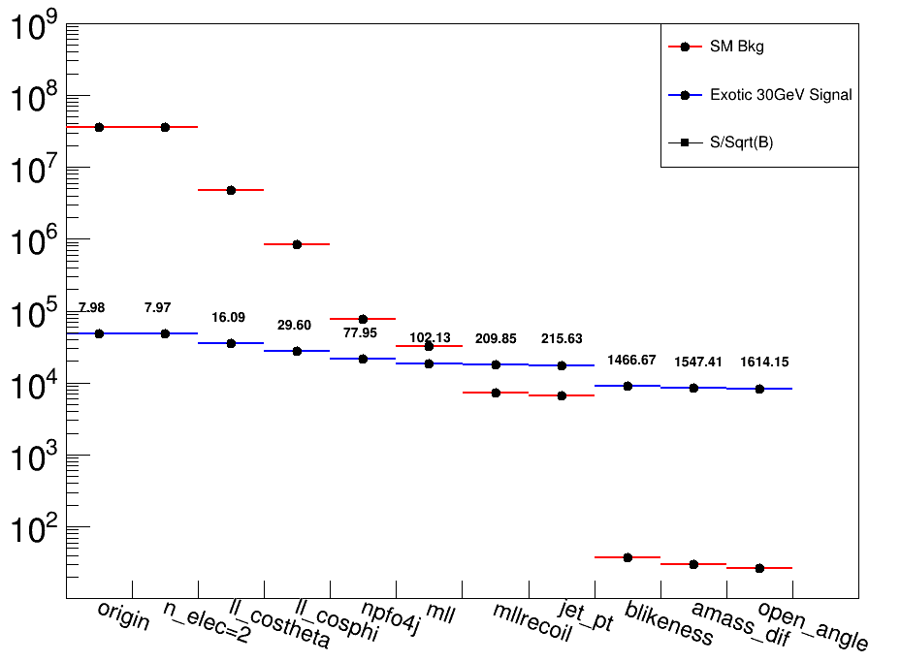
Selections and Cutflow
Thanks to Yu Bai
Origin : Events after FSClasser
ll_costheta : Polar angle of the dilepton system
ll_cosphi : Separation angle between two lep
npfo4j : Number of particles in the 4 jets each with energy larger than 0.4 GeV
blikeness : $\frac{L_{b1}∗L_{b2}∗L_{b3}∗L_{b4}}{L_{b1}∗L_{b2}∗L_{b3}∗L_{b4}+\left(1−L_{b1}\right)∗\left(1−L_{b2}\right)∗\left(1−L_{b3}\right)∗\left(1−L_{b4}\right)}$
amss_dif : Mass difference between the two reconstructed singlet.
Open_angle : Opening angle between the two jets of one singlet

Slide 6
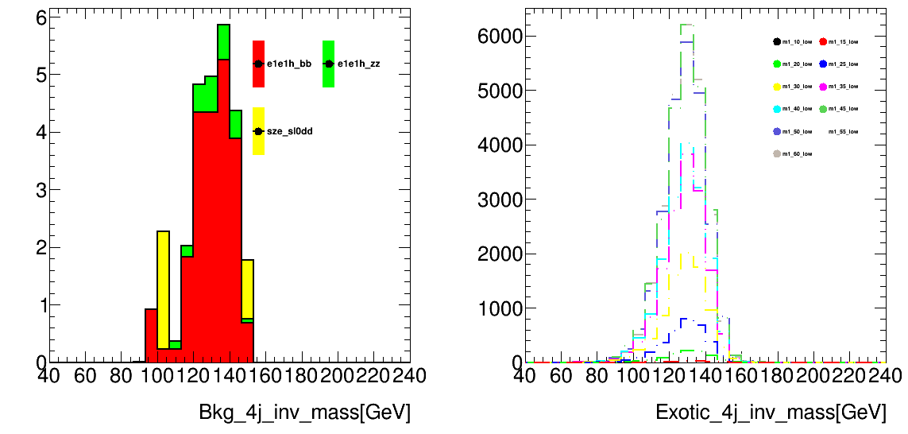
Selections and Cutflow
Cut Set | $$|Cosθ_{ll}|$$ | $$Cosψ$$ | mll | mll_recoil
Cut Baseline | <0.71 | >-0.74 | 77.5~104.5 | 120~140
Cut Set | npfo4j | ljpt | Sljpt | amass_dif | Cos(angle) | blikeness
Cut 1 | >40 | <80 | <50 | <20 | <0.9 | >0.9999
Higgs to bb process is our dominant background
Background process are strongly suppressed by the blikeness cut

Slide 7
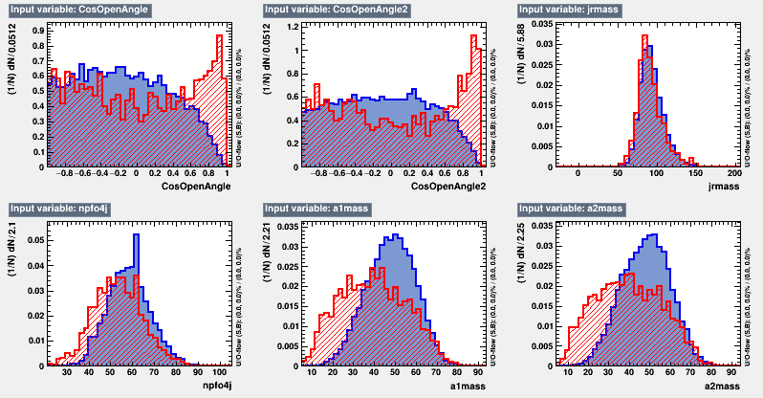
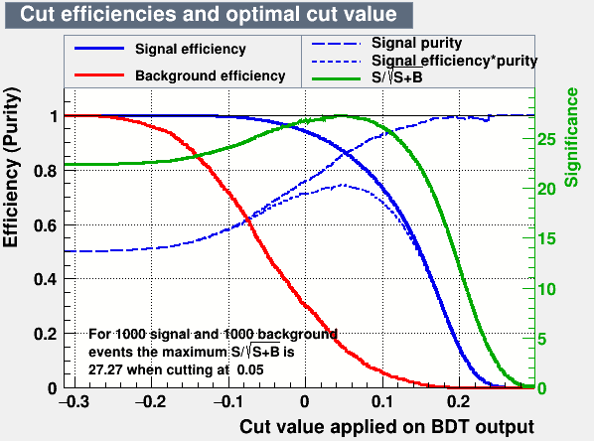
BDT Approach
Cut Set | npfo4j | blikeness
Cut bdt | >20 | >0.01
Trained the variables after some loose selections

Slide 8
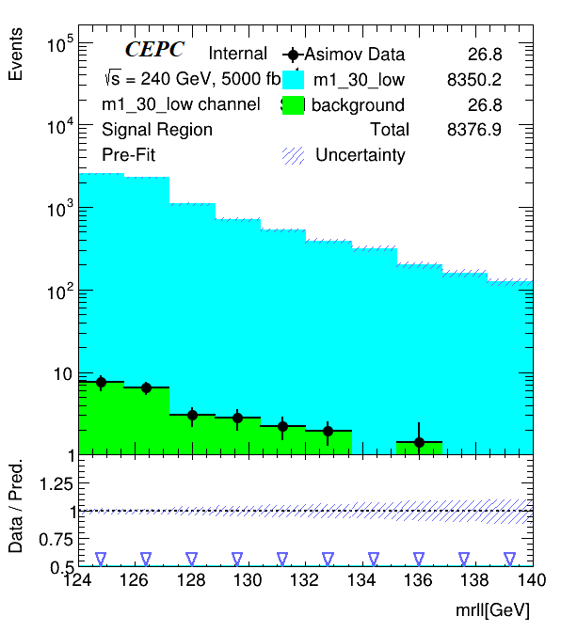
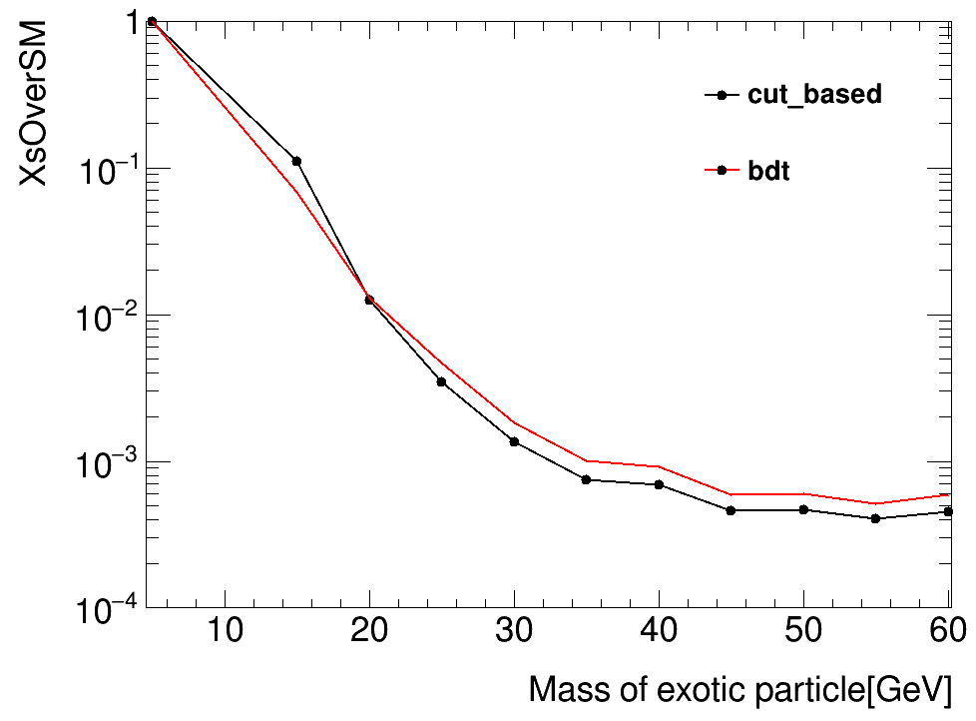
Limit Setting with TRExFitter
Settings :
Variable : m_recoil_ll
Signal Sample : Exotic decay signal at different mass point after selection
Bkg Sample : All the background event after selection
Data : Asimov data with all bkg samples

Slide 9
Future Plans
Muon channel analysis using similar strategy
Optimization of cuts targeting electron and muon channel

