Slide 1
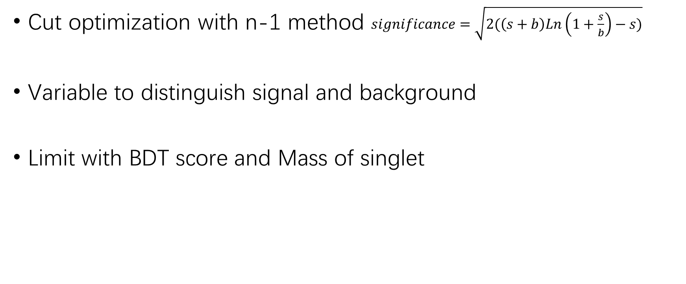
List
Cut optimization with n-1 method $significance=\sqrt{2(\left(s+b\right)Ln\left(1+\frac{s}{b}\right)−s)}$
Variable to distinguish signal and background
Limit with BDT score and Mass of singlet

Slide 2
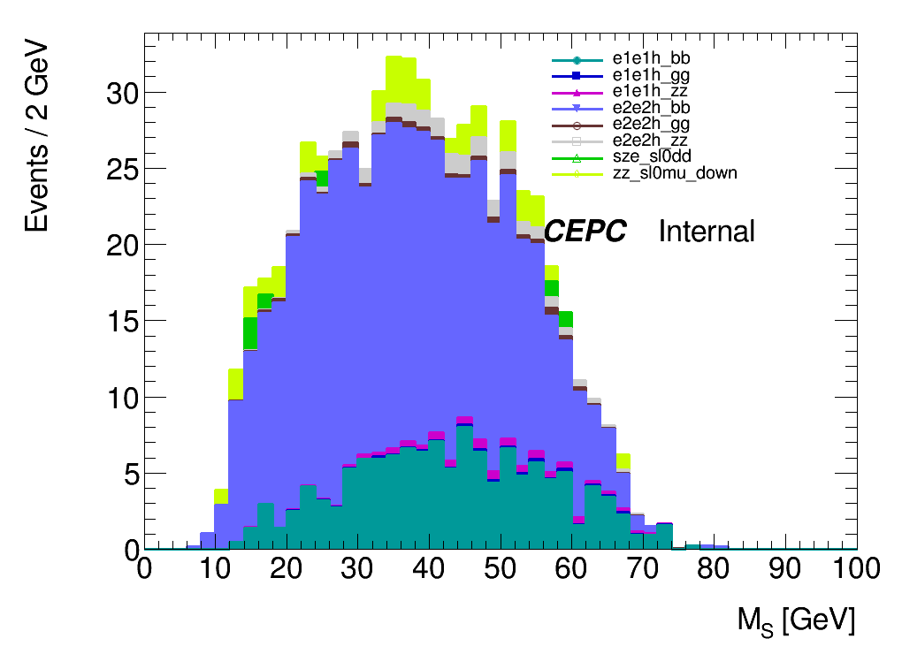
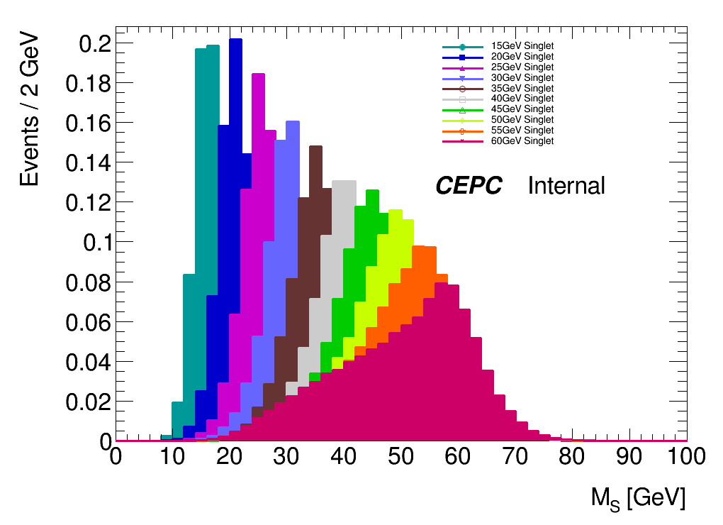
Signal Bkg Distribution
Background
Signal
Signal has peaks at different mass points
Background has no obvious features.

Slide 3
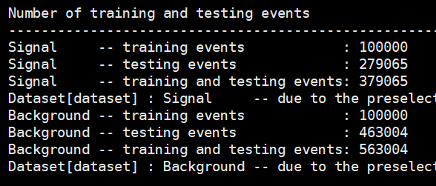
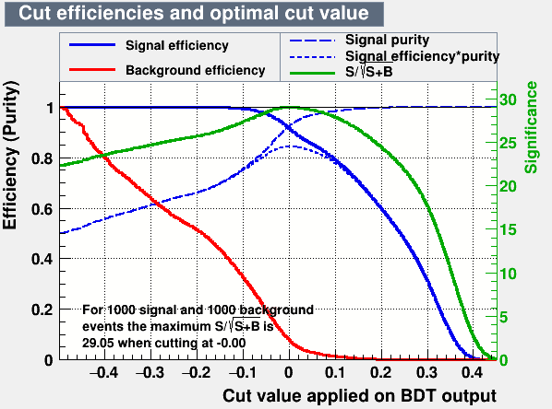
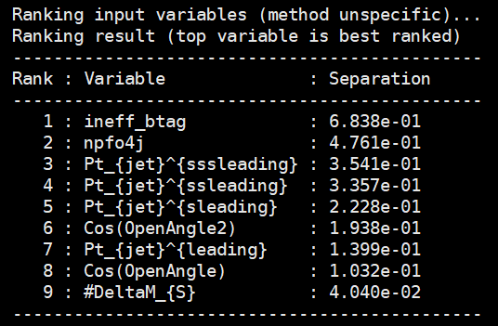
BDT Approach

Slide 4
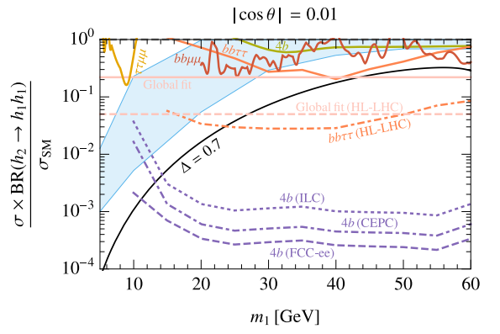
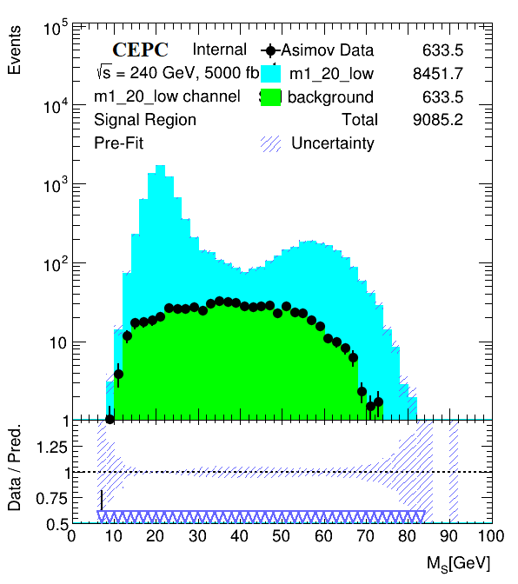
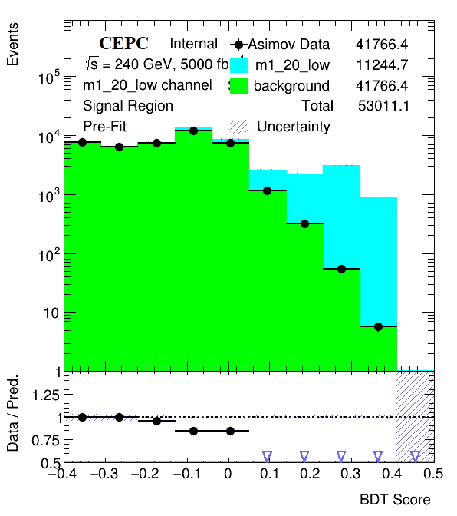
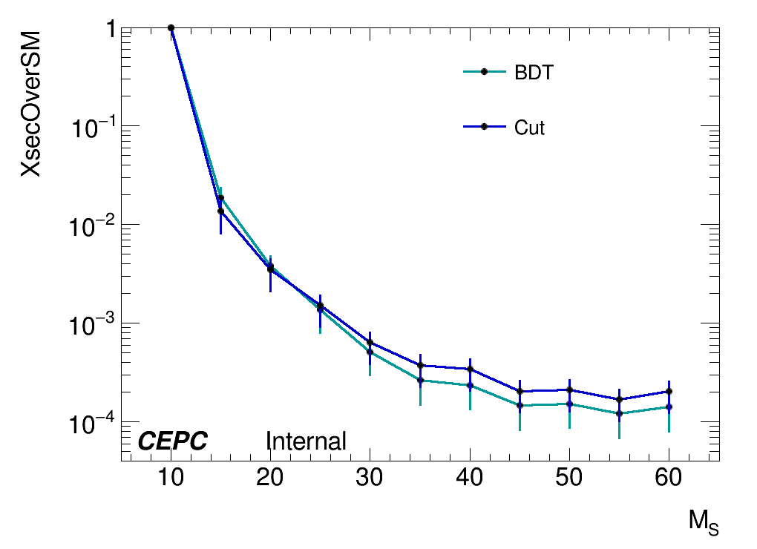
Limit Setting
Cut Based
BDT
20GeV signal and background

Slide 5
Plans
BDT:
Use 30GeV signal to optimize the BDT configuration
Include Ms into the training and set limit on BDT score (10 BDT)
Systematic Study
Statistical uncertainty --TRExFitter
Fixed background –Ebony Zhang (Zhen gives the configs)
Event selection --Xuliang Zhu
Flavor tagging –Elham (reference Yu Bai’s paper)
Lepton identification – reference 62 in Yu Bai’s paper
Luminosity – Xuliang Zhu Ref.62 in Yu Bai’s paper

