Slide 1
Previous
BDT:
Use 30GeV signal to optimize the BDT configuration
Include Ms into the training and set limit on BDT score (10 BDT)
Systematic Study
Statistical uncertainty --TRExFitter
Fixed background –Ebony Zhang (Zhen gives the configs)
Event selection --Xuliang Zhu
Flavor tagging –Elham (reference Yu Bai’s paper)
Lepton identification – reference 62 in Yu Bai’s paper
Luminosity – Xuliang Zhu Ref.62 in Yu Bai’s paper

Slide 2
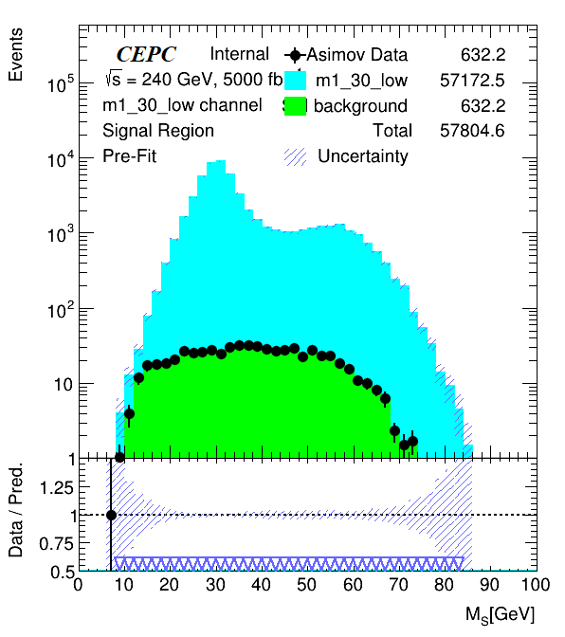
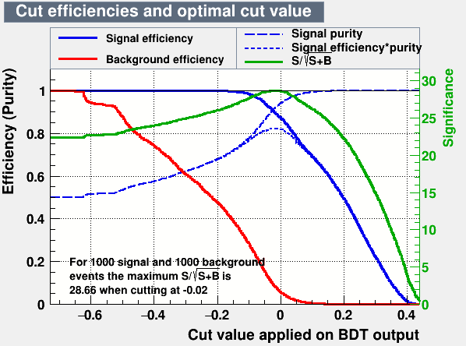
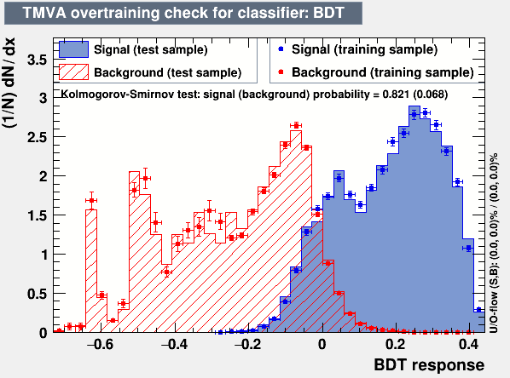
BDT Set1 (30GeV signal vs bkg)
Category | Events
Signal Training | 30000
Signal Testing | 7806
Bkg Training | 400000
Bkg Testing | 163004
Trained 10 variables
Applied cut on BDT score at -0.02
Set limit on the events vs mass of S

Slide 3
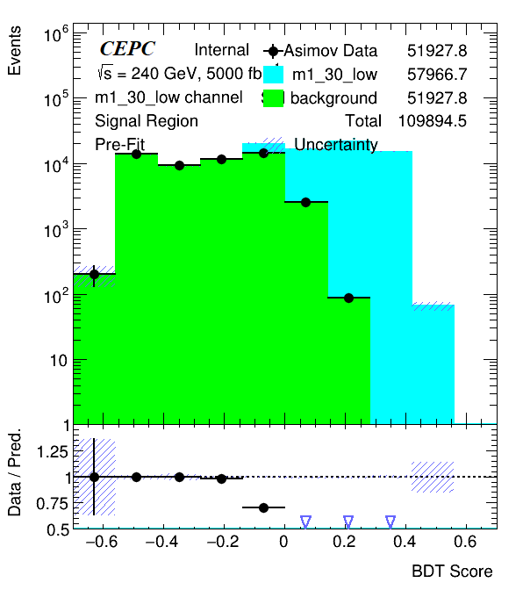
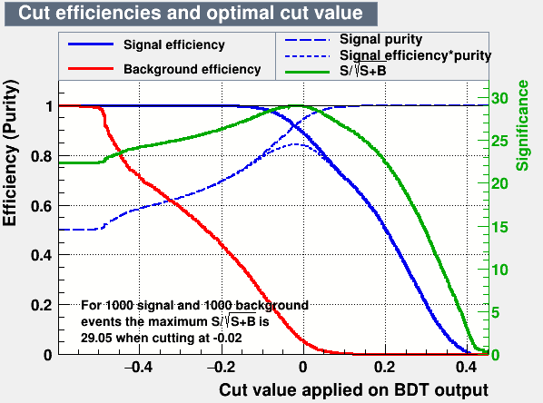
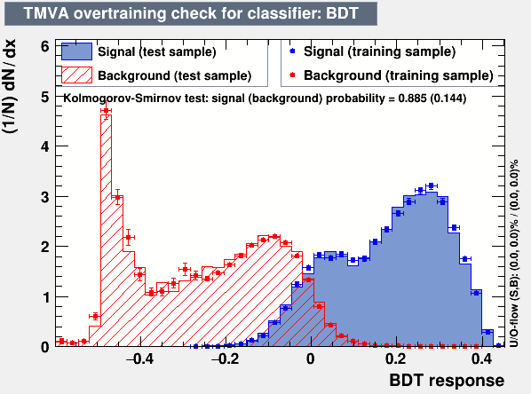
BDT Set2 (10 BDT each signal vs all bkg)
Category | Events
Signal Training | 30000
Signal Testing | The rest
Bkg Training | 400000
Bkg Testing | 163004
Trained 11 variables (Mass of S included).
10 BDT with mass of S between 15 GeV and 60 GeV
Set limit on the BDT score

Slide 4
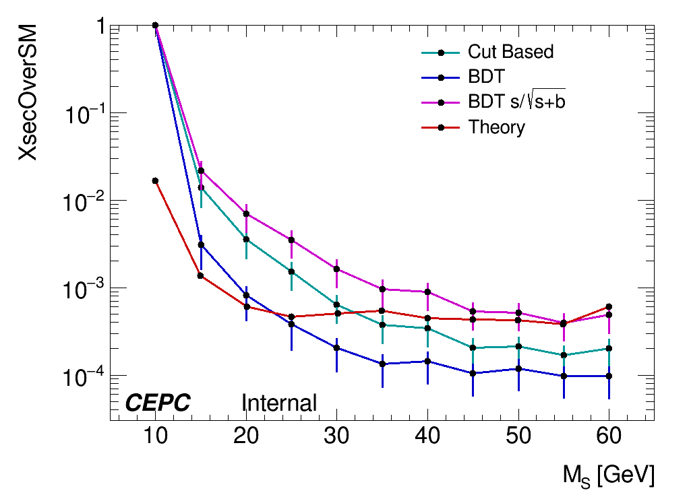
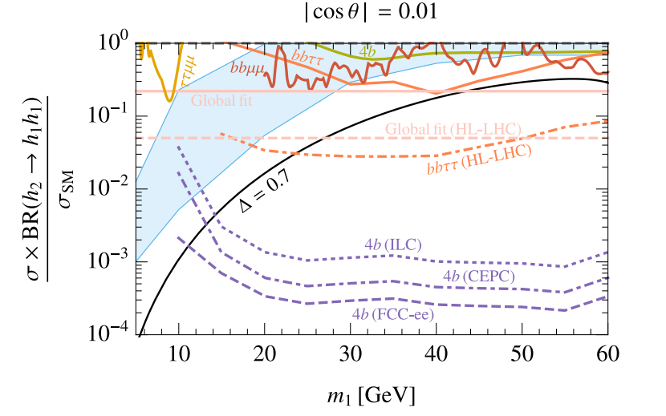
Limit Results
BDT Set2
BDT Set1

Slide 5
Summary and Plans
Plan to use BDT set2 as our nominal BDT approach
Complete systematic study
Mass | Exp. Limit | stat +1σ | stat -1σ
15 | 0.003488 | 0.00167 | 0.000975
20 | 0.000992 | 0.000477 | 0.000277
25 | 0.00051 | 0.000243 | 0.000143
30 | 0.000199 | 9.98E-05 | 5.55E-05
35 | 0.000148 | 7.11E-05 | 4.13E-05
40 | 0.000137 | 6.70E-05 | 3.82E-05
45 | 0.000108 | 5.04E-05 | 3.01E-05
50 | 0.000129 | 5.91E-05 | 3.60E-05
55 | 0.000116 | 5.17E-05 | 3.23E-05
60 | 0.000113 | 5.25E-05 | 3.16E-05

Slide 6
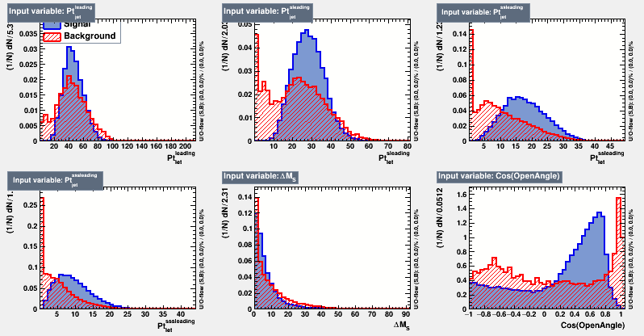
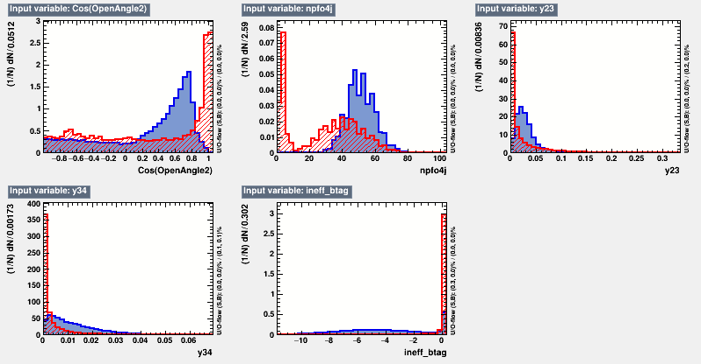
Backup
BDT set1 variables

Slide 7
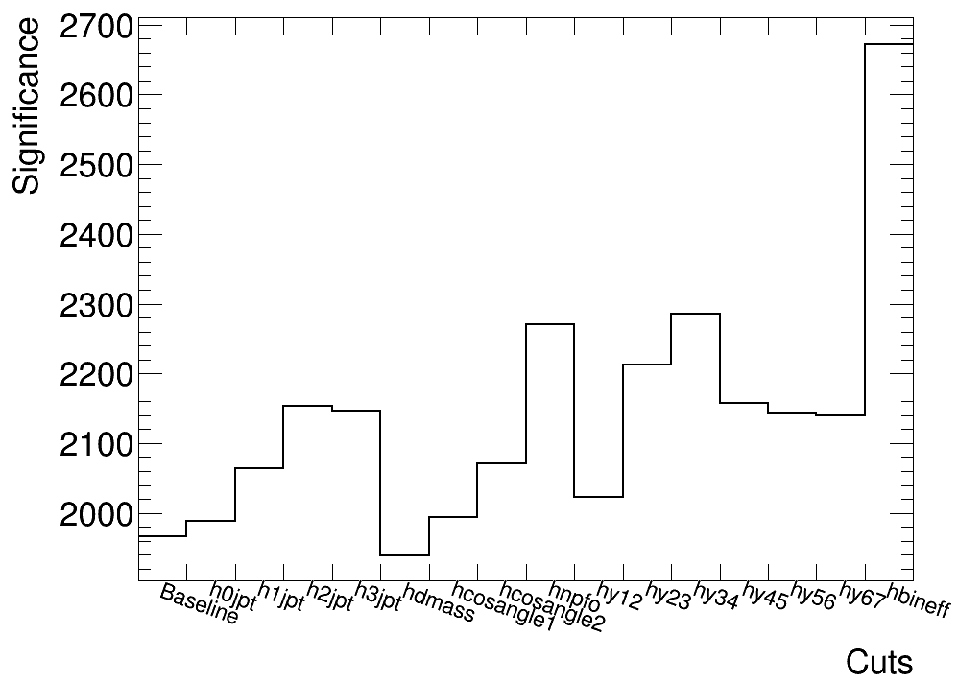
Backup

