Slide 1
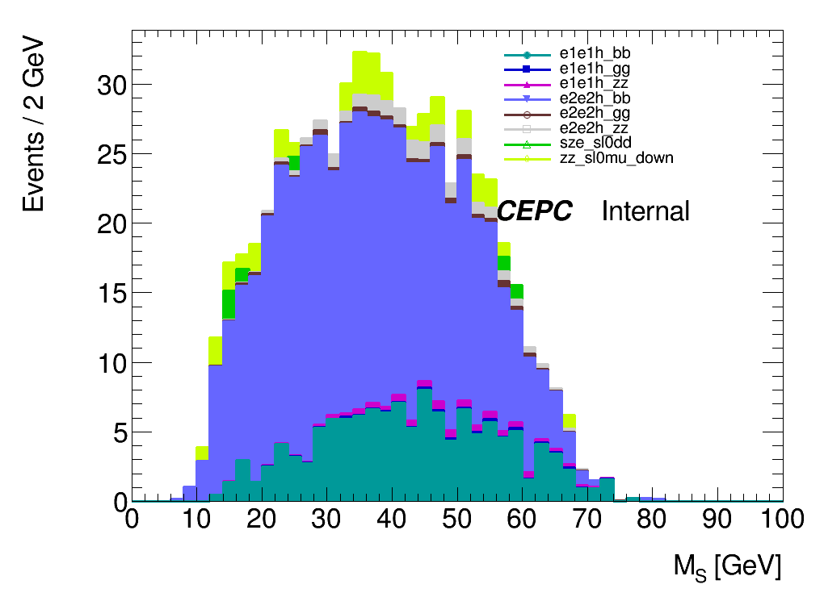
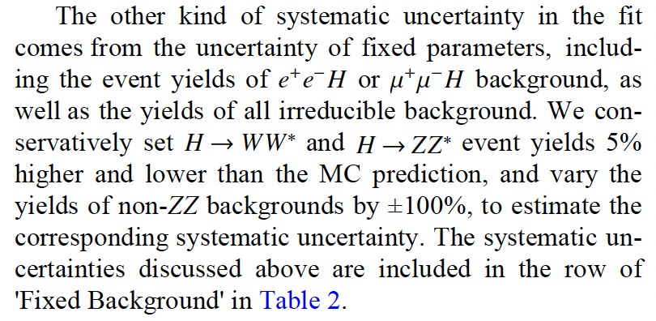
Fixed background uncertainty
Background
e1e1h_bb, e2e2h_bb -> 5%
The others -> 100%

Slide 2
Tune: MCstatScale
 | Fixed background
 | 10 | 15 | 20 | 25 | 30 | 35 | 40 | 45 | 50 | 55 | 60
exp_upperlimit | 1 | 0.0137799 | 0.00352941 | 0.00152299 | 0.000640094 | 0.000376083 | 0.000341125 | 0.00020544 | 0.000211017 | 0.000167799 | 0.000202674
exp_upperlimit_plus1 | 1 | 0.019485 | 0.00498235 | 0.00214498 | 0.000900716 | 0.000528125 | 0.0004789 | 0.000288439 | 0.000296247 | 0.00023561 | 0.000284974
exp_upperlimit_plus2 | 1 | 0.026852 | 0.00684799 | 0.00293713 | 0.00123165 | 0.000719822 | 0.000652408 | 0.000393006 | 0.000403617 | 0.000321105 | 0.000389368
exp_upperlimit_minus1 | 1 | 0.00992915 | 0.00254313 | 0.0010974 | 0.000461223 | 0.000270989 | 0.000245799 | 0.000148031 | 0.000152049 | 0.000120908 | 0.000146038
exp_upperlimit_minus2 | 1 | 0.00739601 | 0.00189432 | 0.000817428 | 0.000343555 | 0.000201853 | 0.00018309 | 0.000110265 | 0.000113258 | 9.0062E-05 | 0.00010878
 | Original
 | 10 | 15 | 20 | 25 | 30 | 35 | 40 | 45 | 50 | 55 | 60
exp_upperlimit | 1 | 0.0137982 | 0.00353138 | 0.00152366 | 0.000640323 | 0.000376318 | 0.000341508 | 0.000205684 | 0.000211258 | 0.000167986 | 0.000203028
exp_upperlimit_plus1 | 1 | 0.0195116 | 0.00498507 | 0.00214589 | 0.000901051 | 0.000528452 | 0.00047943 | 0.000288777 | 0.00029658 | 0.000235868 | 0.000285451
exp_upperlimit_plus2 | 1 | 0.0268903 | 0.00685167 | 0.00293833 | 0.00123214 | 0.000720264 | 0.000653112 | 0.000393456 | 0.000404061 | 0.000321447 | 0.000389967
exp_upperlimit_minus1 | 1 | 0.00994234 | 0.00254456 | 0.00109788 | 0.000461388 | 0.000271158 | 0.000246075 | 0.000148207 | 0.000152223 | 0.000121043 | 0.000146293
exp_upperlimit_minus2 | 1 | 0.00740583 | 0.00189538 | 0.000817786 | 0.000343678 | 0.000201979 | 0.000183296 | 0.000110396 | 0.000113388 | 9.01623Ee-05 | 0.00010897

Slide 3
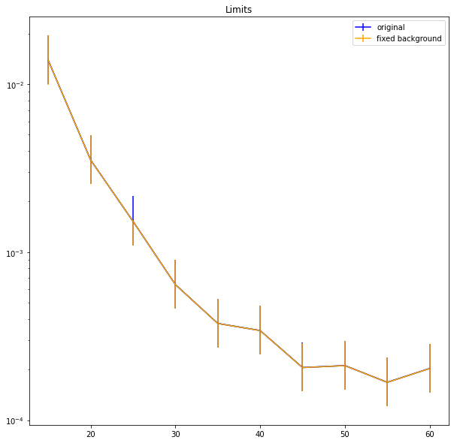
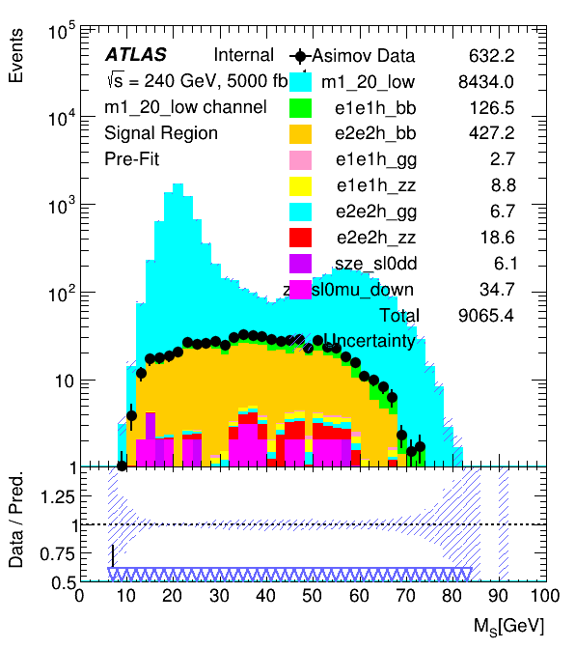
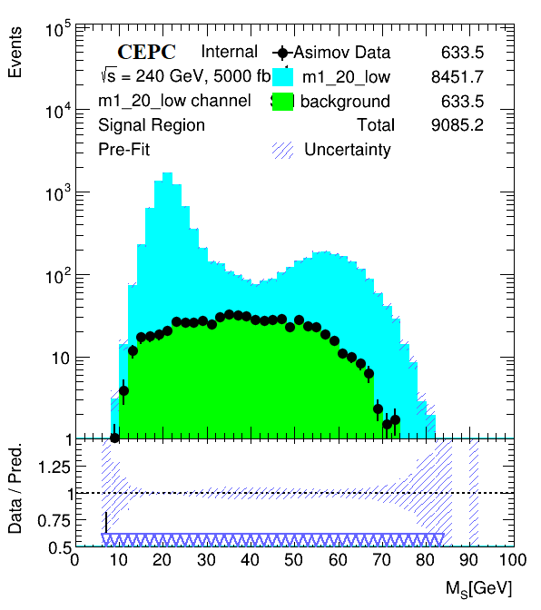
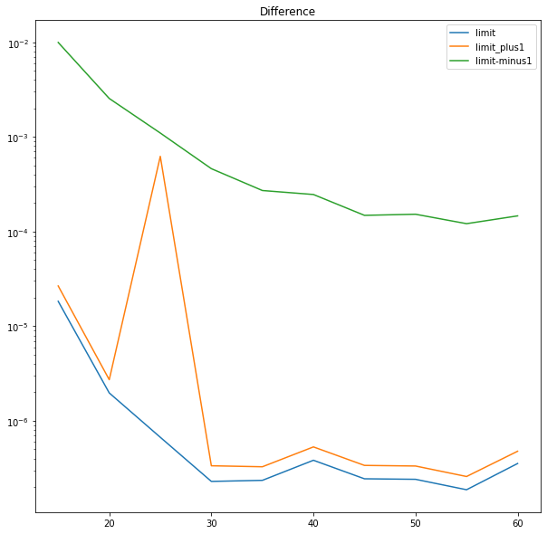
With fixed background
original
Cut Based
20GeV signal and background

