Slide 1
Plans
Check the lepton selection efficiency with Gang or Bai Yu –Zhen
–We are using the same lepton selection method, so we can ref.
Check the number of fixed background uncertainty from Bai Yu –Zhen
--Conservatively use 5% and 100%
Definition of jet energy resolution –Xuliang Zhu
Add the band from Yanda in the limit plot –Zhen
--Done
Luminosity uncertainty –Ke Li
–could be ignored
Check with Gang how to get uncertainty from the flavor tagging—Zhen
–Find a control region and estimate the statistical uncertainty of the selected sample
Check the systematic table from TRExFitter –Xuliang
--Ebony is investigating

Slide 2
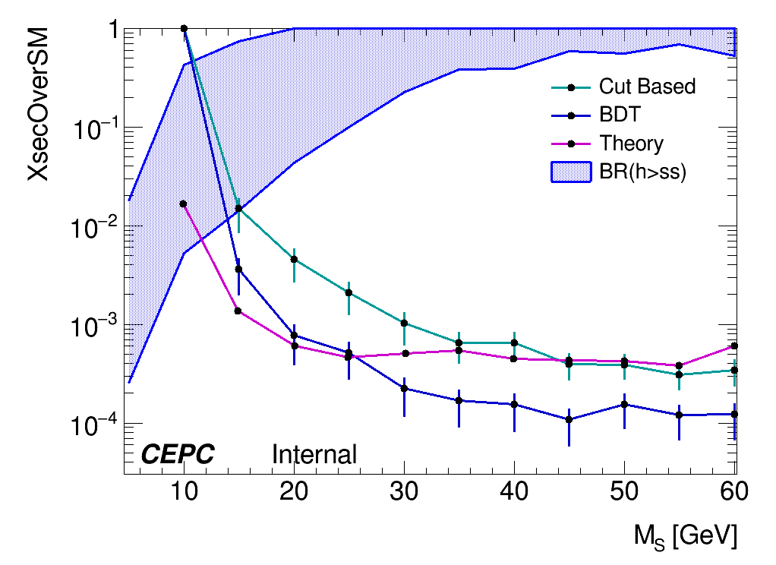
Current Result
Uncertainties included:
Statistical --TRExFitter
Fixed parameters (event yield) --Ebony
Uncertainties needed to be included:
Jet energy resolution –Xuliang
Flavor Tagging --Elham

Slide 3
ITEMS to be done
Systematic terms
--Jet energy resolution
--Flavor tagging
--(Theory uncertainty?) –Yanda
Paper draft writing

