Slide 1
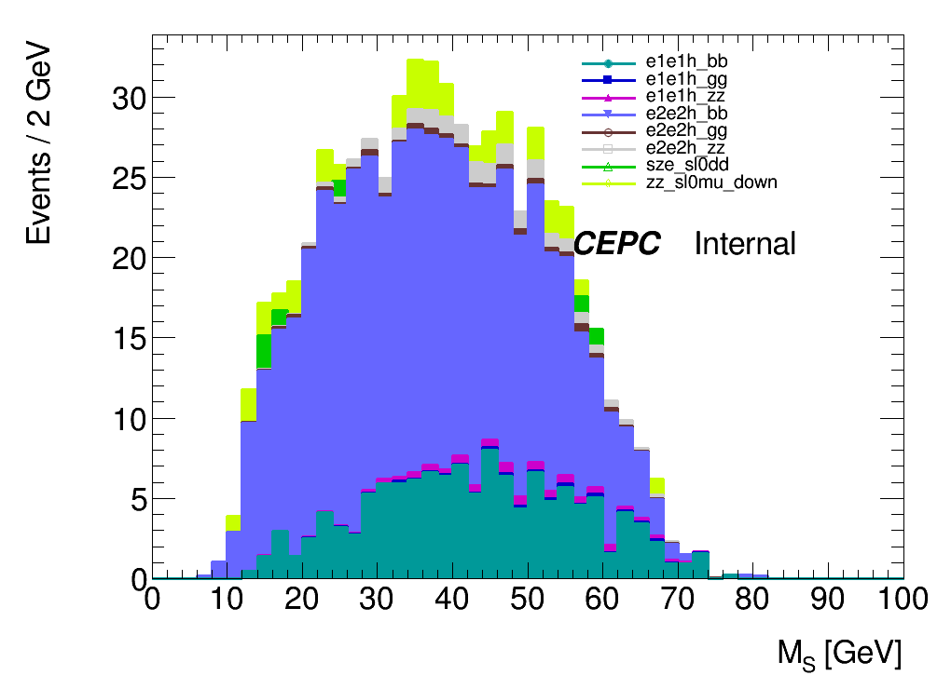
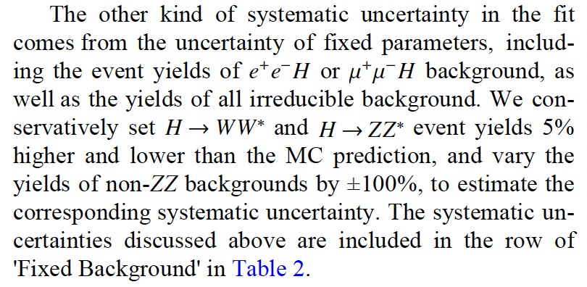
Fixed background uncertainty
Background
e1e1h_bb, e2e2h_bb -> 5%
The others -> 100%

Slide 2
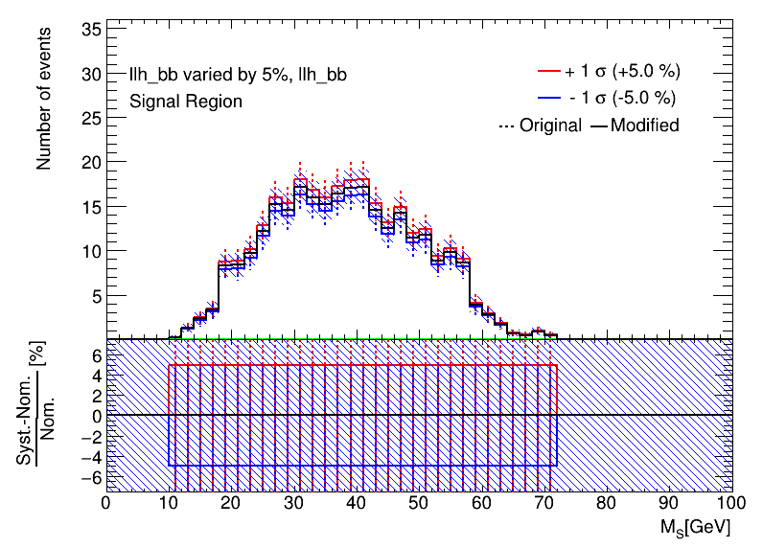
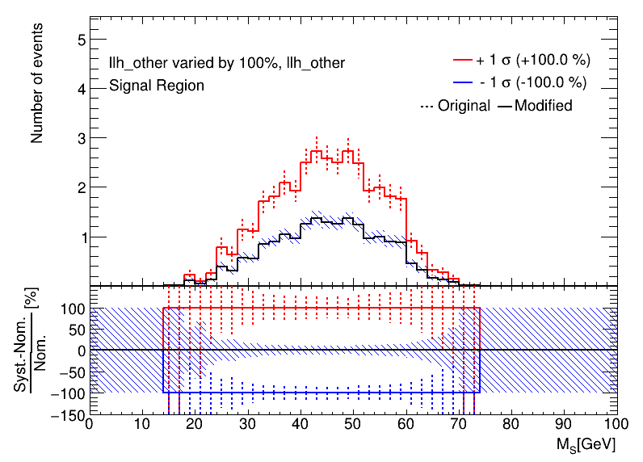
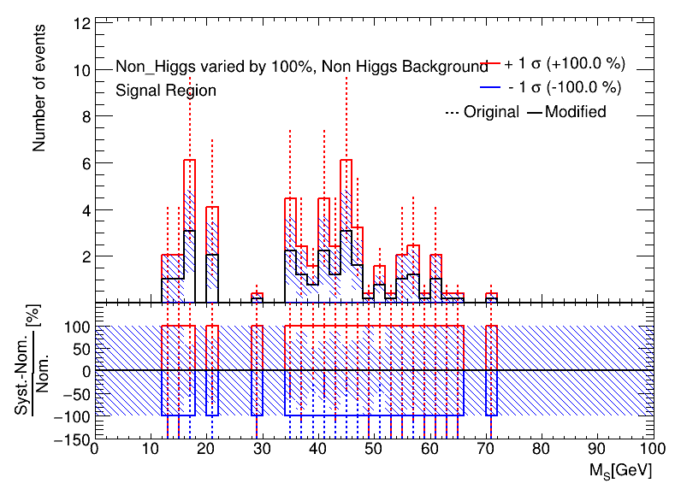
Use block: systematic
Systematic: "llh_bb_syst"
Title: "llh_bb varied by 5%"
Type: OVERALL
Samples: llh_bb
OverallUp: 0.05
OverallDown: -0.05
Systematic: "llh_other_syst";"Non_Higgs_syst"
Title: "llh_other varied by 100%";"Non_Higgs varied by 100%"
Type: OVERALL
Samples: llh_other; Non_Higgs
OverallUp: 1
OverallDown: -1

Slide 3
Limit Comparison
 | Fixed background
 | 15 | 20 | 25 | 30 | 35 | 40 | 45 | 50 | 55 | 60
exp_upperlimit | 0.0181689 | 0.00742368 | 0.00240273 | 0.00114312 | 0.000723523 | 0.000760012 | 0.000460175 | 0.000442851 | 0.000351015 | 0.000409032
exp_upperlimit_plus1 | 0.0255699 | 0.0106617 | 0.00339035 | 0.00160852 | 0.00100887 | 0.00102401 | 0.000613596 | 0.000579417 | 0.00045601 | 0.000537711
exp_upperlimit_plus2 | 0.0348531 | 0.0152073 | 0.00465918 | 0.00219506 | 0.00135142 | 0.00133959 | 0.000797735 | 0.000761949 | 0.000601841 | 0.000713604
exp_upperlimit_minus1 | 0.0130917 | 0.00534917 | 0.0017313 | 0.000823681 | 0.000521338 | 0.000547631 | 0.000331581 | 0.000319099 | 0.000252926 | 0.00029473
exp_upperlimit_minus2 | 0.00975172 | 0.00398448 | 0.00128961 | 0.000613542 | 0.000388333 | 0.000407918 | 0.000246988 | 0.000237689 | 0.000188399 | 0.000219538
 | Original
exp_upperlimit | 0.0145653 | 0.00475106 | 0.0021581 | 0.000957941 | 0.000550759 | 0.000505216 | 0.000296949 | 0.000292472 | 0.00022915 | 0.000269759
exp_upperlimit_plus1 | 0.020908 | 0.00673977 | 0.00304946 | 0.00135079 | 0.000775768 | 0.000711147 | 0.000418251 | 0.000412353 | 0.000323357 | 0.000381991
exp_upperlimit_plus2 | 0.0295984 | 0.00933855 | 0.00419894 | 0.00185383 | 0.00106247 | 0.000973031 | 0.00057287 | 0.000565661 | 0.000444188 | 0.000528107
exp_upperlimit_minus1 | 0.0104951 | 0.0034234 | 0.00155503 | 0.000690249 | 0.000396852 | 0.000364036 | 0.000213968 | 0.000210742 | 0.000165115 | 0.000194376
exp_upperlimit_minus2 | 0.00781759 | 0.00255001 | 0.00115831 | 0.000514151 | 0.000295607 | 0.000271162 | 0.00015938 | 0.000156977 | 0.000122991 | 0.000144786
 | Theory
exp_upperlimit | 0.0013520519 | 0.0006129362 | 0.00046544045 | 0.00050714093 | 0.00054216542 | 0.00045044617 | 0.00043369907 | 0.00042321125 | 0.00038304898 | 0.00060426300

Slide 4
