Slide 1
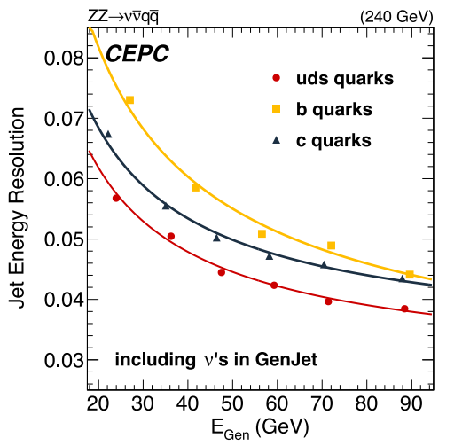
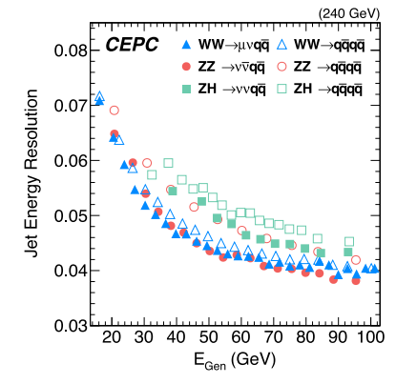
ITEMS
Lepton identification systematics
- Talked with Manqi Ruan and Dan Yu. Can ref that paper, also small could be ignored.
Jet energy resolution
-Talked with Manqi Ruan and Dan Yu. https://iopscience.iop.org/article/10.1088/1748-0221/16/07/P07037/pdf

Slide 2
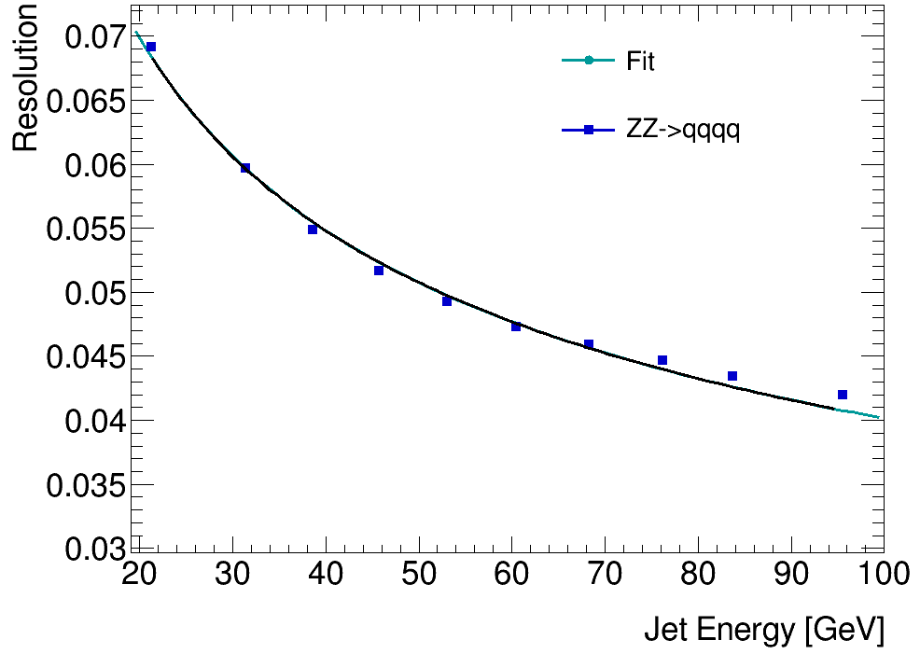
Jet Energy Resolution
We extracted the points in the figure at got a fitted line.
Vary each jet’s energy with a Gaussian distribution with the corresponding resolution

Slide 3
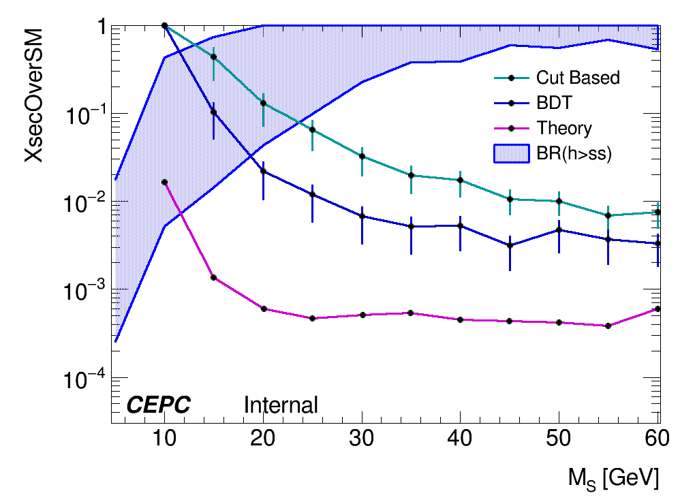
Jet Energy Resolution
Created a new ntuple and redo all the cut based and BDT analysis.
Systematics included for now:
Flavor tagging : 1%
Event yields : 5% for ZH_bb & 100% for others
Jet energy resolution : fluctuate with gaussion

