Slide 1
GenJets study
Xuliang Zhu

Slide 2
Summary of previous update
Event display: When $m_{1}≥25 GeV$, 4 jets are visible to the naked eye. 4 jets merged into 2 fat jets when $m_{1}<25 GeV$.

Slide 3
Wrokflow of Ana
Pei-Zhu Lai, et al. http://arxiv.org/abs/2104.05029
ArborPFOs
RemainPFOs
RefinedJets
(RecoJets)
ntuple
Collection
FSClasser and RootFileProcessor
Processor
IsolatedLeptonFinder
Lcfiplus
MCParticle
RemainPFOs
RefinedJets
(GenJets)
ntuple
Collection

Slide 4
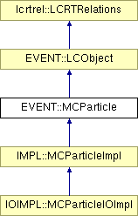
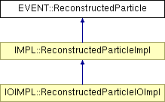
Convert MCParticle to ReconstructedParticle
MCParticle Collection
ArborPFOs Collection

Slide 5
