Slide 1
ITEMS
Re-produce analysis ntuples for signal and Higgs backgrounds with n jets requested == 2
Some quick study of the variables

Slide 2
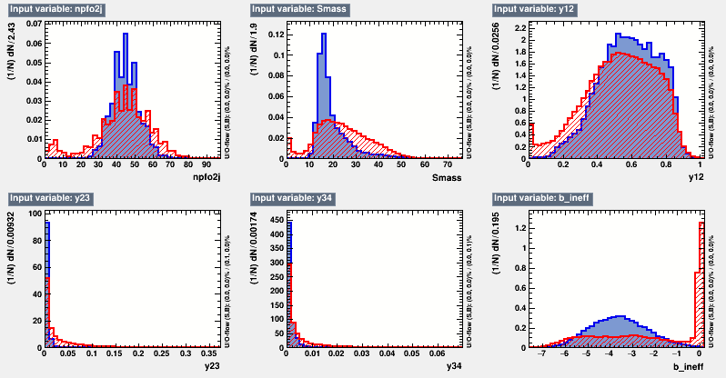
Vars for 2j for signal at 15
Bump at different mass is smaller than 4j case.

Slide 3
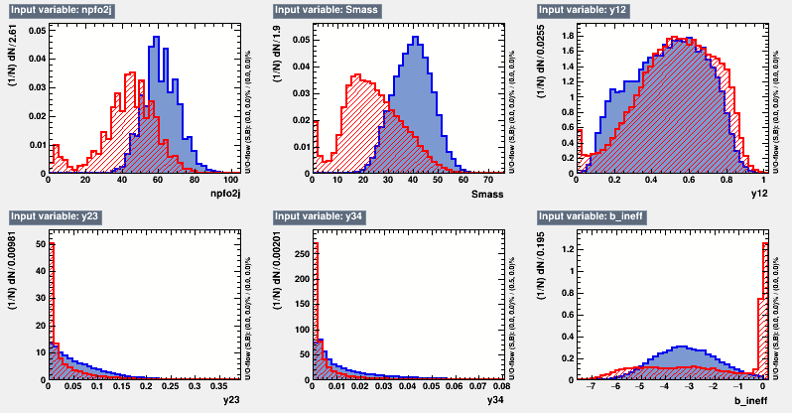
Vars for 2j for signal at 60
One peak but at different location

Slide 4
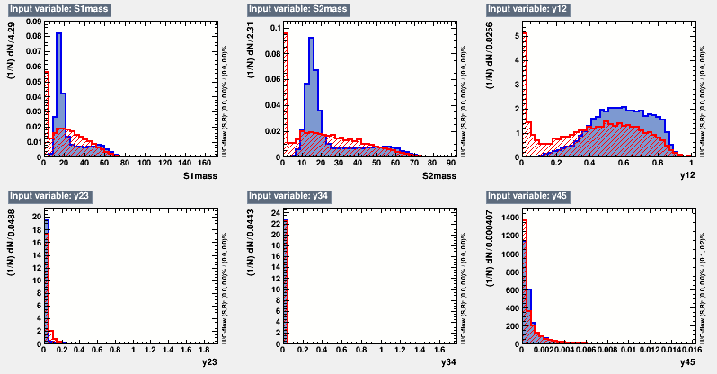
Vars for 4j for signal at 15
Miss reconstructed S mass due to the pairing.

Slide 5
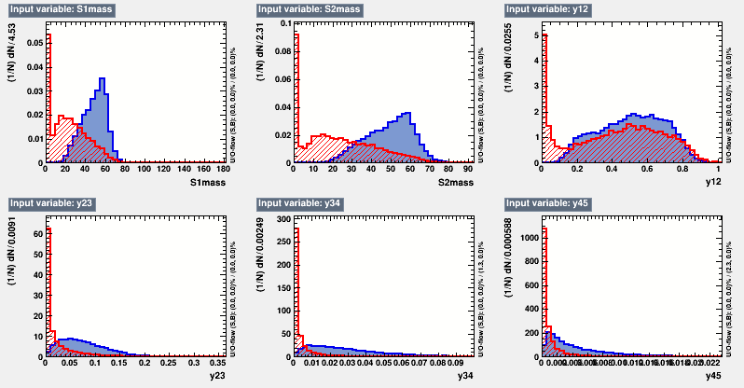
Vars for 4j for signal at 60
Peaks at 60 but wider

Slide 6
Plans
Could define some selections to do cut based analysis or bdt based analysis.
Generating all of the backgrounds for analysis ~3days

