Slide 1
Boosting Decision Tree
Zhu Tao

Slide 2
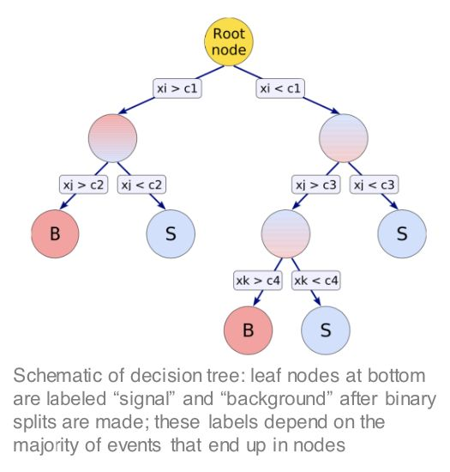
What’s Decision Tree
·an algorithm uesd to classify data
·including building tree, pruning and boosting algorithm

Slide 3
How to train a DT
·Jet = (x1, x2,...), such as (n, E, p_{T})
·xi：entropy or Gini(a criterion)
ci : splitting value which gives the best separation into one side having mostly signal and the other mostly background
·stop condition(avoid over-training)

Slide 4
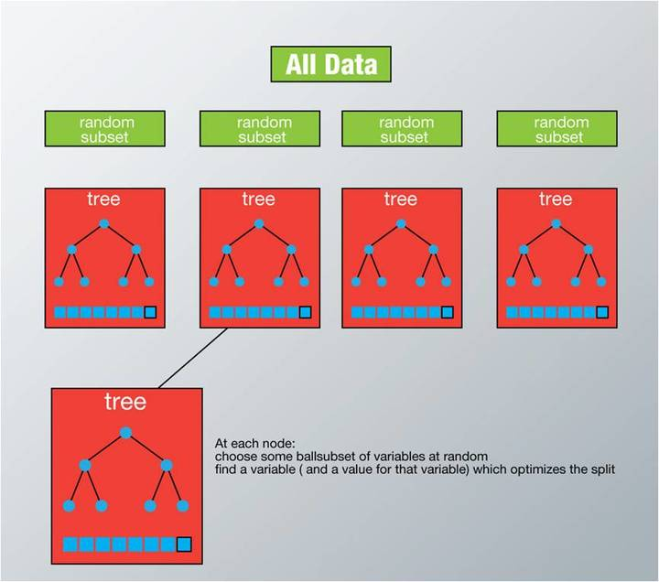
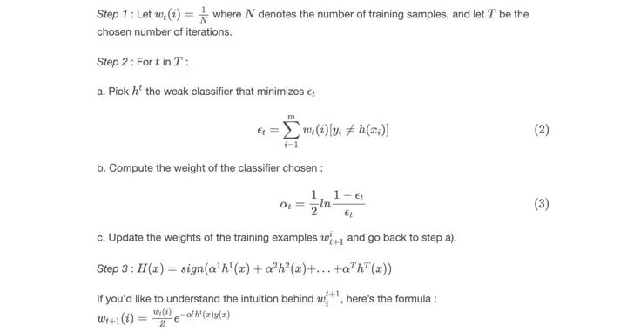
Boosting
Random Forest
Ada
given N trees, and find the weight of each tree
generate N trees randomly and average the N values
To Aviod Overfitting

Slide 5
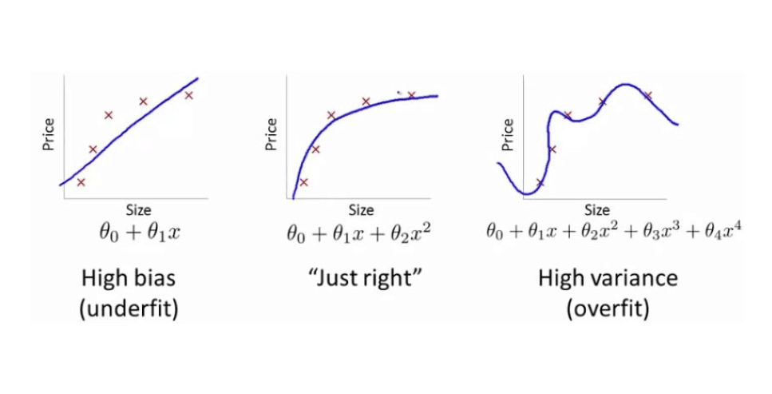
Over-Training
Error-rate can be really low in training dataset, but very high in test dataset!

Slide 6
Thanks!

Slide 7
Questions:
1. Input?
2. What quantities should be used to distinguish background and signal? Why?
3. Why BDT? (instead of SVM, Deep learning or other algorithm?)
4. Error Rate? and its influence to later analysis?

