Slide 1
Status report of EWK Wy VBS analysis
--Zhen Wang , Xi Wang , Shu Li, Jun Guo
Speaker:王震

Slide 2
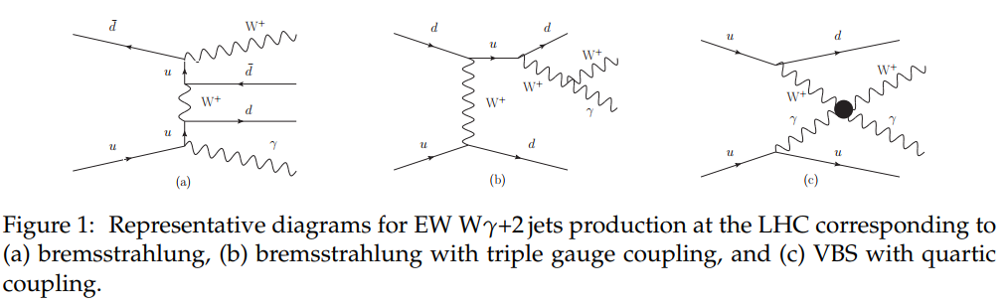
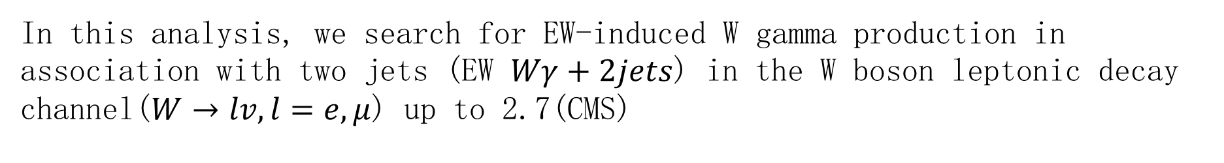
Physics goal
In this analysis, we search for EW-induced W gamma production in association with two jets (EW $Wγ+2jets$) in the W boson leptonic decay channel($W→lv, l=e,μ$) up to 2.7(CMS)
arXiv:1612.09256v2 [hep-ex] 23 Jun 2017

Slide 3
MC and data samples
Signal:
mc16_13TeV.361271.MGH7EG_NNPDF30LO_A14NNPDF23LO_Wmunugamma2jEWK.deriv.DAOD_EXOT6.e7391_a875_r9364_p3931
mc16_13TeV.361270.MGH7EG_NNPDF30LO_A14NNPDF23LO_Wenugamma2jEWK.deriv.DAOD_EXOT6.e7391_a875_r9364_p3931
Background:
mc16_13TeV.364525.Sherpa_222_NNPDF30NNLO_enugamma_pty_140_E_CMS.deriv.DAOD_EXOT6.e5928_s3126_r9364_p3931
mc16_13TeV.364530.Sherpa_222_NNPDF30NNLO_munugamma_pty_140_E_CMS.deriv.DAOD_EXOT6.e5928_s3126_r9364_p3931
mc16_13TeV.410644.PowhegPythia8EvtGen_A14_singletop_schan_lept_top.deriv.DAOD_EXOT6.e6527_s3126_r9364_p3929
mc16_13TeV.410645.PowhegPythia8EvtGen_A14_singletop_schan_lept_antitop.deriv.DAOD_EXOT6.e6527_s3126_r9364_p3929
EWK Wy 2j Events
QCD Wy Events
Single top event
DATA: RUN2(15-18)

Slide 4
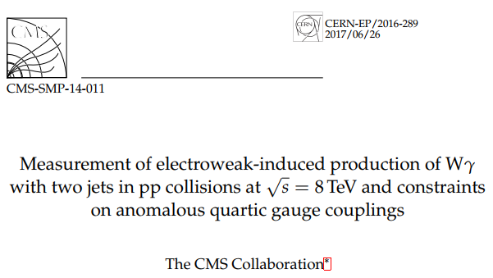
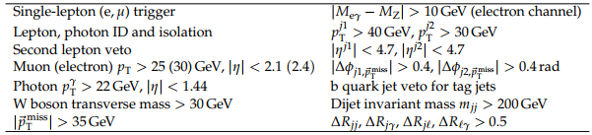

Selection criteria
arXiv:1612.09256v2 [hep-ex] 23 Jun 2017
Published in the Journal of High Energy Physics as doi:10.1007/JHEP06(2017)106.
$$W→lv, l=e,μ$$
Z->e+e- background

Slide 5
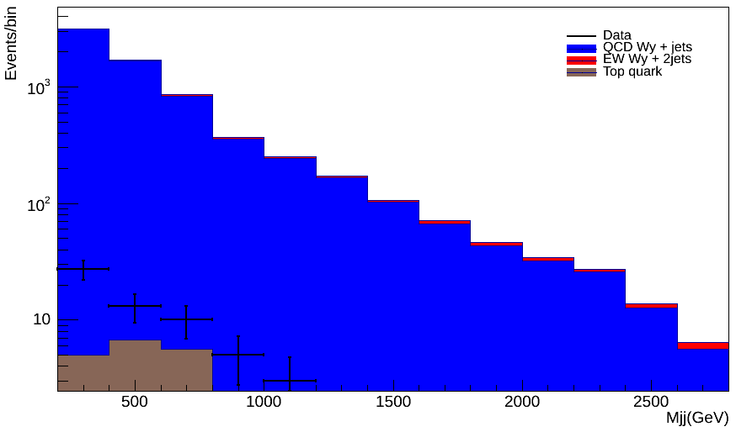
Result histograms
Weight from code is used,
Didn’t do renormalization.
Top quark: Only single top
tty events are not included

Slide 6
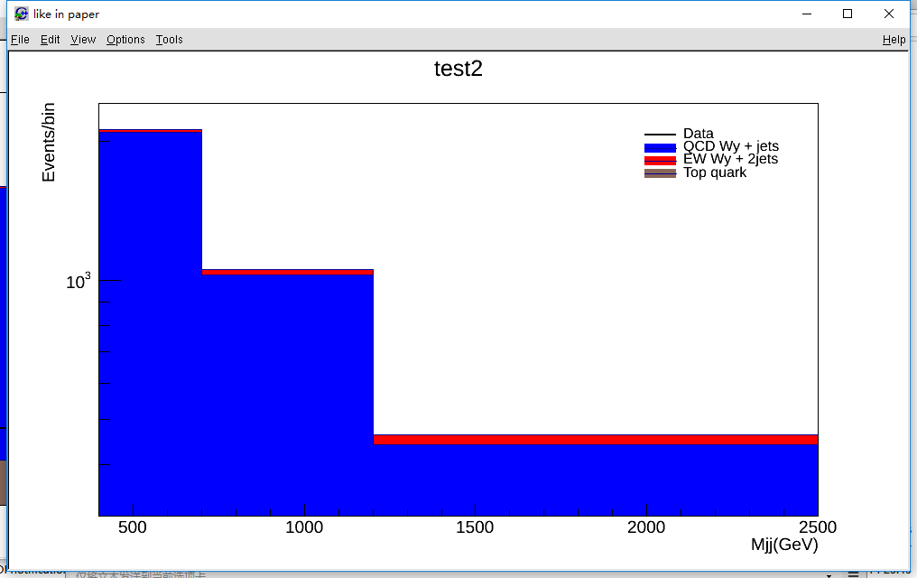
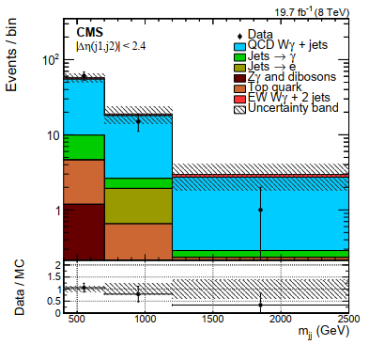
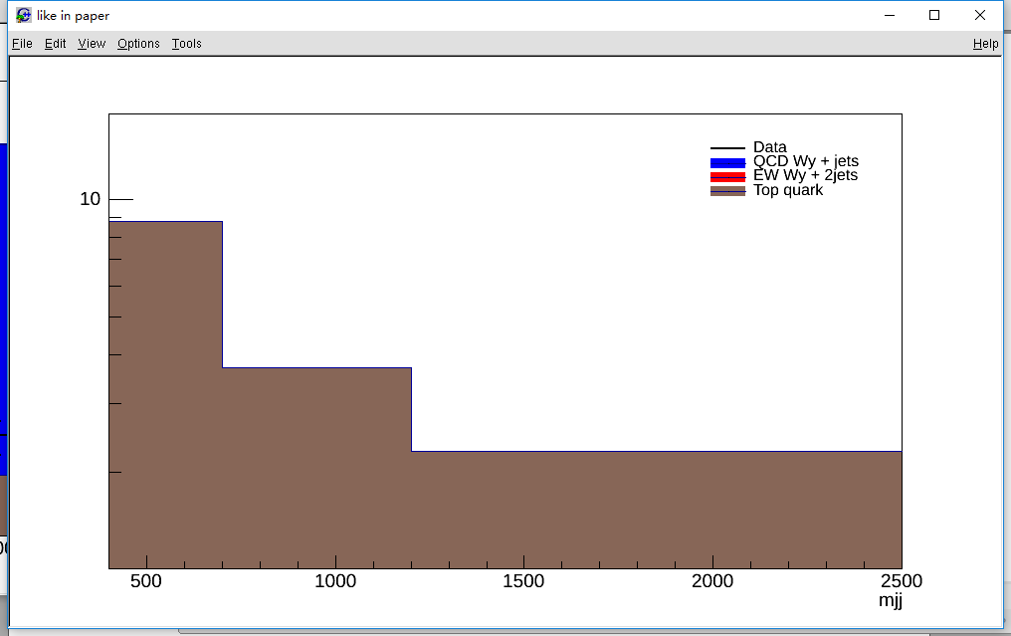
Result histograms

Slide 7
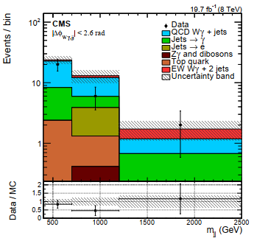
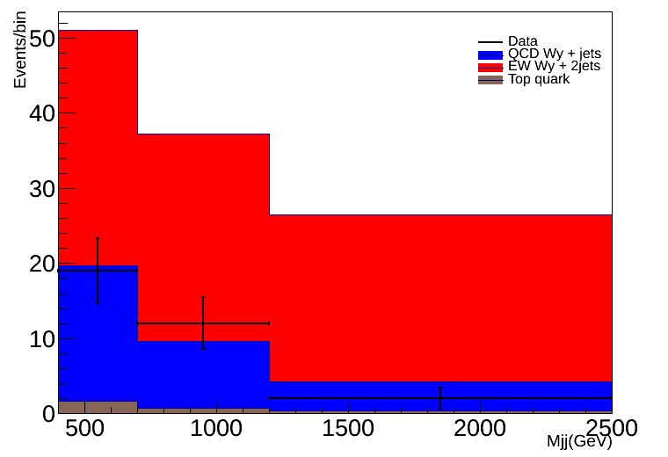
Background normalization
It is estimated using simulation and is normalized to the number of events in data in the region 200 < mjj < 400 GeV (QCD).
Contribution of top quark represents only 3.4% of the total event yield in the EW signal region

Slide 8
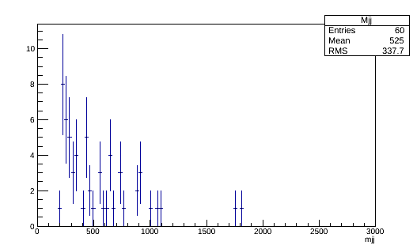
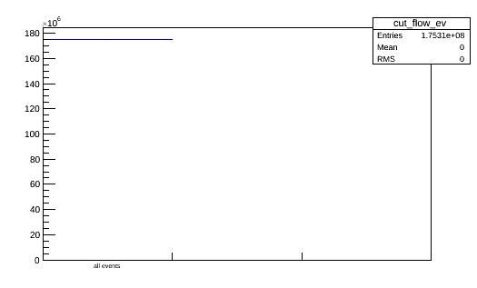
Which is weird
Mjj distribution from data15
Cut_flow_ev from data18
And all the histograms from year 16 and 17 are the same

Slide 9

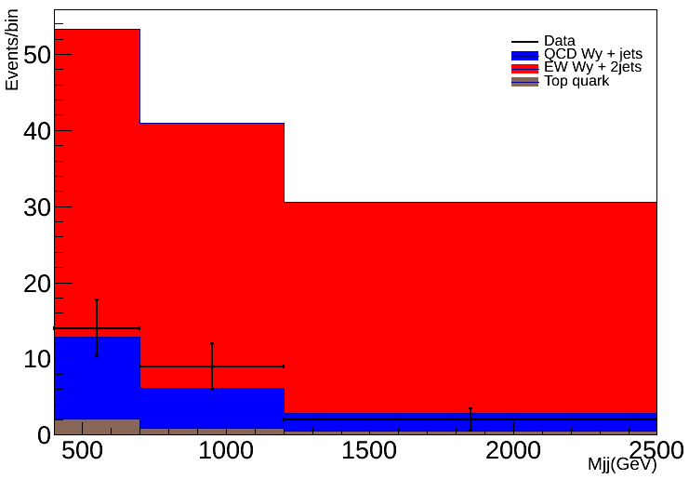
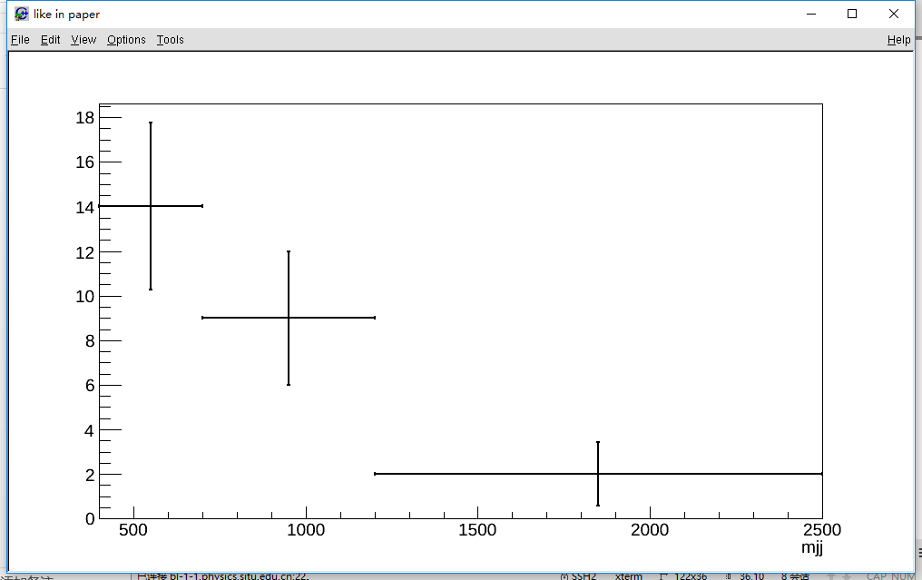
CMS Detector
The tracking system consists of 1440 silicon pixel and 15148 silicon strip detector modules and covers the pseudorapidity range eta<2.5
Currently didn’t find a way to do the normalization of signal events.

Slide 10
Next
Check with detector differences between ATLAS and CMS
Keep modifying code
Change MC datasets (deal with normalization …)
..

Slide 11
That’s all

Slide 12
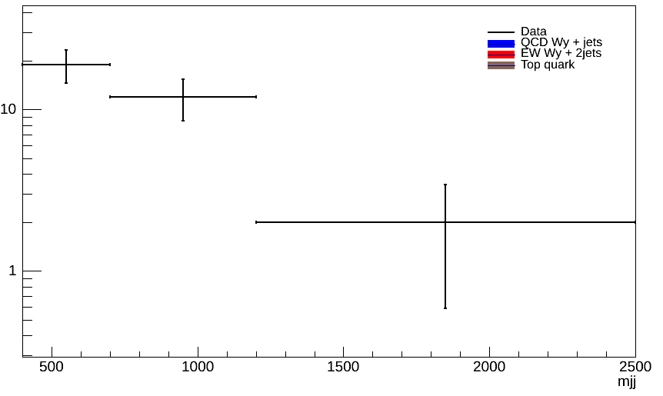

Backup
The reconstructed transverse mass of the leptonically decaying W boson is defined as $M_{T}=\sqrt{2p_{T}^{l}\left|{\vec{p}}_{T}^{miss}\right|[1−cos⁡(∆φ_{l,{\vec{p}}_{T}^{miss}})]}.$

