Slide 1
Gradient Boosting Decision Tree/eXtreme Gradient Boosting
2021.12.29
Jialin Li

Slide 2
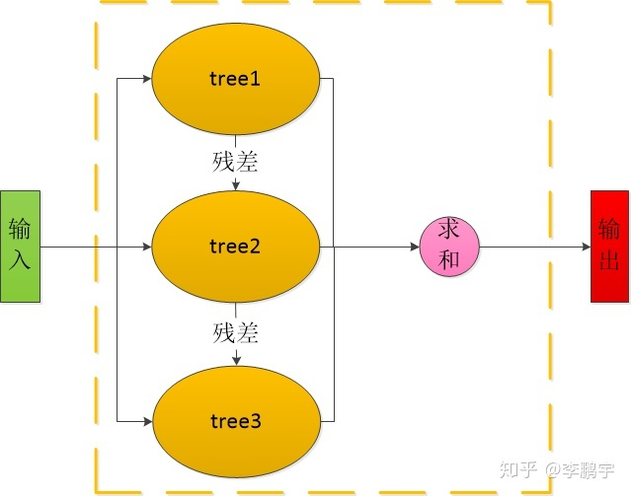
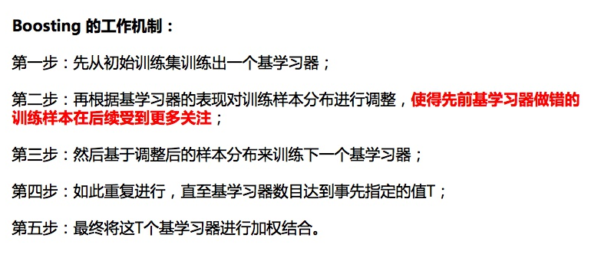
Boosting
Y=f(x)+L
L:redusial function
Samples are strongly relative.

Slide 3
CART 回归树:

Slide 4
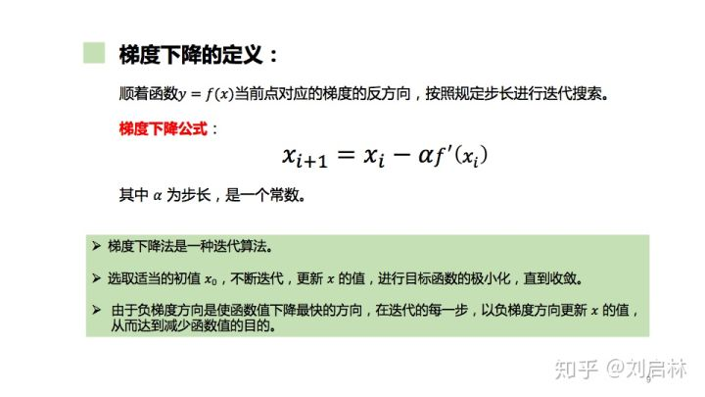
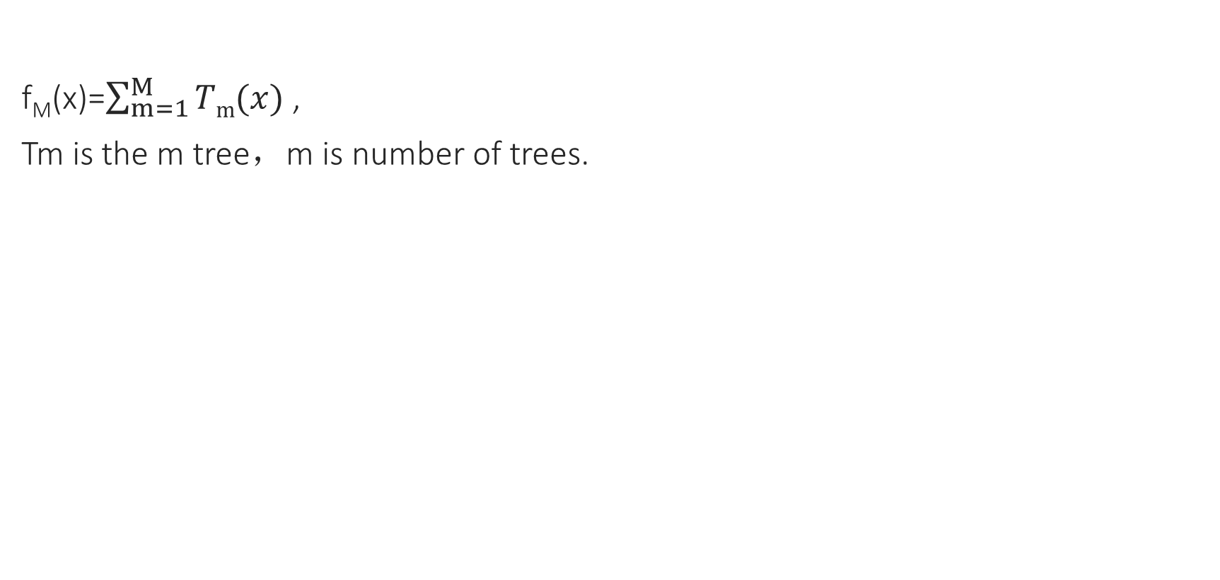
Gradient Boosting Decision Tree
f_{M}(x)=$\sum_{m=1}^{M}{Tm(x)}$ ,
Tm is the m tree，m is number of trees.

Slide 5
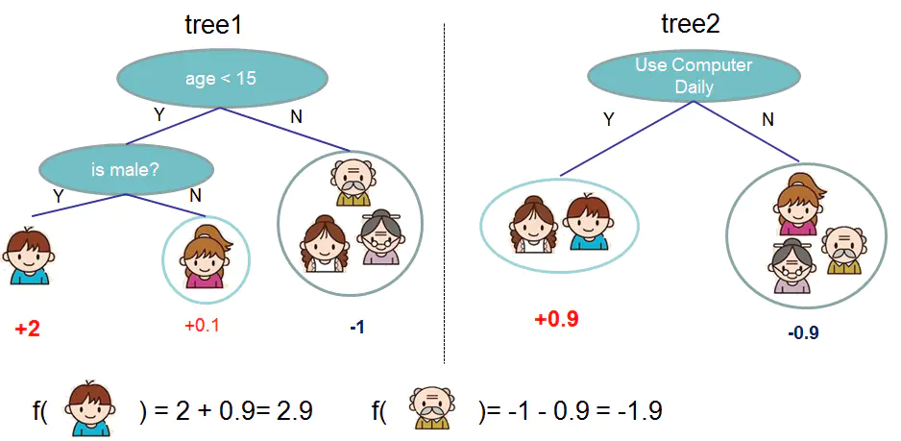
XGboost
optimized GBDT
1.L函数正则化（防止过拟合）
2.对L函数进行二阶泰勒展开
3.支持并行处理

Slide 6
Application
Import xgboost
导入数据
建立模型(train and test)
评估
Some examples：https://github.com/dmlc/xgboost

Slide 7
Next to do
Try to train with our samples
Learn the meaning of parameters (important to adjust the params)

Slide 8
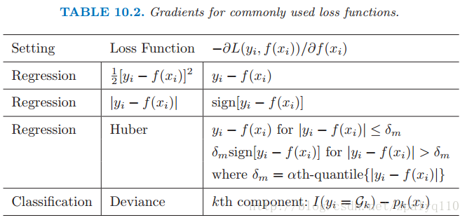
Backup
GBDT常见的损失函数：

Slide 9
Backup
About XGboost
https://indico.cern.ch/event/382895/contributions/910921/attachments/763480/1047450/XGBoost_tianqi.pdf

